Slide 1



1. Invoke build download Script
RFT
2.Download new build
3.Copy build to PXE
4. Send build ID to AMS
5. Copy CLI Cfg to PXE
6. Boot SUTs to PXE
7. Set SBUU GUI Install flag
8. SBUU GUI Installs - Kick off
9. SBUU GUI – complete Status
10. Install OMSA & CLI commands
11. Set OMSA GUI flag
16
7
9
13
12. OMSA GUI Scripts – Kick off
11
15
17
8
12
13. OMSA GUI – complete Status
14. DWS MS install
15. Set DWS Console Scripts flag
16. DWS login Scripts – kick off
14
6
17. DWS GUI – complete Status
AMS
18. OMSA Uninstall
10
19. DWS Uninstall
19
18
DWS
SUT’s
1
4
5
Build share
2
PXE
3

Slide 2
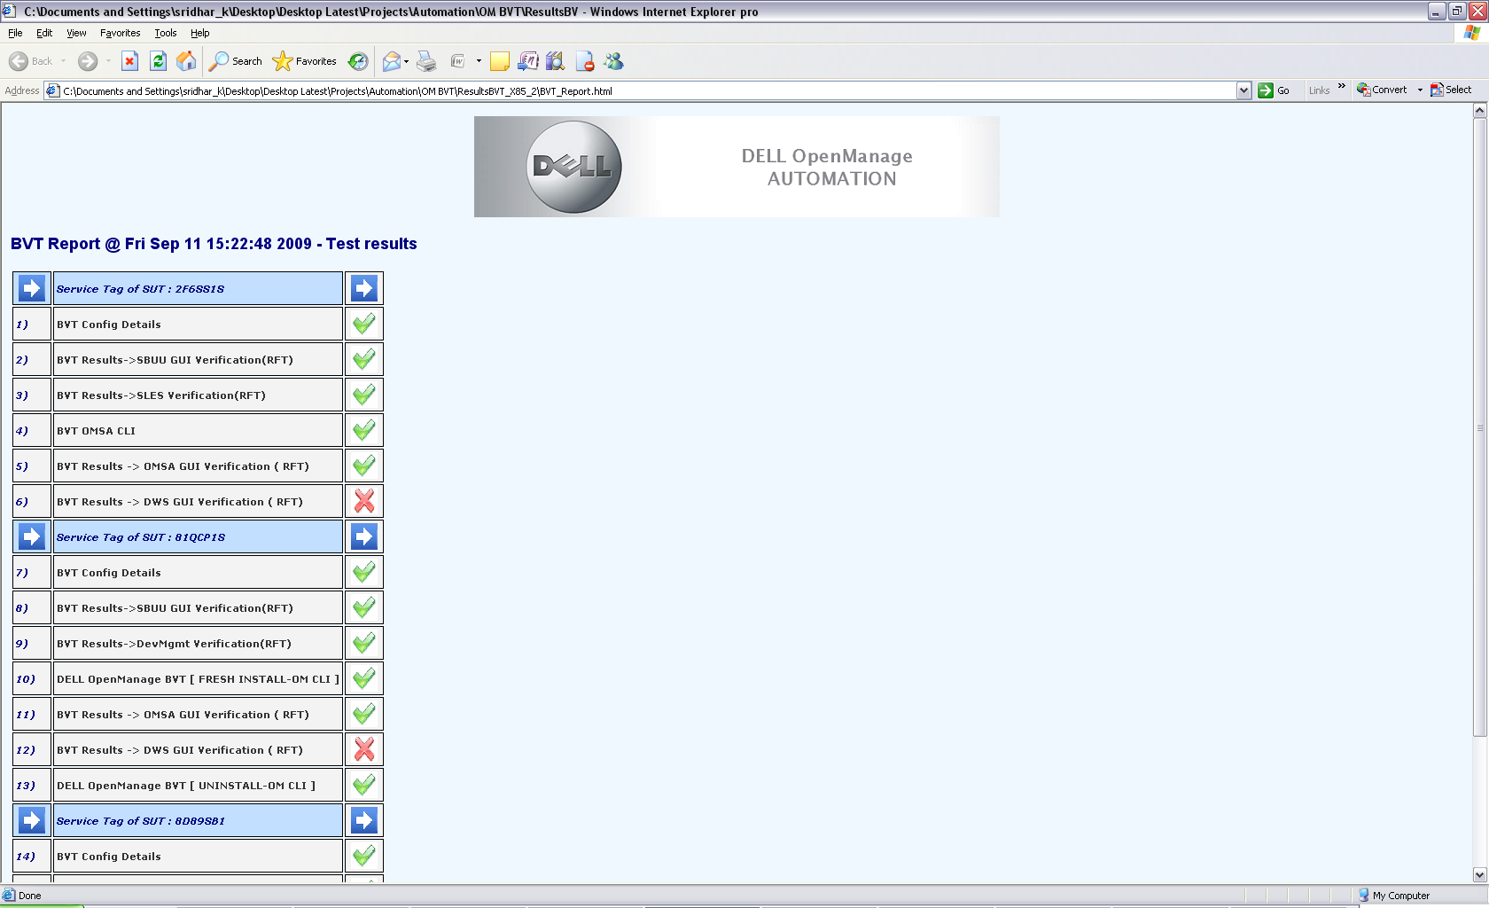
OM BVT Report

