Slide 1
Python threads: Dive into GIL!
PyCon 2011
Pune Sept 16-18
Vishal Kanaujia and Chetan Giridhar

Slide 2
Summary
Benefit of multi-threaded application grows with ubiquity of multi-core architecture that potentially can simultaneously run multiple threads of execution.
Python supports multi-threaded applications and developers are flocking to realize the assured gain of multiple cores with threaded applications.
Unfortunately, Python has significant bottleneck for multi-threading.

Slide 3
Summary…
Any thread in CPython interpreter requires a special lock (GIL) which results in serial, rather than parallel execution of multi-threaded applications, irrespective of cores availability and design techniques.
This talk focuses on the problem, dissects the root cause and its implications.

Slide 4

A jaw dropping example!
A simple python program – two functions()
Count(n) -> iterates from n to 0.
Add(n) -> adds n, n-1, n-2,..,1
Call them as two different threads on:
Single Core
Dual Core
37% performance dip
Increase in CPU Time by ~9 secs.

Slide 5
Threads: Fundamentals
Fundamental to a multi-tasking application
Smallest possible, independent unit of execution
Light weight processes (resource sharing inclusing address space)
Concurrent execution
Uni-core processor: Single thread at a time; Time division multiplexing
Multi-core processor: Threads run at the same time
CPU bound and I/O bound

Slide 6
Python Threads
Real system threads (POSIX/ Windows threads)
Python VM has no intelligence of thread management (priorities, pre-emption, and so on)
Native operative system supervises thread scheduling
Python interpreter just does the per-thread bookkeeping.

Slide 7
Python threads: internals
Only one thread can be active in Python interpreter
Each ‘running’ thread requires exclusive access to data structures in Python interpreter
Global interpreter lock (GIL) provides this exclusive synchronization
This lock is necessary mainly because CPython's memory management is not thread-safe.
Result
A thread waits if another thread is holding the GIL, even on a multi-core processor! So, threads run sequentially, instead of parallel!

Slide 8
Python threads
How do Python manages GIL?
Python interpreter regularly performs a check
A check is done after ‘n’ ticks.
It maps to ‘n’ number of Python VM’s byte-code instructions
A global counter; Ticks decrement as a thread executes
As soon as ticks reach zero:
the active thread releases and reacquires the GIL
Signal handling (only in the main thread)
Effectively, ticks dictate allowed CPU time-slice available to a thread
Is independent of host/native OS scheduling
Can be set with sys.setcheckinterval(interval)
Ticks >0
check

Slide 9
Python thread: internals
CPU operation
I/O operation
CPU operation
Acquire GIL
Release GIL
Acquire GIL
CPU bound thread
check
check
check

Slide 10
GIL: Details and Bottleneck
GIL is a conditional variable.
What goes behind the scene?
If GIL is unavailable, a thread goes to sleep and wait.
At every ‘check’, a thread release the GIL, and tries to re-acquire
GIL release is accompanied with a request to host OS to signal all waiting threads
Regular GIL unlock, thread signaling, wake-up, and GIL relock are an expensive series of operations
Threads effectively run in the serial order

Slide 11
GIL: Battle in multi-cores
Unlike single core, multiple cores allows the host OS to schedule many threads concurrently
A thread that had just released the GIL, will send a signal to waiting threads (through host OS) and is ready to acquire the GIL again!
This is a GIL contention among all threads

Slide 12
GIL: Battle continues…
There is considerable time lag of
Communication
Signal-handling
Thread wake-up
and acquire GIL
These factors along with cache-hotness of influence new GIL owner which is usually the recent owner!
In a [CPU,I/O]-bound mixed application, if the previous owner happens to be a CPU-bound thread, I/O bound thread starves!
Since I/O bound threads are preferred by OS over CPU-bound thread; Python presents a priority inversion on multi-core systems.

Slide 13
New GIL: Python 3.2
Tries to avoid GIL battle. How?
Regular “check” are discontinued and replaced with a time-out.
Default time-out= 5ms
Configurable through sys.setswitchinterval()
For every time-out, current GIL holder, is forced to release it, signals the waiting threads and, waits for a signal from the new owner of GIL.
A thread does not compete for GIL in succession
A sleeping thread wakes up, acquires the GIL, and signals the last owner.
New GIL ensures that every thread gets a chance to run (on a multi-core system)

Slide 14
Thread 1, core0
Thread 2, core1
time
GIL released
waiting for GIL
Running
Wait
Suspended
Signals thread2
Signals thread1
waiting for GIL
GIL acquired
Suspended
Wait
Running

Slide 15
Python v3.2: What’s good?
More responsive threads
Less overhead, lower lock contention
No GIL battle
All iz well☺

Slide 16
New GIL: All is not well
Convoy effect- observed in an application comprising I/O-bound and CPU-bound threads
A side-effect of an optimization in Python interpreter
Release the GIL before executing an I/O service (read, write, send, recv calls)
When an I/O thread releases the GIL, another ‘runnable’ CPU bound thread can acquire it (remember we are on multiple cores).
It leaves the I/O thread waiting for another time-out (5ms)!
Once CPU thread releases GIL, I/O thread acquires and release it again
This cycle goes on => performance suffers ☹

Slide 17
Thread1, core0 (I/O)
Thread2, core1 (CPU)
GIL released
waiting for GIL
Running
Wait
Suspended
Running
Wait
Signals thread2
Signals thread1
waiting for GIL
Suspended
Running
Wait
Suspended

Slide 18
Convoy effect
Adversely impacts an I/O thread, if application has a CPU thread(s)
Voluntary relinquish of GIL proves fatal for I/O thread’s performance
We performed following tests with Python3.2:
CPU thread spends less than few seconds (<10s)!
I/O thread with CPU thread | I/O thread without CPU thread
97 seconds | 23 seconds

Slide 19
Convoy effect: Python v2?
Convoy effect holds true for Python v2 also
The smaller interval of ‘check’ saves the day!
I/O threads don’t have to wait for a longer time (5 m) for CPU threads to finish
Should choose the setswitchtime() interval wisely
The effect is not so visible in Python v2.0

Slide 20
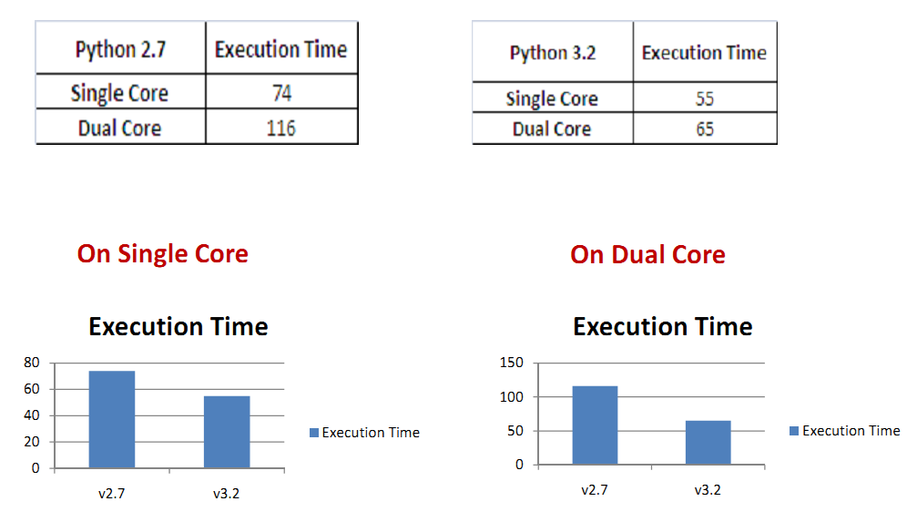
Comparing : Python2.7 and Python3.2

Slide 21
Solving GIL problems
Thought #1: reduce the waiting time interval between threads.
Caveat: increases the overhead of context switching between threads
Thought #2: implement GIL with C API extensions
Caveat: Lot of rework involved
Thought #3: allow running of I/O threads with GIL if they are not blocking other threads.
Caveat: to be analyzed

Slide 22
Jython: GIL
Jython is free of GIL
It can fully exploit multiple cores, as per our experiments
Experiments with Jython2.5
Run with two CPU thread in tandem
Experiment shows positive performance improvement on multi-core system
Jython2.5 | Execution time | User time
Single core | 38 | 0.652
Dual core | 32 | 1.524

Slide 23
Conclusion
Multi-core systems are becoming ubiquitous
Python application should exploit this abundant power
Python inherently suffers the GIL limitation
An intelligent awareness of Python interpreter behavior is helpful in developing multi-threaded applications
Understand and use ☺

Slide 24
References
http://wiki.python.org/moin/GlobalInterpreterLock
http://docs.python.org/c-api/init.html#threads
http://docs.python.org

Slide 25
Backup slides

Slide 26
Python: GIL
A thread needs GIL before updating Python objects, calling C/Python API functions
Concurrency is emulated with regular ‘checks’ to switch threads
Applicable to only CPU bound thread
A blocking I/O operation implies relinquishing the GIL
./Python2.7.5/Include/ceval.h
Py_BEGIN_ALLOW_THREADS
Do some blocking I/O operation ...
Py_END_ALLOW_THREADS
Python file I/O extensively exercise this optimization

Slide 27
GIL: Internals
The function Py_Initialize() creates the GIL
A thread create request in Python is just a pthread_create() call
../Python/ceval.c
static PyThread_type_lock interpreter_lock = 0; /* This is the GIL */
o) thread_PyThread_start_new_thread: we call it for "each" user defined thread.
calls PyEval_InitThreads() -> PyThread_acquire_lock() {}

Slide 28
GIL: in action
Each CPU bound thread requires GIL
‘ticks count’ determine duration of GIL hold
new_threadstate() -> tick_counter
We keep a list of Python threads and each thread-state has its tick_counter value
As soon as tick decrements to zero, the thread release the GIL.

Slide 29
GIL: Details
thread_PyThread_start_new_thread() ->
void PyEval_InitThreads(void)
{
if (interpreter_lock)
return;
interpreter_lock = PyThread_allocate_lock();
PyThread_acquire_lock(interpreter_lock, 1);
main_thread = PyThread_get_thread_ident();
}

