Slide 1

Tracking Emerging Technologies With Python

Slide 2
Pick Topics
There is huge list of emerging technologies. Just a few…
Multi-core Parallel Programming
Web Frameworks Scalable Computing
Cloud Computing Mobile Computing
Social Computing Web Frameworks
Data Analytics Machine Learning
Visualization Game Computing ….

Slide 3
Discover Sources
Search patterns to discover sources
Top in “Cloud Computing”
Blogs in “Cloud Computing”
“Cloud Computing” Portals
Vendors “Cloud Computing”
Products “Cloud Computing”
The query:
Top (Blogs OR Vendors OR Portals OR Products) in “Cloud Computing”
Let us add filetype: xml to get feeds

Slide 4
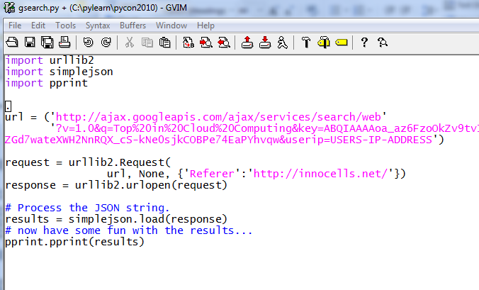
A Bit of Tiny Python Code

Slide 5
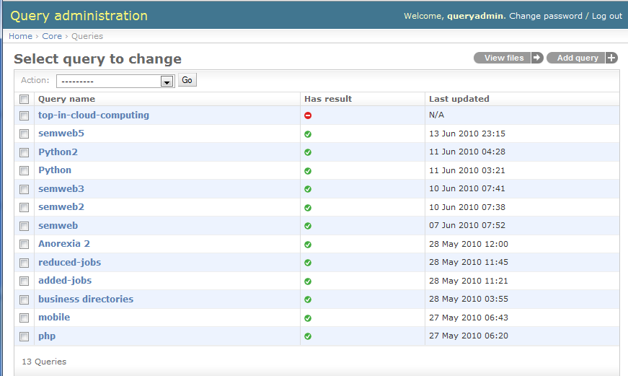
A List of Saved Queries

Slide 6
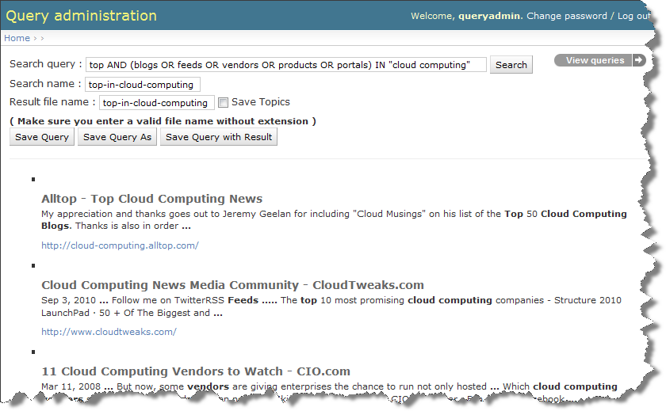
Let Us Look

Slide 7
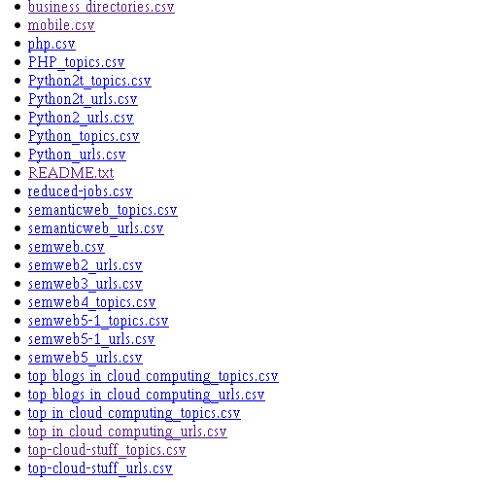
Save the Results in a File

Slide 8
Once You Get the Sources
Let Us Track Them

Slide 9
Track Sources
Track Web pages
@checkpage , InfoMinder
Track Feeds, Blogs
RSS Aggregator, InfoStreams
Combine the stuff
Yahoo Pipes
Do It Yourself
Write your own Python/Django App

Slide 10
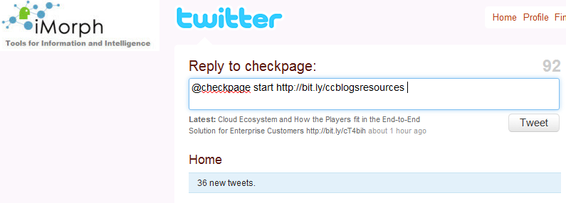
Checkpage – A free Twitter Tool

Slide 11
Eliminate Duplicates
Harder than it looks
URL dups – normalize, check
Similarity Checks
Other Clever Methods
Discussion
Twitter Streams?
Noisy Channels?

Slide 12
Get a List of News Items
Just the headlines
Title + a bit of description
Title + the first para of the article
Title + the entire article

Slide 13
Create a Tag Cloud
Simple tag clouds
Noise words
Standard Words
Incremental Tag Clouds with Visual Cues
WordClouds, Digrams, Tri-grams
Python NLTK to the rescue

Slide 14
Detect Trends
Progressive Tag Clouds
Cumulative Counts over a period
Heat Maps
Visualization Tools
Mind Map Generators

Slide 15
Graph Trends
Splash Lines
Graphs
Motion Charts

Slide 16
Spiral
From the news and trends, find new sources and add them to your list
Repeat the whole process
Rank Sources, Items
Voting (manual)
Click tracking (auto)
Collaborative Filtering

