Slide 1
Web Based Power Management Tool
Vishnu Murty
Subhan M

Slide 2
Contents
Introduction
Block Diagram
How it Works
Development Overview
Tool operations
Demo
What Next
Questions

Slide 3
Introduction
About Power Management Tool
Monitoring Servers
Manage Servers
Power operations
Scheduling operations
Why do we need this Tool
Remote Management
Scheduling
Lab Inventory
Where can we use
Datacenters
Testlabs

Slide 4
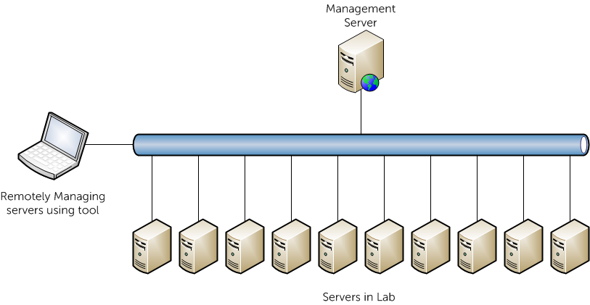
Block Diagram

Slide 5



How It Works
Network

Slide 6
How It Works
Management Server
Server
Web Interface
Django
MySQL
IPMI tool
Baseboard Management Controller
Operating System
Network Interface
Network Interface
Network

Slide 7
Development Overview
Prerequisites
Python
Mysql-server
Python-Mysql
Cherrypy
Django
Ipmitool

Slide 8
Tool operations
Adding server in power management tool
Modifying server details
Deleting server details
Scheduling power operation on servers
Using IPMI
Checking the power status of server
Shutting down server
Starting server

Slide 9
Demo
Video or Live Demo

Slide 10
What Next
Discovering Servers Dynamically
User based Administration
Detailed information about Servers

Slide 11
Questions

