Slide 1



Slide 2

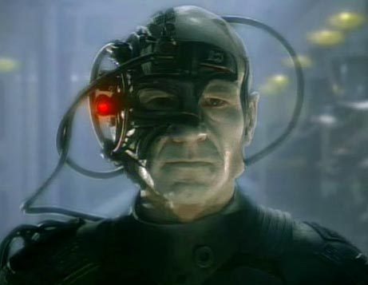

Slide 3
Audio
Video
Streaming
Recording
Editing

Slide 4
Play Audio
Notes:
Borg Collective Voice [Elements, Pipelines, States]

Slide 5
Pipeline
filesrc
decodebin2
autoaudiosink
location=“welcome.mp3”
Notes:
Pipeline, Element, Properties, Links

Slide 6
Play Video
Notes:
Borg Video + Audio [Pads]

Slide 7
Pipeline
filesrc
decodebin2
Autoaudiosink
Audovideosink
location=“sexydrones.avi”
Notes:
Pipeline, Element, Properties, Links

Slide 8
Transmit Audio
Notes:
Transmit my voice, using a streaming protocol

Slide 9
Pipeline
filesrc
decodebin2
tcpserversink
location=“welcome.mp3”
port=3000
tcpclientsrc
audioconvert
autoaudiosink
host=192.168.1.3
port=3000
Notes:
Pipeline, Element, Properties, Links

Slide 10
Transmit Live Audio
Notes:
I, Borg

Slide 11
Pipeline
autoaudiosrc
tcpserversink
flacenc
Device=hw:0,0
port=3000
tcpclientsrc
decodebin2
autoaudiosink
host=192.168.1.3
port=3000
Notes:
Pipeline, Element, Properties, Links

Slide 12
Filters
Notes:
Convert my voice into Borgish voice, and then playback

Slide 13
Pipeline
autoaudiosrc
tcpserversink
Flacenc
pitch
Device=hw:0,0
pitch=0.8
tcpclientsrc
decodebin2
autoaudiosink
host=192.168.1.3
port=3000
Notes:
Pipeline, Element, Properties, Links

Slide 14
Transmit Live Video
Notes:
Transmit my video + voice (+ filters for video and audio)

Slide 15
Pipeline
v4l2src
tcpserversink
jpegenc
videobalance
Hue=0.5
Port=3000
Saturation=0.4
tcpclientsrc
decodebin2
autovideosink
host=192.168.1.3
port=3000
Notes:
Pipeline, Element, Properties, Links

Slide 16
Record to disk
Notes:
The borg keep logs

Slide 17
Pipeline
v4l2src
tee
filesink
jpegenc
tcpserversink
location=“assim.avi”
tcpclientsrc
tee
filesink
decodebin2
autovideosink
location=“rec.avi”
host=192.168.1.3
port=3000

Slide 18
More Cool Things To Do
Media Players (Songbird, Rhythmbox…)
Video Conferencing (Farsight)
Internet Streaming (RTP)
Video Editing (GNonLin)
Speech Recognition (PocketSphinx)
Object/Face Recognition (OpenCV)
Embedded Stuff (Maemo)
… and much more

Slide 19
Infinite multimedia applications
One framework

Slide 20
Links
GStreamer: http://gstreamer.net
Gstreamer on Windows: http://code.google.com/p/ossbuild/
Python Gstreamer Documentation: http://pygstdocs.berlios.de/
Star Trek related news:
http://memory-alpha.org

Slide 21
Who am I?
YuviPanda (Yuvaraj Pandian T)
19 year old student
KCG College, Chennai
Email: yuvipanda@yuvi.in
Web: http://yuvi.in
Twitter: @YuviPanda

