Slide 1
Automation using Python
Nitin K
PyCon India
September 25-26,2010

Slide 2
Index
Why Automation is required
Why Python
Basic requirement for developing Automation Framework.
Demo
How it works
Q & A
PyCon India
September 25-26,2010

Slide 3
Why Automation is required
In our software industry, we used to come across different new/modified application now and then.
There are huge effort involved in terms of Money/Man power to validate each new version.
For ex: Each time google/yahoo/facebook comes up with new window that comes with lots of manual testing.
Using automation from Python these efforts can be reduced many folds.
PyCon India
September 25-26,2010

Slide 4
Why Python
Python comes with huge number of in build modules which make it very easy to automate things.
Ex: sys,os,re ,PIL
If you want to do testing you again have module like unittest,wxPython.
Python can communicate with other languages (with are mainly used to develop different applications we are talking about) like C/C++.
And the best part python is an interpreter language. So need not to worry about platform.
PyCon India
September 25-26,2010

Slide 5
Basic requirement for developing Automation Framework
Python
Wrappers (like SWIG)
Application
PyCon India
September 25-26,2010

Slide 6
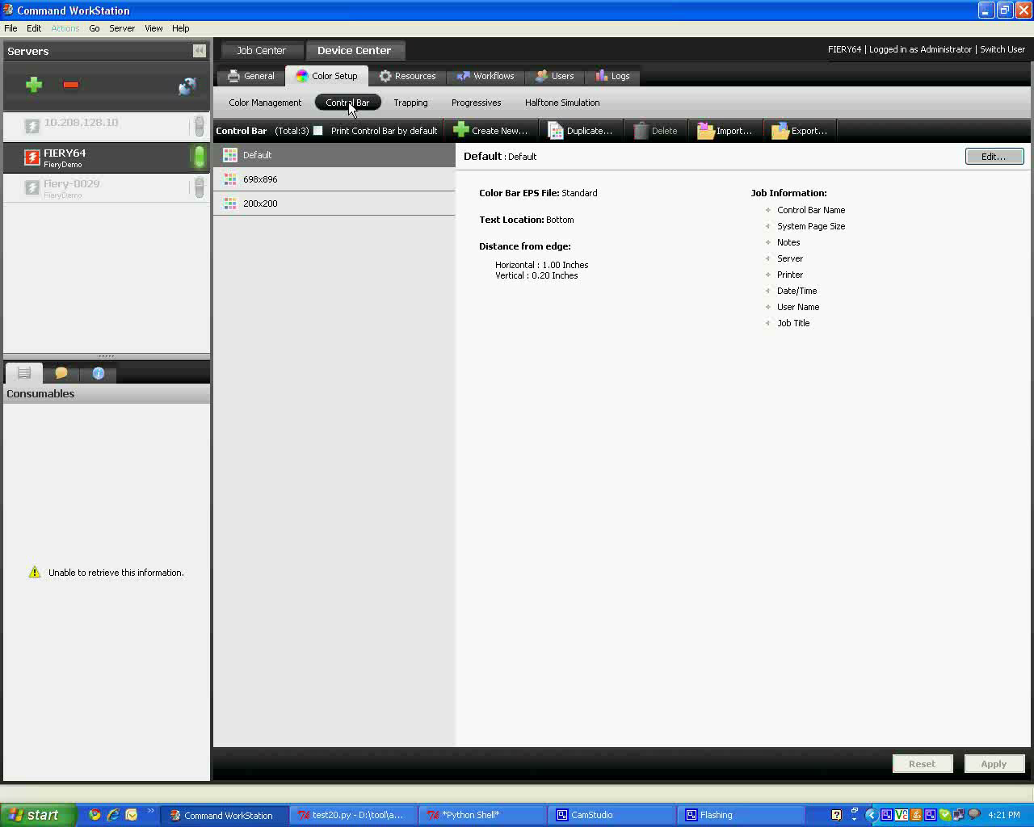
Demo
PyCon India
September 25-26,2010

Slide 7
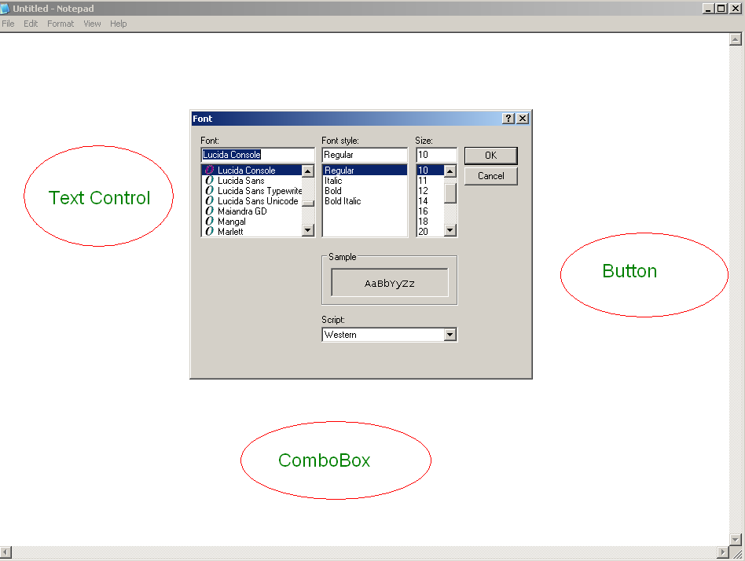
Basic requirement for developing Automation Framework
wxWidgets or similar kind of toolkits which can be recognized by Python.
Ex:
PyCon India
September 25-26,2010

Slide 8
How it works
As Shown in previous slide, we need to recognize the Control class (Combo Box,
Radio Button, Check Box etc) of Application from python with the help of some wrapper
Let say SWIG.
Below I will show a piece of code and its implementation which can explain it in more better/detailed way as I feel examples and demos are best way to understand any thing.
PyCon India
September 25-26,2010

Slide 9
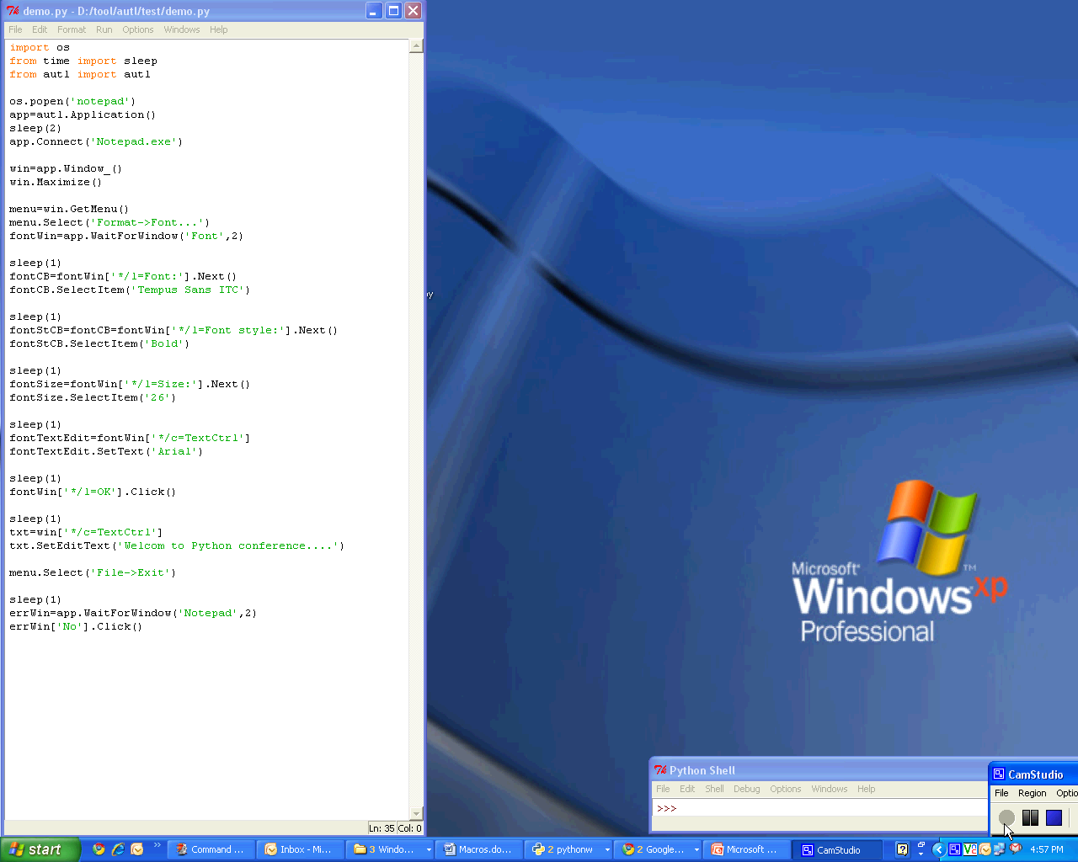
PyCon India
September 25-26,2010

Slide 10
Q & A
nitin.nitp@gmail.com
PyCon India
September 25-26,2010

