Slide 1
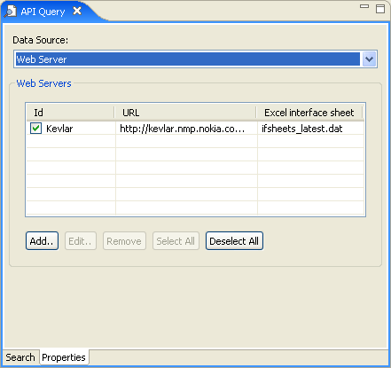
A combo box is used to select the currently used data source.
The content of the data source configuration UI varies dynamically based on the currently selected data source.

Slide 2
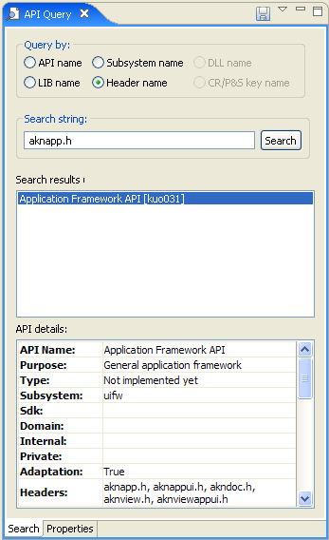

Slide 3
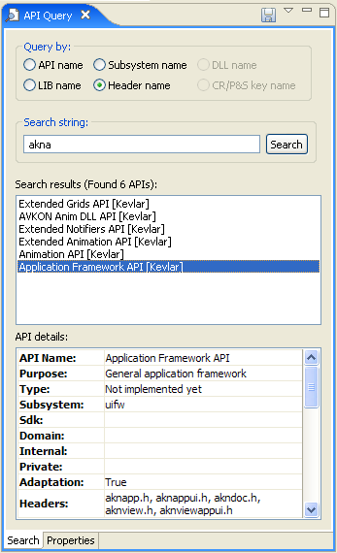

Slide 4
