Slide 1





Tiresias
A GPU Cluster Manager for Distributed Deep Learning
Juncheng Gu, Mosharaf Chowdhury, Kang G. Shin,
Yibo Zhu, Myeongjae Jeon, Junjie Qian, Hongqiang (Harry) Liu, Chuanxiong Guo

Slide 2


GPU Cluster for Deep Learning Training
Deep learning (DL) is popular
  10.5× increase of DL training jobs in Microsoft
  DL training jobs require GPU
    Distributed deep learning (DDL) training with multiple GPUs
GPU cluster for DL training
  5× increase of GPU cluster scale in Microsoft _{[1]}
Google Lens
Siri
How to efficiently manage a GPU cluster for DL training jobs?
[1]. Analysis of Large-Scale Multi-Tenant GPU Clusters for DNN Training Workloads. https://arxiv.org/abs/1901.05758

Slide 3
GPU Cluster Manager
Job Queue
Scheduler
Design Objectives
2
4
1
2
Placement Scheme
1
Minimize
Cluster-Wide Average
Job Completion Time (JCT)
1
N
N-GPU DL job
Free GPU
Achieve
High Resource (GPU) Utilization
Occupied GPU
4-GPU machine
GPU Cluster

Slide 4

Challenge Ⅰ: Unpredictable Training Time
Unknown execution time of DL training jobs
  Job execution time is useful when minimizing JCT
Predict job execution time
  Use the smooth loss curve of DL training jobs (Optimus _{[1]})
1.0
⎯ DSSM
⎯ ResNext
⎯ Seq2Seq
1.0
It’s hard to predict training time of DL jobs in many cases
0.5
0.5
Norm. Train. Loss
Norm. Train. Loss
⎯ Job₁
⎯ Job₂
0.0
0.0
Progress
Progress
[1]. Optimus: An Efficient Dynamic Resource Scheduler for Deep Learning Clusters, EuroSys’18

Slide 5
Challenge ⅠⅠ: Over-Aggressive Job Consolidation
Network overhead in DDL training
Consolidated placement for good training performance
Fragmented free GPUs in the cluster
Longer queuing delay
4
4
N
N-GPU Job
Job Queue
Free GPU
Occupied GPU
Machine 2
Machine 1
Machine 2
Machine 2
Machine 3
Machine 4

Slide 6
Prior Solutions
I. Unpredictable Training Time
(Scheduling)
II. Over-Aggressive Job Consolidation
(Job Placement)
Optimus_{[1]}
None
None
YARN-CS
FIFO
None
Gandiva_{[2]}
Time-sharing
Trial-and-error
[1]. Optimus: An Efficient Dynamic Resource Scheduler for Deep Learning Clusters, EuroSys’18
[2]. Gandiva: Introspective Cluster Scheduling for Deep Learning, OSDI’18

Slide 7
Tiresias
A GPU cluster manager for Distributed Deep Learning Without Complete Knowledge
I. Age-Based Scheduler | Minimize JCT without complete knowledge of jobs
2. Model Profile-Based Placement | Place jobs without additional information from users

Slide 8
Challenge I
How To Schedule DL Training Jobs
Without Complete Job Information?

Slide 9
Temporal and Spatial Co-scheduling
Characteristics of DL Training Jobs
Variations in both temporal and spatial aspects
128
64
# of GPUs
Scheduler should consider both
temporal and spatial aspects of DL training jobs
32
Job execution time
16
Number of GPUs
8
4
2
1
10
10²
10³
10⁴
10⁵
Job execution time (min)

Slide 10
Available Job Information
Spatial: number of GPUs
Temporal: executed time
Executed time
G₃
G₂
# of GPUs
?
…
G₁
0
1
2
3
4
5
6
7
8
9
10
11
Time

Slide 11
Age-Based Schedulers
Least-Attained Service_{[1]} (LAS)
  Prioritize job that has the shortest executed time
Gittins Index policy_{[2]}
  Need the distribution of job execution time
  Prioritize job that has the highest probability to complete in the near future
Age (executed time)
G₃
G₂
# of GPUs
?
…
G₁
# of GPUs
0
1
2
3
4
5
6
7
8
9
10
11
Time
[1]. Feedback queueing models for time-shared systems. JACM, 1968
[2]. Multi-armed bandit allocation indices. Wiley, Chichester, 1989

Slide 12
Two-Dimensional Age-Based Scheduler (2DAS)
Age calculated by two-dimensional attained service
  i.e., a job’s total executed GPU time (# of GPUs × executed time)
No prior information
  2D-LAS
With partial information: distribution of job GPU time
  2D-Gittins Index

Slide 13
2D-Gittins Index: Partial Information
Higher probability to complete (Gittins Index), higher priority
 | # of GPUs | Duration | Attained Service | Gittins Index
J₁ | 2 | 2 | 0 | 0.25
J₂ | 1 | 8 | 0 | 0.25
J₃ | 2 | 6 | 0 | 0.25
 | # of GPUs | Duration | Attained Service | Gittins Index
J₁ | 2 | 2 | 4 | 0.2
J₂ | 1 | 8 | 0 | 0.25
J₃ | 2 | 6 | 0 | 0.25
 | # of GPUs | Duration | Attained Service | Gittins Index
J₁ | 2 | 2 | 4 | 0.2
J₂ | 1 | 8 | 4 | 0.2
J₃ | 2 | 6 | 0 | 0.25
 | # of GPUs | Duration | Attained Service | Gittins Index
J₁ | 2 | 2 | 4 | 0.2
J₂ | 1 | 8 | 8 | 0.125
J₃ | 2 | 6 | 4 | 0.2
 | # of GPUs | Duration | Attained Service | Gittins Index
J₁ | 2 | 2 | 4 | 0.2
J₂ | 1 | 8 | 8 | 0.125
J₃ | 2 | 6 | 12 | N/A
 | # of GPUs | Duration | Attained Service | Gittins Index
J₁ | 2 | 2 | 4 | 0.2
J₂ | 1 | 8 | 4 | 0.2
J₃ | 2 | 6 | 4 | 0.2
Distribution
Execution time
(4, 8,12)
J₁ end
Job switch
Job switch
J₂ end
J₃ end
 | Extra Information | Avg. JCT
2D-Gittins Index | GPU time distribution | 10.0
2D-LAS | None | 11.7
G₂
G₁
0
1
2
3
4
5
6
7
8
9
10
11
12
13
14
15
16
Time

Slide 14
Two-Dimensional Age-Based Scheduler (2DAS)
Age calculated by two-dimensional attained service
  i.e., a job’s total executed GPU time (# of GPUs × executed time)
No prior information
  2D-LAS
With partial information: distribution of job GPU time
  2D-Gittins Index
Fewer job switches
  Priority discretization: Discretized-2DAS

Slide 15
Prior Solutions
I. Unpredictable Training Time
(Scheduling)
II. Over-Aggressive Job Consolidation
(Job Placement)
Optimus_{[1]}
None
None
YARN-CS
FIFO
None
Gandiva_{[2]}
Time-sharing
Trial-and-error
Tiresias
LAS
Gittins Index
?
Discretized-2DAS
[1]. Optimus: An Efficient Dynamic Resource Scheduler for Deep Learning Clusters, EuroSys’18
[2]. Gandiva: Introspective Cluster Scheduling for Deep Learning, OSDI’18

Slide 16
Challenge II
How to Place DL Jobs
Without Hurting Training Performance?

Slide 17
Characteristics of DL Models
Tensor size in DL models
  Large tensors cause network imbalance and contention
600
500
Consolidated placement is needed when the model is highly skewed in its tensor size
400
Size (MB)
300
200
100
0
VGG11
VGG16
VGG19
AlexNet
ResNet50
Inception3
ResNet101
ResNet152
Inception4
GoogleNet

Slide 18
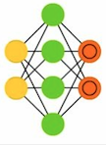
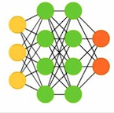
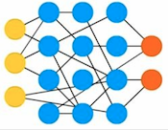
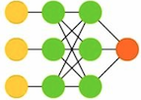
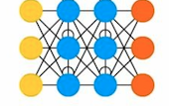
Model Profile-Based Placement
NO
Model Profiler
AlexNet
GoogleNet
Inception3
VGG19
Inception4
VGG11
Consolidation?
VGG16
ResNet101
ResNet152
ResNet50
YES

Slide 19
Discretized-2DAS
Central Master
Placement scheme
DL Job
(model, resource)
Model profiler
Tiresias
Evaluation
Placement
Preemption
60-GPU
Testbed Experiment
Central Master
Network-Level Model Profiler
Large-scale &
Trace-driven Simulation
GPU Cluster

Slide 20
JCT Improvements in Testbed Experiment
Testbed – Michigan ConFlux cluster
  15 machines (4 GPUs each)
  100 Gbps RDMA network
Avg. JCT improvement (w.r.t. YARN-CS): 5.5×
Comparable performance to SRTF
10
10²
10³
10⁴
10⁵
19

Slide 21
JCT Improvements in Trace-Driven Simulation
Discrete-time simulator
  10-week job trace from Microsoft
  2,000-GPU cluster
Avg. JCT improvement (w.r.t. Gandiva): 2×
10²
10³
10⁴
10⁵
10⁶
10⁷

Slide 22

Tiresias
A GPU cluster manager for Distributed Deep Learning Without Complete Knowledge
  Optimize JCT with no or partial job information
  Relax placement constraint without hurting training performance
  Simple, practical, and with significant performance improvements
https://github.com/SymbioticLab/Tiresias

Slide 24
Time Overhead of Job Switch
Notes:
Non-negligible overhead of switch DL jobs on GPU

Slide 25
DL Models
Model | Total size (MB) | Largest tensor (MB)
VGG19 | 548 | 382
VGG16 | 527 | 392
VGG11 | 506 | 392
AlexNet | 235 | 144
ResNet152 | 230 | 9
ResNet101 | 170 | 9
ResNet50 | 98 | 9
Inception4 | 163 | 6
Inception3 | 91 | 8
GoogleNet | 27 | 4
Notes:
Largest tensor is Full-connection layer

Slide 26
JCT in Testbed Experiment
10
10²
10³
10⁴
10⁵
25
Notes:
T-G has the same perf as T-L (1.06 in average, 1.05 in median)

Slide 27
JCT Improvements in Testbed Experiment
Bins | 1(Small-Short) | 2(Small-Long) | 3(Large-Short) | 4(Large-Long)
% of Jobs | 63.5% | 12.5% | 16.5% | 7.5%
26
Notes:
T-G has the same perf as T-L (1.06 in average, 1.05 in median)

Slide 28
GPU Utilization in Testbed Experiment
The makespan is improved by 1.21× (w.r.t. YARN-CS)
27
Notes:
There are small variations, overall utilization across solutions look similar.

Slide 29
Queuing Delay in Testbed Experiment
 | Average | Median | 95th
YARN-CS | 8146s | 7464s | 15327s
SRTF | 593s | 32s | 3133s
Tiresias-G | 1005s | 39s | 7933s
Tiresias-L | 963s | 13s | 7755s
28
Notes:
Most of the overhead is queuing delay!!!!

Slide 30
Training Performance in Testbed Experiment
Training time when Tiresias-L running with and without placement
29
Notes:
Most of the jobs can have faster training speed (image/second)
1.67x in max
<30% jobs experience limited perf. Loss
The major improve. Comes from the job scheduling by avoiding HOL of small/short to large/long jobs

Slide 31
JCT in Trace-Driven Simulation
10²
10³
10⁴
10⁵
10⁶
10⁷

Slide 32
JCT Improvements in Trace-Driven Simulation
 | Average | Median | 95th
YARN-CS | 2.41× | 30.85× | 1.25×
SRTF | 1.00× | 1.00× | 0.84×
Gandiva | 2.00× | 2.59× | 2.08×
Tiresias-G | 0.97× | 1.00× | 0.85×
Notes:
T-G has a little improvements than T-L, however, in real cases, because of more preemptions are triggered in T-G, it’s performance is slightly lower than T-L;

Slide 33
Sensitivity Analysis of 2D-LAS

Slide 34
Sensitivity Analysis of 2D-Gittins Index

Slide 35
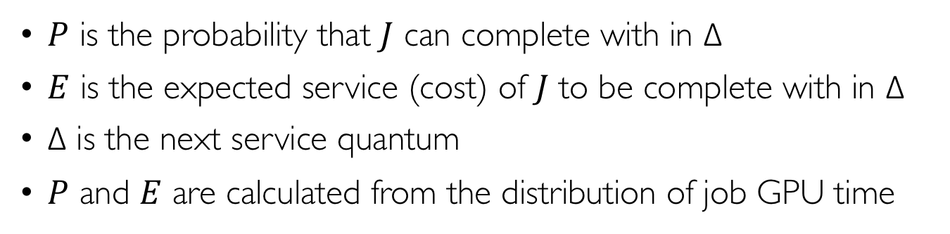
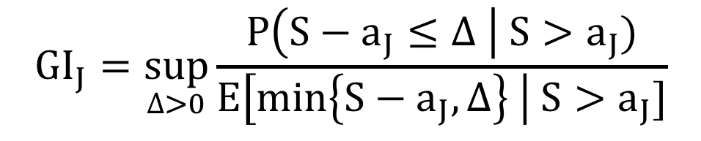
Gittins Index
$${GI}_{J}=\sup_{∆>0}{\frac{P\left(S−a_{J}≤∆ \right| S>a_{J})}{E\left[min\left\{S−a_{J},∆\right\} \right| S>a_{J}]}}$$
$P$ is the probability that $J$ can complete with in Δ
$E$ is the expected service (cost) of $J$ to be complete with in Δ
Δ is the next service quantum
$P$ and $E$ are calculated from the distribution of job GPU time

