Slide 1
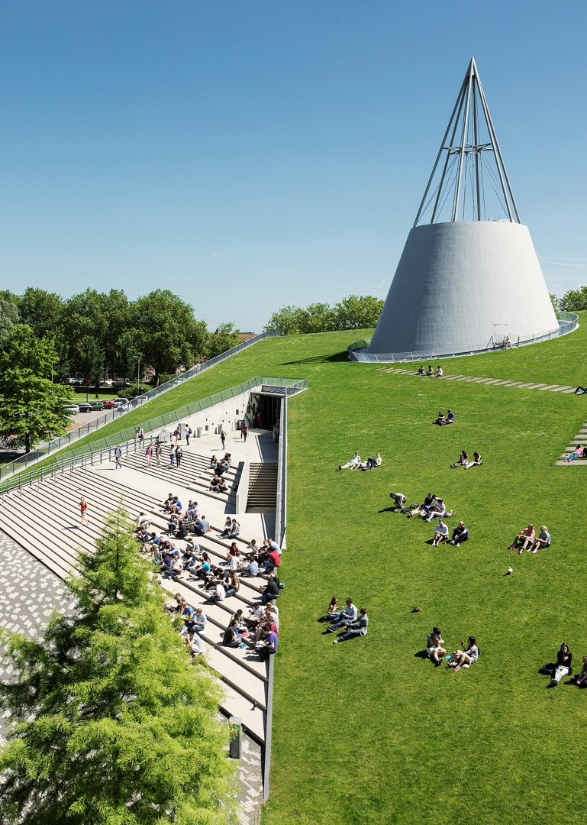
Title slide + image
Digital Business Process Management (MOT122A)
Proposal (Pecha kucha) | Group 3

Slide 2
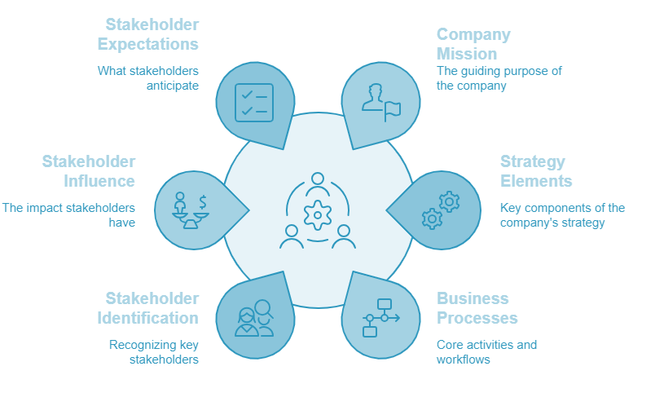
Table of contents

Slide 3
Content Categories
Introduction
Company Overview
Business Process & Strategy
Balanced Scorecard & Performance Metrics
Process Mapping & BPMN
Lean Six Sigma & Process Improvement
Process Mining & Automation
Business Process Controls & Risks
Technology Integration in DBPM
Challenges in DBPM
Future Trends in DBPM
Conclusion
Q&A Slide

Slide 4
Disclaimer
"Lean Company" is a placeholder name chosen to represent the actual company we have selected. The original company is a rapidly growing startup in the ConTech sector. We can provide relevant documents and data from the company for reference upon request.
However, we have been advised not to disclose the company's name publicly, including in academic settings. Despite this restriction, we are permitted to use the data and discussions related to the company for analysis and research.

Slide 5
Introduction
Lean Company is an award-winning cloud-based Construction Management Software that offers real-time solutions to real-time construction problems.
Developed using proven Lean principles and industry-leading BIM and Analytics web technologies, it is the only product that provides a production management workflow integrated with BIM, analytics, and other prevalent construction technologies.
Research Seed
Founded as Company
Presence in 20+ countries
2 decades worth of research in Lean Construction
2013
2020
Leadership Team
Experienced Production Innovation & Technical Leaders
2009
2015
2021....
Academic & Industry experts on Board Team to guide Roadmap of product
Pilot Research Projects
Innovation of The Year in ConTech Category
Source – Lean Company Website
Source – Lean Company Website

Slide 6
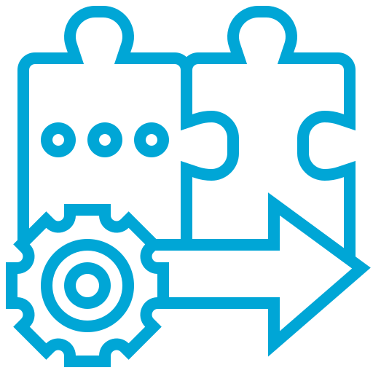
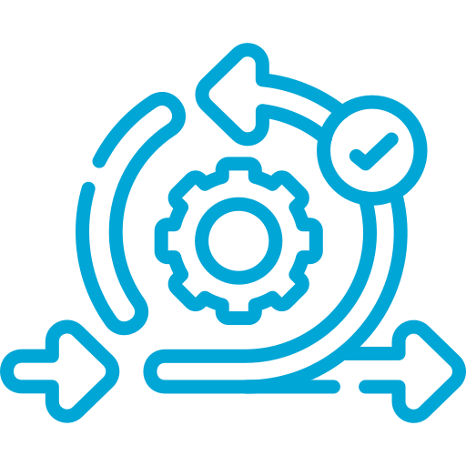
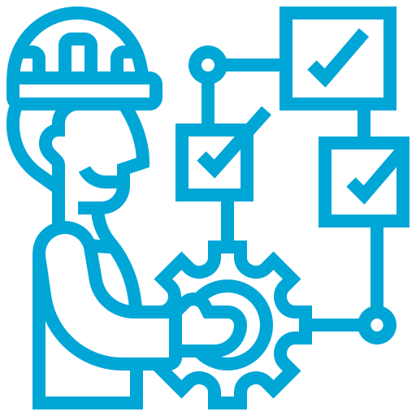
Mission
#00A6D6
The mission is to revolutionize construction management by seamlessly integrating digital technology with Lean construction principles through the software. This software aims to drive Lean adoption in the construction industry by offering a software-driven approach that enhances efficiency without requiring complex organizational changes and technologies.
Source – Lean Company Website
Enhance Collaboration
Refine Project Plans
Integrated Project Delivery
Report real-time progress
Reduce Waste
Integrate CPM & Lean Construction
Increase Transparency
Lean Methods – LPS & TAKT
Eliminate reasons for variance
Support Location based Planning
Industry Friendly Features
Production Planning in Construction
Minimise non-value tasks

Slide 7

Strategy
#00A6D6
PRODUCT LEADERSHIP
Lean Company
E
L
E
M
E
N
T
S
Integrated Project Delivery
Threshold
Lean Construction
Leadership
Cloud-Based Collaboration
Wide-range of Modules & Features
POC Based Approach
Customer-Centric Approach
Continuous Improvement
Treacy, Michael, and Fred Wiersema. "Customer intimacy and other value disciplines." Harvard business review 71.1 (1993): 84-93.
OPERATIONAL EXCELLENCE
CUSTOMER INTIMACY

Slide 8
Product Leadership
#00A6D6
Industry demands
Customer Demands
This part of cycle represents how the company functions to achieve Product Leadership.
The company focuses on construction market demands, whether driven by new technologies or real-world project needs.
Based on these, they set long-term and short-term goals to shape the product roadmap. Research, competitive analysis, and proof of concepts with customers follow.
Once a software module is finalized, it is set in stone—backed by thorough research and a clear purpose.
Product Road Map
UI/UX Research
Domain Experts/ Research
Competitive Analysis
MVP Development
Pilot Customers
In this part of the cycle, the focus is on building strong customer relationships. The team actively gathers feedback in advance and incorporates critical input from industry experts and end users to improve the product.
Final product
roll-out

Slide 9

Product Cycle
#00A6D6
Roadmap
Major Verticals
Conceptual UI/UX
Technical Investigation
Operational changes are crucial, as major failures often occur at this stage.
Technological Integration
Customer Demands
Customized Features
Detailed Specifications
Existing Customer Pool
Improvements
POC
Bugs
Development
Adjustments
Marketing
Testing
Ongoing Development
Integration
MVP Launch
Final Roll-out
Defects

Slide 10
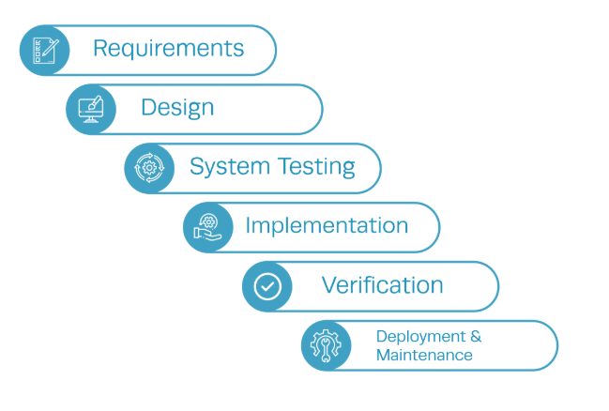
Zooming-In
#00A6D6
The company follows the Waterfall method for development and testing but has made key tweaks to create a customized process.
Standard Process
Why?
Initially, the product requirements were definitive which made the development and testing simple.
The team size was small and was very close knitted, which made this an ideal choice.
Few customization & paid feature request.
The vertical modules, linked to each other were only 3.
Simple method, requires lot less training period & employees can start contributing faster.
Singh, R. (2024, October 9). What is Waterfall Methodology: Everything You Need to Know. Institute of Project Management. https://instituteprojectmanagement.com/blog/waterfall-methodology/

Slide 11
Functional Breakdown
#00A6D6
Demands
Research
POC
Operations
Pilot Release
Feedback
Final Release
Product
Development
Testing
Feature Research
Specifications
Technological Investigation
Development of Features
Test case development
Final QA - Pass/ Fail
UI/UX mock-ups
Features & User story Definition
Individual Feature testing
Integrated internal release
Cross-module Impact
Integration
Competitive technology
UI Interactions
POC for Integration
Technical Architecture
Integrated cross-module testing
Competitors
Defect Solving

Slide 12


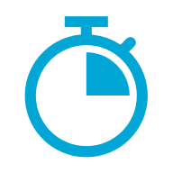
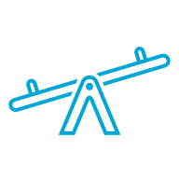



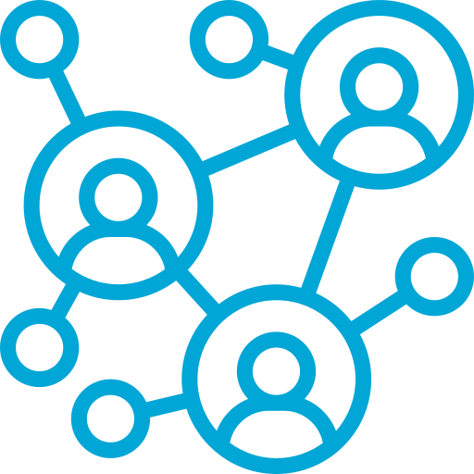
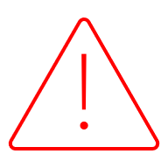
Issues with the Process
#00A6D6
Wrong Estimates
Long release cycle
Surprise features
Wrong work estimates leads to wrong commitment dates
This lead to loss of vision of commitment and promised timelines leading to chaos at the end
Developers see the planned and committed roadmap on first day of sprint cycle
Outdated Work Technology
No Technical investigation
Poor Coordination & Handovers
Using outdated tools along with methods is causing issues in collaboration and people are working in isolated silos
Teams often don’t get enough time to explore new technology which are to be integrated and cross-modules impacts
Unstandardized practises and informal handover often leads to blame-transfer and friction between teams

Slide 13
What Changed?
#00A6D6
The fundamental reason for this operational failure was that the nature of work changes. All four fundamental types of operation shifted to high implication, creating a chaotic environment, where older business processes rendered inefficient.
Then
Now
Volume
Volume
High
Low
High
Low
Variety
Variety
High
Low
High
Low
Variation
Variation
High
Low
High
Low
Visibility
Visibility
High
Low
High
Low

Slide 14

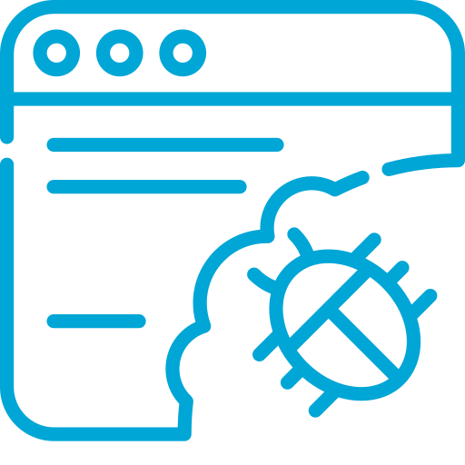
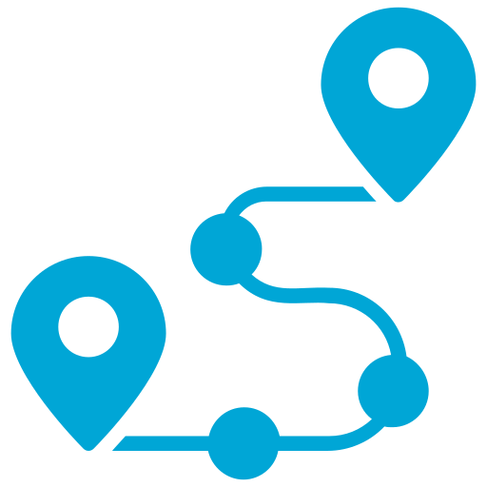

Impact on Business
#00A6D6
As the company grows, outdated methods and tools are making coordination difficult. This is causing a loss of customer confidence and could lead to lost business if corrective measures are not taken in both the short and long term.
Loss of Pilot Customers
Business Loss
Untimely Delivery
Loss of Product Leadership
Inefficient Software
Low Team Trust
Internal team Conflicts
Defects & Bugs in New features
Constantly reworking & revising work done
Wrong Commitments
Brokedown coordination & vision of product
Disrupted RoadMap Vision
High non-value task

Slide 15
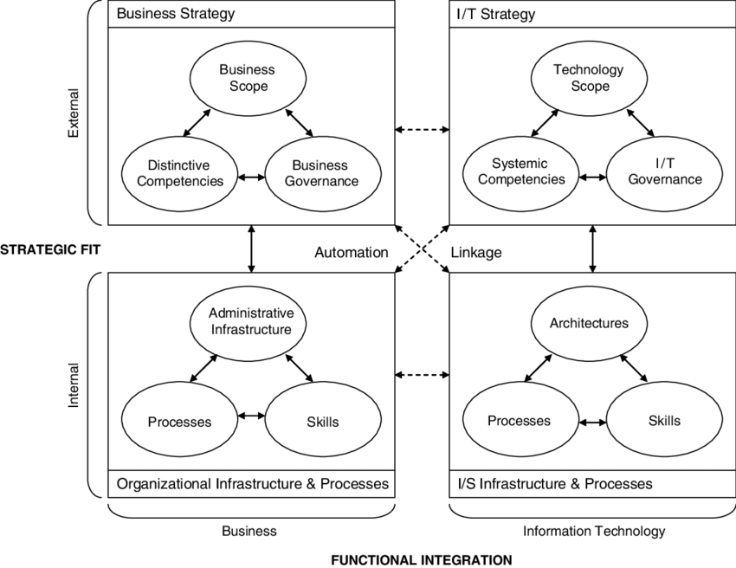
Alignment
#00A6D6
The Lean Company follows a Business-Driven Alignment approach, where business goals are defined first, and IT is adjusted to support them. As seen in the following stakeholder slides, the technical team plays a supporting role in achieving business ambitions led by the CEO and industry leaders.
This development process serves as the core engine driving output, which then becomes input for all other teams to support customers and maintain product leadership. This makes it the most critical process in the chain. However, it is currently at risk due to various factors outlined in the previous slides.
Therefore, we will model various interfaces between the business and development cycles and work on improving the development cycle itself. The goal is to make the existing mechanistic process more seamless, efficient, and effortless.
Henderson, J.C. and Venkatraman, N.: Strategic Alignment: Leveraging Information Technology for Transforming Organizations, IBM Systems Journal, 1999

Slide 16
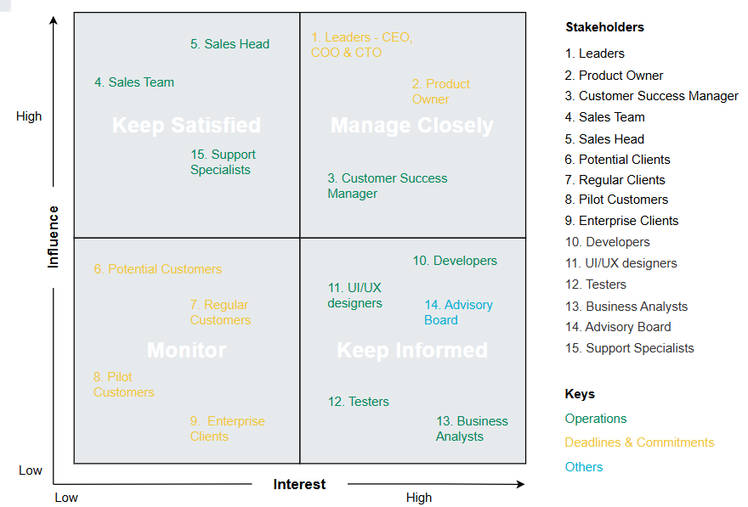
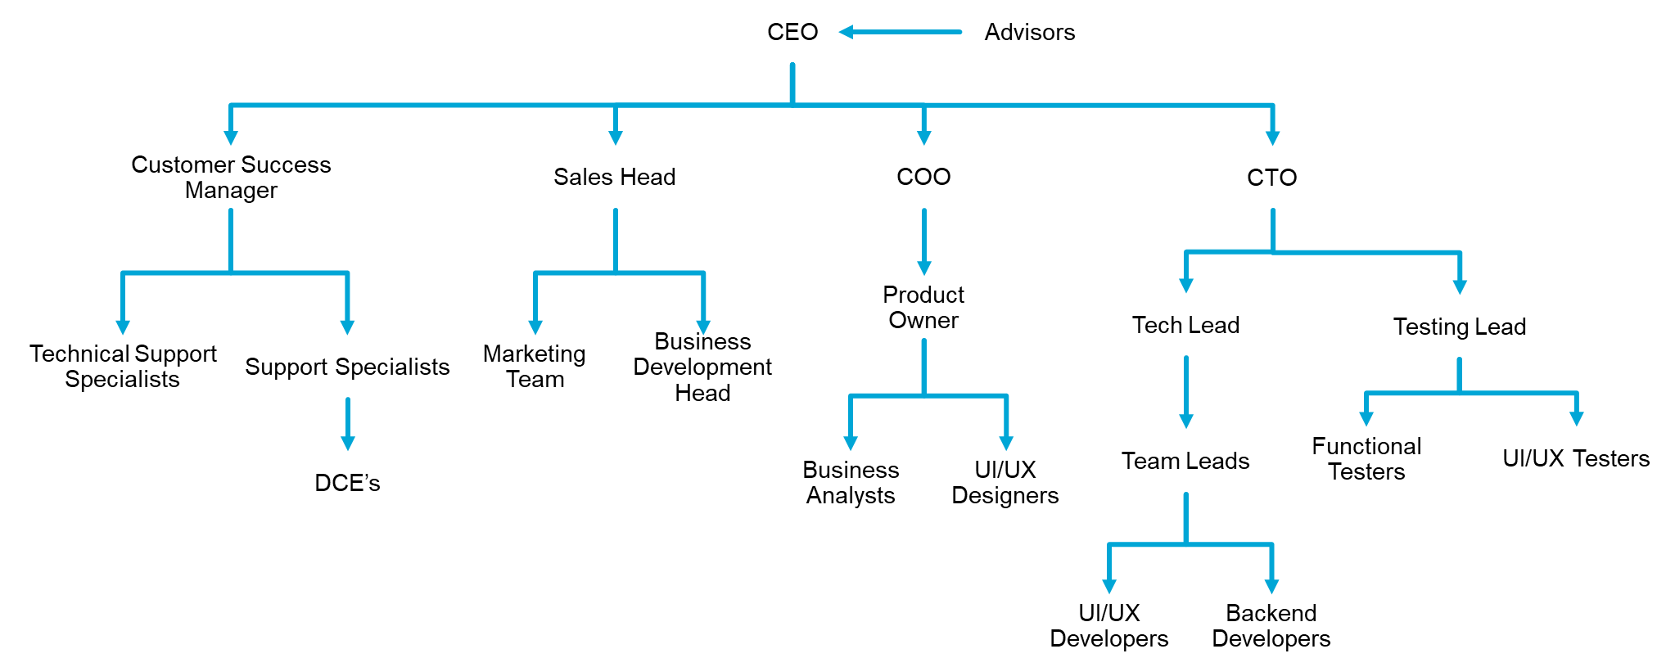
Main Stakeholders & Influence
#00A6D6
Main Stakeholders
Influence Matrix
Keep Satisfied
Manage Closely
Monitor
Keep Informed

Slide 17
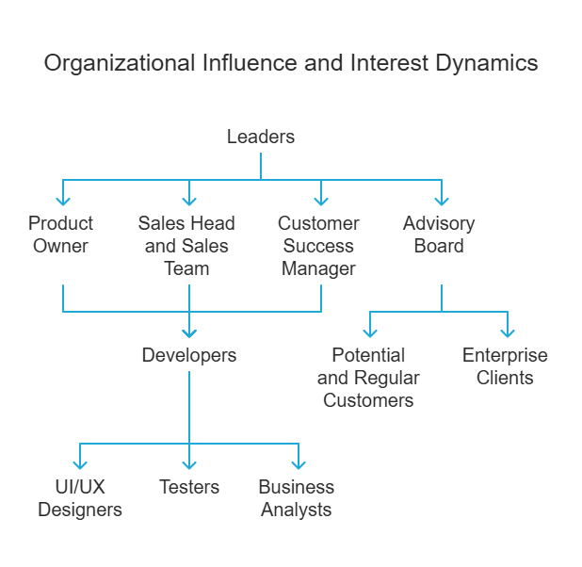
Main Stakeholders & Influence
#00A6D6
Leaders (CEO, COO, CTO) hold the highest influence and interest, driving company decisions and prioritizing business success over product quality. The Product Owner also has high influence and interest, but rather than independently optimizing the product, they follow leadership directives to align with business goals. The Customer Success Manager has moderate influence but high interest, as they gather valuable client feedback but lack decision-making power.
The Sales Head and Sales Team have high influence but low interest, pushing for easily sellable products rather than focusing on innovation. Similarly, Support Specialists hold moderate influence with low interest, ensuring usability but not shaping the product’s core design. Potential and Regular Customers, along with Enterprise Clients and Pilot Customers, have low influence despite moderate interest, as their feedback is considered but does not dictate product development.
Meanwhile, Developers, UI/UX Designers, Testers, and Business Analysts are highly interested but have low influence, focusing on execution, feasibility, and user experience rather than decision-making. The Advisory Board has moderate interest but low influence, providing strategic insights without direct authority. This structure reflects a business-driven approach, where leadership and sales influence product direction more than technical teams or user needs.

Slide 18
Stakeholder Expectations
#00A6D6
Leaders
& Managers
A well-researched, innovative product that ensures a competitive advantage while maintaining operational efficiency and timely delivery.
Designers
& Business Analysts
Clients, supporting infrastructure, and technology enable collaboration with the product owner to innovate and develop ideas. Teams have the autonomy to create, experiment, and present new concepts in an open environment.
Technical Lead
A solid, unchangeable design and specifications are essential to begin technology research and integration into the IT infrastructure. The team requires finalized UI/UX flows, interactions, and a clear understanding of cross-module impacts to accurately estimate time and create an effective work breakdown structure.
Testing Lead
Testing requires a collaborative environment with the development and product teams to create innovative regression test cases. The team expects UI/UX animations to validate flows and functional requirements, along with coding standardization to ensure fault-free code.
Customer Support
& Marketing Team
Both teams expect the development and testing teams to provide a roadmap for the next three releases to ensure customer commitment. They require timely delivery, fault-proof designs, and advance notifications of issues in the current product to manage customer expectations effectively.

Slide 19
Stakeholder – Conflicts
#00A6D6
Product that should exist
Technical Team conflicts with Product Team
Technical team conflicts with Product team on functional documentation
Performance Gap
Product Team conflicts with Testing Team
Product that actually exists
Perception Gap
Marketing/Customer Support Team conflicts with Product Team
Documentation Gap
Product that people think exists
Communication Gap
Leaders conflict with product team
Testing Team conflicts with Development Team for Technical Documentation
Product that is documented
Product Team conflicts with Testing Team

Slide 20
Stakeholder – Requirements
#00A6D6
Leaders
& Managers
Innovate & Well Researched Product
Timely delivery & Operational Efficiency
Designers
& Business Analysts
Technological Support
Support & Contact with clients
Technological limits from Technical team
Technical Lead
Detailed Specifications
Detailed Designs
Standard handover Processes
Standard work formats
UI/UX Interactions
Documentation – Functional
Operational Standardization
Testing Lead
Documentation – Functional & Technical
UI/UX animations
Testing Standardization
Extreme cases for testing
Performance Expectations
Handover & validation Measures
Customer Support
& Marketing Team
Timely Delivery
Timely Delivery
Customizations
Cross-functional features
Open Communication
Responsive Designs
Bug-free software

Slide 21
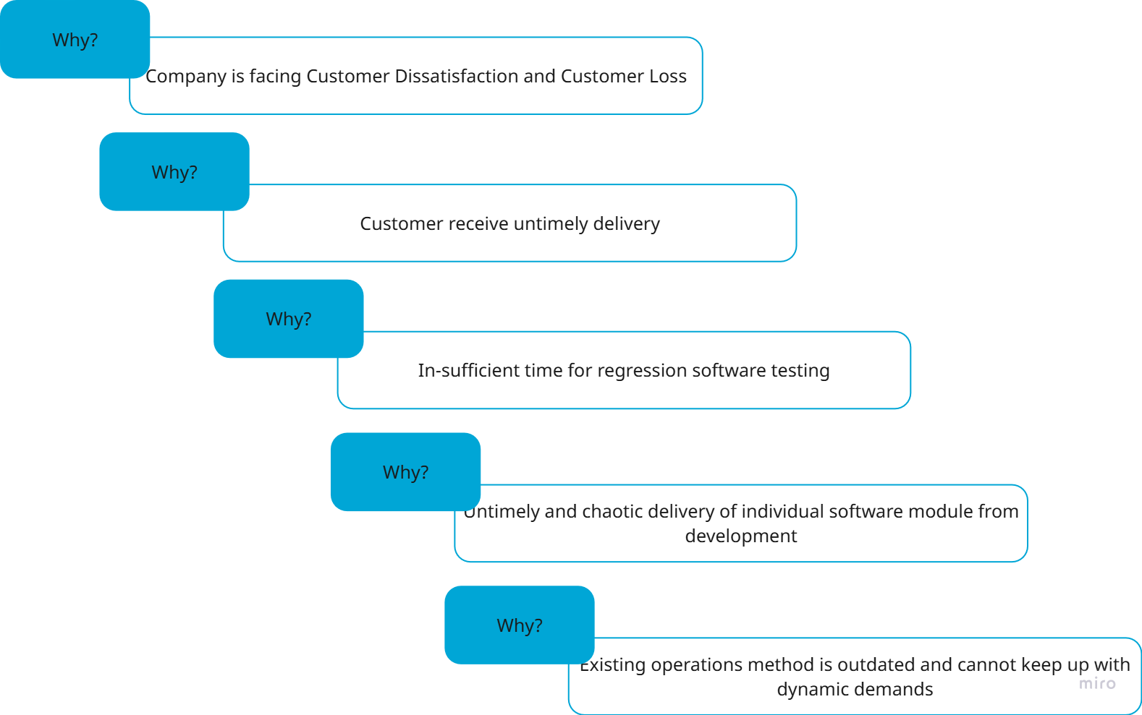
5 – why?
#00A6D6

Slide 22
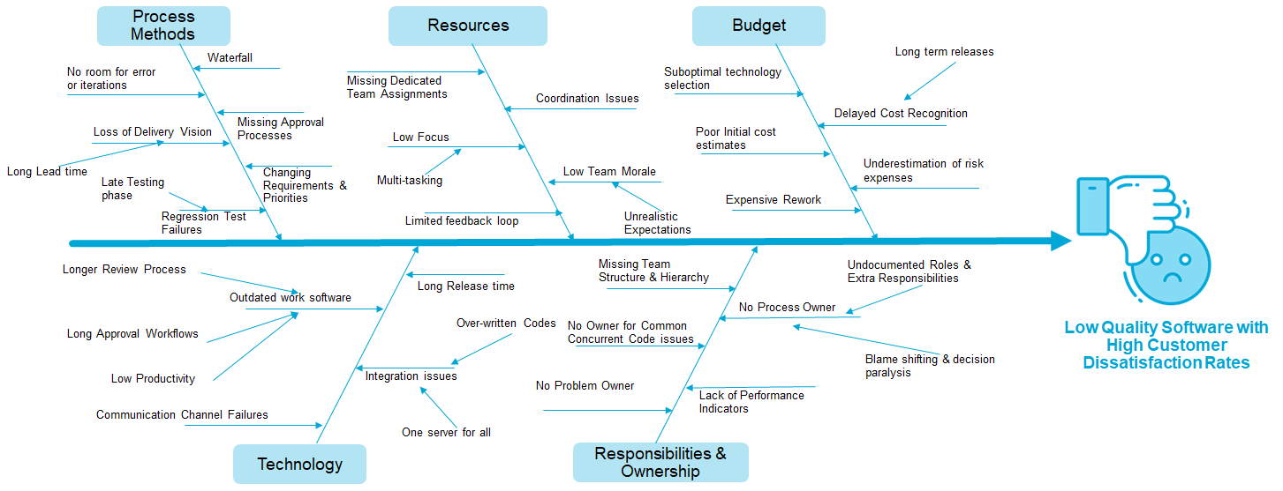
Root-Cause Analysis
#00A6D6

Slide 23
Balanced Score Card
#00A6D6
Perspective | Objective | Measure | Timeframe | Indicator Type | Stakeholder Interest
Financial | Reduce operational costs | Operational costs | Short-term | Lagging, Hard | Shareholders, Management
 | Enhance profitability | Net profit margin | Long-term | Lagging, Hard | Shareholders, Management
 | Increase market share (measured via market reports) | Market share growth | Long-term | Lagging, Soft | Shareholders, Management
Customer | Increase customer satisfaction | Customer satisfaction rate | Long-term | Lagging, Hard | Customers
 | Improve customer retention | Customer retention rate | Long-term | Leading, Hard | Customers
 | Improve response time to customer issues | Average complaint resolution time | Short-term | Leading, Hard | Customers
Internal Business Processes | Enhance real-time project updates | Average time to update clients | Short-term | Leading, Hard | Operations Team
 | Optimize project delivery | Project completion time | Short-term | Lagging, Hard | Operations Team
 | Enhance quality control | Number of defects or reworks | Short & Long-term | Lagging, Hard | Operations Team
 | Reduce Defective Software Delivery | Average project delay (overall average) | Long-term | Lagging, Hard | Operations Team
 | Foster process innovation | Number of implemented process improvements | Long-term | Leading, Objective & Subjective | Operations Team, Employees
Learning and Growth | Improve employee skills | Employee training completion rate | Long-term | Leading, Hard | Employees
 | Foster innovation culture | Number of implemented employee suggestions | Long-term | Leading, Objective & Subjective | Employees
 | Increase employee engagement | Employee satisfaction survey (conducted annually) | Short-term | Lagging, Soft, Subjective | Employees

Slide 24
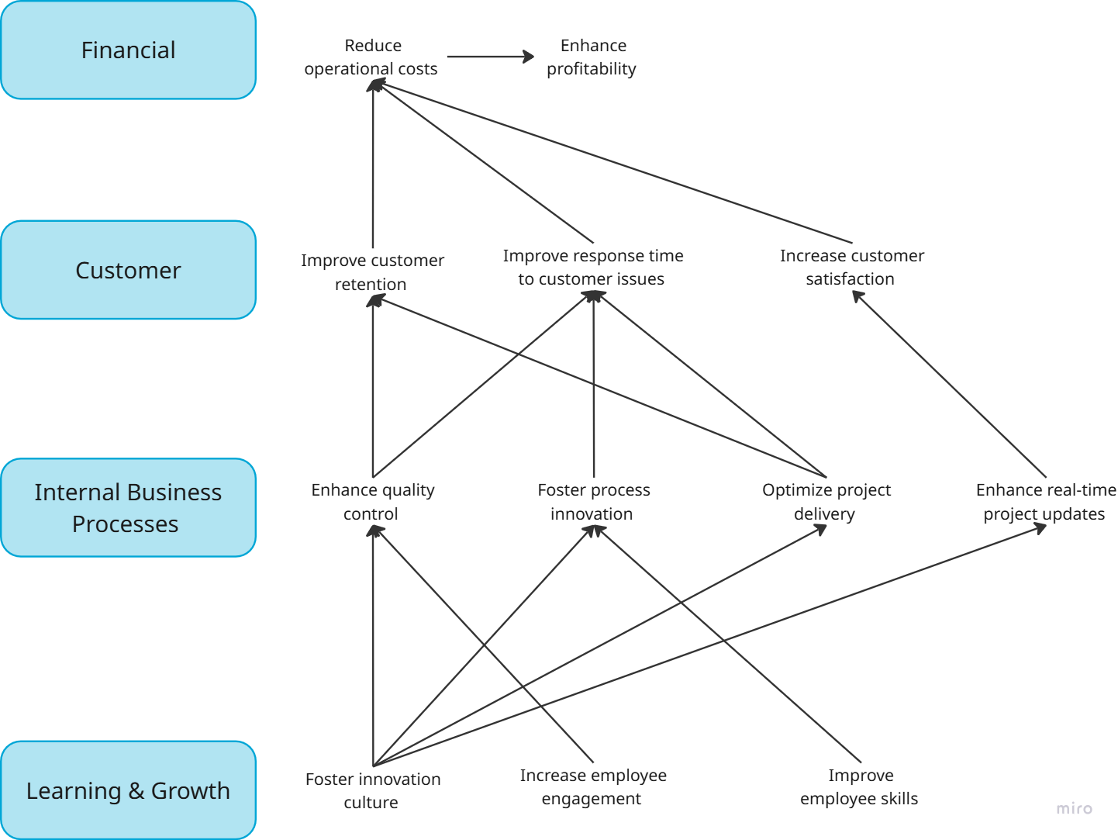
Customer Strategy Map
#00A6D6

Slide 25
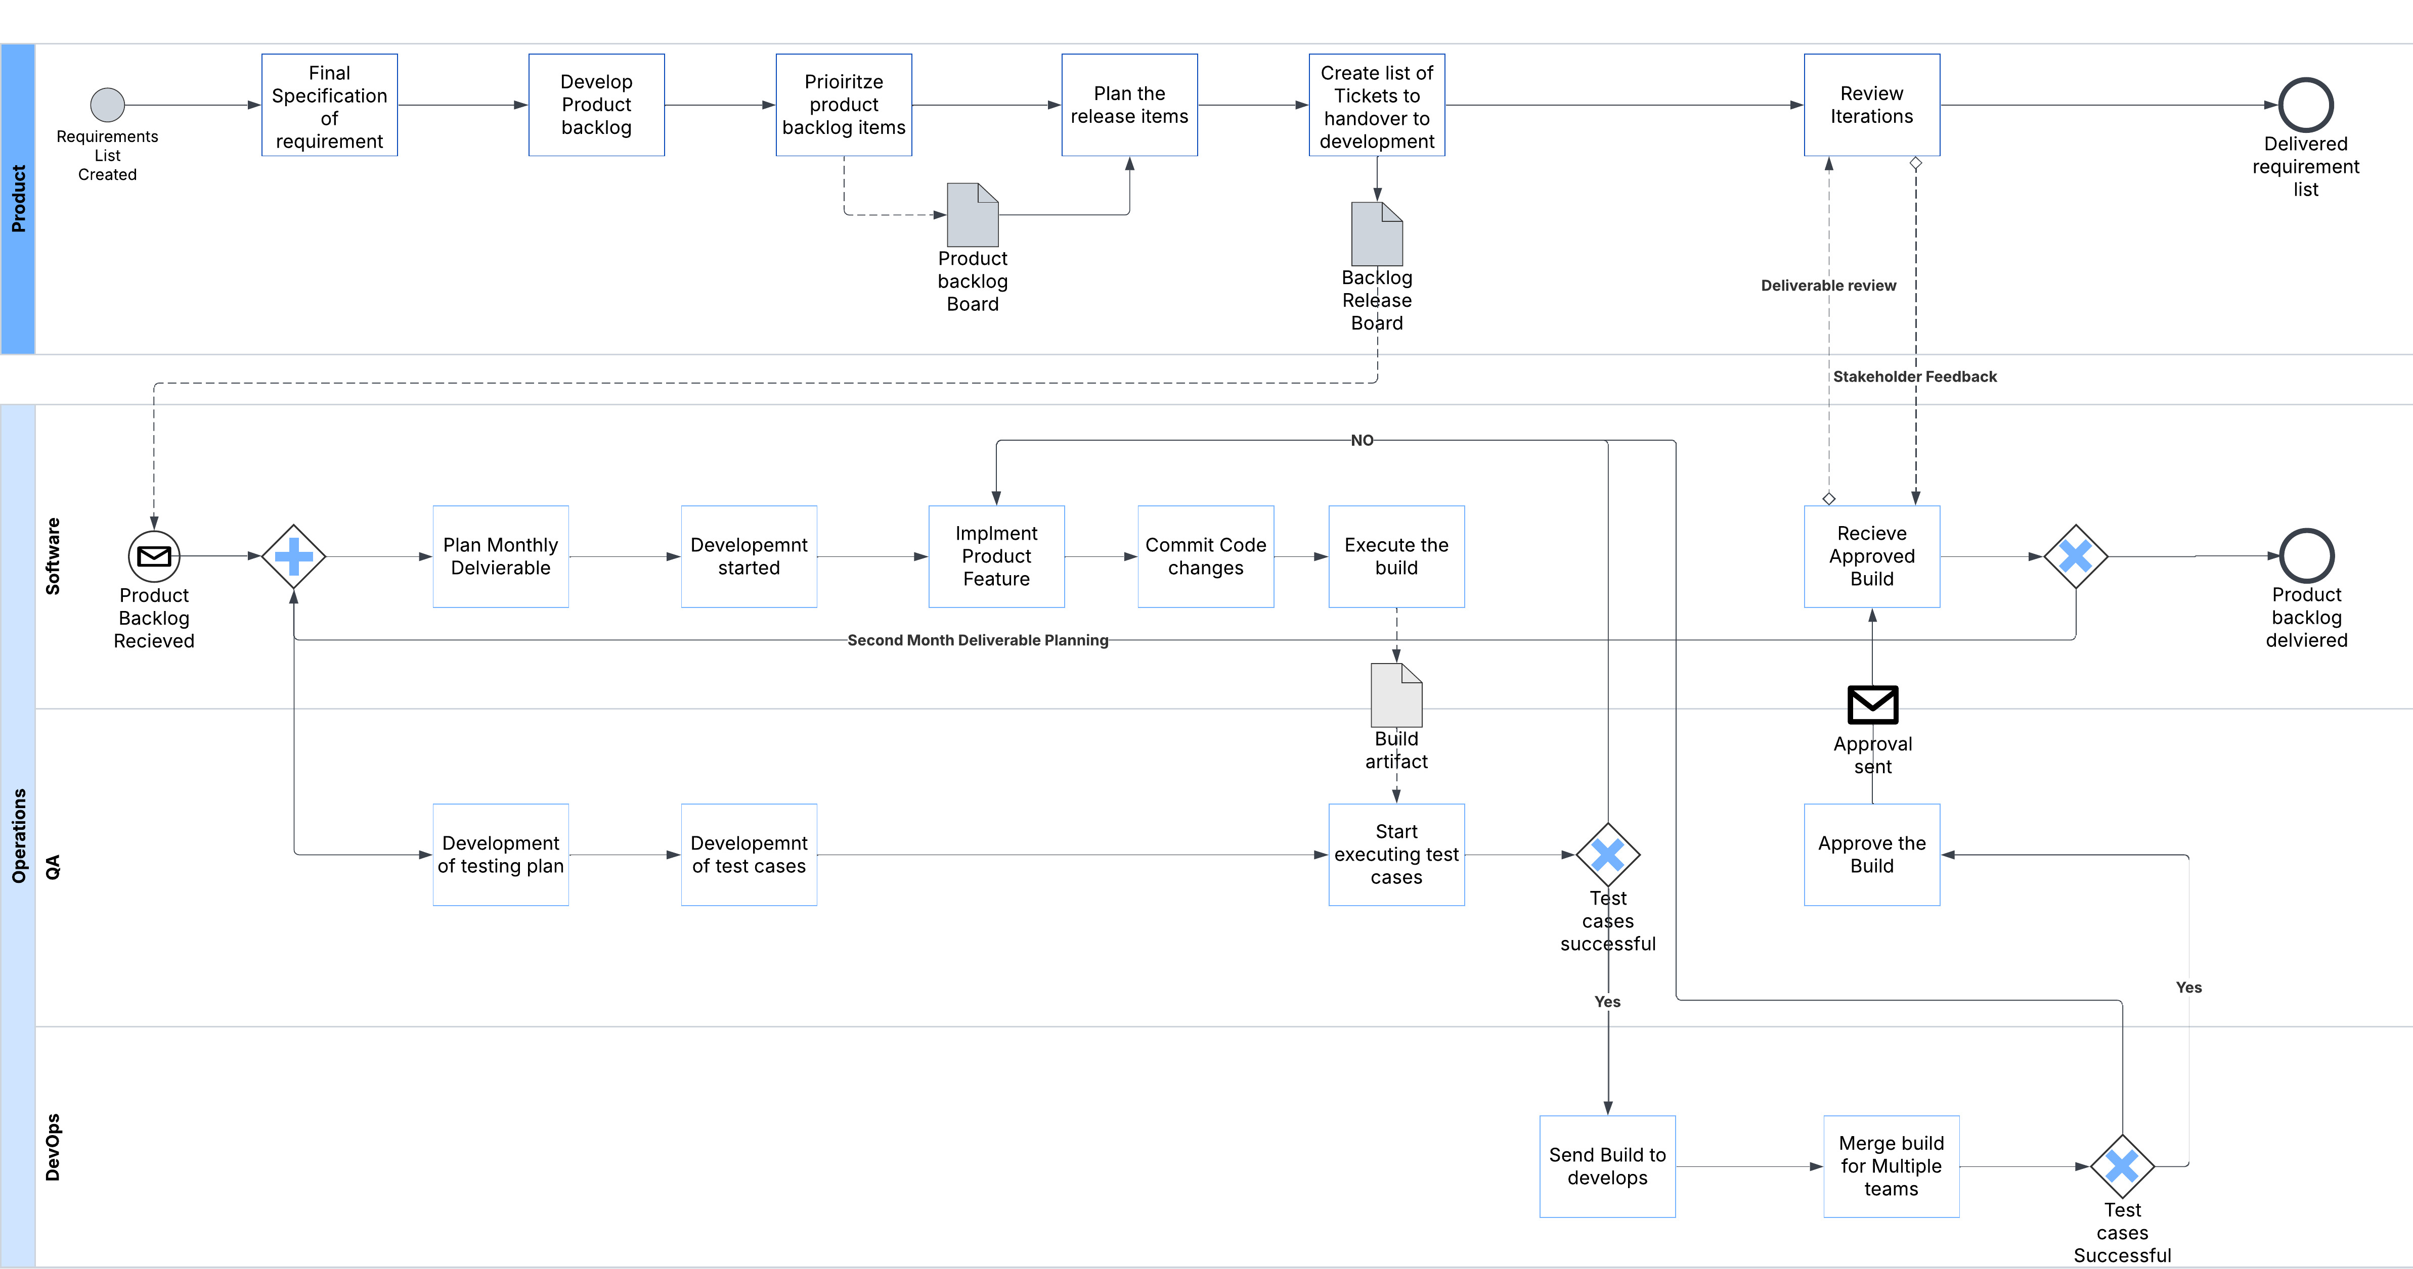
As-is Process
#00A6D6
3-month release cycle with
2 month of development and 1 month of testing

Slide 26
Hidden Loops/ Trade-off points
#00A6D6
Constant negotiations for scope, assuming there are 3 months to develop and test
1
2
Constant Back and Forth before finalization due to technical limitation and technological integration capacity
5
3
Expectations not met in UI/UX, and development scope creep in the delivery of features
Product-Development Each trying to prioritize their work i.e., product backlog and technical debt
4
Often finding hidden test cases and undesired scenarios created in cross-module functionalities. Manual test cases make it very difficult to cover all the bases

Slide 27
Why Agile ?
#00A6D6
Comparison of Waterfall, Stage-Gate, and Agile for Lean Company
Why Agile is selected for the Lean Company?
Aspect | Waterfall | Stage-Gate | Agile (Selected)
Flexibility | Lowàfixed process, hard to change | Moderate changes allowed at gates | Continuous iterations, adaptable
Risk Management | High issues detected late | Moderate risks assessed at gates | Low risks managed continuously
Speed of Delivery | Long development cycles | Moderate | Fastà incremental releases
Customer Involvement | Low | Moderate feedback at checkpoints | High àcontinuous feedback
Collaboration | Low teams work | Moderate collaboration at gates | Highàcross-functional teamwork
Scalability | High for well-defined projects | High for structured projects | Highàscalable with Agile frameworks
Aspect | Explanation
Adaptability | The company faced major process inefficiencies due to changing operational needs. Agile allows quick adaptation to such shifts.
Risk Reduction | Untimely deliveries, defects, and vision misalignment were identified as core business risks. Agile’s iterative approach minimizes risk early
Faster Delivery | The company’s slow rollout of new features resulted in customer loss. Agile ensures frequent feature releases
Customer-Centric | Lean Company follows a customer-first approach. Agile integrates continuous customer feedback, ensuring better alignment.
Collaboration | Team conflicts and communication gaps caused inefficiencies. Agile enhances collaboration, aligning teams better.

Slide 28
Strategy Selected
#00A6D6
Lean + Agile
Mura (variation) exists
Mura (variation) exists
Defects
Waiting
Mura (variation) exists
Non-Utilized Talent
Waiting
Muri (Overburden) exists
Muda (variation) exists

Slide 29
Strategy Selected
#00A6D6
Lean + Agile
Locked in for 3 months release scope
Heavy up-front planning; inflexible to change
Late feedback creates rework and scope creep
Misaligned Priorities
Siloed Prioritization
Manual testing, slow feedback loop, late discovery of defects
Integration issues and test case failures

Slide 30
Waste identified - texts

Slide 31
Risks

Slide 32
Controls required in the system

Slide 33
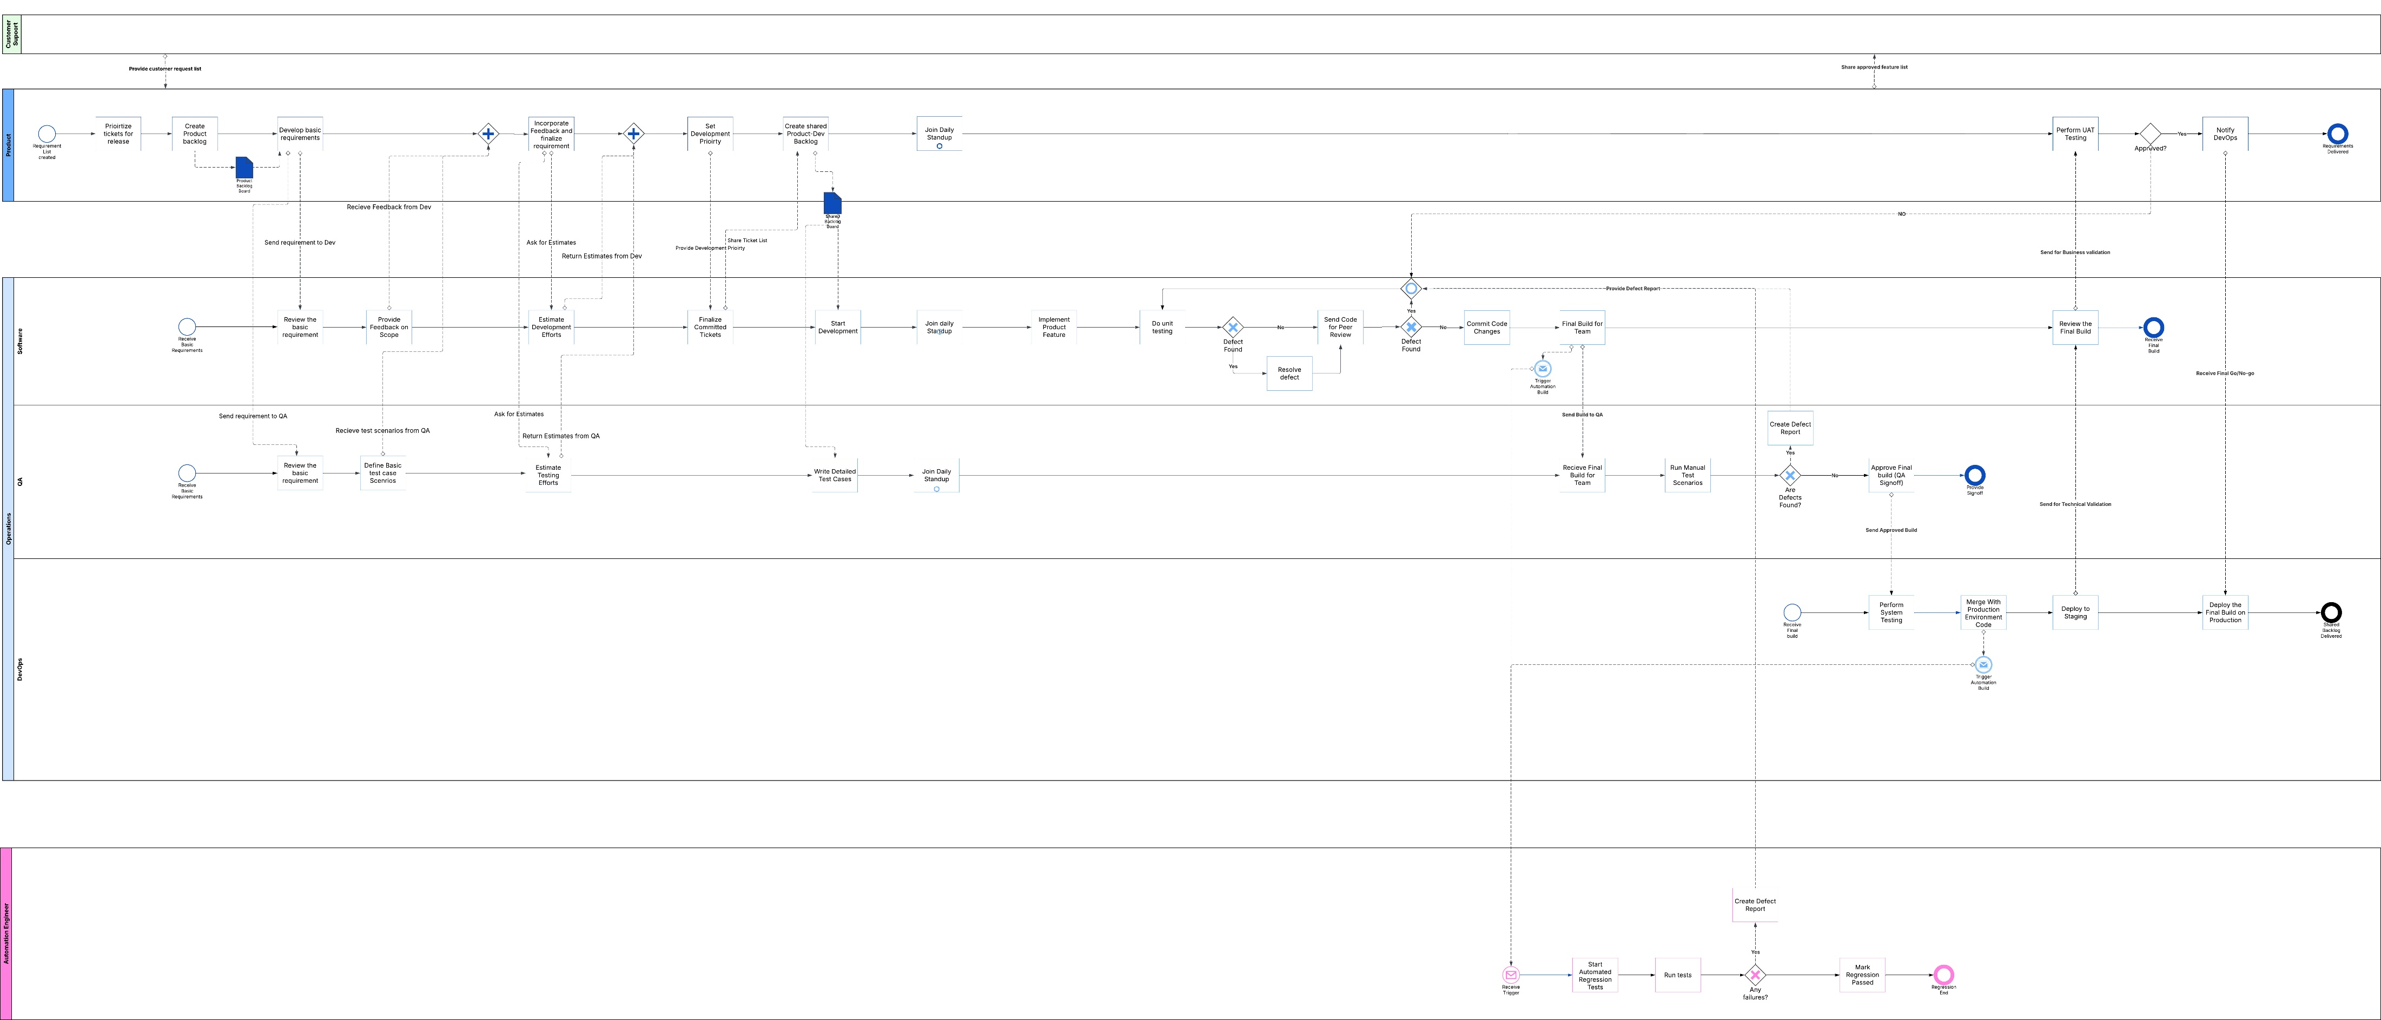
New Process

Slide 34
Risks of New Process

Slide 35
Activity Based Costing

Slide 36
Thank you for your time!

