Slide 1
Mining Maximal Sequential Patterns without Candidate Maintenance
Artificial Intelligence Seminar
10 March 2016
Syméon Malengreau
Mhd Ayad Aldayeh

Slide 2
Table of contents
Authors presentation
  Reference
  Authors
Concepts
  Sequence database
  Sequential pattern
  Closed Sequential pattern
  Maximal Sequential pattern
Algorithm
  PrefixSpan
  MaxSP
Measures

Slide 3
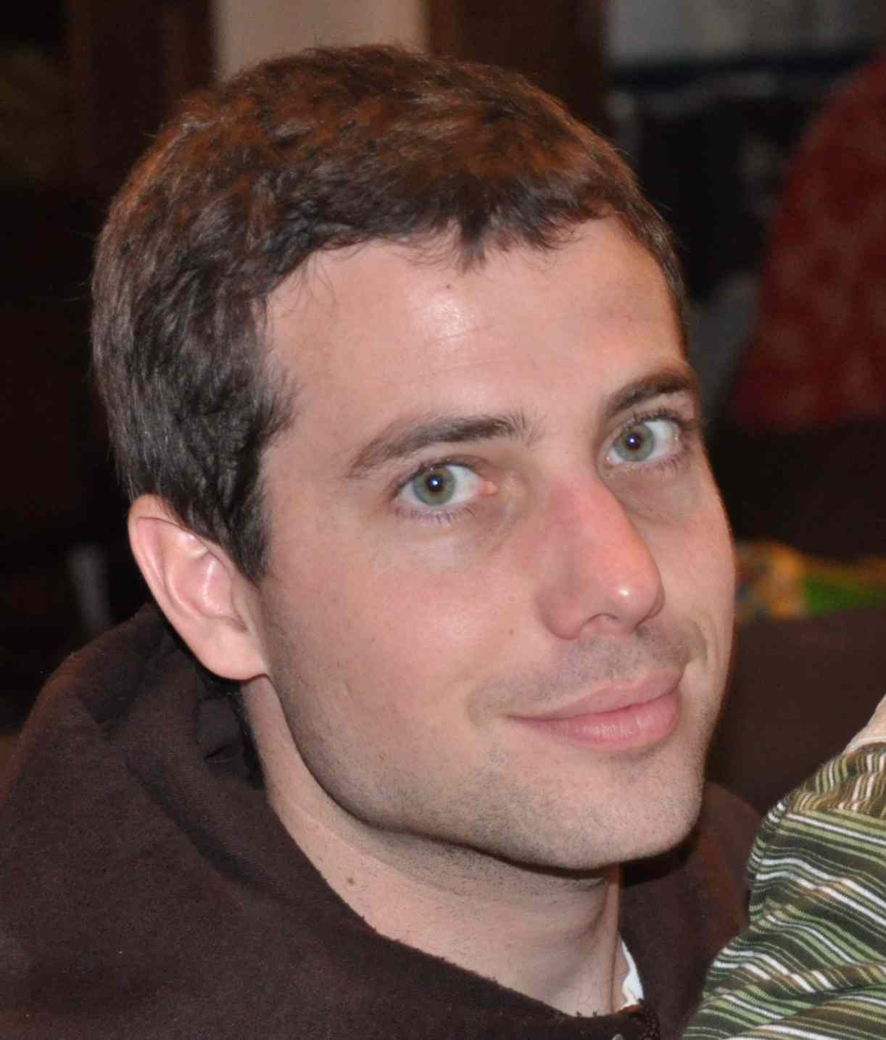
Reference : Pierre Schaus
Let's take a comparison for the article's authors
Pierre Schaus is a UCL professor, you might know him
H-index : 10
Citations : 283

Slide 4
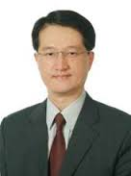
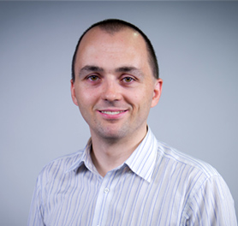

Authors
Vincent S. Tseng
Philippe Fournier-Viger
Cheng-Wei Wu

Slide 5
Authors : Vincent S. Tseng
Ph.D. in Computer Science
Professor, Dept. Computer Science, National Chiao Tung University, Taiwan
H-index : 32
  3,2x more
Citations : 3308
  11,7x more

Slide 6
Authors : Philippe Fournier-Viger
Ph.D. in Computer Science
Associate Professor, Harbin Institute of Technology, Shenzhen Graduate School
He created the SPMF library
H-index : 17
  1,7x more
Citations : 712
  2,5x more

Slide 7
Authors : Cheng-Wei Wu
H-index : 12
  1,2x more
Citations : 518
  1,83x more

Slide 8
About the articles
We can trust the author, but
  We found errors in some examples
  Some part of the articles were mathematicaly not clear enough
After some search else where we made it possible to understand the content of the articles. But based only on it, it wouldn't have be possible.

Slide 9
First Concepts
Sequence Database
Sequential pattern
Closed sequential pattern
Maximal sequential pattern

Slide 10
Sequence Database
A sequence database consist of :
  A set of items
    {1, 2, 3, 4, …, N}
  Itemset (set of item, distinct and unordered)
    {1, 2, 3, 5} or {4, 5} or {3, 7} or ...
  Sequence (set of itemsets)
    <{1,2}, {3}, {5}> or <{4}, {6}> or ...
The sequence database is a set of sequences
What do theses concepts represents ?

Slide 11
Sequence Database : Illustration
Let's take as an example a book
  Set of item → The words
    {He, nice, the, is, a, guy, sun, shine, ...}
  Itemset → A sentence (where words are distinct and unordered)
    {He, a, nice, guy, is}
    {The, sun, shine, in, the, sky}
  Sequence → A chapter of the book
  Sequence Database → The book

Slide 12
Sequential pattern
Synonyms are sub-sequence or frequent sequence
It is a sequence of item that appears a certain number of time, that number is the minimum support threshold (or minsup)
Sequence database
  <{1,2},{3},{4},{6}>
  <{2},{5},{6}>
  <{1,3},{5},{6}>
With minsup = 2, some examples of sequential pattern
  {5},{6}
  {1}
  {3},{6}
  …

Slide 13
Closed sequential pattern
A closed sequential pattern is a sequential pattern not included in another closed pattern having the same frequency.
  <{1},{1 2 3},{1 3},{4},{3 6}>
  <{1 4},{3},{2 3},{1 5}>
  <{5 6},{1 2},{4 6},{3},{2}>
  <{5},{7},{1 6},{3},{2},{3}>
With support 2 (or 2/4 entry → 50 %), here are some closed sequential pattern
  {1}, {3} 100 % (4/4)
  {1}, {3}, {2} 75 % (3/4)
  {5}, {1}, {3}, {2} 50% (2/4)
  {5} 75 % (3/4)
And this one is NOT
  {1} 100 % (4/4)

Slide 14
Maximal sequential pattern
The same as the closed sequential pattern, but if one sequence is in another one, it is not maximal.
Interesting property :
  You can derive every closed sequential patterns from the maximal sequential patterns

Slide 15
Question 1 : Closed and Maximal pattern
Considering the database
  1. Which one of these is not a closed sequential pattern ? Why ?
    → <{a}>
    → <{b}>
    → <{a,b}>
    → <{a},{b},{e}>
  2. Which one of these is a maximal sequential pattern ? Why ?
    → <{a},{e}>
    → <{b}, {b}>
    → <{b}, {f}, {e}>
    → <{a}, {f}>
  <{a,b},{c},{f,g},{g},{e}>
  <{a,d},{c},{b},{a,b,e,f}>
  <{a},{b},{f,g},{e}>
  <{b},{f,g}>

Slide 16
MaxSP Algorithm
Find the maximal sequential pattern
It is build uppon the PrefixSpan Algorithm
Why the need for a new algorithm ?
  → Less memory usage
  → Faster to find sequential pattern

Slide 17
PrefixSpan : Start
First let's explain the PrefixSpan Algorithm
It's the most efficient pattern mining algorithm
We start with a sequence database
  <{1},{1 2 3},{1 3},{4},{3 6}>
  <{1 4},{3},{2 3},{1 5}>
  <{5 6},{1 2},{4 6},{3},{2}>
  <{5},{7},{1 6},{3},{2},{3}>

Slide 18
PrefixSpan : Pattern-growth
It works by pattern-growth, which does not generate any candidates (saving memory)
  1. Scan : Calculate support for each item and existing itemset
  2. Output : Output item that have enough support
  3. Projection : Recursively project the database with every item that have enough support

Slide 19
PrefixSpan : Scan
MinSup 75 % (3)
  <{1},{1 2 3},{1 3},{4},{3 6}>
  <{1 4},{3},{2 3},{1 5}>
  <{5 6},{1 2},{4 6},{3},{2}>
  <{5},{7},{1 6},{3},{2},{3}>
Item | Support
1
2
3
4
5
6
7

Slide 20
PrefixSpan : Scan
MinSup 75 % (3)
  <{1},{1 2 3},{1 3},{4},{3 6}>
  <{1 4},{3},{2 3},{1 5}>
  <{5 6},{1 2},{4 6},{3},{2}>
  <{5},{7},{1 6},{3},{2},{3}>
Item | Support
1 | 100 % (4)
2
3
4
5
6
7

Slide 21
PrefixSpan : Scan
MinSup 75 % (3)
  <{1},{1 2 3},{1 3},{4},{3 6}>
  <{1 4},{3},{2 3},{1 5}>
  <{5 6},{1 2},{4 6},{3},{2}>
  <{5},{7},{1 6},{3},{2},{3}>
Item | Support
1 | 100 % (4)
2 | 100 % (4)
3
4
5
6
7

Slide 22
PrefixSpan : Scan
MinSup 75 % (3)
  <{1},{1 2 3},{1 3},{4},{3 6}>
  <{1 4},{3},{2 3},{1 5}>
  <{5 6},{1 2},{4 6},{3},{2}>
  <{5},{7},{1 6},{3},{2},{3}>
Item | Support
1 | 100 % (4)
2 | 100 % (4)
3 | 100 % (4)
4
5
6
7

Slide 23
PrefixSpan : Scan
MinSup 75 % (3)
  <{1},{1 2 3},{1 3},{4},{3 6}>
  <{1 4},{3},{2 3},{1 5}>
  <{5 6},{1 2},{4 6},{3},{2}>
  <{5},{7},{1 6},{3},{2},{3}>
Item | Support
1 | 100 % (4)
2 | 100 % (4)
3 | 100 % (4)
4 | 75 % (3)
5
6
7

Slide 24
PrefixSpan : Scan
MinSup 75 % (3)
  <{1},{1 2 3},{1 3},{4},{3 6}>
  <{1 4},{3},{2 3},{1 5}>
  <{5 6},{1 2},{4 6},{3},{2}>
  <{5},{7},{1 6},{3},{2},{3}>
Item | Support
1 | 100 % (4)
2 | 100 % (4)
3 | 100 % (4)
4 | 75 % (3)
5 | 75 % (3)
6
7

Slide 25
PrefixSpan : Scan
MinSup 75 % (3)
  <{1},{1 2 3},{1 3},{4},{3 6}>
  <{1 4},{3},{2 3},{1 5}>
  <{5 6},{1 2},{4 6},{3},{2}>
  <{5},{7},{1 6},{3},{2},{3}>
Item | Support
1 | 100 % (4)
2 | 100 % (4)
3 | 100 % (4)
4 | 75 % (3)
5 | 75 % (3)
6 | 75 % (3)
7

Slide 26
PrefixSpan : Scan
MinSup 75 % (3)
  <{1},{1 2 3},{1 3},{4},{3 6}>
  <{1 4},{3},{2 3},{1 5}>
  <{5 6},{1 2},{4 6},{3},{2}>
  <{5},{7},{1 6},{3},{2},{3}>
Item | Support
1 | 100 % (4)
2 | 100 % (4)
3 | 100 % (4)
4 | 75 % (3)
5 | 75 % (3)
6 | 75 % (3)
7 | 25 % (1)

Slide 27
PrefixSpan : Scan
MinSup 75 % (3)
  <{1},{1 2 3},{1 3},{4},{3 6}>
  <{1 4},{3},{2 3},{1 5}>
  <{5 6},{1 2},{4 6},{3},{2}>
  <{5},{7},{1 6},{3},{2},{3}>
Item | Support
1 | 100 % (4)
2 | 100 % (4)
3 | 100 % (4)
4 | 75 % (3)
5 | 75 % (3)
6 | 75 % (3)
7 | 25 % (1)

Slide 28
PrefixSpan : Scan
MinSup 75 % (3)
  <{1},{1 2 3},{1 3},{4},{3 6}>
  <{1 4},{3},{2 3},{1 5}>
  <{5 6},{1 2},{4 6},{3},{2}>
  <{5},{7},{1 6},{3},{2},{3}>
It has to be done for itemsets too…
  {1 2 3}, {1 2}, {1 3}, {3 6}, {1 4}, {2 3},
  {1 5}, {5 6}, {4 6}, {1 6}
Item | Support | Item | Support
1 | 100 % | 1 3 | 50 %
2 | 100 % | 4 6 | 25 %
3 | 100 % | 3 6 | 25 %
4 | 75 % | 1 4 | 25 %
5 | 75 % | 2 3 | 25 %
6 | 75 % | 1 5 | 25 %
7 | 25 % | 5 6 | 25 %
1 2 3 | 25 % | 1 6 | 25 %
1 2 | 50 %

Slide 29
PrefixSpan : Scan
We take each item with the support ≥ minsup, and output it as a sequence with one item.
Here the output :
  <{1}>
  <{2}>
  <{3}>
  <{4}>
  <{5}>
  <{6}>

Slide 30
New Concept : Projection
We need to define a new concept → Projection
If we project a sequence <{1},{2},{3}> by a prefix <{1}>, we take the part of the sequence that follow the prefix. Here <{2},{3}>
Some examples :
  <{1},{2},{1},{3}> by <{1}> → <{2},{1},{3}>
  <{3},{4},{5}> by <{3},{4}> → <{5}>
  <{1}, {3, 4}, {5}, {6}> by <{3}> → <{5},{6}>
  <{2}, {3}, {4}, {5}, {6}> by <{3}, {5}> → <{6}>
→ Projecting a database, means to project every sequence

Slide 31
PrefixSpan : Projection
We will recursively project the database with every item we find with enough support.
Lets take the result we have found so far to make it clearer.
We keep minsup of 75 % (3)

Slide 32
PrefixSpan : Projection
1. Scan Database
  <{1},{1 2 3},{1 3},{4},{3 6}>
  <{1 4},{3},{2 3},{1 5}>
  <{5 6},{1 2},{4 6},{3},{2}>
  <{5},{7},{1 6},{3},{2},{3}>
Item | Support
1 | 100 % (4)
2 | 100 % (4)
3 | 100 % (4)
4 | 75 % (3)
5 | 75 % (3)
6 | 75 % (3)
7 | 25 % (1)

Slide 33
PrefixSpan : Projection
2. Output first item
  <{1}> → Support : 100 % (4)
3. Project first item (2)
  <{1},{1 2 3},{1 3},{4},{3 6}>
  <{1 4},{3},{2 3},{1 5}>
  <{5 6},{1 2},{4 6},{3},{2}>
  <{5},{7},{1 6},{3},{2},{3}>
Item | Support
1 | 100 % (4)
2 | 100 % (4)
3 | 100 % (4)
4 | 75 % (3)
5 | 75 % (3)
6 | 75 % (3)
7 | 25 % (1)

Slide 34
PrefixSpan : Projection
1. Scan Again
  <{1 2 3},{1 3},{4},{3 6}>
  <{3},{2 3},{1 5}>
  <{4 6},{3},{2}>
  <{3},{2},{3}>
Item | Support
1 | 50 % (2)
2 | 100 % (4)
3 | 100 % (4)
4 | 50 % (2)
5 | 25 % (1)
6 | 50 % (2)
7 | 25 % (1)

Slide 35
PrefixSpan : Projection
2. Output the sequence
  <{1},{2}> → Support : 100 % (4)
3. Project first item (2)
  <{1 2 3},{1 3},{4},{3 6}>
  <{3},{2 3},{1 5}>
  <{4 6},{3},{2}>
  <{3},{2},{3}>
Item | Support
1 | 50 % (2)
2 | 100 % (4)
3 | 100 % (4)
4 | 50 % (2)
5 | 25 % (1)
6 | 50 % (2)
7 | 25 % (1)

Slide 36
PrefixSpan : Projection
1. Scan again
  <{1 3},{4},{3 6}>
  <{1 5}>
  <{3}>
Item | Support
1 | 50 % (2)
2 | 0 % (0)
3 | 50 % (2)
4 | 25 % (1)
5 | 25 % (1)
6 | 25 % (1)
7 | 0 % (0)

Slide 37
PrefixSpan : Projection
Operation are over
We continue with other items
Item | Support
1 | 50 % (2)
2 | 0 % (0)
3 | 50 % (2)
4 | 25 % (1)
5 | 25 % (1)
6 | 25 % (1)
7 | 0 % (0)

Slide 38
PrefixSpan : Projection
2. Output the sequence
  <{1},{3}> → Support : 100 % (4)
3. Project second item (2)
  <{1 2 3},{1 3},{4},{3 6}>
  <{3},{2 3},{1 5}>
  <{4 6},{3},{2}>
  <{3},{2},{3}>
Item | Support
1 | 50 % (2)
2 | 100 % (4)
3 | 100 % (4)
4 | 50 % (2)
5 | 25 % (1)
6 | 50 % (2)
7 | 25 % (1)

Slide 39
PrefixSpan : Projection
1. Scan again
  <{1 3},{4},{3 6}>
  <{2 3},{1 5}>
  <{2}>
  <{2},{3}>
Item | Support
1 | 50 % (2)
2 | 75 % (3)
3 | 75 % (3)
4 | 25 % (1)
5 | 25 % (1)
6 | 25 % (1)
7 | 0 % (0)

Slide 40
PrefixSpan : Projection
2. Output the sequence
  <{1}, {3}, {2}> → Support : 75 % (3)
3. Project first item (2)
  <{1 3},{4},{3 6}>
  <{2 3},{1 5}>
  <{2}>
  <{2},{3}>
Item | Support
1 | 50 % (2)
2 | 75 % (3)
3 | 75 % (3)
4 | 25 % (1)
5 | 25 % (1)
6 | 25 % (1)
7 | 0 % (0)

Slide 41
PrefixSpan : Projection
Do all recursive projection would take a certain amount of times
We will skip the projection, as the process repeat itself
Pattern | Support (≥ 75%) | Pattern | Support (≥ 75%)
<{1}> | 100 % | <{3},{2}> | 75 %
<{1},{2}> | 100 % | <{3},{3}> | 75 %
<{1},{3}> | 100 % | <{4}> | 75 %
<{1},{3},{2}> | 75 % | <{4},{3}> | 75 %
<{1},{3},{3}> | 75 % | <{5}> | 75 %
<{2}> | 100 % | <{6}> | 75 %
<{2},{3}> | 75 %
<{3}> | 100 %

Slide 42
Question 2 : Projection
Considering the database
  1. What is the result of the projection of <{b},{f}> on the database ?
  2. In previous sequence, which are not closed and which are maximal ?
  <{a,b},{c},{f,g},{g},{e}>
  <{a,d},{c},{b},{a,b,e,f}>
  <{a},{b},{f,g},{e}>
  <{b},{f,g}>
Pattern | Support (≥ 75%) | Pattern | Support (≥ 75%)
<{1}> | 100 % | <{3},{2}> | 75 %
<{1},{2}> | 100 % | <{3},{3}> | 75 %
<{1},{3}> | 100 % | <{4}> | 75 %
<{1},{3},{2}> | 75 % | <{4},{3}> | 75 %
<{1},{3},{3}> | 75 % | <{5}> | 75 %
<{2}> | 100 % | <{6}> | 75 %
<{2},{3}> | 75 %
<{3}> | 100 %

Slide 43
PrefixSpan : Projection
Here are the closed and maximal.
Pattern | Support (≥ 75%) | Pattern | Support (≥ 75%)
<{1}> | 100 % | <{3},{2}> | 75 %
<{1},{2}> | 100 % | <{3},{3}> | 75 %
<{1},{3}> | 100 % | <{4}> | 75 %
<{1},{3},{2}> | 75 % | <{4},{3}> | 75 %
<{1},{3},{3}> | 75 % | <{5}> | 75 %
<{2}> | 100 % | <{6}> | 75 %
<{2},{3}> | 75 %
<{3}> | 100 %

Slide 44
MaxSp
MaxSP extends the PrefixSpan
A naïve approach would be to keep all sequence in memory and to check every time a new sequence arrives if it is maximal.
That is CloSpan
  → Inefficient
  → Memory consuming
Lets define some new concepts

