Slide 1
Mining Maximal Sequential Patterns without Candidate Maintenance
Artificial Intelligence Seminar
10 March 2016
Syméon Malengreau
Mhd Ayad Aldayeh

Slide 2
Table of contents
Authors presentation
  Reference
  Authors
Concepts
  Sequence database
  Sequential pattern
  Closed Sequential pattern
  Maximal Sequential pattern
Algorithm
  PrefixSpan
  MaxSP
Measures

Slide 3
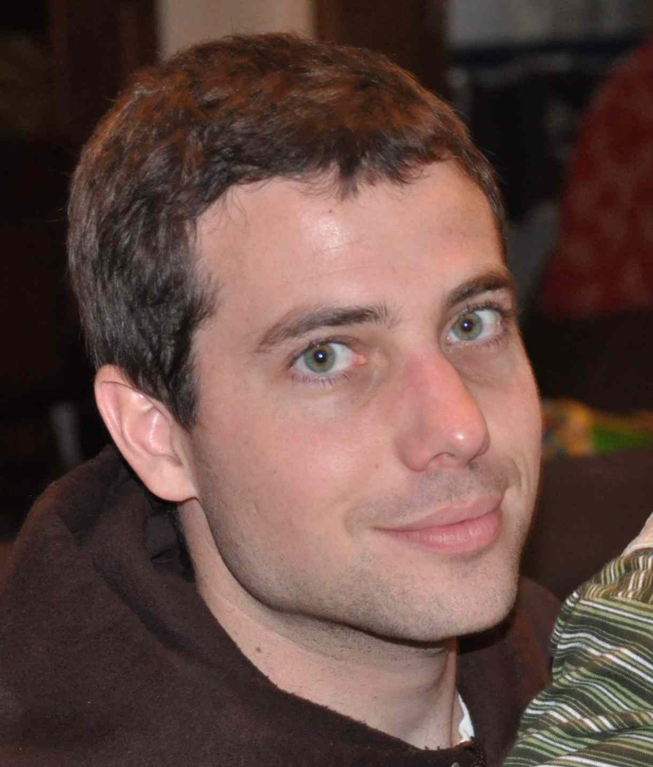
Reference : Pierre Schauss
Let's take a comparison for the article's authors
Pierre Schauss is a UCL professor, you might know him
H-index : 10
Citations : 283

Slide 4
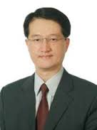
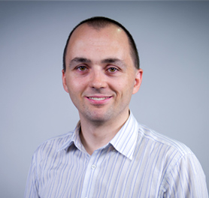

Authors
Vincent S. Tseng
Philippe Fournier-Viger
Cheng-Wei Wu

Slide 5
Authors : Vincent S. Tseng
Ph.D. in Computer Science
Professor, Dept. Computer Science, National Chiao Tung University, Taiwan
H-index : 32
  3,2x more
Citations : 3308
  11,7x more

Slide 6
Authors : Philippe Fournier-Viger
Ph.D. in Computer Science
Associate Professor, Harbin Institute of Technology, Shenzhen Graduate School
He created the SPMF library
H-index : 17
  1,7x more
Citations : 712
  2,5x more

Slide 7
Authors : Cheng-Wei Wu
H-index : 12
  1,2x more
Citations : 518
  1,83x more

Slide 8
First Concepts
Sequence Database
Sequential pattern
Closed sequential pattern
Maximal sequential pattern

Slide 9
Sequence Database
A sequence database consist of :
  A set of items
    {1, 2, 3, 4, …, N}
  Itemset (set of item, distinct and unordered)
    {1, 2, 3, 5} or {4, 5} or {3, 7} or ...
  Sequence (set of itemsets)
    <{1,2}, {3}, {5}> or <{4}, {6}> or ...
The sequence database is a set of sequences
What do theses concepts represents ?

Slide 10
Sequence Database : Illustration
Let's take as an example a book
  Set of item → The words
    {He, nice, the, is, a, guy, sun, shine, ...}
  Itemset → A sentence (where words are distinct and unordered)
    {He, a, nice, guy, is}
    {The, sun, shine, in, the, sky}
  Sequence → A chapter of the book
  Sequence Database → The book

Slide 11
Sequential pattern
Synonyms are sub-sequence or frequent sequence
It is a sequence of item that appears a certain number of time, that number is the minimum support threshold (or minsup)
Sequence database
  <{1,2},{3},{4},{6}>
  <{2},{5},{6}>
  <{1,3},{5},{6}>
With minsup = 2, some examples of sequential pattern
  {5},{6}
  {1}
  {3},{6}
  …

Slide 12
Closed sequential pattern
A closed sequential pattern is a sequential pattern not included in another closed pattern having the same frequency.
  <{1},{1 2 3},{1 3},{4},{3 6}>
  <{1 4},{3},{2 3},{1 5}>
  <{5 6},{1 2},{4 6},{3},{2}>
  <{5},{7},{1 6},{3},{2},{3}>
With support 2 (or 2/4 entry → 50 %), here are some closed sequential pattern
  {1}, {3} 100 % (4/4)
  {1}, {3}, {2} 75 % (3/4)
  {5}, {1}, {3}, {2} 50% (2/4)
  {5} 75 % (3/4)
And this one is NOT
  {1} 100 % (4/4)

Slide 13
Maximal sequential pattern
The same as the closed sequential pattern, but if one sequence is in another one, it is not maximal.
Interesting property :
  You can derive every closed sequential patterns from the maximal sequential patterns

Slide 14
MaxSP Algorithm
Find the maximal sequential pattern
It is build uppon the PrefixSpan Algorithm
Why the need for a new algorithm ?
  → Less memory usage
  → Faster to find sequential pattern

Slide 15
PrefixSpan : Start
First let's explain the PrefixSpan Algorithm
We start with a sequence database
  <{1},{1 2 3},{1 3},{4},{3 6}>
  <{1 4},{3},{2 3},{1 5}>
  <{5 6},{1 2},{4 6},{3},{2}>
  <{5},{7},{1 6},{3},{2},{3}>

Slide 16
PrefixSpan : Pattern-growth
It works by pattern-growth, which does not generate any candidates (saving memory)
1. Scan : Calculate support for each item
2.

Slide 17
PrefixSpan : Scan
MinSup 75 % (3)
  <{1},{1 2 3},{1 3},{4},{3 6}>
  <{1 4},{3},{2 3},{1 5}>
  <{5 6},{1 2},{4 6},{3},{2}>
  <{5},{7},{1 6},{3},{2},{3}>
Item | Support
1
2
3
4
5
6
7

Slide 18
PrefixSpan : Scan
MinSup 75 % (3)
  <{1},{1 2 3},{1 3},{4},{3 6}>
  <{1 4},{3},{2 3},{1 5}>
  <{5 6},{1 2},{4 6},{3},{2}>
  <{5},{7},{1 6},{3},{2},{3}>
Item | Support
1 | 100 % (4)
2
3
4
5
6
7

Slide 19
PrefixSpan : Scan
MinSup 75 % (3)
  <{1},{1 2 3},{1 3},{4},{3 6}>
  <{1 4},{3},{2 3},{1 5}>
  <{5 6},{1 2},{4 6},{3},{2}>
  <{5},{7},{1 6},{3},{2},{3}>
Item | Support
1 | 100 % (4)
2 | 100 % (4)
3
4
5
6
7

Slide 20
PrefixSpan : Scan
MinSup 75 % (3)
  <{1},{1 2 3},{1 3},{4},{3 6}>
  <{1 4},{3},{2 3},{1 5}>
  <{5 6},{1 2},{4 6},{3},{2}>
  <{5},{7},{1 6},{3},{2},{3}>
Item | Support
1 | 100 % (4)
2 | 100 % (4)
3 | 100 % (4)
4
5
6
7

Slide 21
PrefixSpan : Scan
MinSup 75 % (3)
  <{1},{1 2 3},{1 3},{4},{3 6}>
  <{1 4},{3},{2 3},{1 5}>
  <{5 6},{1 2},{4 6},{3},{2}>
  <{5},{7},{1 6},{3},{2},{3}>
Item | Support
1 | 100 % (4)
2 | 100 % (4)
3 | 100 % (4)
4 | 75 % (3)
5
6
7

Slide 22
PrefixSpan : Scan
MinSup 75 % (3)
  <{1},{1 2 3},{1 3},{4},{3 6}>
  <{1 4},{3},{2 3},{1 5}>
  <{5 6},{1 2},{4 6},{3},{2}>
  <{5},{7},{1 6},{3},{2},{3}>
Item | Support
1 | 100 % (4)
2 | 100 % (4)
3 | 100 % (4)
4 | 75 % (3)
5 | 75 % (3)
6
7

Slide 23
PrefixSpan : Scan
MinSup 75 % (3)
  <{1},{1 2 3},{1 3},{4},{3 6}>
  <{1 4},{3},{2 3},{1 5}>
  <{5 6},{1 2},{4 6},{3},{2}>
  <{5},{7},{1 6},{3},{2},{3}>
Item | Support
1 | 100 % (4)
2 | 100 % (4)
3 | 100 % (4)
4 | 75 % (3)
5 | 75 % (3)
6 | 75 % (3)
7

Slide 24
PrefixSpan : Scan
MinSup 75 % (3)
  <{1},{1 2 3},{1 3},{4},{3 6}>
  <{1 4},{3},{2 3},{1 5}>
  <{5 6},{1 2},{4 6},{3},{2}>
  <{5},{7},{1 6},{3},{2},{3}>
Item | Support
1 | 100 % (4)
2 | 100 % (4)
3 | 100 % (4)
4 | 75 % (3)
5 | 75 % (3)
6 | 75 % (3)
7 | 25 % (1)

Slide 25
PrefixSpan : Scan
MinSup 75 % (3)
  <{1},{1 2 3},{1 3},{4},{3 6}>
  <{1 4},{3},{2 3},{1 5}>
  <{5 6},{1 2},{4 6},{3},{2}>
  <{5},{7},{1 6},{3},{2},{3}>
Item | Support
1 | 100 % (4)
2 | 100 % (4)
3 | 100 % (4)
4 | 75 % (3)
5 | 75 % (3)
6 | 75 % (3)
7 | 25 % (1)

