Slide 1

第1章 Oracle简介

Slide 2
Notes:
Today we will be talking about Oracle’s corporate strategy of delivering complete software and hardware solutions. The purpose is to give you an overview of what Oracle is doing to help customers use technology for competitive advantage by reducing complexity, leveraging new technologies and improving performance.

Slide 3
请将手机调整到震动或静音状态

Slide 4

Oracle发展历史 I
1977 – 在 ‘软件开发实验室’基础上创建
  Ampex软件公司为中情局设计一套名叫Oracle的数据库，
  Ellison是程序员之一 。
  1978 -更名为关系软件公司(RSI)
1979 – 1983
  甲骨文第2版是在1979年发布的世界上第一个商用关系数据库
  成长与挣扎 - 作为创业企业的生命
  在1982年更名为甲骨文公司
  甲骨文第2版用C语言重写
1984 – 1986
  在荷兰,英国, 德国, 瑞典,瑞士,法国,挪威,西班牙, …等设立办公室
  甲骨文在1986年公开上市
  收入5500万美元
1987 –成为世界上最大的数据库管理系统公司
  收入1.31亿美元
  开始应用业务，开始咨询和技术支持服务
1989 –总部搬迁到到硅谷红木海岸
  重点放在销售业绩上，收入5.71亿美元
Notes:
Related to Oracle Corp. – 30 years ago:
The word Oracle was the code name of a CIA project which the founders had all worked on.
June 16, 1977: Oracle Corporation was incorporated as Software Development Laboratories (SDL) by Larry Ellison, Bob Miner and Ed Oates.
1978 SDL changed its name to Relational Software, Inc. (RSI).
1979: written in assembly language, world‘s first relational DB
1980/1981: Growing and Struggling, life as start-up comp.
1982: Change name to Oracle (RSI -> Oracle Systems Corp -> Oracle Corp) to be more closely alligned with primary product
1983 Rewrite Oracle in C (,V3‘) for more portabilit; Larry in charge of overall operations
1984 a number of offices founded
1986 Oracle GOES PUBLIC with revenues of $55 million USD.
1987 becomes world largest DB Company; Oracle founds its Applications division, building business management software closely integrated with its database software.
1989 Oracle moves world headquarters to Redwood Shores, California. Aggressive focus on sales results

Slide 5

Larry Ellison（拉里.埃里森）
Notes:
Redwood Shores Headquarter:
Property Information
1. Oracle WW HQ was built on Marine World’s former grounds so you will see wildlife still here such as rabbits, geese, ducks, stingrays, birds etc…
2. Oracle’s Worldwide Headquarters includes 1,482,629 total office space square footage.
3. 4,477 total parking stalls.
4. 96 total stories
5. WW HQ occupies 66 acres. Approximately 10 acres are salt water lagoon from SF Bay.
6. The campus is open 7am to 7pm. Access to building and some key floors requires id badge/card key. 24 hour security provides after hours access. A telephone linked to security is located on each level of the parking garages.
7. The surrounding green glass building mainly houses developers. Developers are king and queens at Oracle. A few floors in the entire complex are assigned to finance, marketing, sales and consulting. All lines of business occupy space in surrounding buildings such as 1000 BP, Oracle Plaza, Belmont Shores, 1 Davis Drive, Island Parkway which houses Product Lines (HP, Sun, IBM, Unix etc..)
First Building 500 was completed in 1989. Last building completed was 600 in 1998.

Slide 6
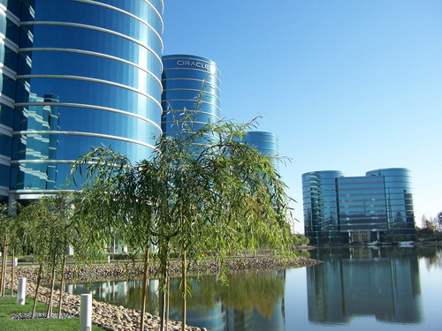
位于红木海岸的总部
Notes:
Redwood Shores Headquarter:
Property Information
1. Oracle WW HQ was built on Marine World’s former grounds so you will see wildlife still here such as rabbits, geese, ducks, stingrays, birds etc…
2. Oracle’s Worldwide Headquarters includes 1,482,629 total office space square footage.
3. 4,477 total parking stalls.
4. 96 total stories
5. WW HQ occupies 66 acres. Approximately 10 acres are salt water lagoon from SF Bay.
6. The campus is open 7am to 7pm. Access to building and some key floors requires id badge/card key. 24 hour security provides after hours access. A telephone linked to security is located on each level of the parking garages.
7. The surrounding green glass building mainly houses developers. Developers are king and queens at Oracle. A few floors in the entire complex are assigned to finance, marketing, sales and consulting. All lines of business occupy space in surrounding buildings such as 1000 BP, Oracle Plaza, Belmont Shores, 1 Davis Drive, Island Parkway which houses Product Lines (HP, Sun, IBM, Unix etc..)
First Building 500 was completed in 1989. Last building completed was 600 in 1998.

Slide 7
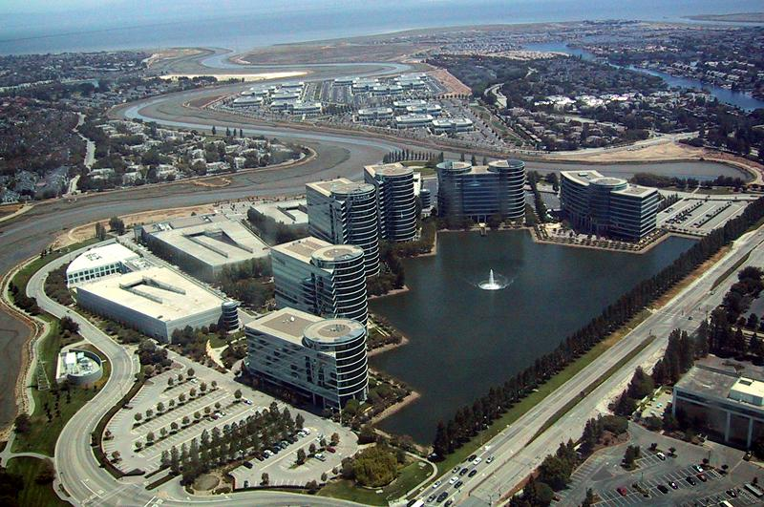
Notes:
Details about 500 Building: 500 was the first tower constructed. It was completed in October of 1989. The 500 Building is 11stories high and the top floor hosts the executive office of Larry Ellison. Also in this building are the finance, legal, and marketing departments. It houses 853 employees and 229,000 square feet. This building has an California Cuisine Café , 2 Executive Dining Rooms, Oracle’s Corporate Visit Center, and employee services such as an ATM and Photo Processing, along with an Oracle Store.
400 Building: The 400 Building was the second building to be constructed and was completed in 1990. It has 14 stories (268,000 square feet) and houses the Data Center along with the following groups: Data Server, Global IT, and Networking. This is where the kernel developers live and breathe. These developers are considered the elite group at Oracle. It holds 945 employees. The lobby features the Bon Appetit Cafeteria & Grill
Oracle has two Data Centers - one in RWS (400 Building) and one in Colorado Springs, CO. There are less than 1000 Global IT employees worldwide. HQ’s Data Center is 20,000 square feet, 16,000 feet of which is raised floor. Colorado’s DC is 7,000 square feet of raised floor. There are 500 production and test servers (includes hosted systems). Production systems hold over 140 terabytes of disk on Oracle enterprise databases. The DC supports Oracle personnel in more than 60 countries.From a test and stage perspective, the DC manages the migration from development into production, verifies the installation procedures and compatibility with other applications. The Oracle campus is wired with a minimum 10mbps Ethernet, has 10/100 FDDI and gigabit backbones, has high speed WAN connections to connect offices outside HQ, has high speed Internet connections to support remote users, and has extranet for Oracle Internet presence. Oracle’s Internet connections include T1s, T3s, and OC3s.
300 Building:The 300 building was completed in 1991 and houses 1591 employees. It is 16 stories high (the tallest of all of the buildings). During a major rain and wind storm, those at the top can actually feel the building swaying! The 300 building is home to application developers and consultants. The building features a market including a coffee shop, pasta bar, pizzeria, bakery, ice cream fountain, florist, and grill. The building also has a dry cleaning service and shoe repair, a stamp machine, a mother’s lounge, and a grand piano.
200 Building: Constructed in 1996. It has over 249,000 square feet. There are 12 stories that house the Tools Developers. Inhouse contractors such as Xerox are stationed in the 200 building. There is a Sushi Bar and Japanese Café.
100 Building: Completed in 1995. Houses 697 employees. Has 152,000 square feet. Houses 9i Application Server group. Q&A/testing software under secure conditions. Building is off limits to non-100 building employees after 7:00pm. Features New York Deli in the lobby.
600 Building: The 600 building is Oracle’s newest building. Construction finished in January 1998. A topping off party was held before the last beam was placed. Employees signed the beam before it was raised. It has 270,000 square feet. 600 houses 1117 employees. This building contains the CRM development team. This building features yet another dramatically designed lobby as well as a large, colorful café (Equatorial Cuisine including Indian, Middleastern, and Mexican foods) with outdoor patio seating along the lagoon. Oracle’s E-Business Center is on the lobby floor of the 600 building. The E-Business Center is a state of the art facility with rich multi-media and multiple demo capability.
Oracle Club (Fitness Center): Constructed in 1990; expanded in 1996. 52,000 square feet. Free to all Oracle employees. Amenities include: meeting rooms, dining rooms, pizza café, club room, year round heated pool, sand volleyball, complete physical fitness equipment, basketball and volleyball courts, aerobic rooms and classes, a fully equipped commercial kitchen, masseuse, manicurist, billiards, and locker rooms with saunas.
Conference Centre: Opened in November 1998. 50,000 square feet. Main auditorium that seats 450 people. 8 meeting rooms which can accommodate groups of 10-160 people. State of the art audio/visual equipment and acoustically designed meeting rooms with a 3,000 square foot catering kitchen. Used primarily for employee and management meetings.
Reduced costs to Oracle as we no longer have to pay for outside conference rooms.

Slide 8

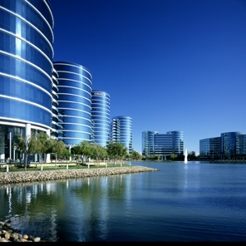

Oracle发展历史 II
1997 – Oracle 8
1999 – Oracle 8i 正式进入互联网时代
2001 – Oracle 9i RAC
10亿美元减省计划
  收入 108.60亿美元
  边际利润由19.6%，升上31.4%，成为哈佛学院的商业个案 。
2002 – Creation of Advanced Product Services (APS)
  甲骨文推出外包服务
  收入 96.73亿美元
2003 – Oracle 10g Enterprise Grid Computing
2004 – 2006 收购PeopleSoft(仁科 ) ，Oblix, Retek, Times Ten, Profit Logic, G-Log，Siebel, 360 Commerce, Sleepy Cat, Portal and more
2007 – Oracle 11g
2008 – 85亿美元收购BEA，商用中间件Tuxdeo、Weblogic供应商。
2009 – Oracle 11g R2(第二版)，74亿美元收购Sun，拥有了自己的硬件存储和服务器。
Notes:
1990 Too much focus on sales results
last-minute discounts; loose payment terms
lack of collection process; DSO =180-200 - DSO (Days Sales Outstanding) = average number of days between date of invoice issue and receipt of payment.
1991 Oracle reports its first ever loss, hundreds of employees are laid off.
=>Ellison hires Jeffrey O. Henley as CFO and Raymond Lane as COO. In 1991 an 1992
1993: Development Tools / Dev environment GUI toolset
1994: RdB from DEC and Development in India
1996: Announce Internet Strategy as first large country/ Network computer concept
1997: Oracle releases Oracle Applications 10.7 NCA. All the applications in the business software now run across the web in a standard web browser.
1998: Oracle announces its commitment to the Java platform, and introduces Oracle's Java integrated development environment, which will come to be known as Oracle JDeveloper.
2000: Oracle 9i (iFS + Application Server) + and E-Business Suite 11i (CRM + ERP)
2001: Ellison announces that Oracle saved $1 billion implementing and using its own business applications => Single Instance
2002: Creation on APS
"Advanced Product Services".
In July 2002 we received directions for 3 APS packages, named SDM1, SDM2, and SDM3. In September, they were renamed to TA/BCA/SSC.
The onsite / T&M part of this support delivery organization was requested to move to consulting. This originated the OCS Expert Services.
ACS Specificity:
Until 31-05-2002 we had Gold Support and T&M based Field Support services.
History:
1. Metals Support Program = Bronze (8x5 with local Product Support), Silver (24x7 global centers) and Gold (Silver + local Support AM + TAM)
2. Global/EMEA structure was implemented for Product Support
3. Bronze and Silver were combined to one single Support Level -> Naming for Gold had to change => Advanced Product Support
4. Oracle On Demand (‘Outsourcing’) was announced

Slide 9
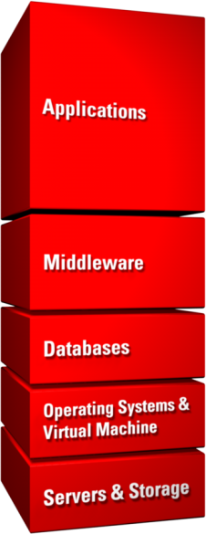






































甲骨文收购最佳的一流企业
(pending)
Middleware Platform and Management
Business Intelligence
Data Integration
Identity & Access Management
Performance Management
Enterprise Content Management
(pending)
Operating Systems
Systems Management
Virtual Machines
Notes:
In the last five years, Oracle has invested more than $40 billion in over 60 acquisitions. We acquire technology and domain experts that complete components of our product stack, resulting in a best-in-class portfolio of software and hardware capabilities.

Slide 10
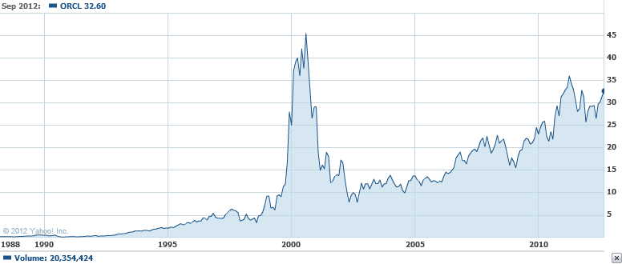
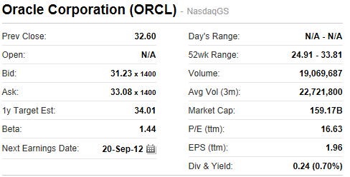
Oracle (ORCL) 股票历史
Source: http://finance.yahoo.com

Slide 11

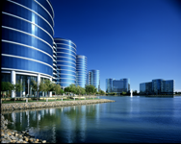
甲骨文公司
规模
242亿收入
50多类产品和行业NO. 1
遍及145 个国家的37万客户
3万个合作伙伴
2005年以来，花费400亿美元收购超过60家公司
10.6万雇员
Oracle 在线社区里有1000万开发者
创新与投资
2万9千名开发人员和工程师
1.55万名客户支持专家，支持27种语言
2万明实施顾问
100万名学生支持
870 个独立的Oracle用户组，包含35万5千名用户
Notes:
Charles Phillips screen
Oracle is the world’s largest enterprise software company. Here are some figures that illustrate the scale of Oracle’s ecosystem. This puts us in a unique position to make significant investments in product innovation and customer support, at a rate that has grown consistently every year.

Slide 12
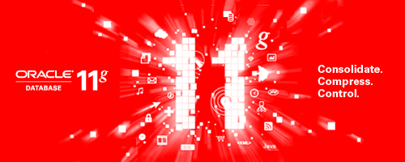
Oracle Database 11g Release 2
降低IT成本
降低服务器成本5倍
提高性能至少10倍
降低存储成本10倍
消除停机时间和未利用冗余
DBA的生产力提高至少2倍
Notes:
The innovation continues with Oracle Database 11g Release 2 to lower IT costs and deliver a higher quality of service by:
Consolidating business applications onto fast, reliable and scalable database grids.
Compressing data onto low cost storage partitions for faster performance.
Maximizing availability and eliminating idle data center redundancy.
Doubling DBA productivity and reducing the risk of change.

Slide 13
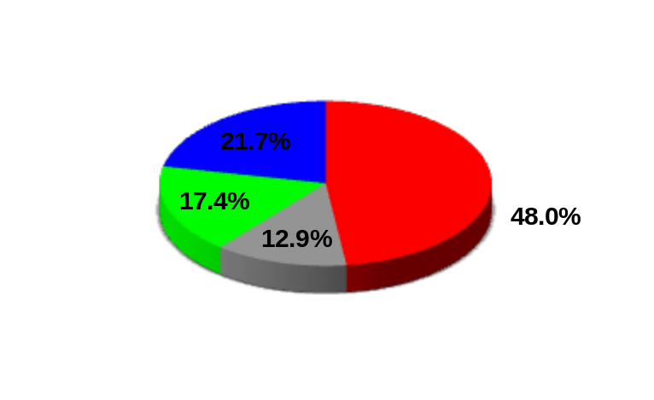
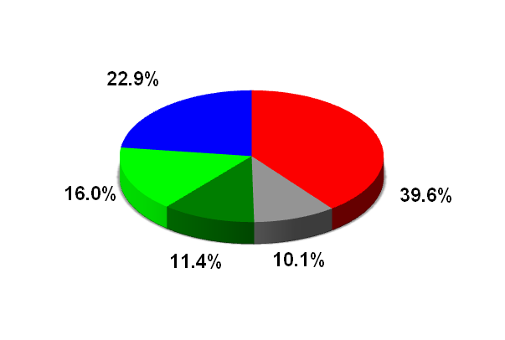
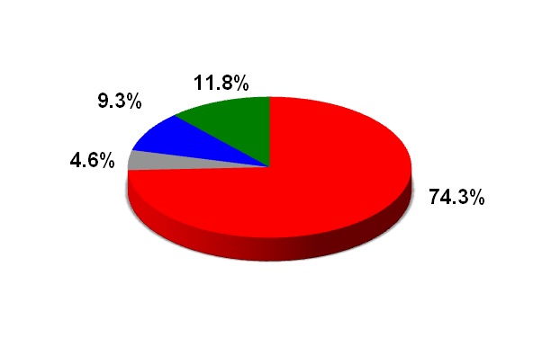
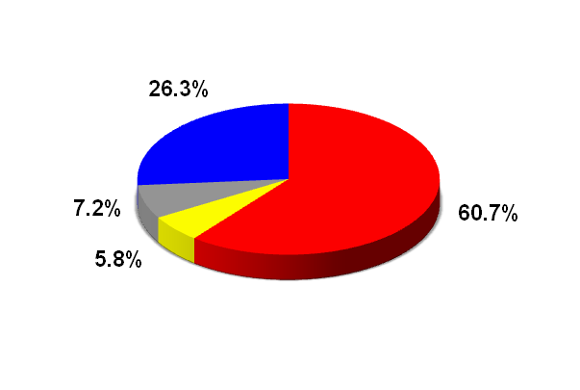
世界第一的数据库
Database Market
Data Warehouse Market
Oracle
IBM
Microsoft
Other
Oracle
IBM
M/soft
Teradata
Others
Database for Linux
Database for Unix
Oracle
IBM
Teradata
Others
Oracle
IBM
Sybase
Others
Oracle Database 11g Release 2 Available since 1st September 2009
Source: Gartner 2009 RDBMS Vendor Shares, April 2010 & IDC Data Warehouse 2008 Vendor Shares, August 2009

Slide 14
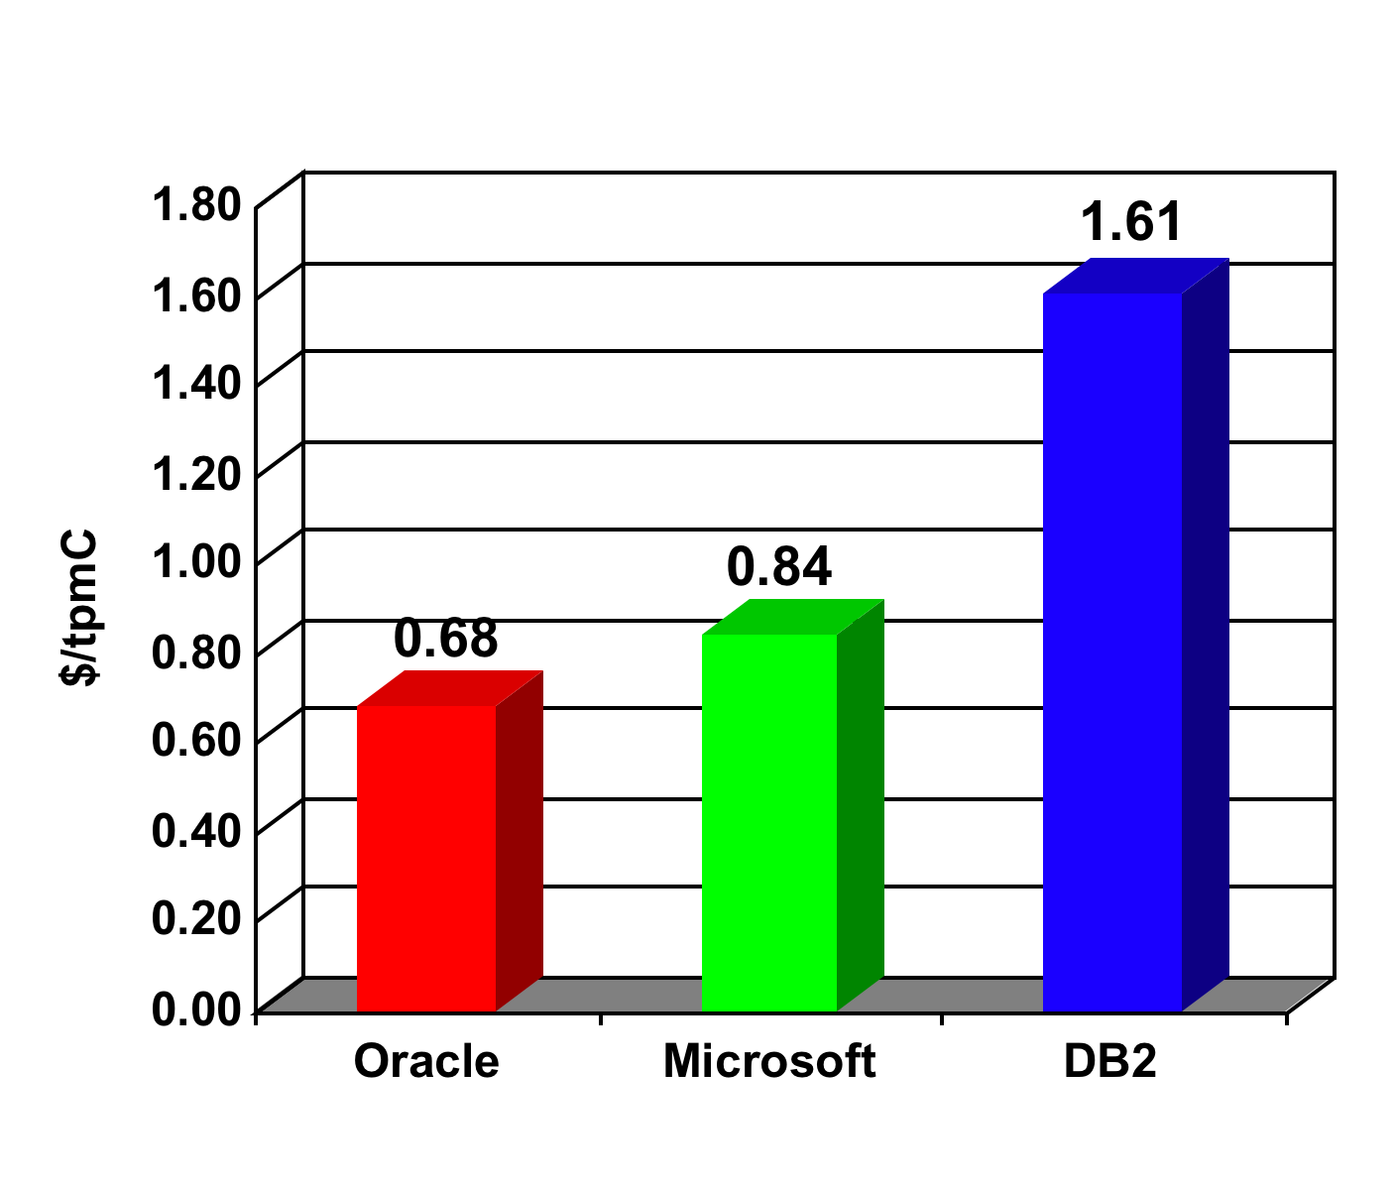
Oracle Database -最佳价值
World Record TPC-C Price Performance
Single Intel Processor
Best Price Performance on BOTH Linux and Windows
As of June 16, 2008: Oracle Database 11g Standard Edition One on Dell PowerEdge 2900 (World record TPC-C price/performance result) .97,083 tpmC, .68/tpmC, available 6/16/08. Microsoft SQL Server on HP ProLiant ML350G5, 82,774, $0.84/tpmC, available 03/27/07 (Microsoft Best TPC-C price/performance result).. IBM DB/2 on HP ProLiant ML350, 18,661 tpmC, $1.61 tpmC, available 12/15/05. Best TPC-C Price Performance on Linux: Oracle Database 10g Standard Edition One w/ OEL on HP ProLiant ML350G5, 100,926 tpmC, .74/tpmC, available 6/8/07. Source: Transaction Processing Performance Council (www.tpc.org)
Notes:
June 2007
For the first time ever, Oracle is the most affordable database at the low end, taking first place in the price/ performance category
For the first time ever, a single database holds the world record in both best performance as well as best price/performance categories. Please note that we already hold several world records for best performance, including TPC-C, TPC-H 300 GB, TPC-H 1 TB, TPC-H 3 TB and SAP SD 2 Tier, etc. just to name a few. It's extremely difficult to be the best/fastest and the most affordable at anything simultaneously. For instance, you will probably never see a Honda Civic win the Indianapolis 500
For the first time ever, Oracle beat Microsoft on its strongest selling point, affordability
For the first time ever, Oracle beat Microsoft on industry standard X86 processor performance
For the first time ever, we have published a benchmark running on an Oracle OS - Enterprise Linux, and secured the first place
For the first time ever, we have a comparison of the Oracle stack (Oracle on Enterprise Linux) versus the Microsoft stack (SQL Server on Windows)
In short, this benchmark will be a potent weapon to launch a strong marketing counter offensive against Microsoft.

Slide 15




Oracle 数据库版本
Non-Oracle developers, open source developers, new DBAs, students, non-Oracle ISVs, hardware vendors
Low-price option for SMB/LOB Deployments, ISVs who need a supported Oracle database
Full-featured database for SMBs with optional clustering support (up to 4 CPUs)
Large-scale Enterprises
that demand
high-performance BI (ETL, DW, OLTP), security, scalability, availability, etc.
Uses 1 CPU
< 4GB DB size
1 instance per CPU
Use up to 1GB RAM
2 CPU
< 500GB DB size
Single or clustered up to 4 CPUs
< 500 GB DB size
4+ CPUs
> 500 GB DB size
Free OTN
Community Forum
Fee-based Support
available
Fee-based Support
available
Fee-based Support
available
Notes:
Oracle Database 11g is available in a choice of editions tailored to meet the business and IT needs of needs of all sizes of organizations. Oracle also offers several optional database products that enhance the capabilities of Oracle Database 11g for specific application requirements.
Oracle Database 11g Standard Edition One (SE1) delivers unprecedented ease-of-use, power, and price/performance for workgroup, departmental, and web applications on single servers with maximum capacity of two sockets
Oracle Database 11g Standard Edition (SE) is available on single or clustered servers with a maximum capacity of four sockets in total. It includes Oracle Real Application Clusters as a standard feature at no additional cost
Oracle Database 11g Enterprise Edition (EE) provides efficient, reliable, secure data management for mission-critical on-line transaction processing applications, query-intensive data warehouses, and content management and Web2.0 applications. It’s available on single and clustered servers with no socket limitation.
Oracle Database Express Edition (XE) is an entry-level, small-footprint database based on the enterprise code base that's free to develop, deploy, and distribute; fast to download; and simple to administer. Oracle Database XE can be installed on any size host machine with any number of CPUs (one database per machine), but XE will only store up to 4GB of user data, use up to 1GB of memory, and use one CPU on the host machine. XE can be easily upgraded to SE or EE when necessary without costly and complex migrations.

Slide 16
支持平台
Available for multiple operating systems
  Windows (2000, 2003, 2008, XP, Vista)
  Linux (Oracle Enterprise, Red Hat Enterprise, Suse Enterprise)
  Solaris
  HP-UX
  AIX
  Mac OS/X
  z/OS
On multiple hardware platforms
  Intel x86 (32/64 bit)
  Itanium
  Sparc
  Power PC
Notes:
All four editions of Oracle Database 11g are built using the same reliable database engine architecture and are completely compatible with each other. They are also available on a choice of operating systems and include a common set of application development tools and programming interfaces. Using Oracle Database 11g you can start out with Standard Edition One, and as business grows, you can easily upgrade to Standard Edition or Enterprise Edition depending on what best meets your needs. One of the benefits of Oracle is that it's so easy to upgrade -- just install the next edition’s software -- you make *no* changes to your database or applications, and you get the additional reliability, scalability, for which Oracle is renowned.

Slide 17
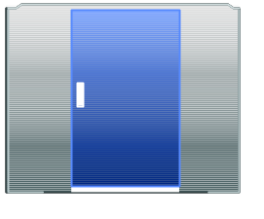
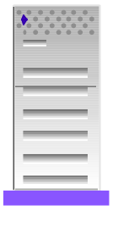
Develop Once, Deploy Anywhere
Grid
Cluster
SMP
AIX
Linux
Solaris
HP-UX
HP Tru64
HP VMS
Windows
OS/390
Uniprocessor
Desktop Server
Single User
Notes:
Unlike other vendor solutions, the Oracle Database provides 100% support for all standards across all the major operating system and hardware architectures available today - from Linux, to Windows, to Unix, to OS390. The superior portability of the Oracle Database empowers an organization to easily change their preferred hardware and operating system infrastructure - ensuring the right of an organization to choose the best price/performance offering from different vendors now and into the future. Any organization can leverage the Oracle Database to lower initial deployment costs and also insure their ability to remain flexible in the future.
Previous version
Oracle is dedicated to supporting the needs of all sizes of enterprises with a scalable technology architecture that allows you to:
* Deploy on any size platform, from single user to massively parallel.
* Protect and leverage investments in coding and training by providing
an identical data management foundation across all platforms and operating systems.
* Enable you [customer] to choose the optimum platform, networking protocol and data integration solution.
* Choose an all Oracle or modular solution based on the needs of your users and applications

Slide 18
Core Features
Programmable
  Server side logic, applications, triggers, …
  PL/SQL, Java, .Net, C, C++, PHP, Perl
Easy Development
  Application Express, SQL Developer, JDeveloper
Networked
  LDAP, HTTP, WebDAV, FTP, Web Services, Message Queuing
Content Aware
  XML, Bio-Informatic, Text, Spatial, Images
Self Managing
  Automatic Storage Management, Memory Allocation, Partition Management, …
Notes:
The Oracle Database provides an organisation with one of the most flexible application delivery platforms with direct programming support on the database server to allow you to create server-side functionality specific to your needs. That could take the form of triggers that respond to data access requests, implementing custom data management functions or even building entire applications that can be deployed to the web or from a SOA base. You can do everything in the Database or the Database can be part of the solution infrastructure. The choice is yours.
Oracle Database supports the most popular programming languages and offers the developer a modern and flexible application building environment using free tools like SQL Developer, JDeveloper (for Java of course) and Application Express, a development environment built for the web.
An Oracle Database nearly always lives in a networked environment and provides “out of the box” support to let it connect to corporate directories (LDAP), communicate in an intranet or even the Internet, be an service point in a web services architecture, integrate with message based systems like IBM’s MQ or Tibco.
It is literally true that the Database can handle any kind of information that your customers may need to manage. There is even specialised internal support to handle complex data type like XML, images, spatial data, text and so on. Because the Database “knows” about these complex data types, it can provide the kind of semantic support that make the creation of applications easy.
And finally, but not all least, the Oracle Database is designed to ease the day-to-day management itself by automatically working out how to best manage things like storage allocation, memory configuration, data partitioning and so on. By letting Oracle manage the Database automatically, your customers can release their DBAs and system specialists to concentrate on the more valuable activities needed to keep the business running and.

Slide 19

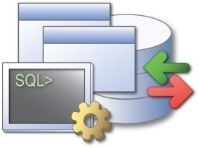




应用开发
SQL
Developer
Application
Express
PL/SQL
Java
PHP
.NET
Migration Workbench
Third party database support
Access migration
Flash Charting, PDF output
FAST Native Compiler
Fine Grained Dependency Tracking
FAST Native Transparent JIT Compiler
Easy JDK-like environment
Scalability with Database Resident Connection Pool
Integration with Visual Studio 2005
Microsoft ADO.NET 2.0 support
Notes:
For the database application developer, Oracle provides SQL Developer – an Integrated Development Environment especially designed to ease the development of objects like tables, stored procedures, meta-data access and so on. The tool is multi-platform, supported for Windows, Mac OS X as well as Linux. You can use SQL/Developer against databases other than Oracle if you wish.
Application Express offers an easy to use development environment that is browser based, with wizards to support the user/developer. Applications and reports can be created very quickly and afford the user an environment that is in many ways like Microsoft Access but with the durability, performance and centralised management and backup that Access does not possess.
Applications, stored procedures/functions and other programmed database features (like triggers) may be developed in the traditional PL/SQL procedural language or Java. Modules created in either language can work together so that you can take advantage of much more of your programming skill base than has traditionally been available. For PL/SQL, native code compilation is a standard feature for those routines that demand the utmost levels of performance such as numerically intensive operations where an interpreted execution environment would be disadvantageous. Where possible, PL/SQL can take advantage of native CPU registers for numerical and floating point operations. Java developed modules benefit from the use of “Just In Time” compilation techniques to boost performance. The great thing about using Java is that you can export or import Java to/from other execution environments. You can also draw on the wider development team to help produce (Database) server side code.
PHP and .Net development is also supported for the Database.

Slide 20
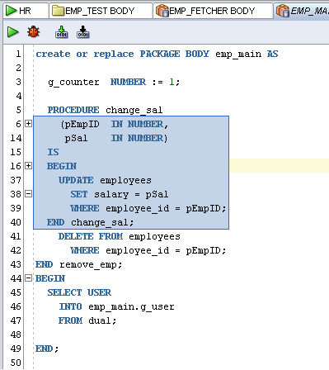
SQL Developer
Database Development Productivity Tool
Targeted at the DBA - Developer
Rich Client SQL plus functionality
Requires no Oracle home; simple to install
Notes:
We mentioned SQL Developer just now. Many developers use tools like Eclipse, Visual Studio, JDeveloper and are used to the format of those IDEs. SQL Developer offers them a familiar working environment that means that they can be productive quickly and accomplish development tasks for the Database faster and at lower cost (because SQL Developer is free!) .
The tool provides the familiar object navigation tree in one pane, code development in another and execution and messaging in other panes in the IDE. Comprehensive PL/SQL code creation support, compilation error report handling, debugging etc. are naturally the main focus of the tool.
It is targeted as a Developer / DBA tool and installs on Windows, Linux and Mac clients. Installation is simple, quick and does not require an “Oracle Home” construction (that just makes installation more complex than it needs to be).
And did I mention it was FREE? ;)

Slide 21





































































甲骨文部分全球知名客户
Notes:
Let’s begin with our integrated user experience. This is a sampling of the 1,000 organizations (not all of whom are customers) that participated in our user experience program. When we were in the process of developing our next generation applications, we solicited input from businesses in every industry and geography, gathering thousands of hours of design validation and testing. These findings were shared with development teams across Oracle and are being incorporated in today’s Applications Unlimited and Fusion Middleware products.

