Slide 1
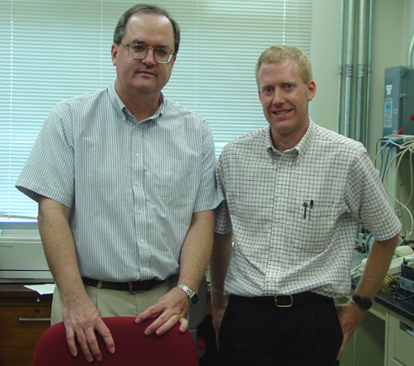
Spacetime pq theory for ac and dc systems
Leon M. Tolbert
Chancellor’s Professor and Min H. Kao Professor The University of Tennessee
John Chiasson Symposium
7 May 2025
Boise State University

Slide 2
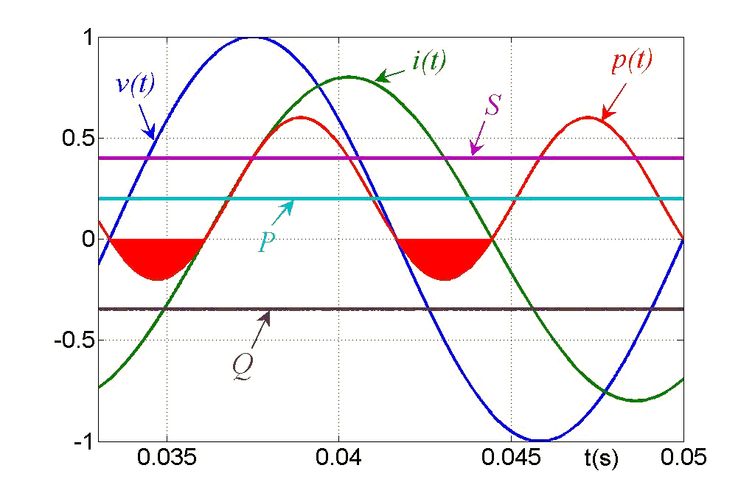
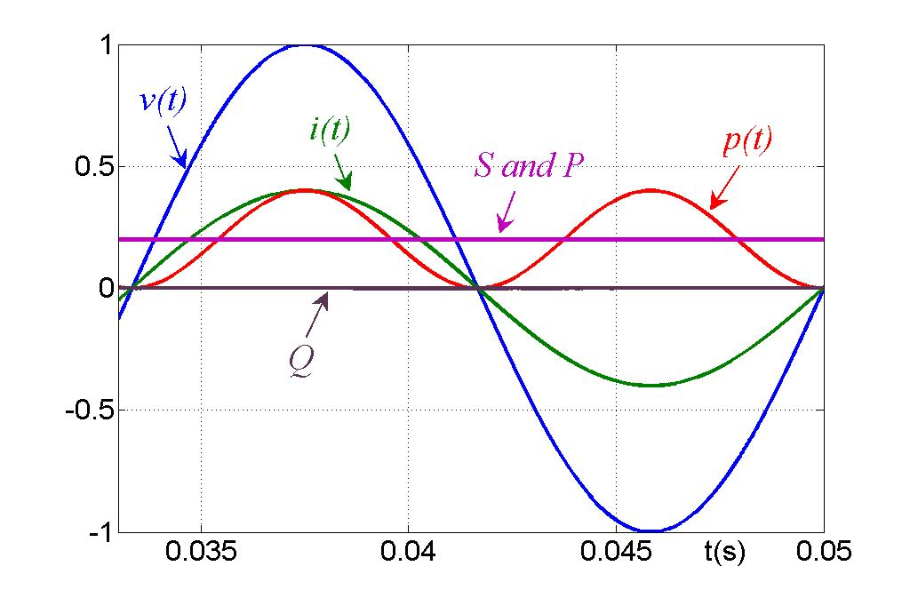
Reactive Power: Single-Phase RL load and R load
(a) RL load, pf < 1 (b) R load, unity power factor
In an RL load, θ < 0, the current lags the voltage.
In an R load, θ = 0, current and voltage are in phase.
Note difference of p(t) and i(t) in the two cases.

Slide 3
Instantaneous Power Theory
For a 3-phase system:
where T_{c} is the averaging interval.
Instantaneous active current and nonactive current:
RMS value of the reference voltage:
where v_{p}(t) is the reference voltage, and V_{p}(t) is the rms value of v_{p}(t).
v_{p}(t) could be the system voltage itself, or could be some other reference, based on the compensation objectives (such as fundamental component only).
i_{a}(t) is the active component in current i(t), and i_{n}(t) is the nonactive component in i(t). i_{a}(t) and i_{n}(t) are orthogonal.
Y. Xu, L. M. Tolbert, F. Z. Peng, J. N. Chiasson, J. Chen, “Compensation-based Non-active Power Definition,” IEEE Power Electronics Letters, vol. 1, no. 2, June 2003, pp. 45-50.

Slide 4
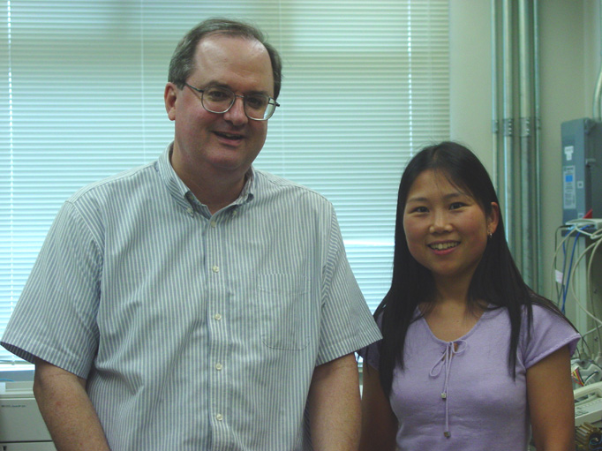
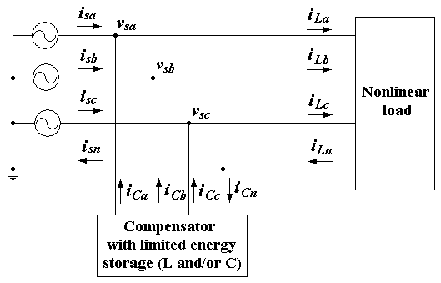
Generalized Compensation-based Reactive Power Theory
Objectives
In ac systems, eliminate the non-active power or current so that source (utility) does not have to supply it
Balance the load voltages and source currents
Sinusoidal source current
Unity power factor
Generalized Reactive Power Theory
The theory has a flexible form.
Independent of the number of phases.
Valid in both periodic and non-periodic systems.
Valid in balanced and unbalanced systems.
Consistent with the standard definitions in a sinusoidal system.
Other reactive power theories can be derived from this generalized theory: Akagi’s p-q, Fryze, FBD, Hilbert space
John Chiasson and Ph.D. student Yan Xu (2003)
Y. Xu, L. M. Tolbert, F. Z. Peng, J. N. Chiasson, J. Chen, “Compensation-based Non-active Power Definition,” IEEE Power Electronics Letters, vol. 1, no. 2, June 2003, pp. 45-50.

Slide 5
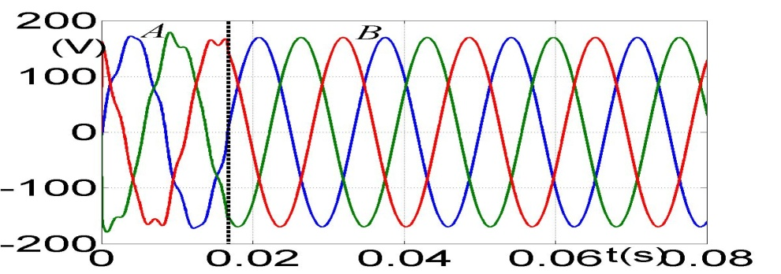
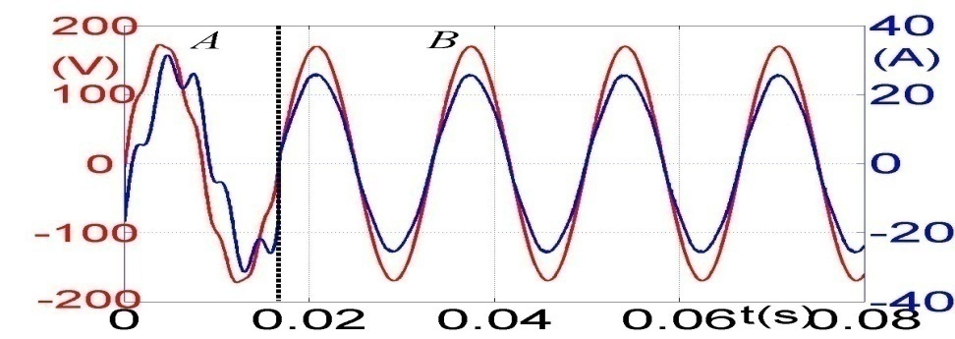
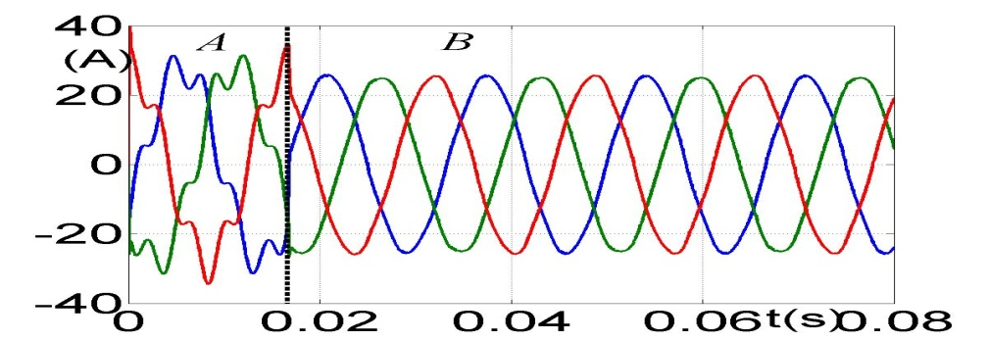
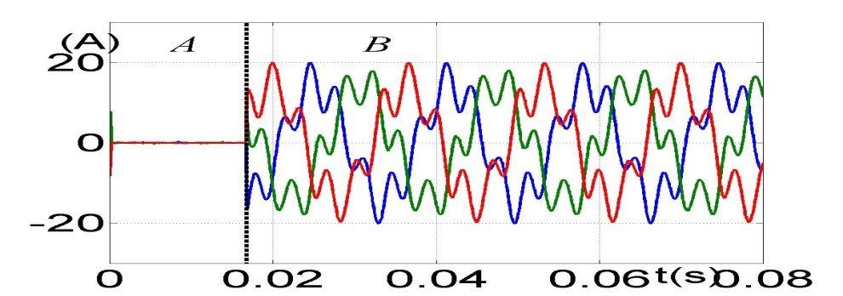
Compensator Control Design
Source voltage
Phase A source voltage and current
Source current
Compensator current

Slide 6
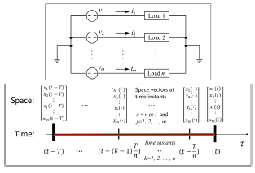
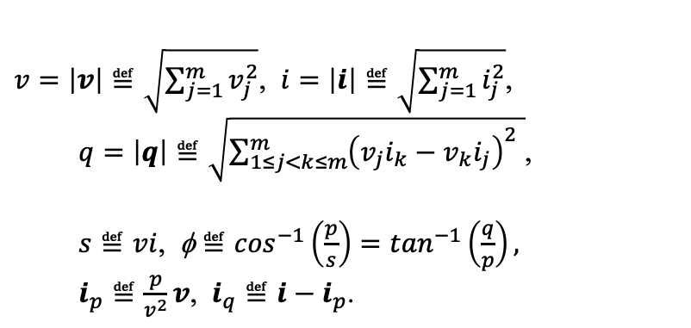
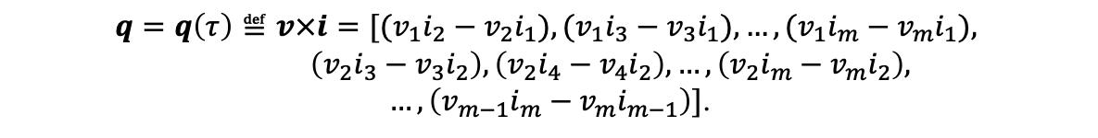
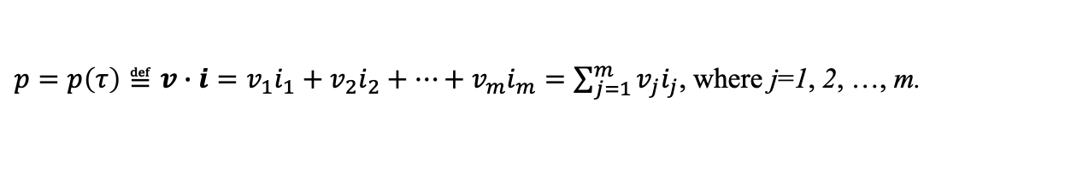
Spacetime pq theory (2025)
Spacetime pq theory:
Applicable for AC and DC systems.
Time-dimension (temporal) active, reactive, and apparent power and power factor angle at a single point (source or node voltage—load or branch current) of the space
Space-average (or spatial) active, reactive, and apparent powers and power factor angle at a single instant of time
Spacetime (or spatiotemporal) active, reactive, and apparent power and power factor angle of the m-dimensional space over n-dimensional time
$v=\left|v\right|≝\sqrt{\sum_{j=1}^{m}{v_{j}^{2}}}$, $i=\left|i\right|≝\sqrt{\sum_{j=1}^{m}{i_{j}^{2}}}$,
$q=\left|q\right|≝\sqrt{\sum_{1≤j<k≤m}^{m}{{\left(v_{j}i_{k}−v_{k}i_{j}\right)}_{}^{2}}}$,
$s≝vi$, φ $≝\cos^{−1}\left(\frac{p}{s}\right)=\tan^{−1}\left(\frac{q}{p}\right),$
$i_{p}≝\frac{p}{v^{2}}v$, $i_{q}≝i−i_{p}$.
$p=p\left(τ\right)≝v∙i=v_{1}i_{1}+v_{2}i_{2}+⋯+v_{m}i_{m}=\sum_{j=1}^{m}{v_{j}i_{j}}$, where j=1, 2, …, m.
$$q=q\left(τ\right)≝v×i=[(v_{1}i_{2}−v_{2}i_{1}), (v_{1}i_{3}−v_{3}i_{1}),…, (v_{1}i_{m}−v_{m}i_{1}),$$
$$\left(v_{2}i_{3}−v_{3}i_{2}\right), \left(v_{2}i_{4}−v_{4}i_{2}\right),…, \left(v_{2}i_{m}−v_{m}i_{2}\right),$$
$…,\left(v_{m−1}i_{m}−v_{m}i_{m−1}\right)]$.
F. Z. Peng, H. Huang, L. M. Tolbert, B. Lehman, Y. Li, “Spacetime pq theory for AC and DC systems,” Nature: Scientific Reports, 15/8169, 2025, 21 pages, doi: 10.1038/s41598-025-90021-3.

Slide 7
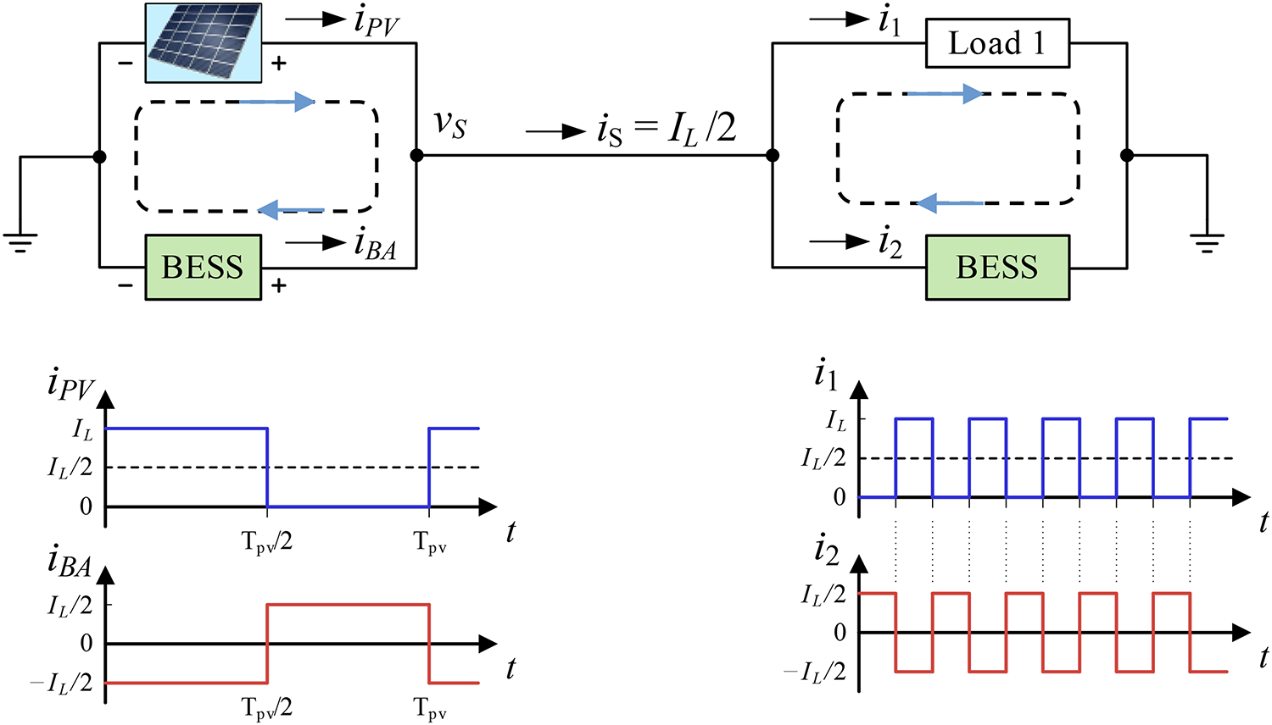
Spacetime power in ac/dc systems – reducing system peak real/reactive power
Future Work (from 2009 presentation):
Utilization of the reactive power theory in distributed energy resources.
More research on the economic analysis.
System-wide active and/or reactive power control and operation.
Key Takeaways
Spatial reactive current/power are the part of instantaneous current and power that circulates among subsystems and components at a given instant
Time reactive current/power are power fluctuations over a considered time-interval between subsystems or between sources and loads.
In DC power circuits and systems that contain ripples or fluctuations, there are reactive current and reactive power just like AC circuits.
A battery is NOT an energy source or an active power source in a long-term sense; it’s just an energy storage device like an inductor or capacitor but with larger energy capacity.

Slide 8
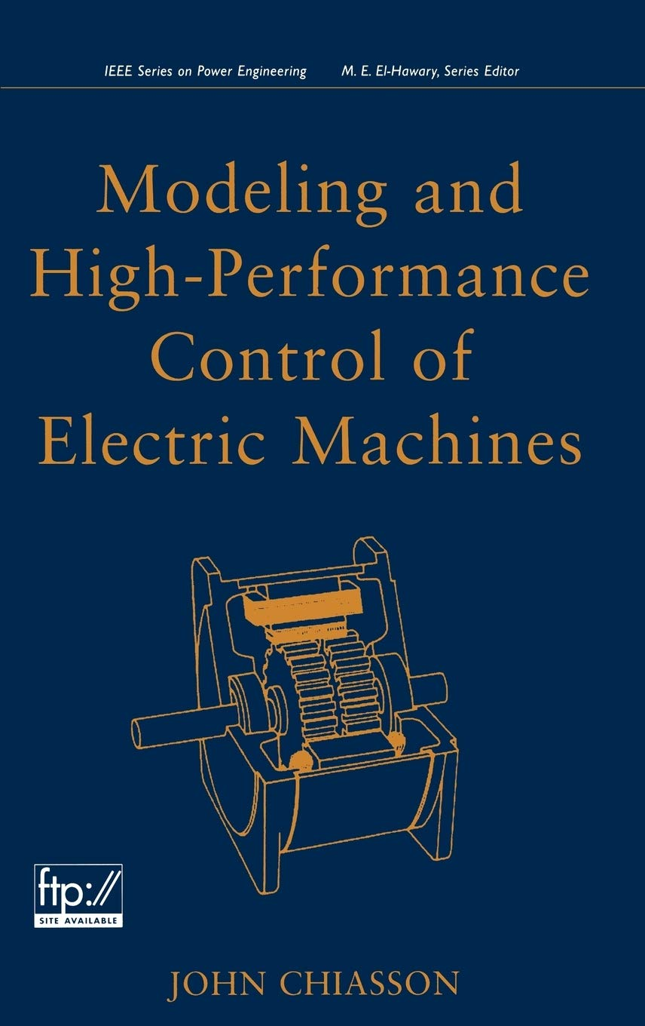
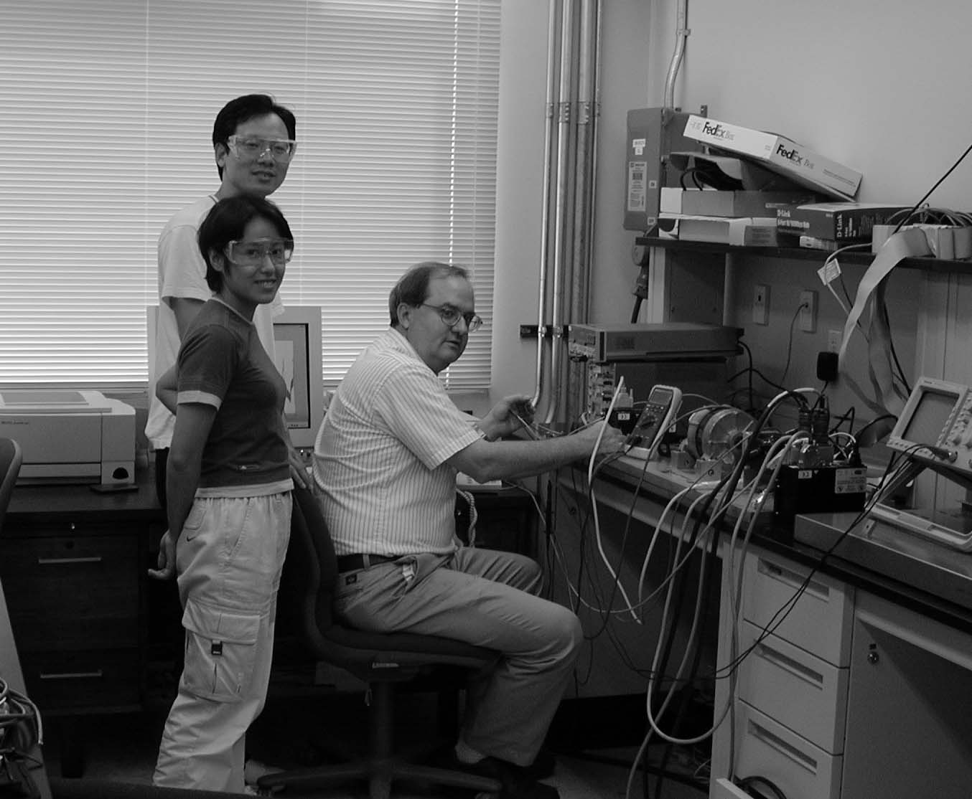
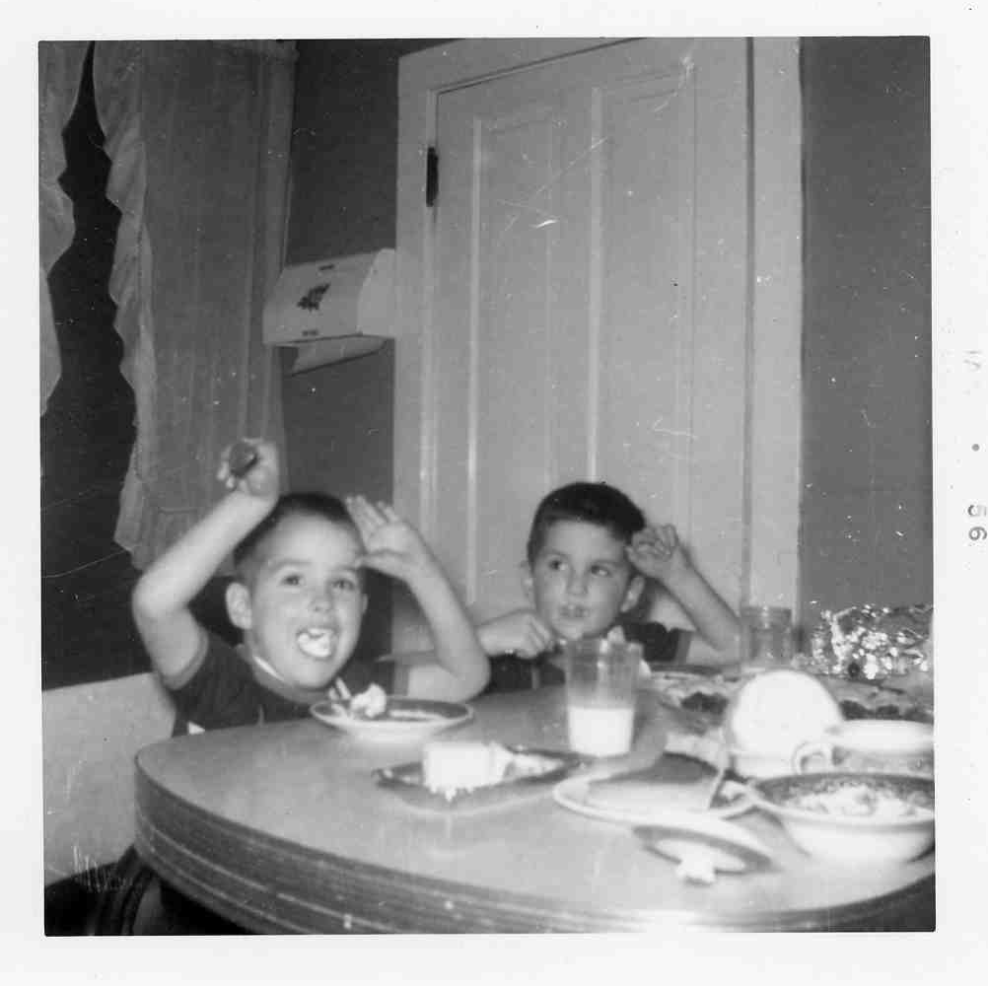
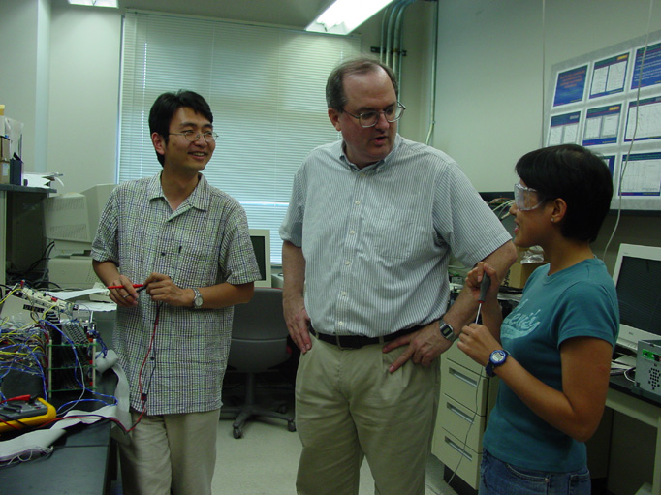
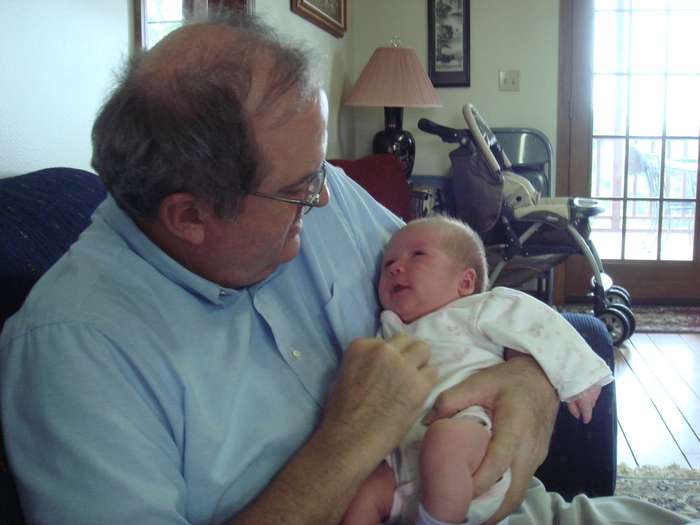
John Chiasson’s Motors Book
(1955) John’s childhood wish: “When I grow up, I’m going to be a published author!”
(2007) John: “Olivia, have you bought a copy of my book yet?”
Olivia: “My parents read it to me every night!”

Slide 9
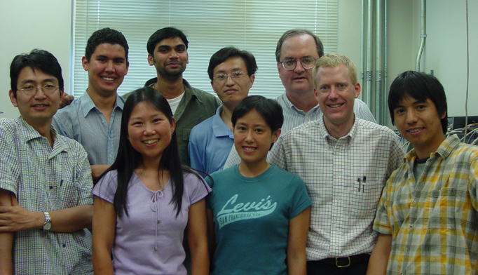

Student Acknowledgements
Dr. Chiasson was the first person I met in the US. He was always so supportive inside and outside the classroom. He loved teaching - I greatly enjoyed his classes.
Dr. Chiasson was an excellent advisor and great friend. He is always willing to discuss questions with students and take effort to help them succeed. The life in UT is a special memory to me.
He was a friend and a great influence during my PhD years at UT.
Dr. Chiasson is not only one of my best advisors, but also one of my best friends. Dr. Chiasson gave me a lot of help on my Ph.D study, research and life. UT time is one of my best lifetimes I have experienced. I was so happy to learn from him, work with him, and publish papers with him.
I immensely enjoyed his courses at UT. His energy and curiosity in the class was infectious. It is a great loss to Boise and overall electrical engineering fraternity.
When I had just arrived in the U.S., everything was so new and left a deep impression on me. Dr. Chiasson's knowledge, his attitude toward research, and his kindness toward others—looking back now, I realize I have always admired and appreciated him.
I have a lot of fond memories of Dr. Chiasson during my graduate school days. I remember him as a very friendly and enthusiastic person who encouraged me even when things did not go well.
Dr. Chiasson was such a kind person and very fun to be around.

Slide 10
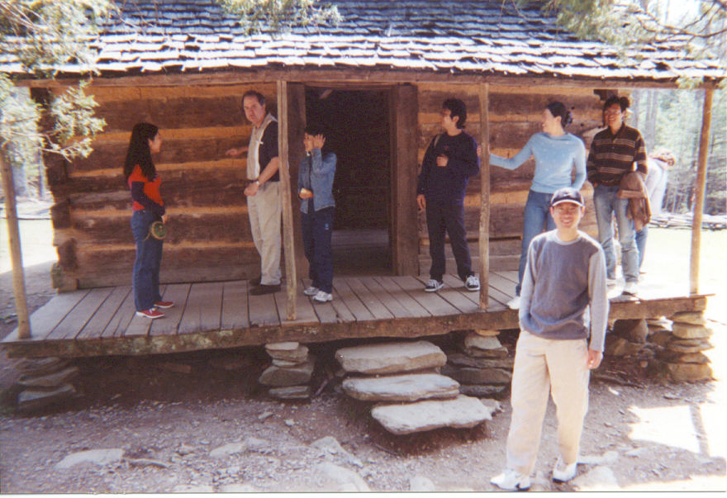
Student Acknowledgements
Dr. Chiasson was a great person, advisor, and friend. He was knowledgeable as a teacher, inspiring as an advisor, curious and mischievous as a friend. I hope that he now believes that Chinese people eat potatoes.
I still remember Dr. Chiasson's happy and friendly face. In March 2003, he gave me a lab tour and welcomed me to the campus. It was a turning point in my life.
He was kind to everyone in his class and showing his warmest smile all the time. He was a nice teacher and advisor at my Tennessee times.
It feels like just yesterday that I sat there as a student, listening to him explain control theories, modeling, and simulations with such passion and insight.
I hold John with extreme regard because of the space/emotion/environment that he created. I am extremely grateful.
He helped me to understand nonlinear theory " flatness" and to do "disturbance observer." He made my student time in Knoxville. His energy to conduct the class was outstanding.
I still remember that he told me why we need nonlinear controllers. He told me, " Life is nonlinear !"

Slide 11
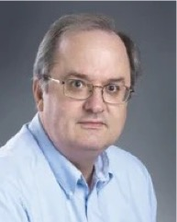
Student Acknowledgements
Dr. Chiasson was one of the kindest professors I encountered during my time at UT. I have only fond memories of him—his insightful technical questions, thoughtful comments, and valuable suggestions, always delivered with a touch of humor. A friend once told me, "Never trust people with a bad sense of humor." By that measure, Dr. Chiasson was an exceptionally trustworthy person.
Dr. Chiasson was always more than just a professor to us. He was a mentor, a guide, and a friend. I remember how he would sit beside us, patiently working through mathematical formulas and simulations, thoughtfully discussing every detail. His dedication to teaching and genuine care for his students left a lasting impact on all of us.
Dr. Chiasson was a wonderful person and friend.
His smile and cheerful spirit will always stay in our hearts.
We will really miss him. His legacy will live forever.

