Slide 1

Perm National Research Polytechnic University
Foreign Language (English)
Alexander Popov: The Inventor of Radio
Presented by:
Sheremet Semen, РИС-25-2б
2026

Slide 2
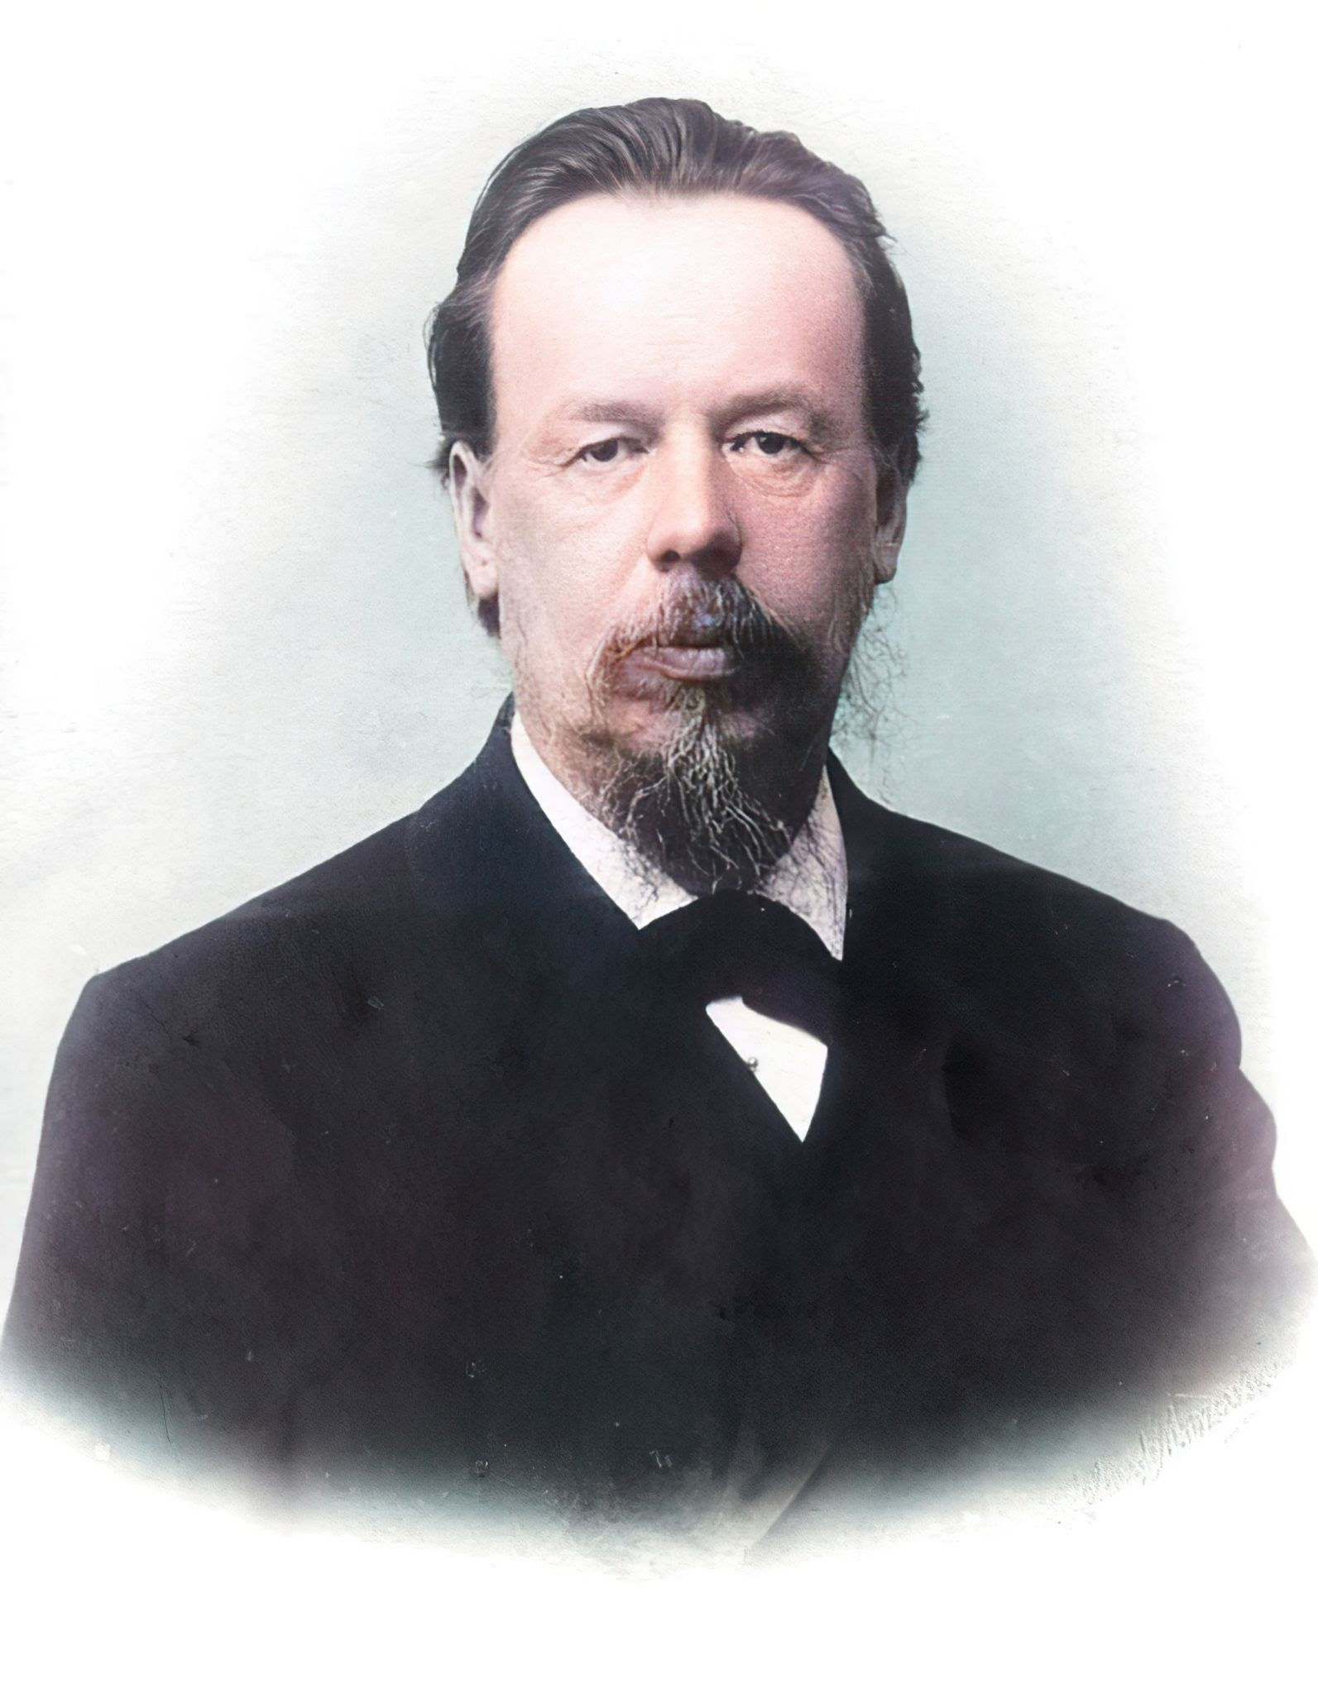
Contents
Vocabulary
Biography
The Path to Invention
The Day of Radio
Practical Applications in History
Modern Use and Perspectives
Conclusion

Slide 3
Vocabulary
Electromagnetic waves
Hertzian waves
/ɪˌlektrəʊmæɡˈnetɪk ˈweɪvz/— электромагнитные волны
/ˈhɜːrtsiən ˈweɪvz/ — волны Герца
Coherer
Wireless telegraphy
/kəʊˈhɪərə/ — когерер
/ˈwaɪəlɪs tɪˈleɡrəfi/ — беспроводная телеграфия
Antenna
Spark-gap transmitter
/ænˈtenə/ — антенна
/ˈspɑːk ɡæp trænzˈmɪtə/ — искровой передатчик
Receiver
Resonance
[/rɪˈsiːvə/ — приёмник
/ˈrezənəns/ — резонанс
Transmitter
Morse code
/trænzˈmɪtə/ — передатчик
/ˌmɔːs ˈkəʊd/ — азбука Морзе

Slide 4
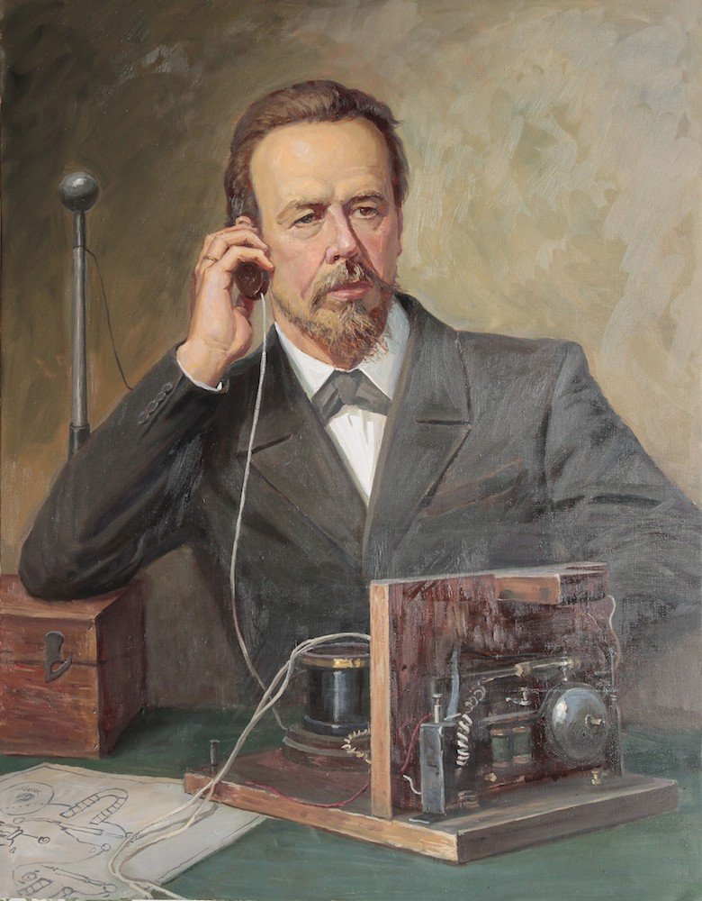
Biography
Early life
1859 – born in the Urals
Education
St. Petersburg University (Physics & Mathematics)
Teaching Activity
Lecturer at Kronstadt Navy School
Scientifics interests
Electromagnetism, meteorology

Slide 5
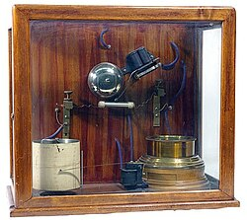
The Path to Invention
- Studied Hertz’s experiments
- Goal: detect lightning at a distance
- Improved the coherer (Branly’s tube)
- Added antenna and automatic decoherer

Slide 6

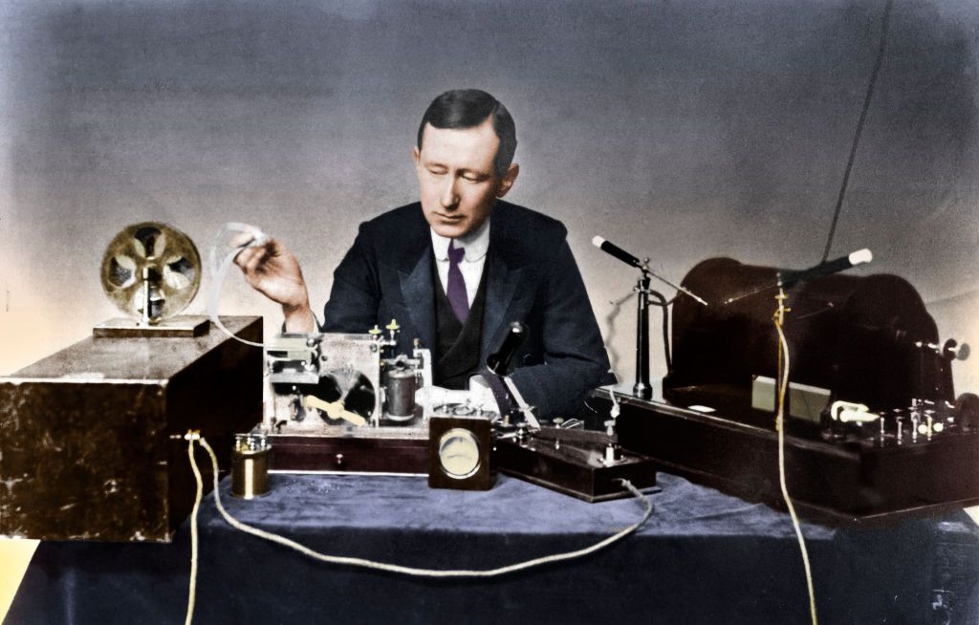


The Invention of Radio
May 7, 1895 – demonstration of
«device for detecting and recording electrical
oscillations»
First wireless receiver in the world
Transmitted signal «Heinrich Hertz»
in 1896

Slide 7
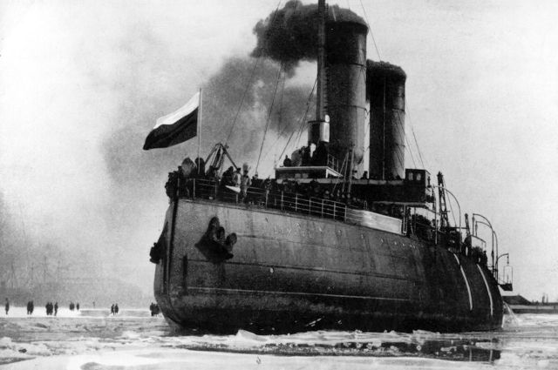
Practical Applications in History
The First Radio Rescue
Operation
The First Practical Wireless
Line
1899 – saved crew of ship «General-Admiral Apraksin»
1900 – first radio link between islands (Gogland–Kotka)
Icebreaker Support by Radio
Ship «Ermak» – icebreaker communication

Slide 8
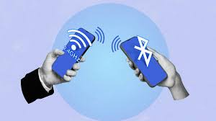
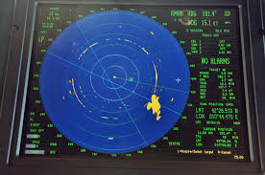

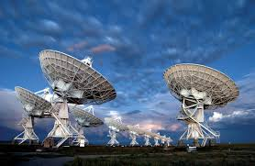
Modern Use of Radio Technology
Cell phones,
Wi-Fi, Bluetooth
Radar, GPS
Broadcasting,
TV
Radio astronomy,
satellite comm.

Slide 9

Conclusion
Legacy
Popov's work launched the era of wireless communication
Impact
Foundation for today's global networks (mobile, Wi-Fi, satellite)
Future
5G, quantum radio, deep-space communication
Philosophy
"An invention belongs not to one person, but to humanity"

Slide 10
References
1. IEEE Spectrum — Who Invented Radio: Guglielmo Marconi or Aleksandr Popov? (2020)
https://spectrum.ieee.org/who-invented-radio-guglielmo-marconi-or-aleksandr-popov
2. Britannica — Aleksandr Popov | Russian Radio Pioneer & Invento
https://www.britannica.com/biography/Aleksandr-Popov-Russian-engineer
3. ETHW (Engineering and Technology History Wiki) — Aleksandr Popov (2016)
https://ethw.org/Aleksandr_Popov

