Slide 1
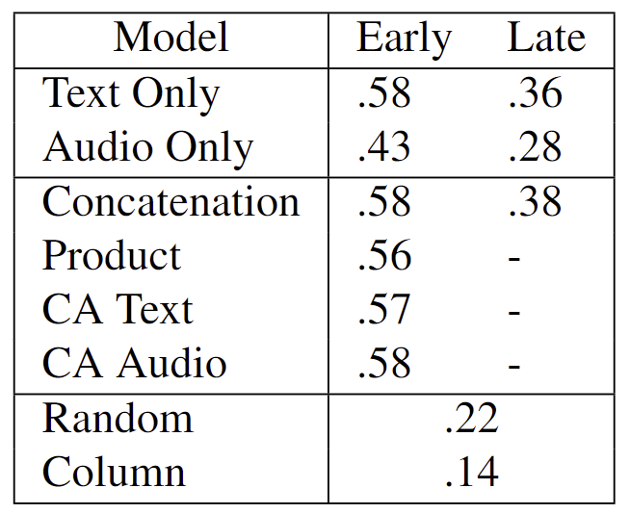
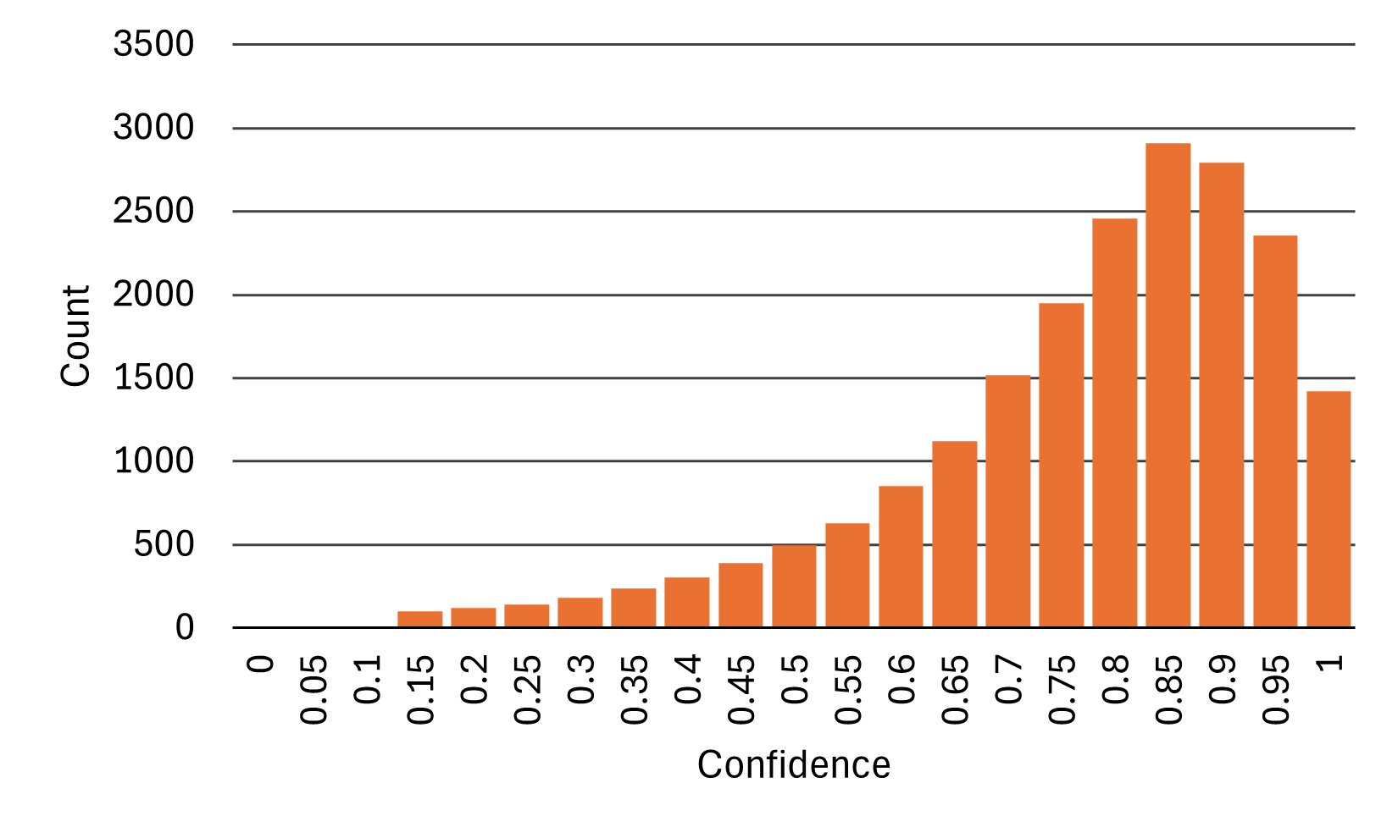
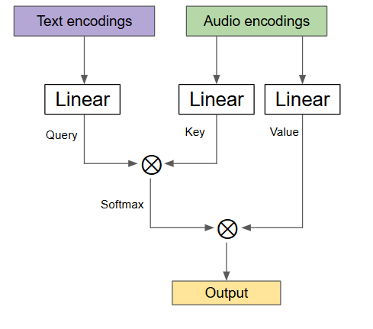
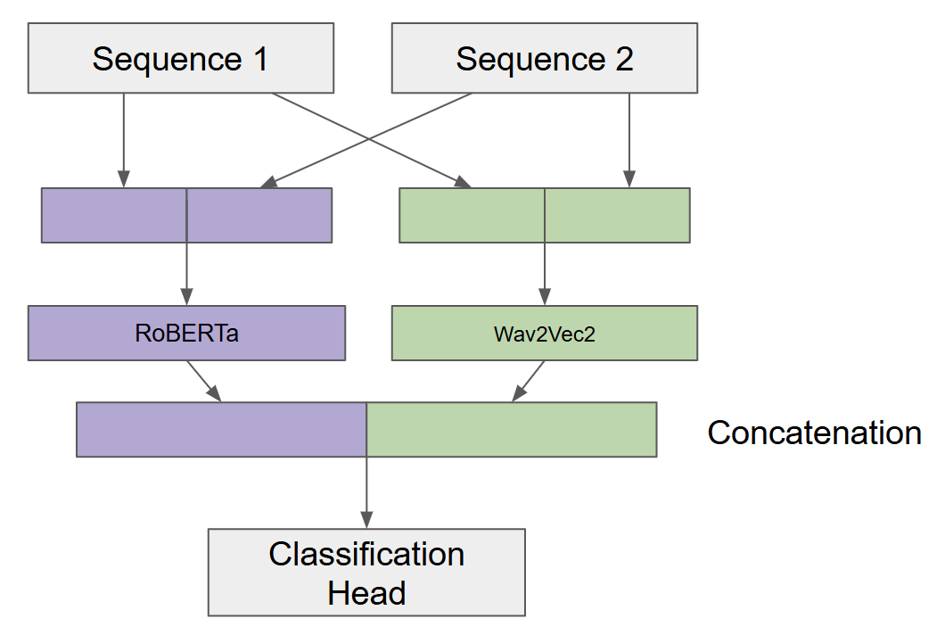
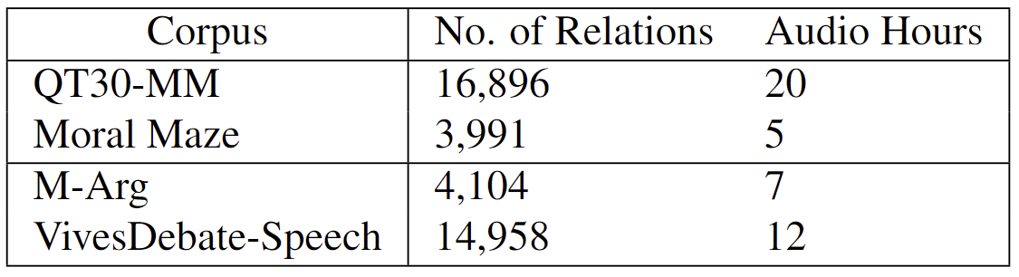
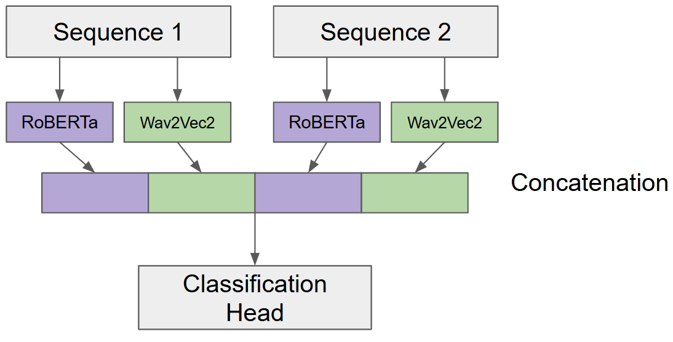
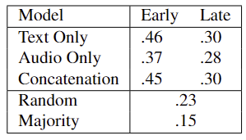
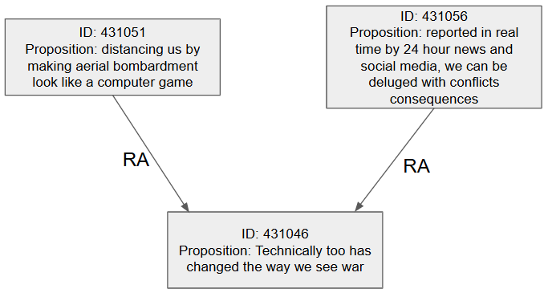
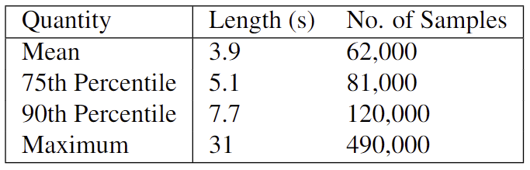
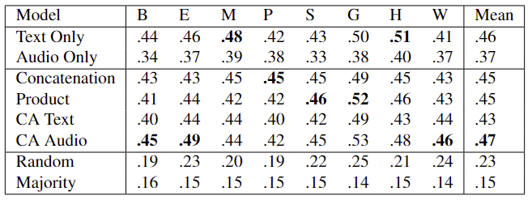
Acoustic Features in Cross-Domain Argument Mining Oscar Morris – Advised by Dr. Ramon Ruiz-Dolz
Introduction
Audio Data
Model Architectures
Multimodal Fusion
In-Domain Results
The goals of this project are twofold:
Extend two existing debate corpora with their audio data, allowing their use for multimodal or audio only AM applications. The first of these is the large QT30 corpus and the second is a smaller but cross-domain corpus created from episodes of the Moral Maze.
The implementation and evaluation of different multimodal techniques and models in a cross-domain setting on the task of ARI.
Forced Alignment
PyTorch’s forced alignment API could be used to find the start and end times of each locution.
The API also provides ‘confidence’ scores derived from the model’s output probabilities
Corpus Analysis
QT30-MM is the largest currently available multimodal ARI dataset, both in pair count and in audio hours
Moral Maze is the only currently available cross-domain multimodal ARI dataset
Data regarding the lengths of locutions was also analysed
There are two areas of fusion in a multimodal pair classification model:
Sequence fusion – the point at which the data from the different sequences are fused.
Multimodal fusion – the point at which the data from the different modalities are fused.
The following multimodal fusion methods are evaluated:
Concatenation
Elementwise-product
Crossmodal Attention (CA)
Sequence Fusion
Argument Data
Early Sequence Fusion
Late Sequence Fusion
Conclusions
The argument data was structured as a computational graph
When sampling node pairs, all related nodes are sampled and unrelated nodes are either:
simply undersampled,
sampled such that they come from different QT30 episodes, or
sampled such that they come from the same QT30 episode.
The latter of these sampling methods is considered the most realistic
Two major argumentative corpora have been extended into multimodal datasets for use in ARI:
the large QT30-MM corpus; and
the cross-domain Moral Maze corpus.
QT30-MM is the largest dataset for the ARI task which is currently available.
The model implementations were evaluated on the created datasets.
Acoustic features were not useful for ARI.
The sequence fusion technique chosen during model creation is vitally important for the performance of the model.
Cross-Domain Results
the addition of acoustic features makes little difference
sequence fusion is vitally important with early fusion performing much better than late fusion.
CA Audio performs best out of all the multimodal approaches
Acknowledgements
I would like to thank my supervisor Dr. Ramon Ruiz-Dolz for his unfailing support and advice throughout this project, and the rest of the Centre for Argument Technology at the University of Dundee for their advice and knowledge in the subject. I would also like to thank all of my friends and family without whom life would be a misery.

Slide 2
Argument Data

Slide 3
Types of Relation
Three types of relation:
Inference (RA) – holds when one (the premise) provides a reason to accept the other (the conclusion).
Conflict (CA) – holds when one is used to provide an incompatible alternative to the other.
Rephrase (MA) – holds when one proposition rephrases, restates or reformulates another but with different content
Acoustic Features in Cross-Domain Argument Mining

Slide 4
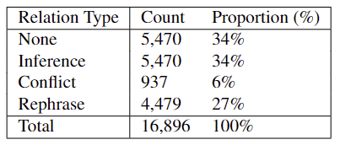
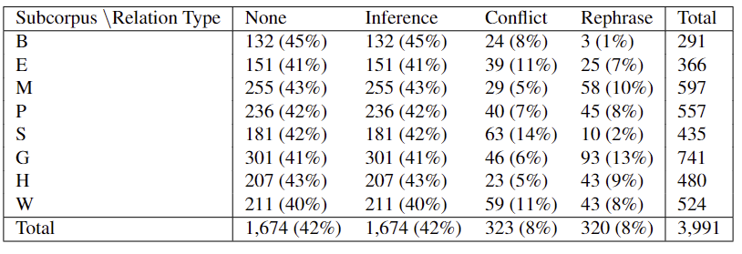
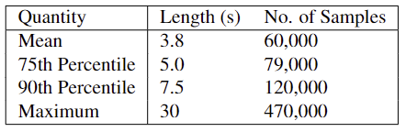
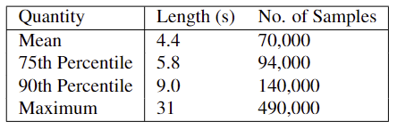
Dataset Details
QT30
Moral Maze
Acoustic Features in Cross-Domain Argument Mining

Slide 5
Audio Data

Slide 6
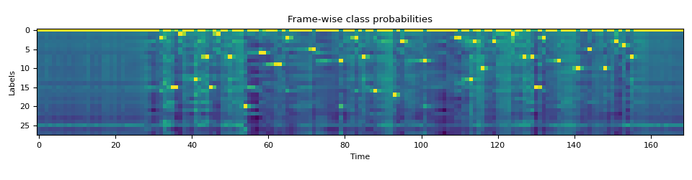
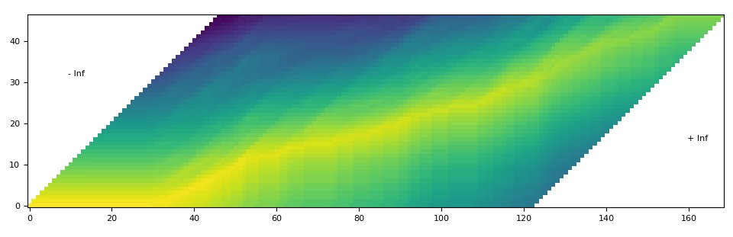
Forced Alignment
The model outputs a probability distribution across each token appearing in each frame
This is then used to construct a ‘trellis matrix’ describing the probabilities of either staying at the same token in the transcript or continuing to the next
From this we can derive the frame where each token begins/ends (extend to words and locutions)
Transcript
Frame
Acoustic Features in Cross-Domain Argument Mining

Slide 7
Analysis
Acoustic Features in Cross-Domain Argument Mining

Slide 8
Model Architectures

Slide 9
Sequence Fusion
Acoustic Features in Cross-Domain Argument Mining

Slide 10
Multimodal Fusion
The following multimodal fusion strategies are evaluated:
Concatenation
Elementwise-product
Crossmodal Attention (CA)
Acoustic Features in Cross-Domain Argument Mining

Slide 11
Results

Slide 12
In-Domain
Generally adding acoustic features does little to affect performance
Sequence fusion, however, is vitally important to the model’s performance
Acoustic Features in Cross-Domain Argument Mining

Slide 13
Cross-Domain
The addition of acoustic features does not aid the model’s ability to generalise cross-domain
Again, sequence fusion is vitally important for the model’s performance
Acoustic Features in Cross-Domain Argument Mining

Slide 14
Summary

Slide 15
Questions?

