Slide 1
Acoustic Features in Cross-Domain Argument Mining
Oscar Morris, April 2025

Slide 2
Argument Data

Slide 3
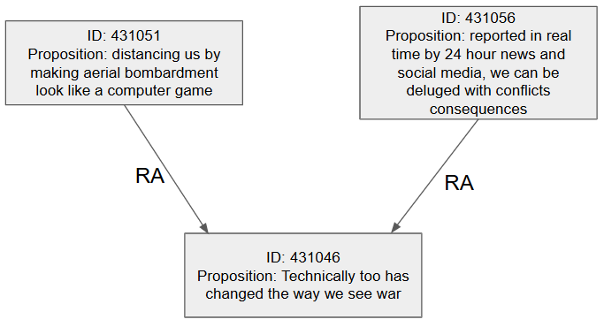
Types of Relation
Three types of relation:
Inference (RA) – holds when one (the premise) provides a reason to accept the other (the conclusion).
Conflict (CA) – holds when one is used to provide an incompatible alternative to the other.
Rephrase (MA) – holds when one proposition rephrases, restates or reformulates another but with different content
Acoustic Features in Cross-Domain Argument Mining

Slide 4
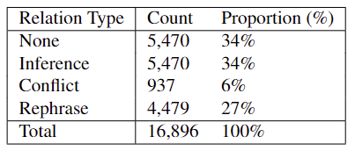
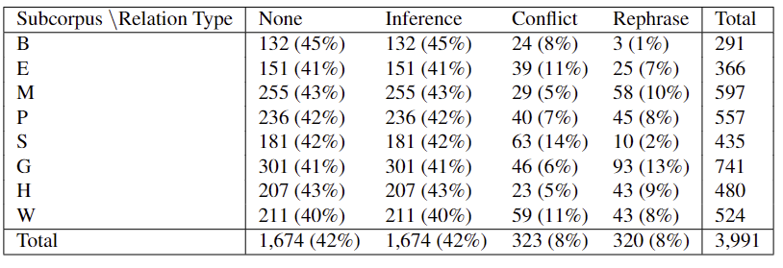
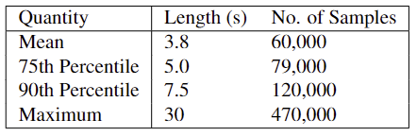
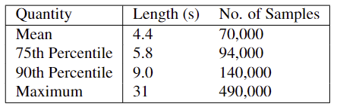
Dataset Details
QT30
Moral Maze
Acoustic Features in Cross-Domain Argument Mining

Slide 5
Audio Data

Slide 6
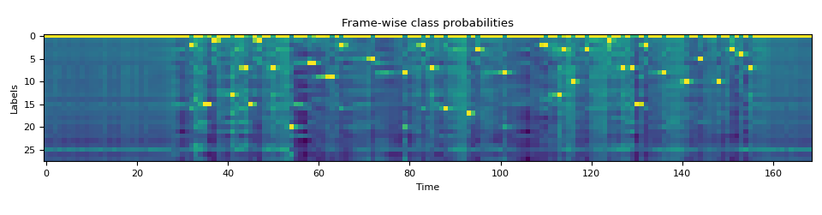
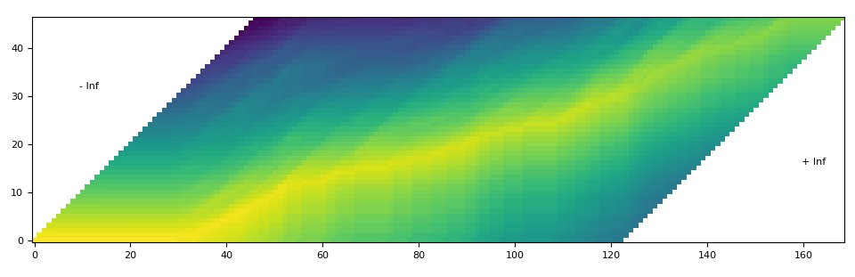
Forced Alignment
The model outputs a probability distribution across each token appearing in each frame
This is then used to construct a ‘trellis matrix’ describing the probabilities of either staying at the same token in the transcript or continuing to the next
From this we can derive the frame where each token begins/ends (extend to words and locutions)
Transcript
Frame
Acoustic Features in Cross-Domain Argument Mining

Slide 7
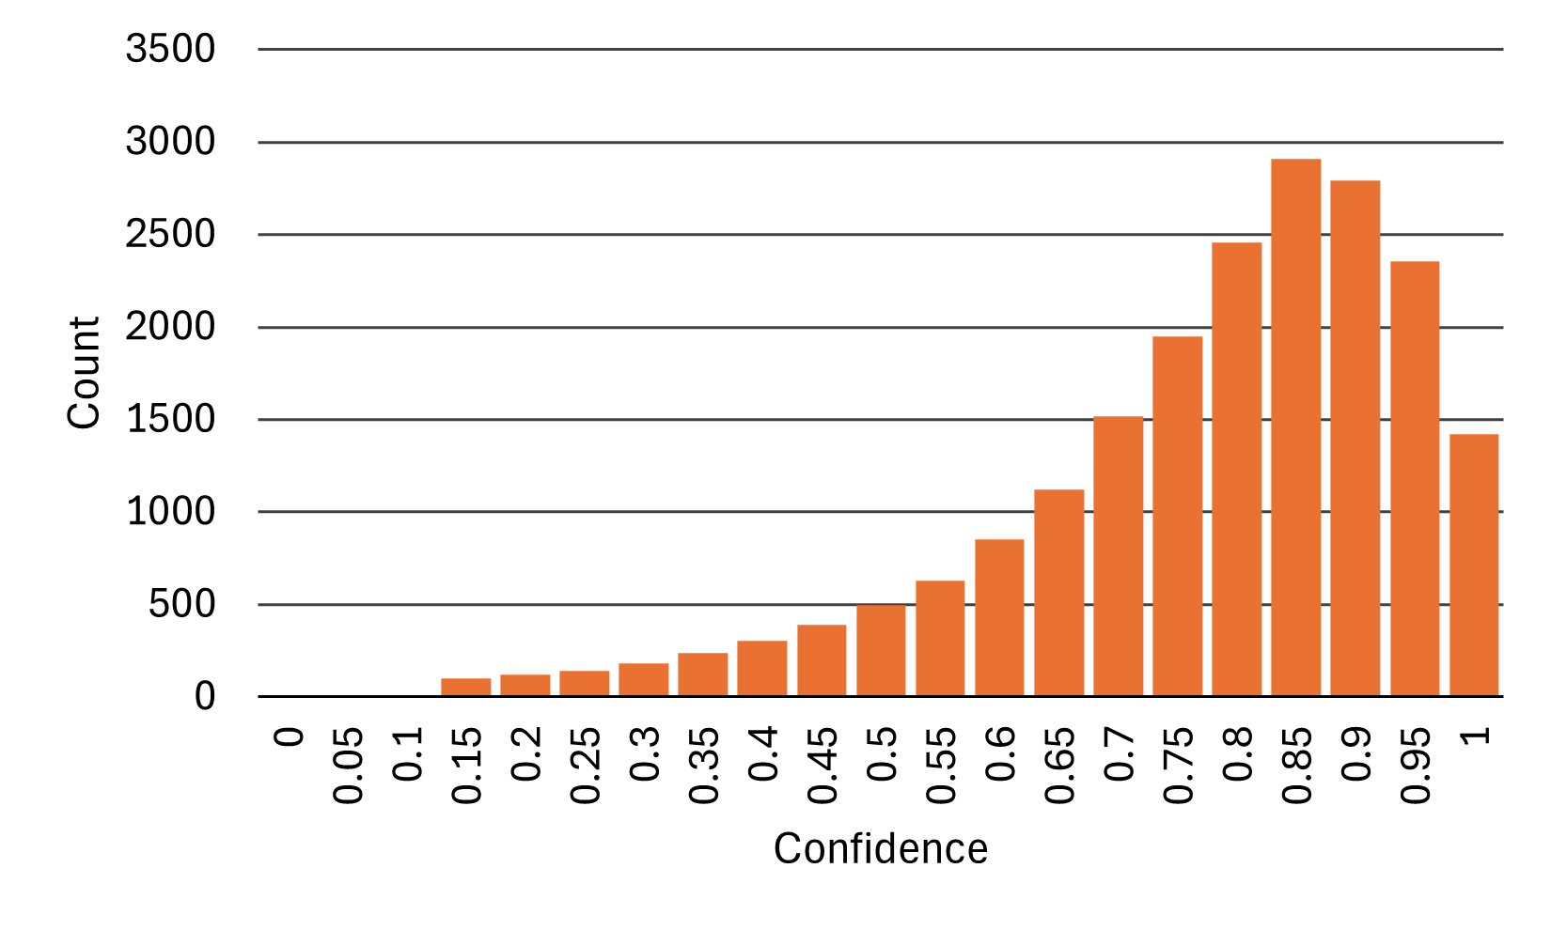
Analysis
Acoustic Features in Cross-Domain Argument Mining

Slide 8
Model Architectures

Slide 9
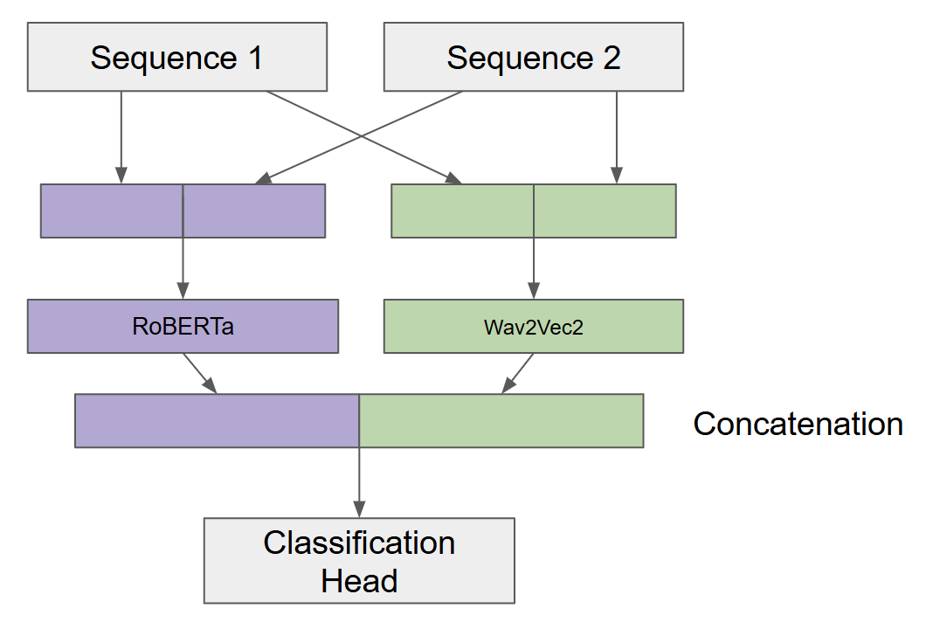
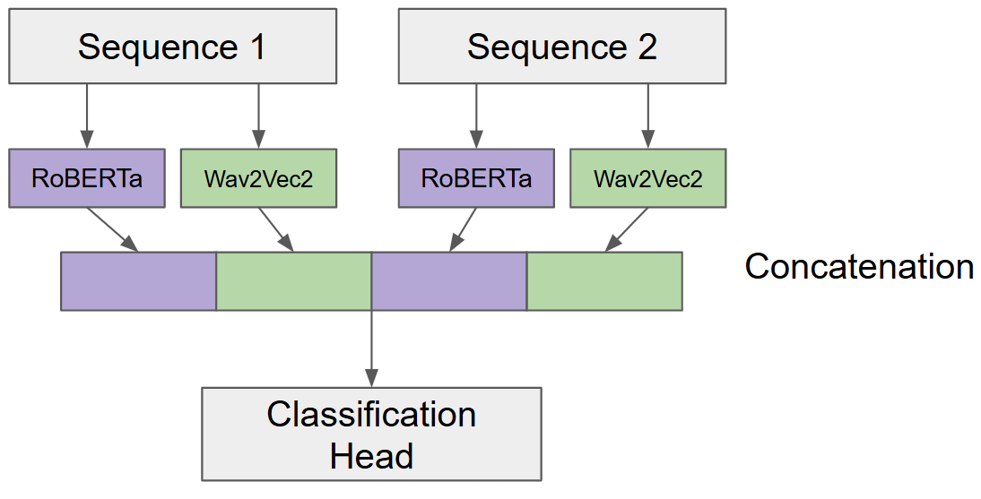
Sequence Fusion
Acoustic Features in Cross-Domain Argument Mining

Slide 10
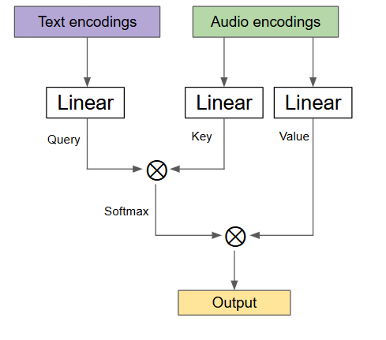
Multimodal Fusion
The following multimodal fusion strategies are evaluated:
Concatenation
Elementwise-product
Crossmodal Attention (CA)
Acoustic Features in Cross-Domain Argument Mining

Slide 11
Results

Slide 12
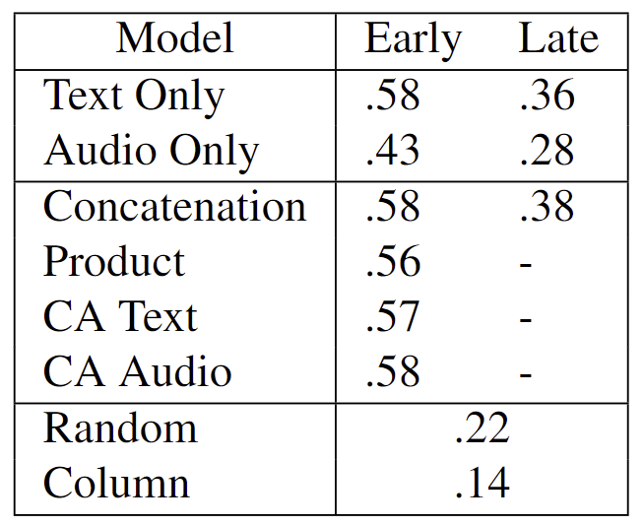
In-Domain
Generally adding acoustic features does little to affect performance
Sequence fusion, however, is vitally important to the model’s performance
Acoustic Features in Cross-Domain Argument Mining

Slide 13
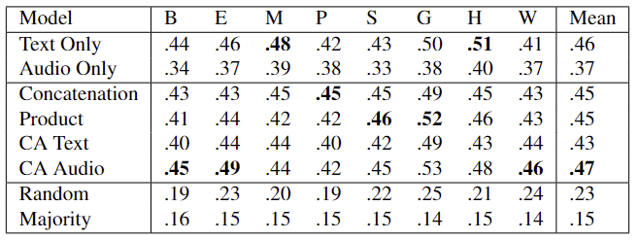
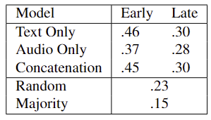
Cross-Domain
The addition of acoustic features does not aid the model’s ability to generalise cross-domain
Again, sequence fusion is vitally important for the model’s performance
Acoustic Features in Cross-Domain Argument Mining

Slide 14
Summary

Slide 15
Questions?

