Slide 1

C
CERVANTES
Narrative-Driven Assessment for Higher Education
Cambridge EdTech x Hack 2026 — EduX Challenge 1
Jordan
Liu
Adrian
Notes:
“Hi everyone, we’re presenting Cervantes: Narrative-Driven Assessment for Higher Education.
This project responds to the EduX challenge of rethinking assessment in the age of generative AI.
The core issue is no longer just whether students use AI. It is that traditional assessments are losing the ability to reveal whether students actually understand what they are doing.
So our idea is simple: instead of assessing only final outputs, we assess the student’s reasoning process through an interactive narrative experience.”

Slide 2
THE PROBLEM
Traditional Assessments Are Broken
• High-stakes exams measure recall under pressure, not genuine understanding
• Rigid formats reduce rich learning to multiple choice and short answers
• No reasoning visibility — educators see scores, never thought processes
• Student anxiety distorts performance and undermines learning outcomes
THE GAP
Universities need assessments that reveal how students think — not just what they remember.
Current tools offer no middle ground between hand-graded essays and automated quizzes.
Notes:
“Traditional assessments are breaking down.
Exams often reward recall under pressure rather than genuine conceptual mastery. Essays and take-home tasks can now be heavily assisted by generative AI. And automated quizzes are scalable, but shallow — they tell you whether a student got something right, but not how they thought.
That creates the real crisis: atrophy of thought and a loss of visibility into student reasoning.
Educators are stuck between two bad options: hand-graded work that does not scale, or automated assessment that strips away depth.
What universities need is a middle ground — something that still scales, but actually captures reasoning, reflection, and conceptual understanding.”

Slide 3
OUR SOLUTION
Assessment Through Interactive Narrative
Cervantes transforms assessment into Visual Novel experiences — curriculum-aligned, AI-generated scenarios where students demonstrate understanding through dialogue and decision-making.
1. Narrative Immersion
Students engage with characters and scenarios, not question sheets
2. Socratic Questioning
AI-driven dialogue probes understanding at natural checkpoints
3. Reasoning Traces
Every decision path is captured, giving educators deep insight
Textbook → Interactive Story → Rich Analytics
Textbook content becomes interactive story, producing rich analytics
Curriculum-Aligned
AI-Generated
Real-Time
Notes:
“That is where Cervantes comes in.
Cervantes transforms assessment into a visual-novel-style interactive experience where students demonstrate understanding through dialogue, decisions, and reflection inside curriculum-aligned scenarios.
Instead of being handed a dead question sheet, students enter a situation. They interact with characters, respond to prompts, and move through branching scenes designed to reveal how they think.
Part of our inspiration came from narrative works like World End Economica, which show that complex ideas can be meaningfully explored through story and dialogue. That shaped our view that narrative here is not decoration — it is a serious medium for surfacing understanding.
Inside these scenarios, AI acts as a Socratic partner. It does not just ask for answers. It probes reasoning, challenges weak responses, and keeps the student actively thinking.
So the result is no longer just a final answer. It is a reasoning trace.”

Slide 4
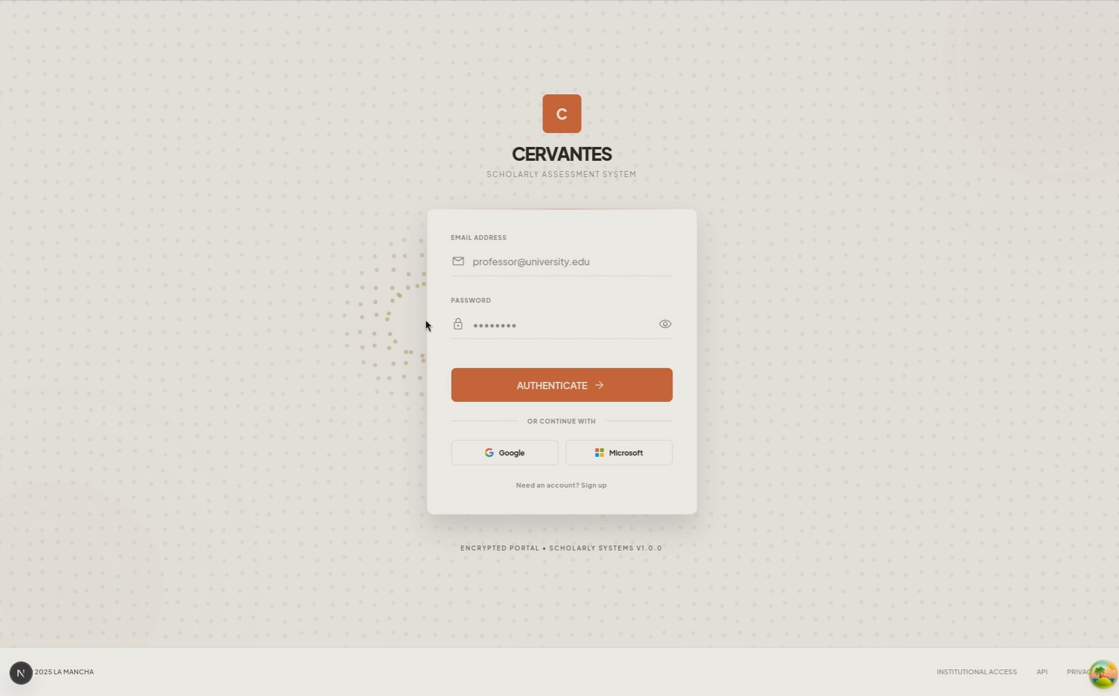
TEACHER FLOW
From Curriculum to Classroom in Minutes
1. Upload Materials
Subject, module, concept targets, rubric focus (PDF / DOCX / TXT)
2. CurricuLLM Alignment
Auto-maps content to Australian curriculum standards and rubric structure
3. Narrative Generation
Gemini builds scenes, characters, Socratic checkpoints, and branching dialogue
4. Review & Publish
Approve the arc, assign to classes, and monitor live progress
▶
VIDEO OF TEACHER DASHBOARD DEMO GOES HERE
Notes:
“For teachers, this has to be practical, or it fails.
So the teacher workflow is designed to be simple.
First, the teacher uploads their materials: subject content, concept targets, and rubric focus.
Then our curriculum alignment layer, CurricuLLM, maps that material to standards, extracts key concepts, and identifies likely misconceptions.
Next, Gemini generates scenes, characters, Socratic checkpoints, and branching dialogue based on those educational targets.
Then the teacher reviews the generated assessment, makes adjustments if needed, and publishes it to students.
So the system is not asking teachers to become writers, game designers, or prompt engineers. It reduces administrative burden while still keeping the educator in control.”

Slide 5
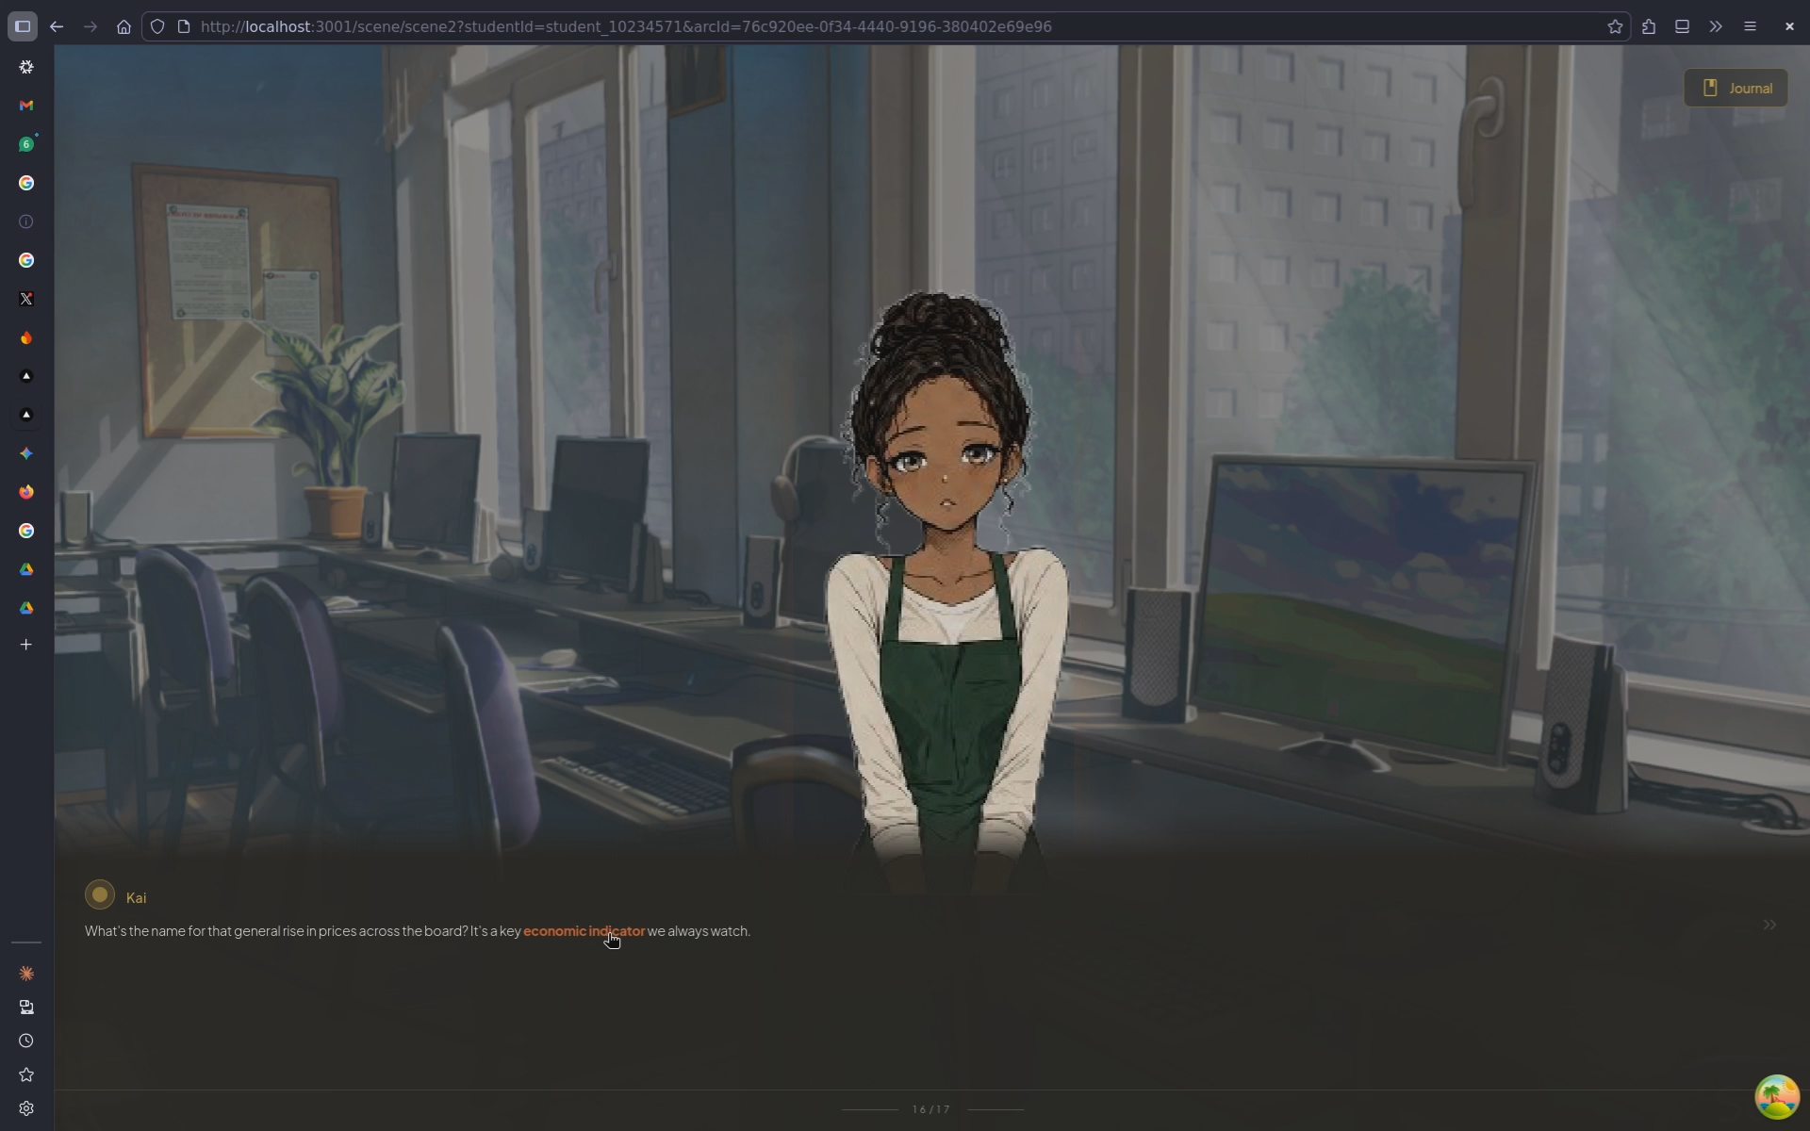
STUDENT EXPERIENCE
Learn by Living the Story
▶
VIDEO OF STUDENT VN EXPERIENCE GOES HERE
Narrative Immersion
Characters, scenes, and branching dialogue make assessment feel like gameplay — accessible via PWA on any device
Socratic Checkpoints
AI-driven questions appear at natural story beats, probing understanding without breaking immersion
Reasoning Journaling
Every choice, response, and dialogue path is captured in arc_journals and reasoning_traces
Notes:
“For students, Cervantes is designed to feel more like an unfolding experience than a static test.
They access the assessment through a PWA on any device. As they move through the story, they encounter natural dialogue moments where they need to explain, justify, predict, or revise their thinking.
A key feature here is our pushback system.
When a student gives a shallow, inconsistent, or weakly justified response, the AI does not simply accept it and move on. It pushes back. It asks the student to clarify, defend, compare, or rethink their reasoning.
That matters because it stops the interaction from becoming passive Q and A. It turns it into a genuine reflection and verification loop.
At the same time, every choice, response, and branch is recorded into reasoning journals and traces, so educators can later see not just what the student answered, but how they got there.”

Slide 6
INTELLIGENCE LAYER
AI That Understands Curriculum and Cognition
CurricuLLM
Grounds all assessment content in Australian curriculum standards
• Concept target extraction
• Rubric structure alignment
• Misconception identification
Gemini 2.5 Flash
Powers narrative generation and real-time dialogue
• Scene & character generation
• Socratic questioning engine
• Adaptive branching logic
Reasoning Graphs
Captures how students think, not just what they answer
• Decision path tracking
• Misconception flagging
• Per-student trace views
Notes:
“The intelligence layer has three main components.
First is CurricuLLM, which grounds everything in real curriculum and rubric expectations. It extracts concept targets, aligns to standards, and identifies possible misconceptions before the scenario is even generated.
Second is Gemini 2.5 Flash, which powers the narrative generation and the real-time Socratic dialogue. This is what allows scenes and questioning to adapt to the student’s responses in the moment.
Third is our reasoning graph layer, which captures the student’s decision path and surfaces patterns in their thinking.
This is important because the challenge is not asking for a chatbot that gives better answers. It is asking for AI-as-infrastructure for deep conceptual mastery.
Our pushback and reasoning graph system is how we operationalise that. The AI is not there to replace thinking. It is there to expose, test, and deepen it.”

Slide 7
ARCHITECTURE
Full-Stack on Google Cloud
FRONTEND
Next.js 16
Teacher Dashboard
Student PWA
Vercel Hosting
BACKEND
FastAPI
Auth + User Mgmt
Arc Generation
Dialogue Engine
Google Cloud Run
SERVICES
Firebase Auth + Firestore
Gemini 2.5 Flash
CurricuLLM Standards
Google Cloud Platform
FRONTEND
BACKEND
SERVICES
REST / API
SDK / APIs
Notes:
“Technically, we built Cervantes as a realistic full-stack system.
Our frontend uses Next.js for both the teacher dashboard and the student-facing PWA. The backend uses FastAPI to handle generation, dialogue orchestration, and system logic.
For services, we use Firebase Auth and Firestore for authentication and real-time data flow, and Gemini for content generation and adaptive questioning. The system is deployed in a cloud-ready architecture designed to be accessible and scalable.
We chose this stack for feasibility. Students do not need to install an app. Teachers can access the dashboard directly. And reasoning traces can be surfaced live as students progress.
So from a judging standpoint, this is not just conceptually interesting — it is technically achievable.”

Slide 8
TECH HIGHLIGHTS
What Makes It Work
Curriculum Grounding
CurricuLLM ensures every generated scenario maps to real curriculum standards — no hallucinated assessments
Real-Time Traces
Firestore listeners push live reasoning data to teacher dashboards as students progress through scenarios
Adaptive Dialogue
Gemini-powered Socratic engine adjusts questioning depth based on student responses in real-time
PWA-First Mobile
Students access VN assessments on any device via Progressive Web App — no app store, no installation
Responsible AI By Design
Teachers retain full oversight — AI generates and probes, but educators control published content and final evaluation. Student reasoning traces treated as protected educational records. Pushback engine challenges reasoning quality, not penalising non-standard thinking styles.
Notes:
“There are four main technical strengths behind Cervantes.
First, curriculum grounding. This keeps generated assessments tied to real learning outcomes rather than drifting into generic AI content.
Second, adaptive dialogue. The system changes its questioning depth based on the student’s responses, which makes the assessment more diagnostic and less static.
Third, real-time reasoning traces. Teachers can monitor student progress and inspect the path a student took, not just the endpoint.
And fourth, PWA-first delivery. That means lower friction, broader accessibility, and easier classroom adoption.
So what makes Cervantes strong is not just that it uses AI. It is that it uses AI in a way that supports pedagogy, visibility, and reflection.”

Slide 9
AI ETHICS
Responsible AI by Design
Cervantes embeds ethical safeguards at every layer — from content generation to student interaction to data handling.
⚓ Human Oversight
Teachers review and approve all AI-generated content before students see it. AI proposes — educators decide.
⚖ Fairness & Inclusion
Socratic pushback evaluates reasoning quality, not language fluency or cultural background. No penalty for non-standard expression.
⚠ Transparency
Students know they are interacting with AI. Teachers see exactly which AI models generated each scene and assessment.
☕ Student Wellbeing
Narrative format reduces exam anxiety. Socratic dialogue encourages growth, never punishes mistakes or uncertainty.
♠ Data Minimisation
Reasoning traces are treated as protected educational records. Only data necessary for assessment is collected and retained.
⚙ Robustness & Safety
Gemini outputs are validated against curriculum standards via CurricuLLM. Retry logic and fallbacks prevent hallucinated assessments.

Slide 10
AI ETHICS
Data Privacy & Student Protection
WHAT WE PROTECT
• Reasoning Traces — classified as protected educational records, never shared with third parties
• Student Identity — randomised character assignments prevent cross-student data leakage
• Conversation Data — stored in Firestore with project-level access controls
• AI Model Inputs — student responses sent to Gemini API with zero-retention policy
• Assessment Outcomes — visible only to the assigned professor, not other students
ALIGNMENT & COMMITMENTS
• FERPA-Ready — architecture supports Family Educational Rights and Privacy Act compliance
• GDPR Principles — data minimisation, purpose limitation, and right to erasure supported
• Australian Privacy Act — handles student data in accordance with APP guidelines
• UNESCO AI Ethics — aligned with UNESCO Recommendation on Ethics of AI in Education
• Google AI Principles — Gemini usage follows Google's Responsible AI commitments
AI generates and probes — Educators control and evaluate — Students own their data

Slide 11
AI ETHICS
Bias Mitigation & Assessment Integrity
HOW WE MITIGATE BIAS
• Curriculum Grounding — CurricuLLM anchors all content to official standards, preventing AI hallucination or off-topic assessment
• Character Randomisation — students receive different character names, personalities, and sprite variants to prevent stereotyping
• Reasoning-First Evaluation — signal extraction judges logical reasoning quality, not grammar, vocabulary, or writing style
• Socratic Neutrality — pushback dialogue challenges all students equally, probing misconceptions without assuming deficit
• Multi-Path Assessment — branching dialogue allows multiple valid reasoning approaches, respecting diverse thinking styles
• Teacher Override — professors can edit any AI-generated scene, question, or misconception target before publishing
TRUST ARCHITECTURE
① Curriculum Layer
CurricuLLM validates learning objectives against national standards
② Generation Layer
Gemini produces content within curriculum-defined boundaries
③ Review Layer
Professor reviews, edits, and approves before publication
④ Interaction Layer
Socratic dialogue probes reasoning without leading or biasing
⑤ Evaluation Layer
Signal extraction uses rubric-aligned criteria, not AI opinion
⑥ Audit Layer
Full reasoning traces stored for transparency and appeals

Slide 12
IMPACT & FUTURE
Redefining Assessment at Scale
0%
Exam Anxiety
100%
Reasoning Visibility
ROADMAP
• Multi-language narrative support
• LMS integration (Moodle, Canvas, Blackboard)
• Collaborative multiplayer VN scenarios
• Global curricula beyond Australian standards
• Voice interaction via Gemini TTS/STT
WHAT CHANGES
• Students assessed through engagement, not pressure
• Educators see thought processes, not just grades
• Curriculum alignment is automated, not manual
Notes:
“The impact of Cervantes is that it changes what assessment rewards.
Instead of rewarding polished final outputs alone, it rewards engagement, justification, revision, and conceptual clarity.
For students, that means less emphasis on performance under pressure and more emphasis on meaningful understanding.
For educators, it means being able to see thought processes, misconceptions, and reasoning gaps that would usually stay invisible.
And for institutions, it offers a path toward AI-era assessment that is scalable, structured, and more aligned with actual learning.
Looking forward, we see clear expansion paths: LMS integration, multilingual support, collaborative narrative scenarios, and voice-based interaction. But the core idea stays the same — assessment should not just measure what a student produces. It should reveal how they think.”

Slide 13
Thank You
Redefining assessment, one story at a time.
Jordan
Liu
Adrian
Frontend + Narrative Arc
Backend + Cloud
Assets + Infrastructure
GitHub github.com/SynAeri/IncubedHackathon
Next.js 16
FastAPI
Firebase
Gemini 2.5 Flash
CurricuLLM
Notes:
“To close, the EduX challenge asks how we can move beyond static outputs and build assessment for deep conceptual mastery in the age of AI.
Our answer is Cervantes.
A system where AI acts as a Socratic interlocutor, narrative becomes the assessment medium, and reasoning becomes the thing we actually evaluate.
Rather than treating AI as a shortcut around learning, we use it as infrastructure for exposing and strengthening thought.
Thank you.”

