Slide 1
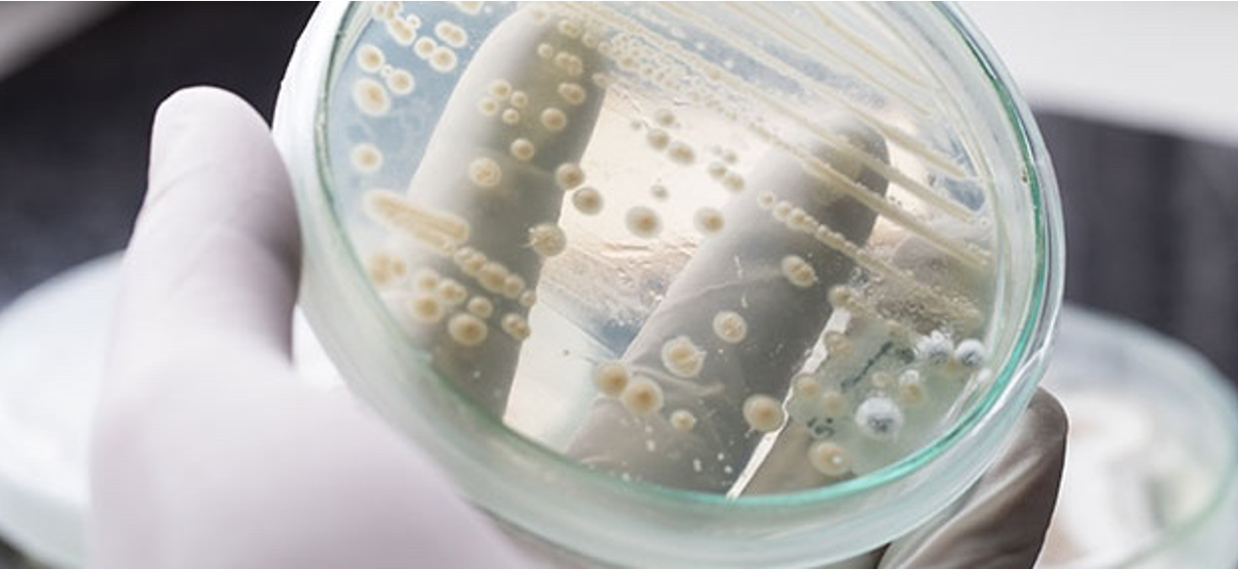
pySBOL3 – A Python implementation of SBOL3
For IWBDA 2022
Tom Mitchell, Bryan Bartley, Jake Beal
October 2022
This document does not contain technology or technical data controlled under either U.S. International Traffic in Arms Regulation or U.S. Export Administration Regulations.
Notes:
intro slide – say something about myself – Software engineer, how I got involved in synthetic biology

Slide 2


pySBOL3 Evolution
SBOL2
SBOL3
libSBOL
pySBOL
pySBOL2
pySBOL3
C++ with Python Bindings
Pure Python
Pure Python
time
Notes:
Talk about Evolving to be more pythonic
pySBOL was a window into the C++ library
pySBOL2 was a drop in replacement
pySBOL3 adopts a pythonic approach

Slide 3
pySBOL3 Implements SBOL3
SBOL3 is the newest iteration of The Synthetic Biology Open Language
3.0 was released on April 1, 2020
3.0.1 was released on October 27, 2021
Follow along at https://github.com/SynBioDex/SBOL-specification
pySBOL3 implements SBOL3 3.0.1 specification

Slide 4
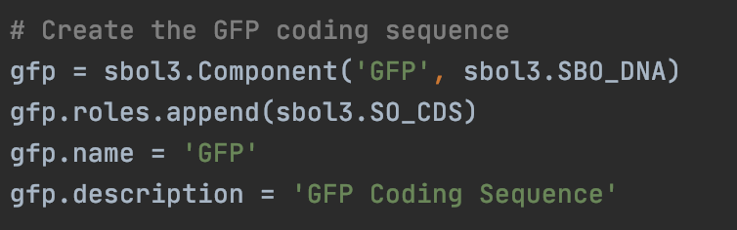
Familiar, Python-like API
pySBOL3 represents each SBOL3 entity as a Python class
Instance properties are either native types or list-like objects
Python snake case is used for properties instead of camel case
display_id instead of displayId
derived_from instead of wasDerivedFrom
https://github.com/SynBioDex/pySBOL3

Slide 5
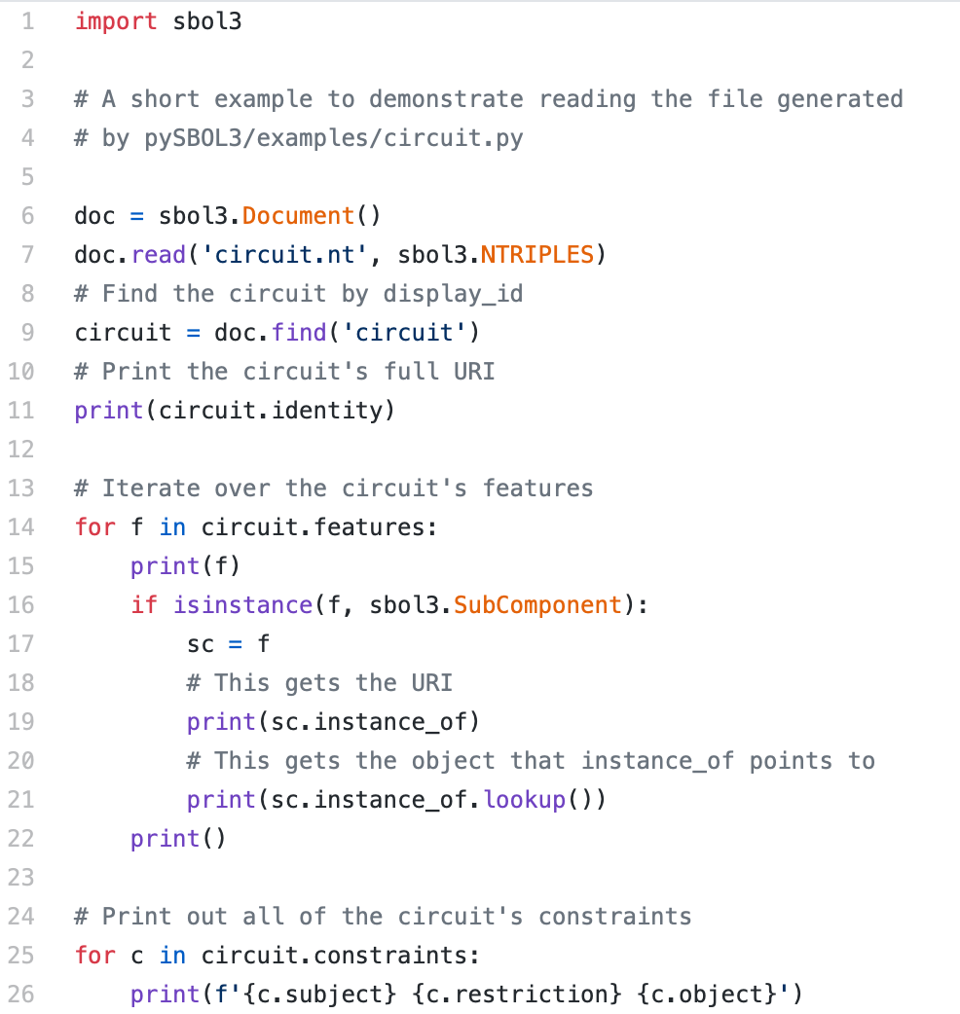
Example: Read an SBOL Document
Read the SBOL file
Find a component
Loop over the component’s features
Look up a referenced object
Print the component’s constraints
https://github.com/SynBioDex/pySBOL3/blob/master/examples/read-circuit.py

Slide 6
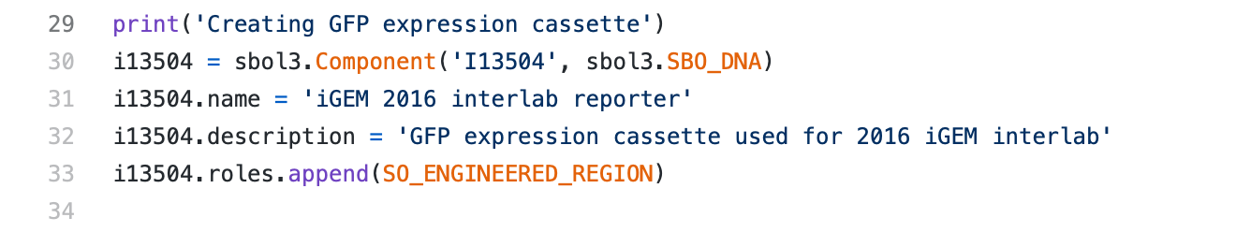
Example: Create an iGEM Component
Component
identity: iGEM#I13504
name: “iGEM 2016 interlab reporter”
description: “GFP expression cassette used for 2016 iGEM interlab”
type: SBO: DNA
role: SO: Engineered Region

Slide 7
Example: Create an iGEM Component
Component
identity: iGEM#I13504
name: “iGEM 2016 interlab reporter”
description: “GFP expression cassette used for 2016 iGEM interlab”
type: SBO: DNA
role: SO: Engineered Region

Slide 8
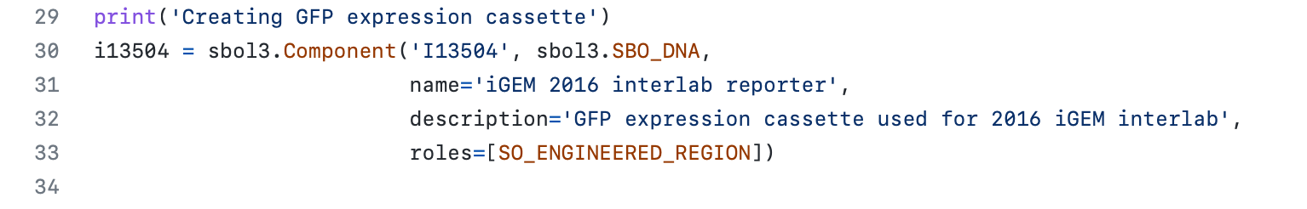
Example: Create an iGEM Component (keyword args)
Component
identity: iGEM#I13504
name: “iGEM 2016 interlab reporter”
description: “GFP expression cassette used for 2016 iGEM interlab”
type: SBO: DNA
role: SO: Engineered Region

Slide 9
Example: Create an iGEM Component (keyword args)
Component
identity: iGEM#I13504
name: “iGEM 2016 interlab reporter”
description: “GFP expression cassette used for 2016 iGEM interlab”
type: SBO: DNA
role: SO: Engineered Region

Slide 10
Example: SBOL Composition
Component: iGEM#I13504
hasFeature
SubComponent
SubComponent
SubComponent
instanceOf
instanceOf
instanceOf
RBS
CDS
Terminator
Component
identity: iGEM#B0034
name: RBS (Elowitz 1999)
type: SBO: DNA
role: SO: Ribosome Entry Site
Component
identity: iGEM#E0040
name: GFP
type: SBO: DNA
role: SO: CDS
Component
identity: iGEM#B0015
name: double terminator
type: SBO: DNA
role: SO: Terminator
10

Slide 11
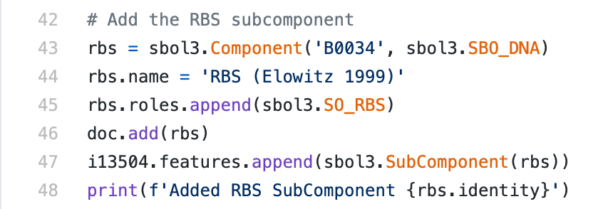
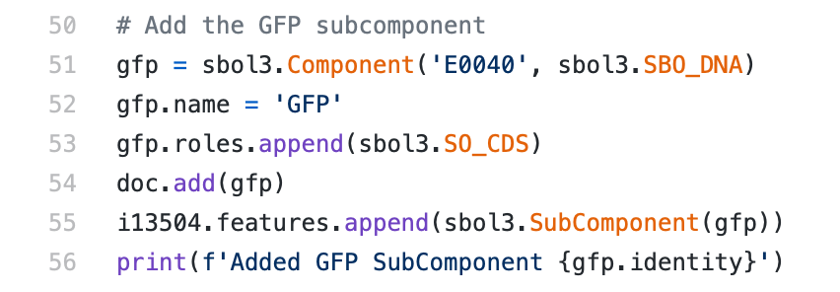
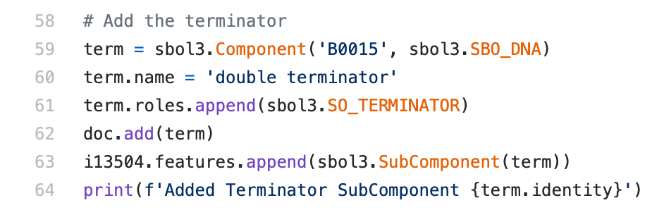
Example: SBOL Composition
RBS
CDS
Terminator

Slide 12
pySBOL3 Status
pip install sbol3
Version 1.0.1 is available now
Open development on GitHub
Use issues to report bugs and request features
Contributions are welcome
https://github.com/synbiodex/pySBOL3
Notes:
Mention other implementations: libSBOLj (Java), sboljs (JavaScript), and ShortBOL, its own scripting language.

Slide 13
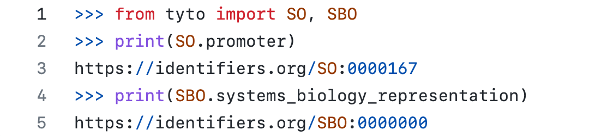
Related Tools: Tyto
Tyto - Take Your Terms from Ontologies
A more intuitive approach to using semantic web ontologies
Generates symbols for URIs based on the ontology terms themselves
https://github.com/SynBioDex/tyto

Slide 14
Related Tools: SBOL-utilities
SBOL-utilities
A collection of scripts and functions for manipulating SBOL 3 data
Layers on top of pySBOL3 and provides higher level functionality
Capabilities:
Graph SBOL Documents
Convert an Excel template file to SBOL
Convert beween SBOL3 and other genetic design formats
Expand the combinatorial derivations in an SBOL file
And more…
https://github.com/synbiodex/sbol-utilities

Slide 15
Questions?

Slide 16
Tutorial Set-up
Get the tutorial:
[Optional] Launch a virtual environment
Install dependencies (sbol3, tyto, and jupyter notebook)
Run notebook
git clone https://github.com/SynBioDex/Community-Media.git
cd Community-Media/2022/IWBDA22/sbol3-workshop
python3 -m venv iwbda
source iwbda/bin/activate
python3 -m pip install -r requirements.txt
jupyter notebook tutorial.ipynb

