Slide 1
Compiling a model to a Genbank file
Anil Wipat
School of Computing Science/Center for Bacterial Cell Biology, Newcastle University, UK

Slide 2


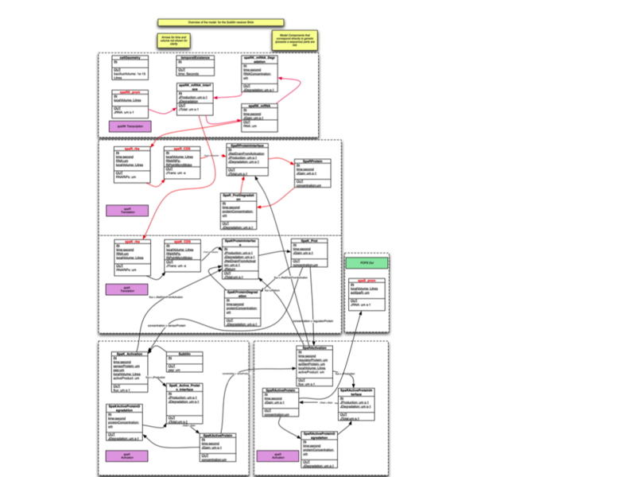
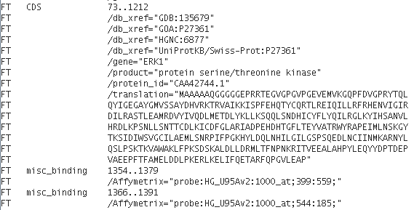
Motivation
DNA
Synthesis
?
Notes:
Not trivial especially for large models

Slide 3
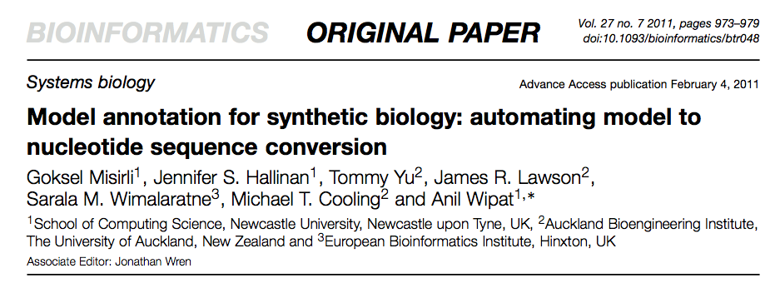
MoSeC

Slide 4
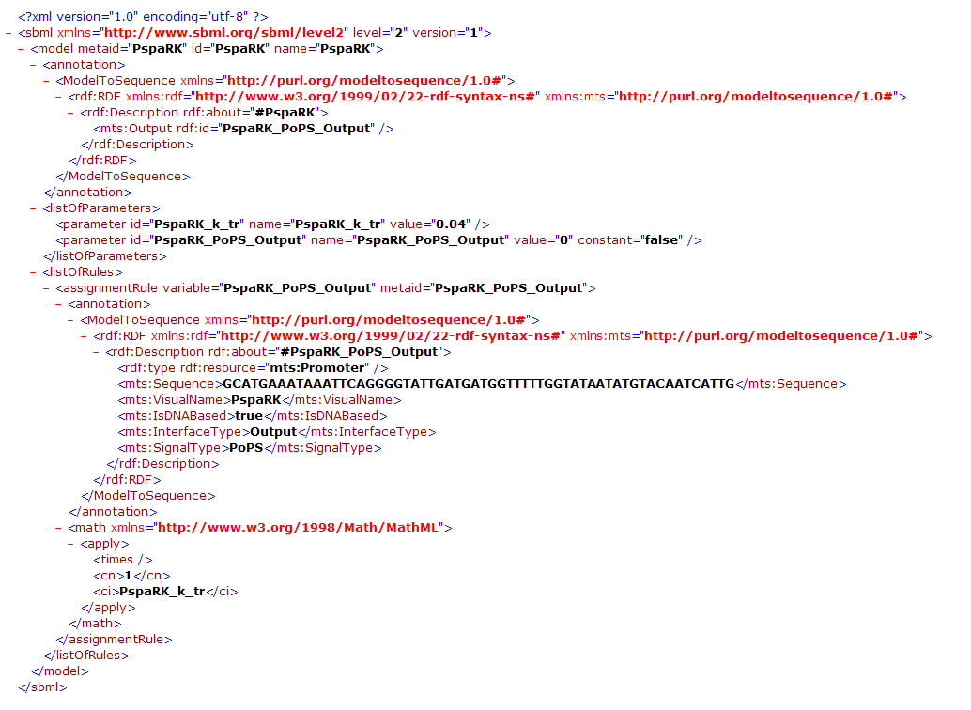
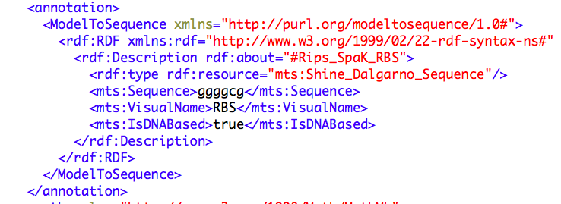
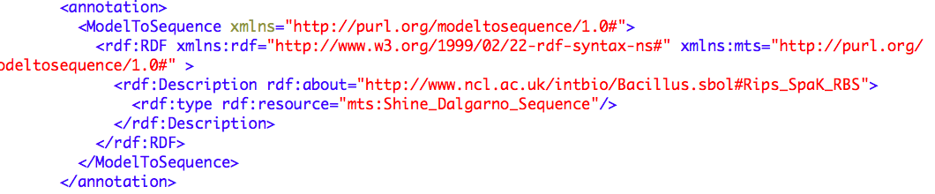
How does MoSeC work?: (1) Annotations
Annotation with the sequence
Annotation with SBOL
Notes:
Annotations provide information about the entities and relationships in the model, including those entities that correspond to genetic elements such as CDS, RBS, Promoters etc., in a computationally amenable format.
The annotations are fragments of RDF incorporated in the model to annotate model components with properties such as type, and their corresponding attributes such as their sequence.
These attributes can be directly incorporated into the RDF or URLs to where this information can be found.
So originally we provided the sequence directly in the model as RDF tags, but now we can provide RDF tags that provide a URL to the SBOL that describes these genetic elements and extract the sequence from there. In this case we point to SBOL instances hosted in the SBOL stack that Matt has just described.
This model has been built from smaller Virtual parts that Jen described earlier and the SBOL pointers are included in these. However, this approach will work with an ordinary handcrafted SBML model.

Slide 5
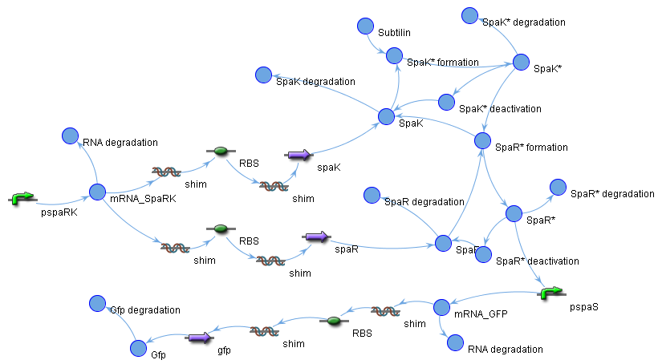
How does MoSeC work?:(2) An algorithm to find paths to order genetic elements
Notes:
Once elements corresponding to genetic elements and their attributes have been identified we need to determine the order in which they will be assembled in the finished DNA sequence. Whilst this information is implicit in the model it is not a simple task to extract this ordering, since species representing these elements are not necessarily connected directly in the model. The additional species necessary to represent layers of biology provided by transcription and translation need to be removed.
MoSeC uses an algorithm that first represents the model as a graph and then finds paths in the model corresponding to valid orderings of genetic elements.

Slide 6
Demo

