Slide 1
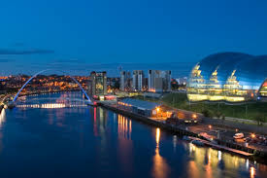
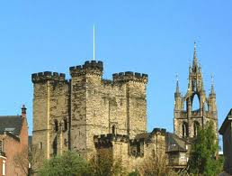

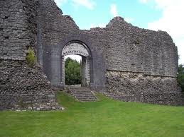
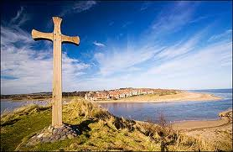

Welcome to Newcastle
SBOL workshop 2013

Slide 2
Fire and emergency
Alarm will sound continuously
Exit the same way as you came in or turn right out of lecture theatre and follow exit signs

Slide 3
Housekeeping
Lunch and coffee in this room
Restrooms – out of door turn left
Small shop and pub – out of main doors turn left – 100m

Slide 4
Sponsors
Centre for Synthetic Biology and BioExploitation (CSBB)

Slide 5
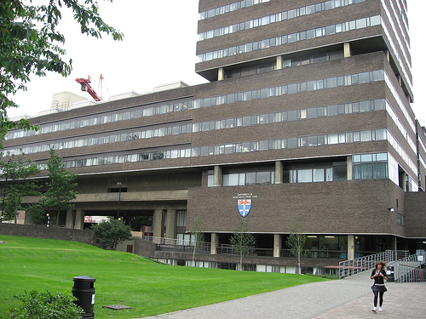
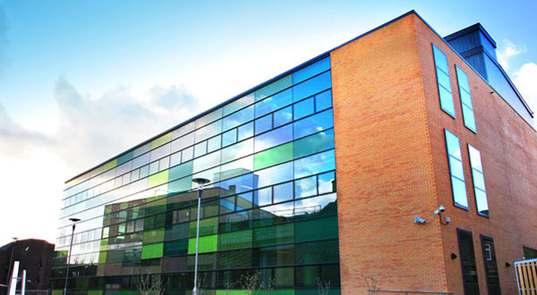
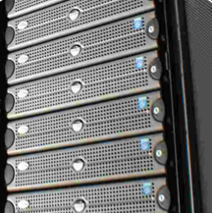
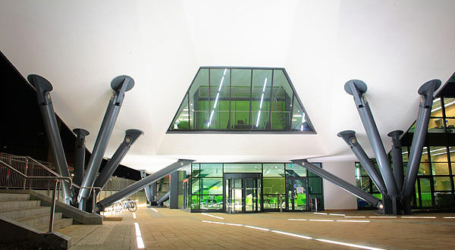
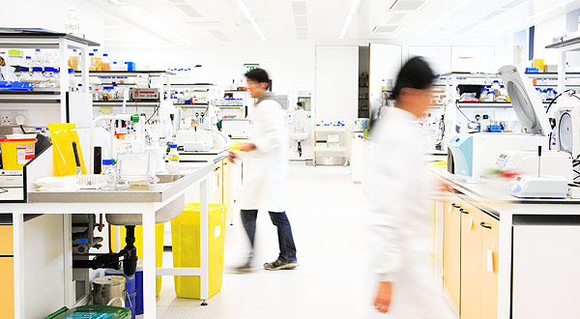
School of Computing Science, Centre for Synthetic Biology and BioExploitation (CSBB) and Centre for Bacterial Cell Biology (CBCB)

Slide 6
Industrial Sponsors
Autodesk
Turing Ate My Hamster Ltd.

Slide 7
Acknowledgements
Thanks to:
Jill Green
Matt Pocock
Goksel Misirli
Owen Gilfellon
The integrative bioinformatics group
The SBOL editors

