Slide 1
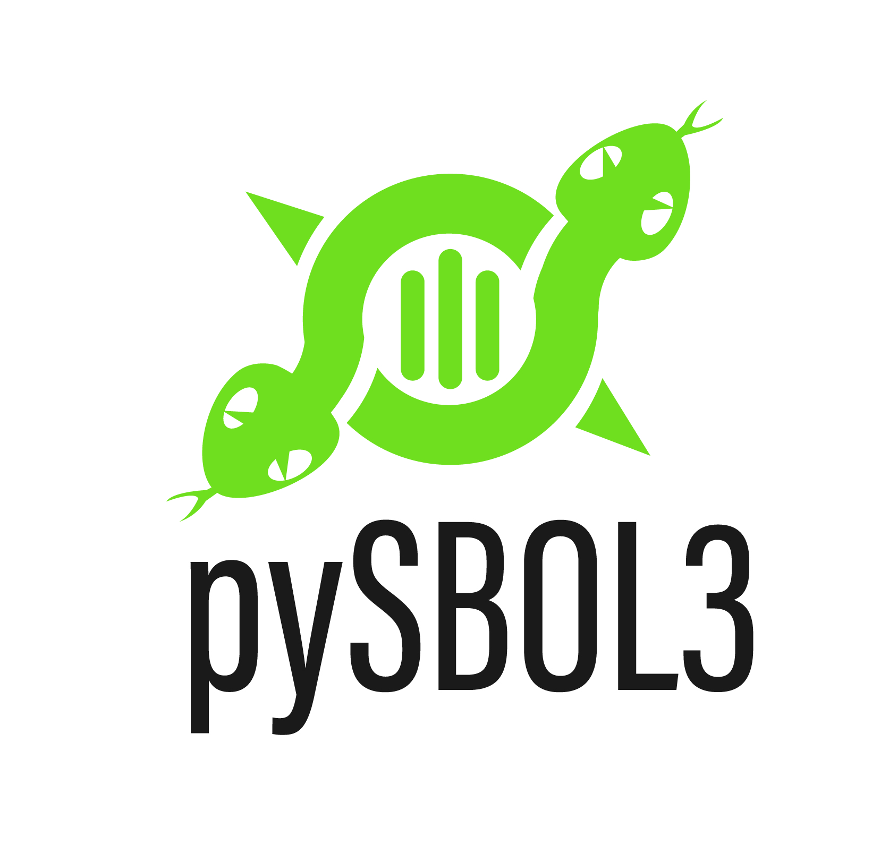
pySBOL3: Python Package for SBOL3
Stable Release 1.0.x
Pure Python package, works with Python 3.7 and newer
In use by numerous projects including:
SBOL-utilities, sbol_factory, PAML, OPIL, iGEM-distribution, and more
Documentation: https://pysbol3.readthedocs.io/
Code: https://github.com/SynBioDex/pySBOL3
Issues and pull requests are welcome
Pypi: https://pypi.org/project/sbol3/
pip install sbol3
https://github.com/synbiodex/pySBOL3

