Slide 1
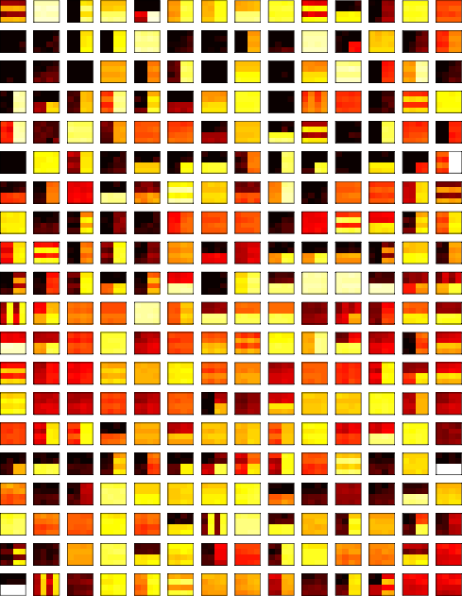
A Menagerie of Gene Regulation Functions
R S C 3

Slide 2
Non transcriptional
Enzyme allostery in metabolism
Transport and membranes
Translation and folding

Slide 3
cis-Regulatory Input functions
Regulatory Motifs
Combinatorial Promoters
Prokaryotic versus Eukaryotic

Slide 4

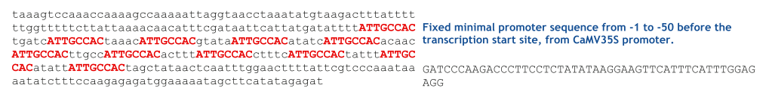
Motifs cis-regulatory transcription factor binding sites
TSS
(100%)
TATA
(10-30%)
UTR
(100%)
TFBS
(variable)
~40 bp
~100 bp
ATG
(80%)
Enhancers
INR
(10-20%)
a generic plant promoter
a synthetic plant promoter sequence

Slide 5
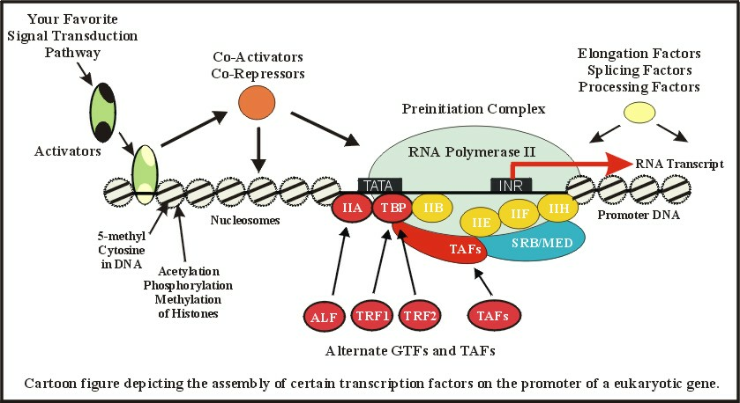
Eukaryotes

Slide 6
Environmental Inputs
Chemical inputs
  sugars
  antibiotics
  quorum sensing, hormones, second messengers
Biological inputs
Physical inputs

Slide 7
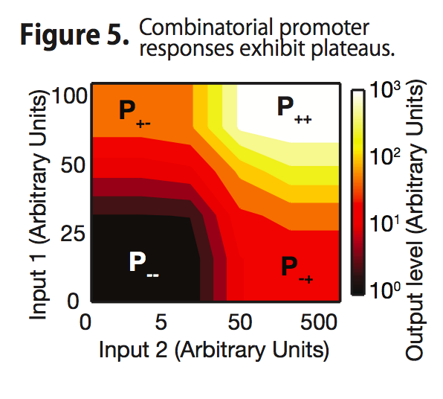
Combinatorial Promoters: surface representation
often TMI!

Slide 8
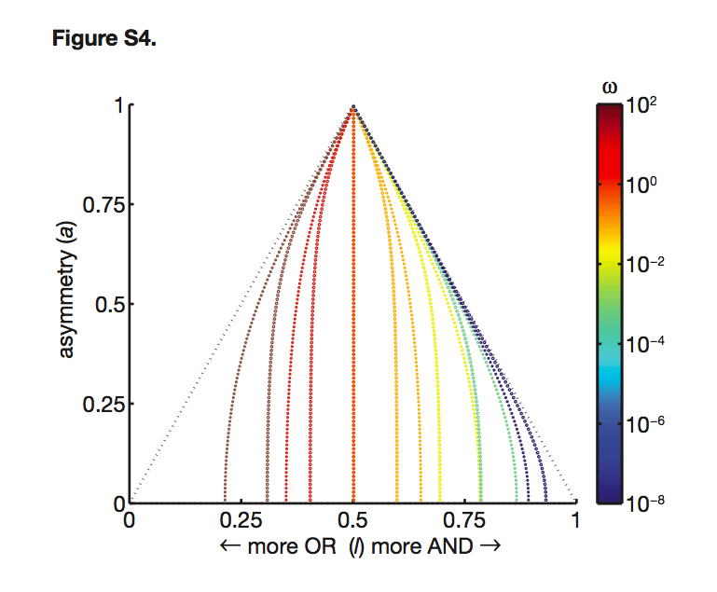
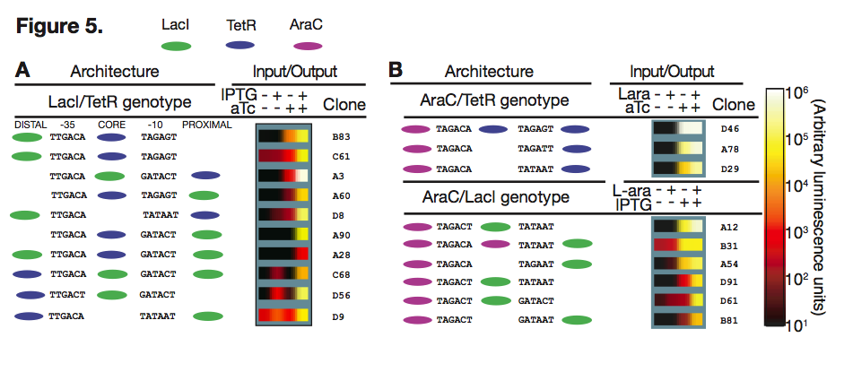
Combinatorial Promoters: plateau representation

Slide 9
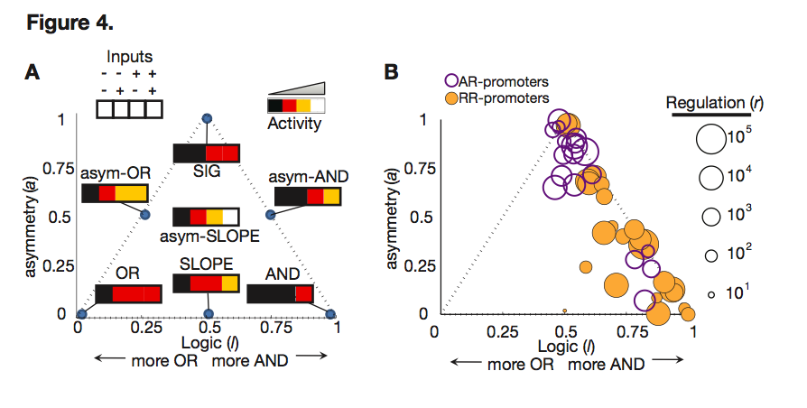
Combinatorial promoters: logic representation

Slide 10
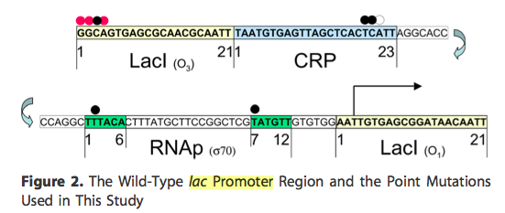
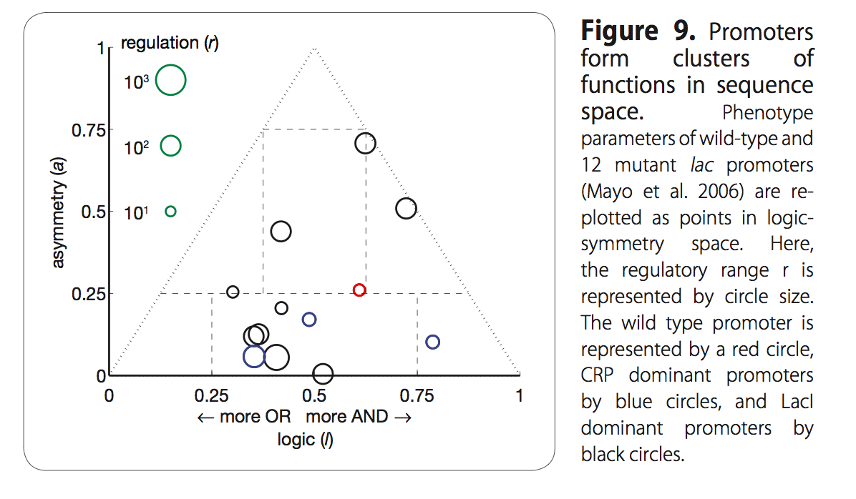
Lac promoter: accessible logic space

Slide 11
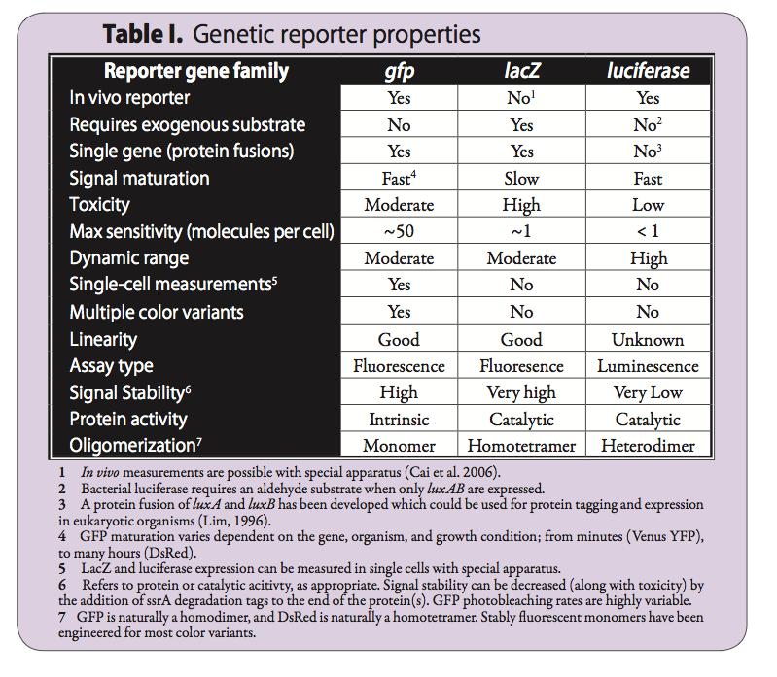
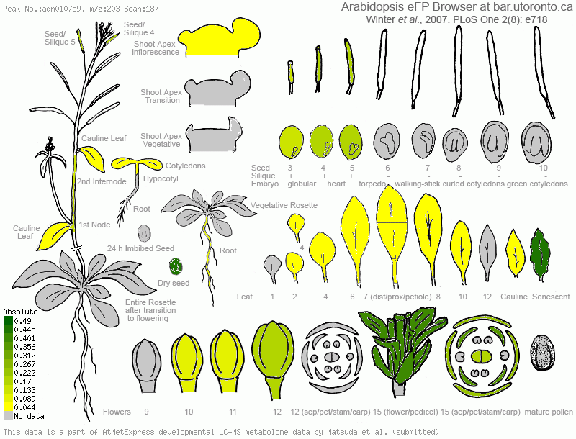
Gene Expression measurements

Slide 12
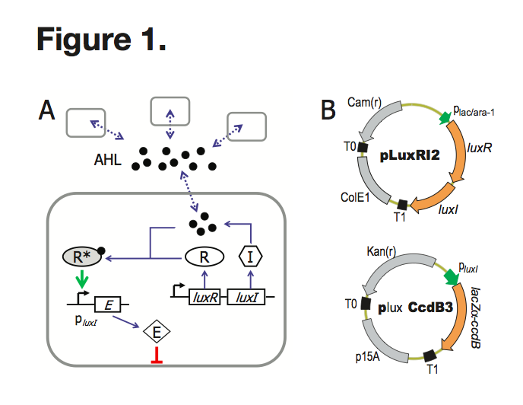
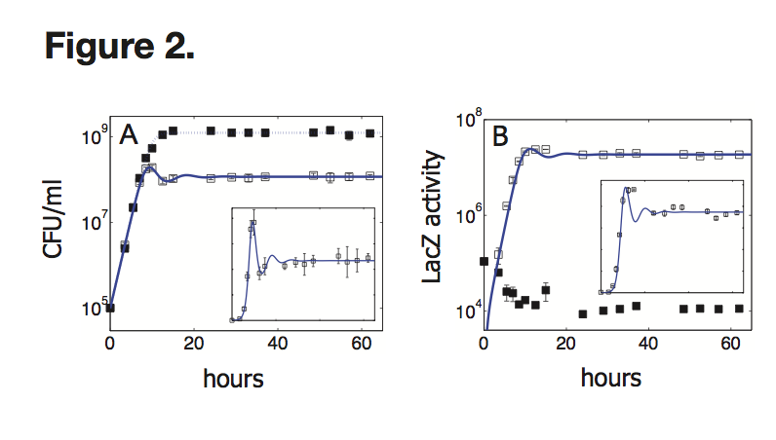
Circuit example: growth and expression

Slide 13
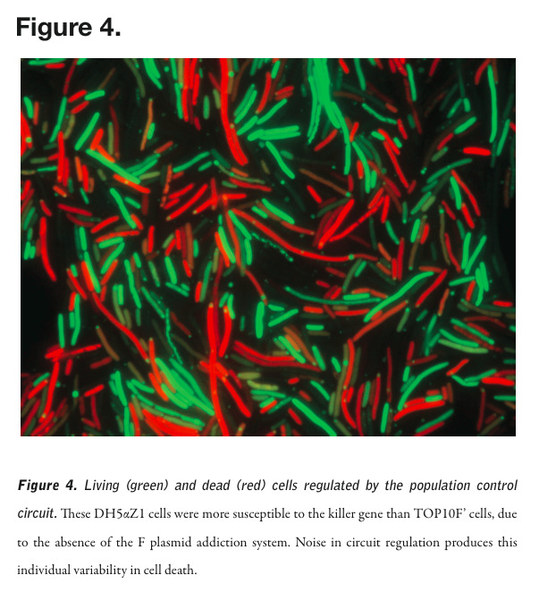

Slide 14
Transcriptomics

Slide 15
Translation Atlases

Slide 16
Flourescent proteins

Slide 17
Luminescence

Slide 18
Gene Regulatory Functions as Transfer Function Formalisms
fold change
Michaelis function
The Hill Approximation
Piecewise Linear
Savageau

Slide 19
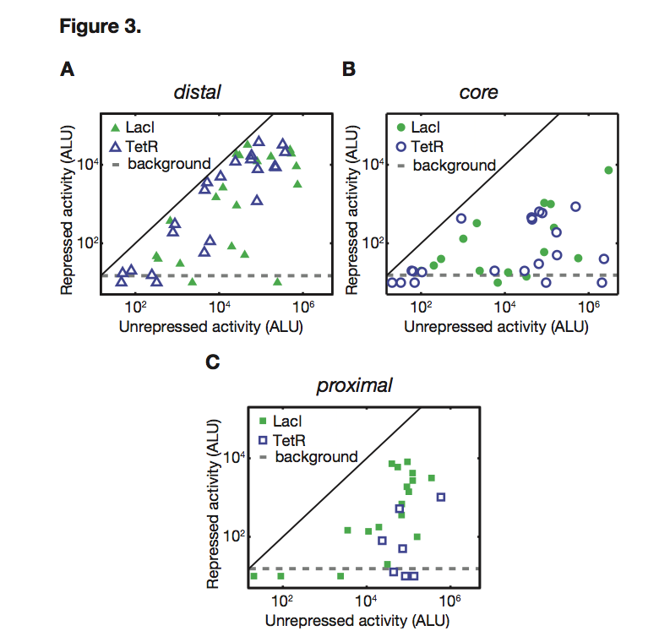
fold change: repression

Slide 20
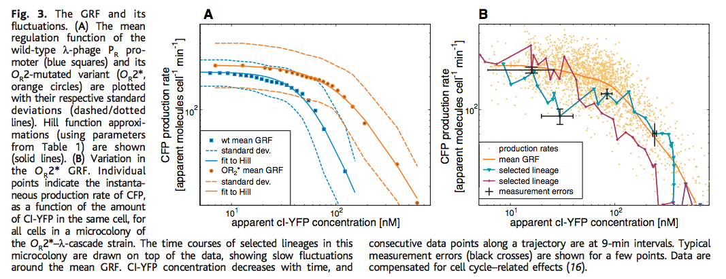
Enzyme kinetic models

Slide 21
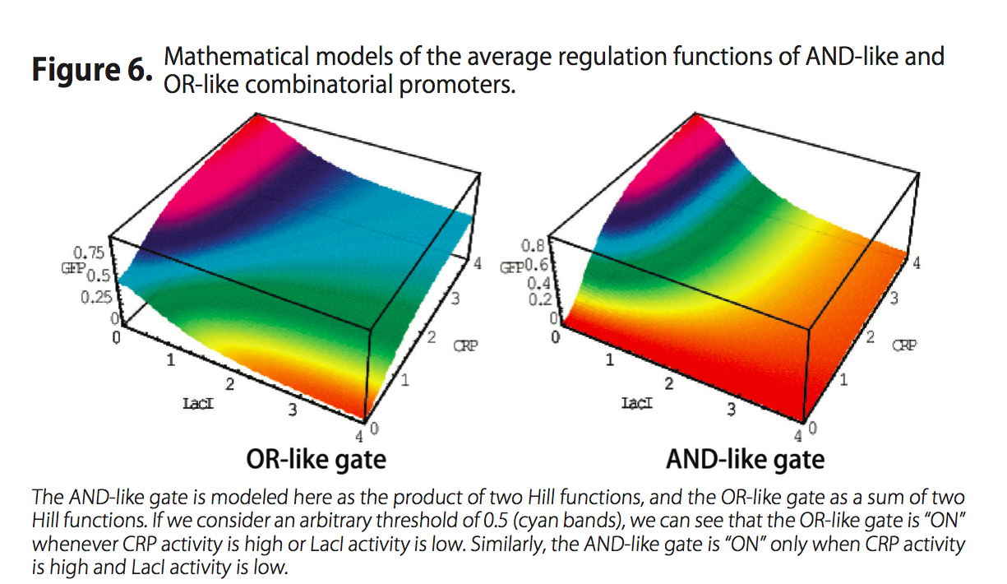
2-input hill

Slide 22
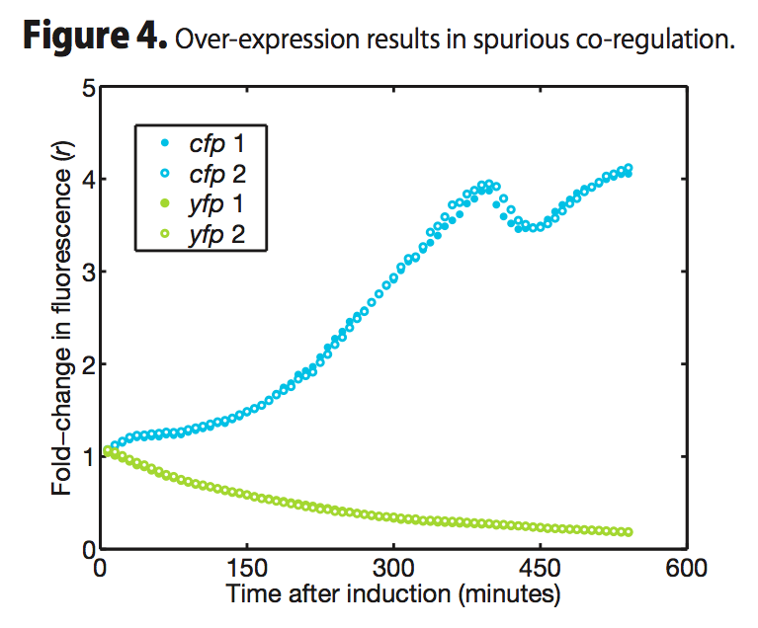
Linear

Slide 23
S-sytems

Slide 24
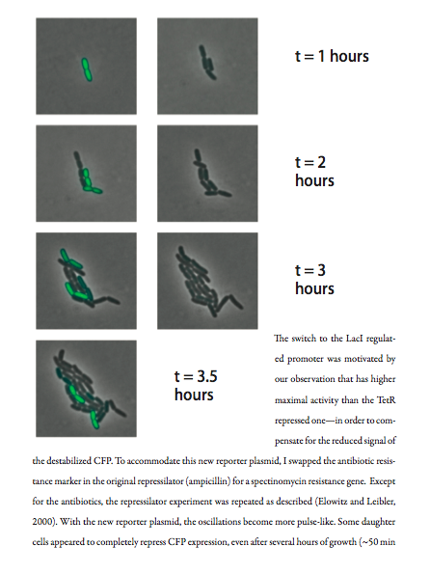
Stochastic Gene Expression
Induction of noisy genes
Single cell gene regulation function
Noise scanning of GRFs

Slide 25
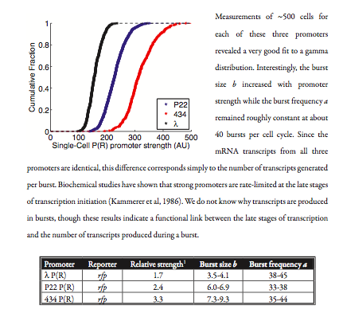
Induction noise

Slide 26
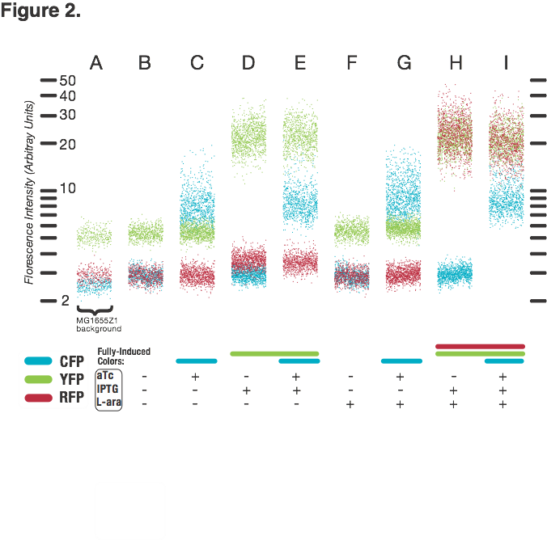
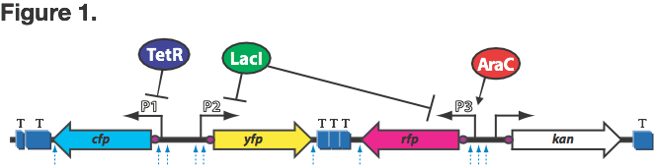
Induction noise

Slide 27
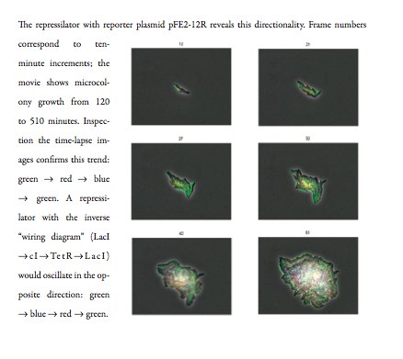
Noisy GRFs

Slide 28
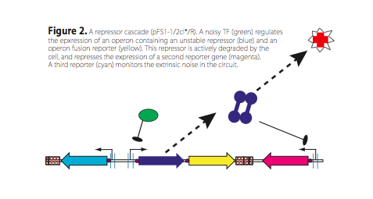
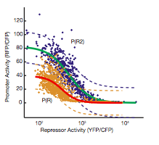
Noise scanning

