Slide 1
converter Function
table Class
sbol_methods Class
read_in_sheet Function
column Class
check_name function
helper_functions.py
column_functions.py
col_to_Num function
truthy_strings Function
initialise_functions.py
converter_function.py
June 11, 2021

Slide 2
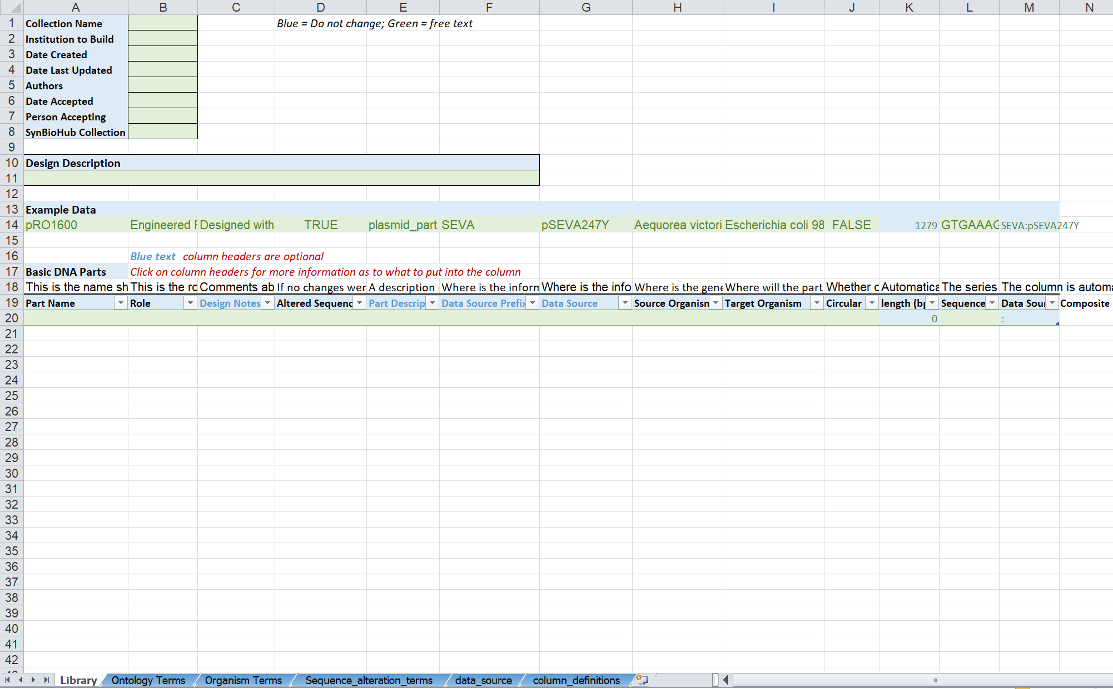
Overview Information
Design Description
Part Table
Column Definitions sheets
Library sheet
Ontology sheets

