Slide 1
tableaukiller
File created on: 30.11.20 16:28:04 GMT+01:00

Slide 2
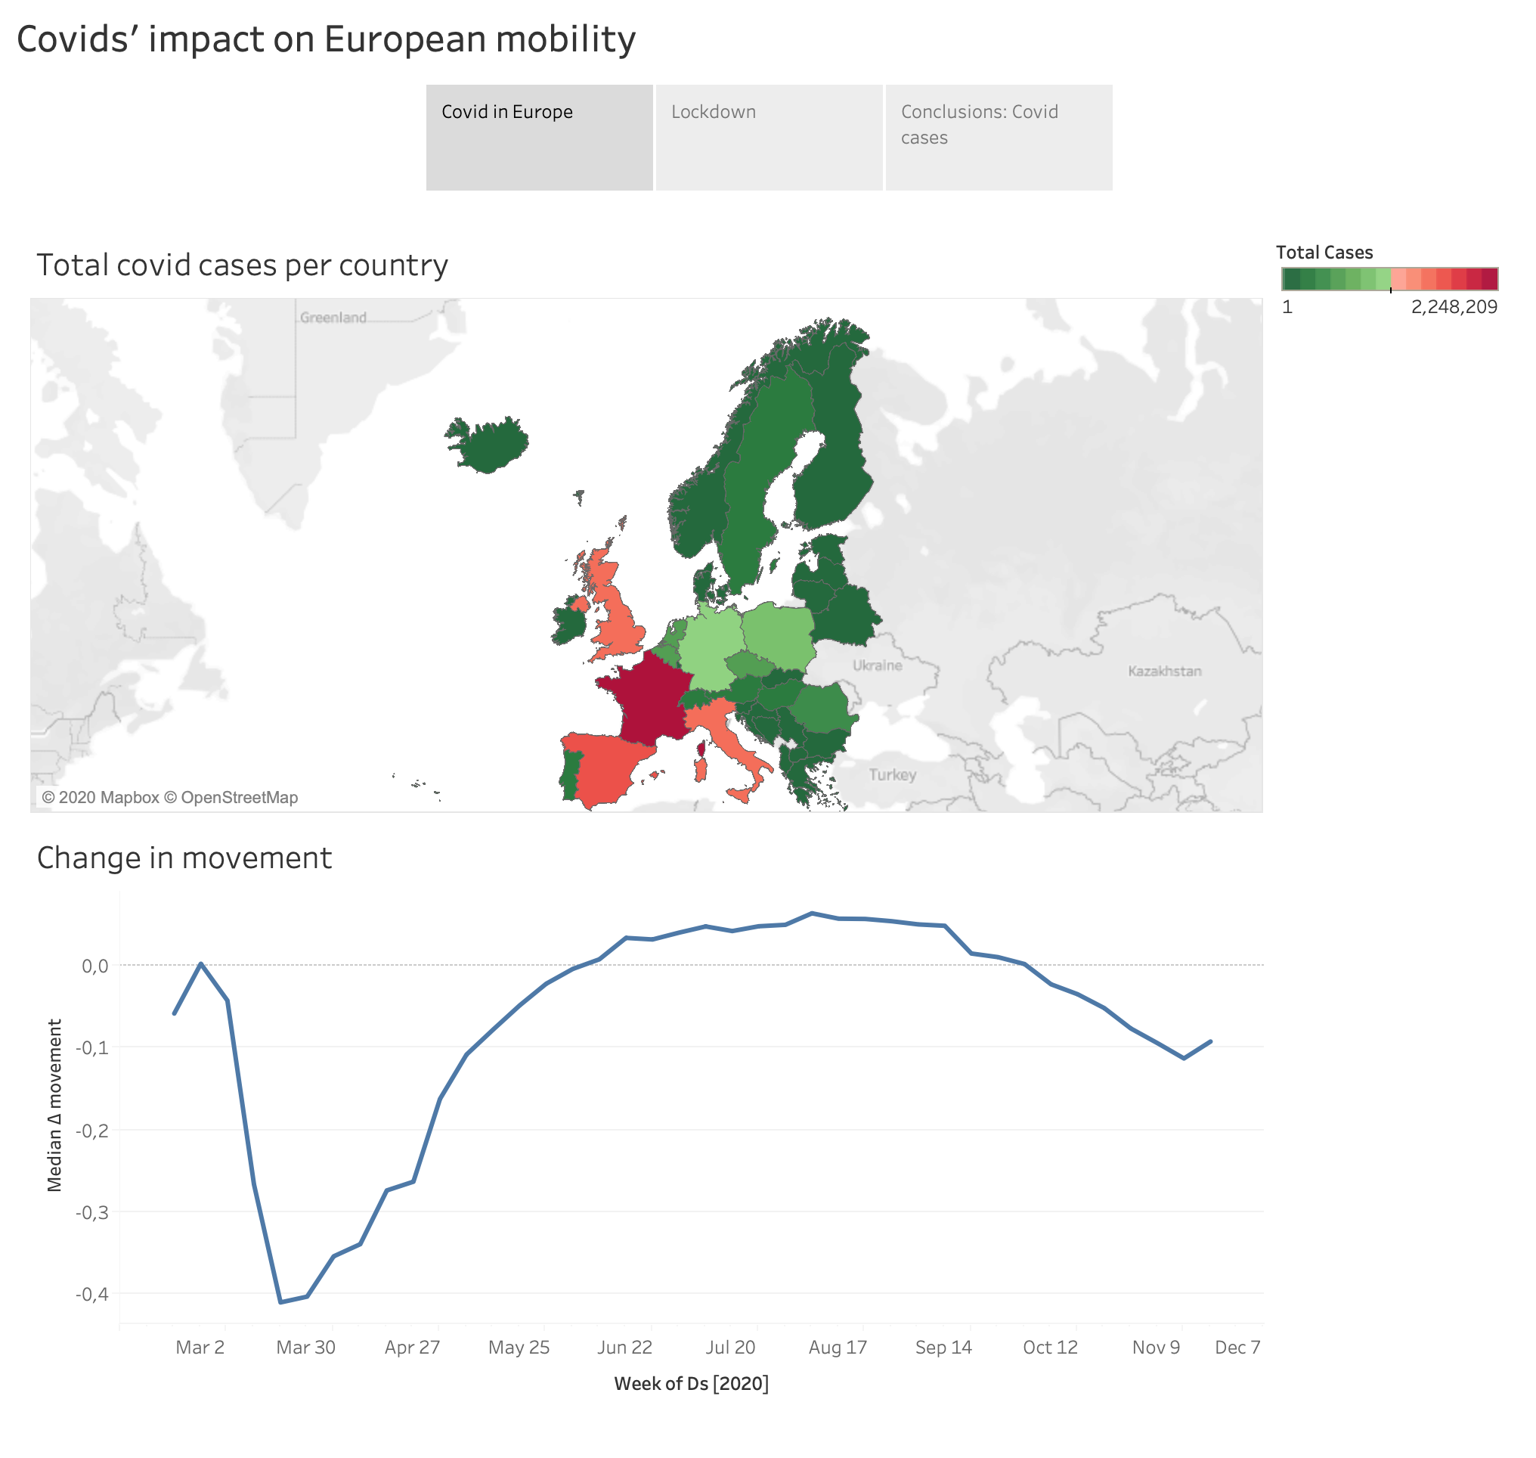

Slide 3
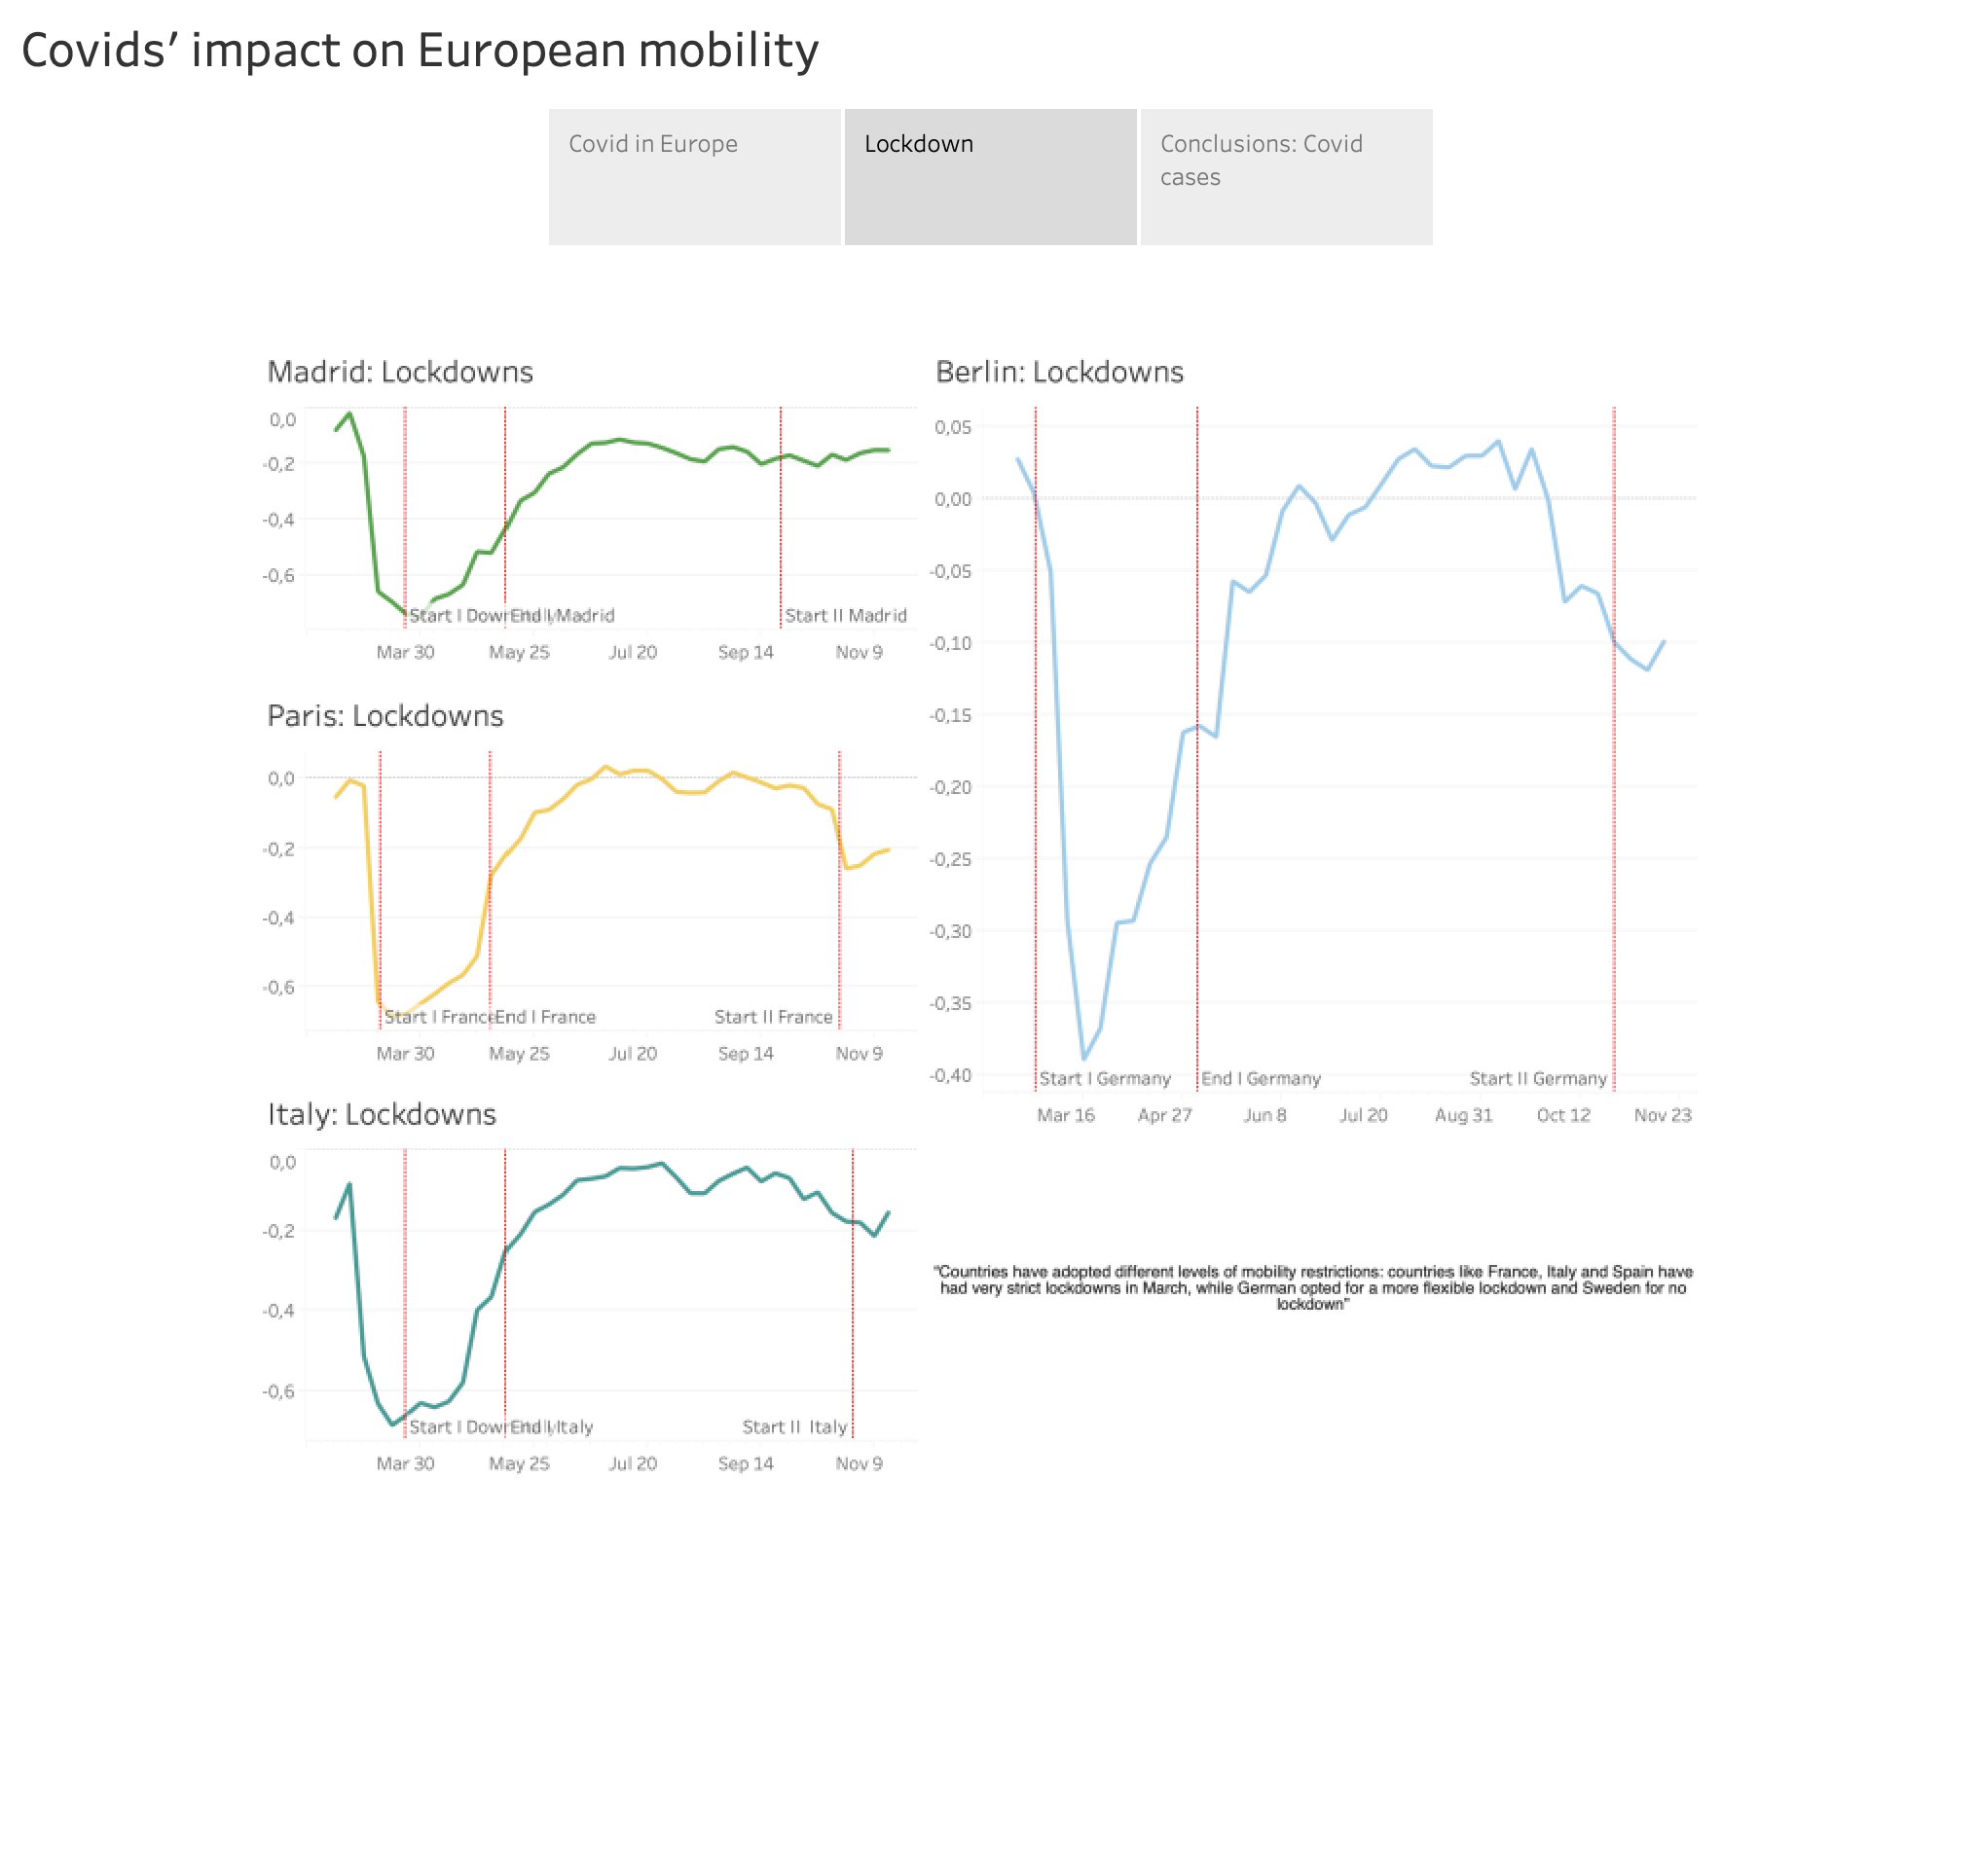

Slide 4
