Slide 1

LensHH-LT
GPU Pre-Screen Architecture
Value-only Multistart sieve, CPU analytic LM polish
Release
LensHH-LT 1.0.115
June 4, 2026

Slide 2
A map for this deck — three flowcharts
Three flowcharts from the LensHH-LT user guide do the heavy lifting in this talk.
Multistart, CPU-only — the baseline Basin-Hopping loop every release before 1.0.115 ran
Inside one trial: HJ-LM — what each Multistart trial actually does on the CPU
Multistart with GPU pre-screen — what changes in 1.0.115
We walk the three diagrams first, then unpack the GPU mental model: one CUDA thread per candidate lens
All three diagrams live in docs/optimization.md and the User Guide PDF.

Slide 3
Basin Hopping is the bottleneck of lens design
Local LM converges in seconds — lens design is a global problem.
The wall-clock budget of a real design session is dominated by Basin Hopping (Multistart + Metropolis acceptance) — the exploration of design space
Every accepted basin can re-anchor the search; every rejected basin still cost a full HJ-LM polish on the CPU
The fundamental design choice (Cooke vs double-Gauss vs split-flint) is made during exploration. Everything downstream is refinement
Speeding up Basin Hopping = speeding up the actual day-to-day work of a lens designer

Slide 4
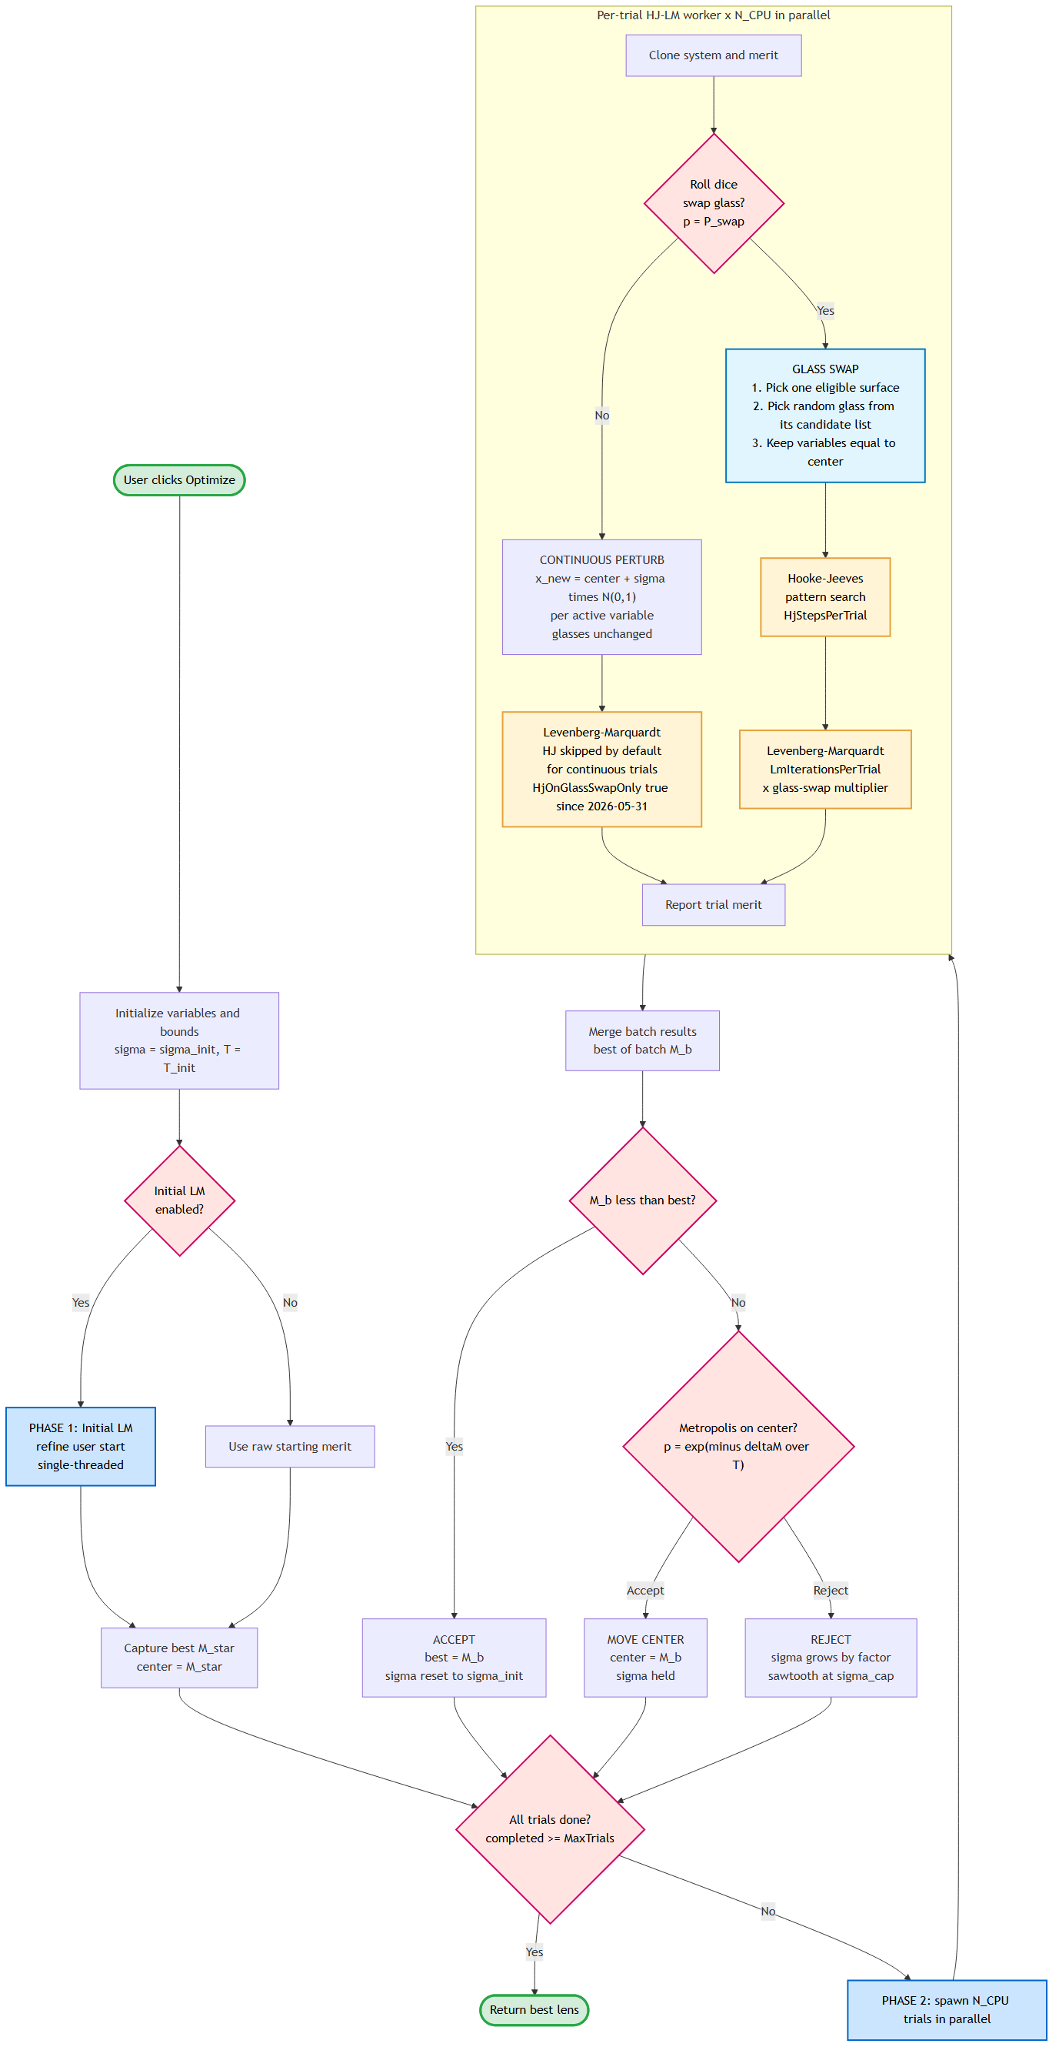
Multistart today: the CPU-only baseline
Same outer Basin-Hopping loop every release before 1.0.115.
Phase 1: initial LM refines the user start
Phase 2: spawn N_CPU trials in parallel — every trial is a full HJ-LM polish
Each trial is expensive: a typical 20-surface multi-field polish ~80 ms times LM iterations times N_CPU cores
Merge, accept best-of-batch or run Metropolis, then loop
Throughput is bounded by HJ-LM cost times core count — the number of basins you can try in a fixed wall-clock
1_multistart.mmd in docs/build/diagrams/

Slide 5
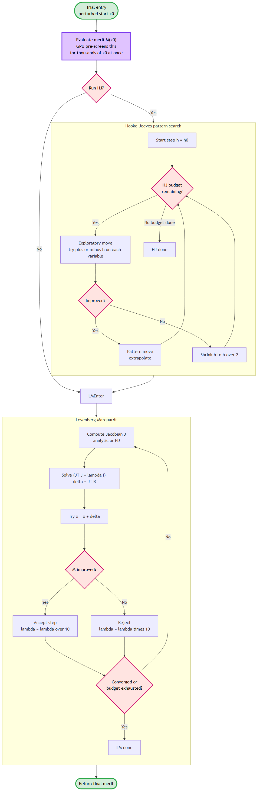
Inside one trial: HJ-LM
What each Multistart trial actually does on the CPU.
Each trial clones the system, rolls a glass-swap dice, then perturbs continuous variables
Glass-swap trials get Hooke-Jeeves pattern search PLUS Levenberg-Marquardt (HJ helps escape sharp local minima from the swap)
Continuous trials run LM only — HJ is skipped by default since 2026-05-31
LM with analytical Jacobian (1.0.115) drops the per-iteration cost ~4x vs FD — that win compounds across every trial
2_hj_lm.mmd in docs/build/diagrams/

Slide 6
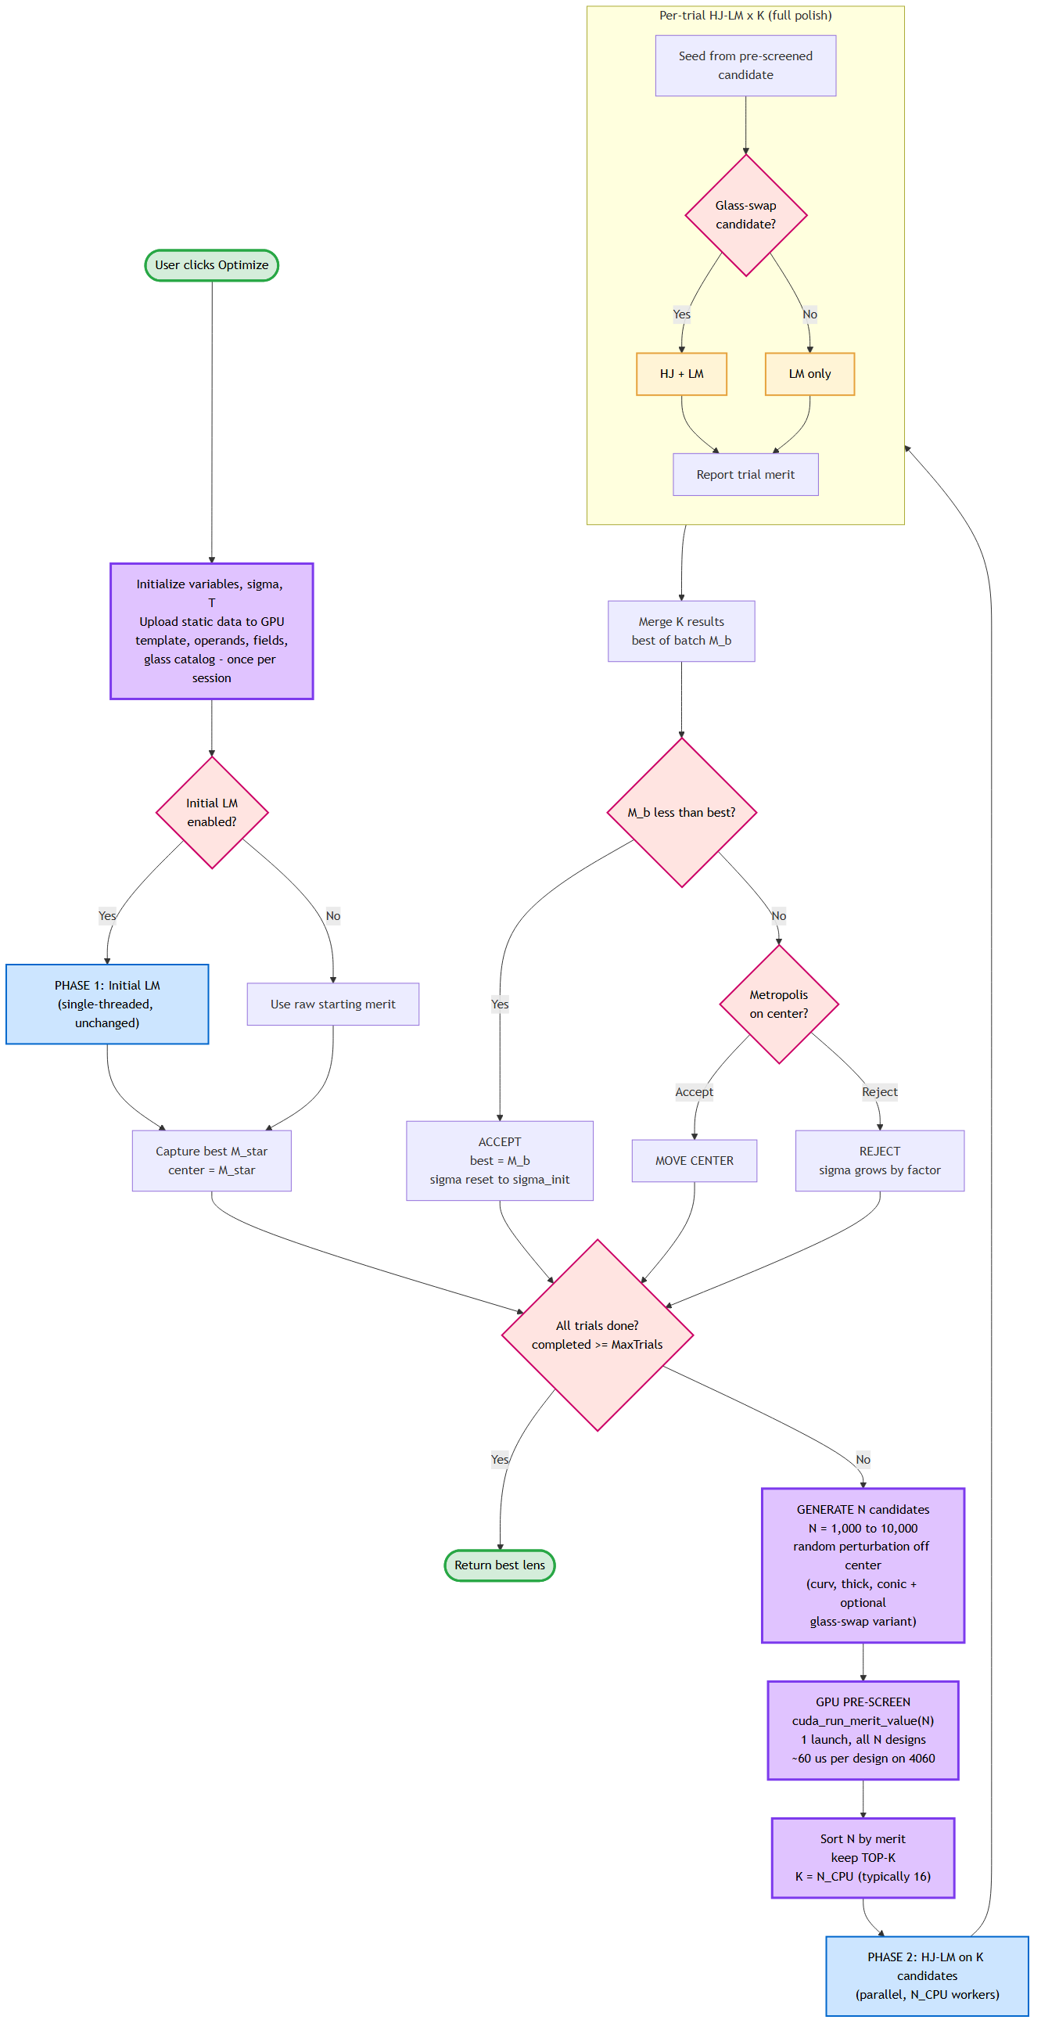
Multistart with GPU pre-screen — 1.0.115
Same outer loop. One stage added between candidate generation and HJ-LM polish.
GENERATE N = 1,000 to 10,000 candidates — much wider than the CPU could ever polish
GPU PRE-SCREEN: one CUDA launch, full merit value per candidate, ~60 us per design on a 4060
Sort by merit, keep top-K (K = N_CPU, typically 16 to 64) — the rest are abandoned
CPU HJ-LM polish runs only on the survivors — same cost as before, applied to better candidates
3_gpu_prescreen.mmd in docs/build/diagrams/

Slide 7
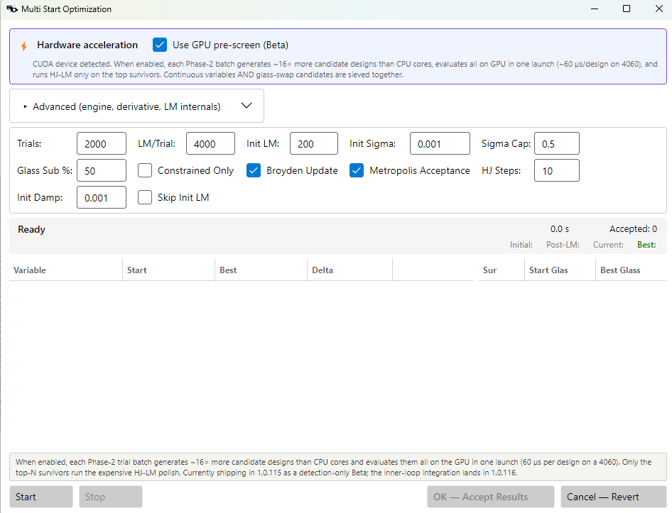
How it looks in 1.0.115
The GPU pre-screen toggle in the Multistart dialog — Beta-labeled, auto-disabled when the design uses features the GPU kernel does not cover.
Engine / Derivative controls sit alongside the Hardware acceleration strip
GPU pre-screen toggle defaults ON when a CUDA device is detected and the active design is GPU-eligible
Auto-disables with a visible reason when it cannot help (aspherics today, certain multi-config layouts)
Same dialog, same workflow as before — pre-screen is an additive option, never a behavior change
Beta in 1.0.115 — surface will harden as we collect production feedback.

Slide 8
The shift: wider exploration in the same wall-clock
Pre-screen cost is ~1000x cheaper per candidate than HJ-LM polish.
Pre-screen ~60 us per candidate on GPU vs HJ-LM ~80 ms per candidate on CPU
For the same wall-clock that CPU-only spent polishing K candidates, 1.0.115 can pre-screen 1,000K candidates AND polish the K best
CPU-only Basin Hopping was always picking the best-of-K random shots; 1.0.115 picks the best-of-1000K random shots, then polishes those
The exploration radius around the current center grows because we sample more before committing budget
Same Metropolis acceptance, same convergence guarantees — just a wider net cast at each step

Slide 9
Every lens is a thread
The CUDA mental model behind the pre-screen kernel.
CUDA grid: gridDim = (N candidates), one thread per candidate design
Each thread loads only its own variables — curvature[V], thickness[V], conic[V], material_ids[N_surfaces]
All threads execute the SAME code: the whole evaluate_merit value path
Session-persistent device data shared by all threads: glass catalog, fields, operands, merit template
Thread divergence is data-driven, not code-driven — same instructions, different lens

Slide 10
How big is the batch, and how fast does it run?
Each lens is a thread. The per-SM concurrent thread budget is FUNCTION-DEPENDENT — set by register and shared-memory pressure per thread.
evaluate_merit is register-heavy (ray trace + refraction + operand scratch per thread): 256 concurrent threads per SM is the practical budget — well below the hardware's theoretical 1,536-2,048
Resident-thread budget per launch = N_SMs x 256:
RTX 4060 (consumer): 24 x 256 = ~6,100 resident lenses (one wave)
A100 80GB (data center): 108 x 256 = ~27,600 resident lenses — about 4.5x wider wave than 4060
H100 SXM5 (data center): 132 x 256 = ~33,800 resident lenses — about 5.5x wider wave than 4060
Launching more candidates than one wave is fine — extra warps queue and run as later waves; the SM never idles. The 256 number is wave width, not the launch cap.
Throughput follows the total FP64 TFLOPS ratio. 4060 = 0.24 TFLOPS, A100 = 9.7 TFLOPS, H100 = 34 TFLOPS. evaluate_merit is FP64-compute-bound (sin / cos / sqrt / division per ray, state lives in registers), so wall-clock scales close to the TFLOPS ratio — memory bandwidth (~7x A100, ~12x H100) sets a floor but does not bind here.
A100 vs 4060: ~40x throughput — process ~40x more lenses per second, or finish the same batch in ~1/40 the time. H100 vs 4060: ~140x throughput.
Net effect: A100 finishes the same Multistart loop ~40x faster than 4060, OR covers ~40x more candidates in the same wall-clock minute. H100 pushes that to ~140x. The 4.5x wider wave on A100 is HOW it gets there — not a separate factor on top.

Slide 11
Why filling GPU occupancy matters
Memory latency is hidden by parallel work, not by faster cores.
Global memory access takes ~400 to 800 cycles to return on a GPU — much longer than a CPU cache miss
A stalled thread is invisible if the SM can swap in another warp (32 threads) that is ready to run
Each SM needs MANY resident warps to keep its execution units fed — that is the definition of "occupancy". At 256 concurrent threads per SM we get 8 warps in flight per SM — enough to overlap typical memory latency
Under-occupied launches (a few candidates per SM, not a few thousand total) leave SMs idle on memory stalls — wasted silicon, no speedup vs CPU
Multistart's natural width — 1,000 to 10,000+ random candidates per outer iteration — saturates a consumer 4060's ~6K-thread budget and starts to make the A100's ~28K-thread budget worth paying for
Rule of thumb: launch enough candidates to fill the function-specific concurrent budget. Wider Multistart loops = better GPU utilization = closer to the FP64 ceiling.

Slide 12
What runs on the device
Whole evaluate_merit value path, ported to __device__ via LENSHH_HD header refactor.
About 1,560 lines of merit-eval code — paraxial, refraction, surface intersection, ray trace, robust ray-aim, exit-pupil trace, every operand family
Bit-equal to the CPU value path by construction — same source, just compiled for the device
Validation: representative imaging lenses (Cooke triplet at 6 surfaces, complex multi-element designs at 20+ surfaces) both produce delta = 0 vs CPU evaluate_merit
No derivatives, no Duals, no Jacobian — pure scalar value path
Phase G1.C: 10 slices, ~2,100 device lines, bedrock 134/134 native tests green throughout.

Slide 13
Glass swap is a single int
Discrete glass substitutions ride alongside continuous perturbations in the same launch.
Device-side glass catalog stored once per session: K_glasses x W_wavelengths refractive-index table
Each candidate carries a material_ids[N_surfaces] int32 array — one int per surface
Swapping N-BK7 for N-SK16 on surface 3 changes ONE int — no host->device transfer, no re-upload
A single batched launch can mix continuous candidates with glass-swap variants
Combinatorial coverage of geometry x glass that single-trial CPU never had the budget for

Slide 14
Why value-only? Why not GPU Jacobian?
Use each piece of silicon where it wins.
Consumer GPU FP64 throughput is the binding constraint: ~0.23 TFLOPS on a 4060
CPU AVX2 FP64 is comparable or better for sequential dual-number derivative work — about 0.8 TFLOPS
CPU analytic Jacobian on a typical multi-field merit is already 13 ms (4x faster than FD)
GPU comparative advantage is WIDTH — thousands of independent candidates, not narrow derivative chains
GPU for pre-screen breadth, CPU for analytic LM depth
A100 raises the FP64 ceiling — a full-LM GPU port becomes attractive on data-center hardware. Open question, not a 1.0.115 promise.

Slide 15
GPU FP64 landscape — consumer to data center
Why "value-only" is the right architectural choice for consumer GPUs — and what scales on A100 / H100.
Model | SMs | FP32 (TFLOPS) | FP64 (TFLOPS) | Memory | Bandwidth
RTX 4060 (desktop) | 24 | 15.1 | 0.24 | 8 GB GDDR6 | 0.272 TB/s
A100 80GB | 108 | 19.5 | 9.7 vector / 19.5 tensor | 80 GB HBM2e | 2.0 TB/s
H100 SXM5 | 132 | 67 | 34 vector / 67 tensor | 80 GB HBM3 | 3.35 TB/s
H200 SXM | 132 | 67 | 34 vector / 67 tensor | 141 GB HBM3e | 4.8 TB/s
B200 | 148 | 70-80 | 40 tensor | 192 GB HBM3e | 8 TB/s
B300 | 148 | high | 1.4 (FP64 gutted) | 288 GB HBM3e | 8 TB/s
Consumer 4060 FP64 ~0.24 TFLOPS, data-center A100 vector FP64 ~9.7 TFLOPS — a ~40x ceiling lift. Note Blackwell B300 explicitly gutted FP64 for AI workloads.

Slide 16
FP64 per dollar — what each tier actually costs
Throughput-per-dollar drives the deployment decision. Cloud rental is where the real lever is.
Model | Vector FP64 | Buy (USD) | FP64 / $1k | Cloud $/hr | FP64 per $/hr
RTX 4060 | 0.24 | 300 | 0.80 | 0.15 | 1.6
A100 80GB | 9.7 | 10,000 | 0.97 | 1.50 | 6.5
H100 SXM5 | 34 | 28,000 | 1.21 | 2.50 | 13.6
H200 SXM | 34 | 32,000 | 1.06 | 3.70 | 9.2
B200 | 20 (est) | 35,000 | 0.57 | 5.50 | 3.6
B300 | 1.4 (est) | 40,000+ | 0.035 | n/a | n/a
Cloud H100 at $2.50/hr buys the most FP64 per dollar-hour. Buying a 4060 for a developer desk still gives surprisingly good FP64 per dollar.

Slide 17
Measured throughput
Where 1.0.115 lands on real fixtures.
Consumer 4060 (24 SMs, sm_89): about 2x end-to-end Multistart speedup across a representative range of imaging lenses (6 to 20+ surfaces)
Per-design value cost ~60 us — thousands of candidates per second on commodity hardware
CPU pieces (analytic LM, hybrid CT-family / TTRACK / span ops) keep their existing speed unchanged
A100 (data-center): code path is implemented end-to-end and expected to scale with FP64 throughput; cloud-test validation pending
Combined with the analytic-Jacobian + oversubscription fixes, 1.0.115 is the biggest end-to-end Multistart speedup the project has shipped

Slide 18
Summary
One mental model, three numbers.
Basin Hopping (Multistart + Metropolis) dominates the wall-clock of a real lens-design session
Every lens is a thread — N candidate designs evaluated in one CUDA launch
GPU runs the whole merit function VALUE — no derivatives, no Jacobian
CPU does the analytical Jacobian during HJ-LM polish on the top-K survivors
Net effect: same Basin-Hopping loop, but the exploration radius widens by ~1000x for the same wall-clock

