Slide 1

LensHH-LT · MeritEvalBench
Merit-Function Throughput
Across CPUs and GPUs
Eight systems · three lenses · one bit-identical kernel
June 2026

Slide 2
Eight systems, one binary
From a fanless laptop to an H100 — the same MeritEvalBench, the same engine.
System | CPU | GPU | GPU arch (SMs) | Mem BW
Laptop | Core i7-1255U (12T) | — (Iris Xe) | — | —
MacBook Air | Apple Silicon (ARM64) | — (integrated) | — | —
Mini-desktop | Ryzen 3 5300G (8T) | — (Radeon) | — | —
Desktop | Core i5-13400F (16T) | RTX 4060 | Ada sm_89 (24) | 272 GB/s
Workstation | Ryzen 7 9800X3D (16T) | RTX 5070 Ti | Blackwell sm_120 (70) | ~896 GB/s
Cloud | 16 vCPU | A100 40GB | Ampere sm_80 (108) | ~1.55 TB/s
Cloud | 24 vCPU | H100 80GB | Hopper sm_90 (132) | ~3.35 TB/s
Cloud | 28 vCPU | RTX PRO 6000 | Blackwell sm_120 (188) | ~1.79 TB/s
Linux / Windows / macOS · GPU via prebuilt native cubin (sm_80/89/90/120) — no CUDA toolkit on the target machine.

Slide 3
Three test lenses
Small to large merit functions — the GPU advantage grows with merit size.
▸ triplet1 — Cooke triplet, 8 surfaces, 12 variables. Light merit: 7 operands → 240 expanded.
▸ Tanabe1 — imaging lens (US 12,321,041 B2, Example 2), 21 surfaces, 36 variables. WAVEX wavefront-error operand on Forbes quadrature, 6 rings × 12 arms: 8 operands → 241 expanded.
▸ Tanabe2 — same lens and WAVEX, plus a SENS sensitivity operand for manufacturability. SENS perturbs every surface, expanding the merit to 8 operands → 4,686 sub-operands — ~19× more work per evaluation.
▸ All three — 3 wavelengths, 3 fields, infinite conjugate; the identical merit runs on every system.
Tanabe lens: Tanabe et al., U.S. Patent US 12,321,041 B2 — Example 2. Operand counts from MeritEvalBench expansion (n operands → m expanded).

Slide 4
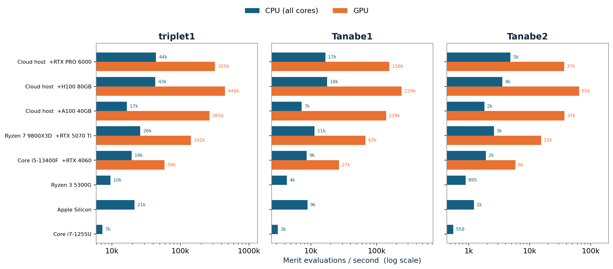
Merit evaluations per second — CPU vs GPU
Every lens is a GPU thread; the device evaluates thousands of designs at once.
CPU = best all-core throughput (C# / C++). GPU = whole-merit value kernel at device-fill. GPU output bit-identical to CPU (|GPU−CPU| ≤ 6.6e-14) on every card.

Slide 5
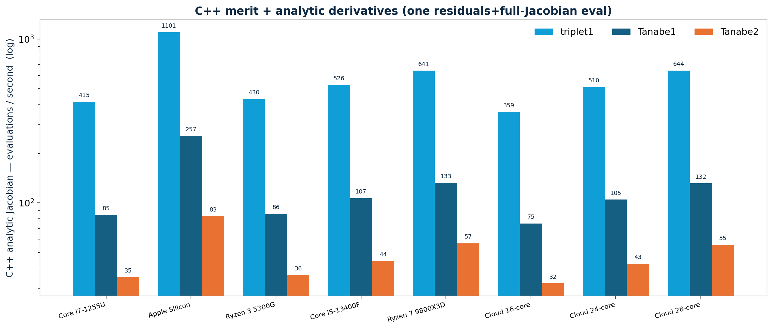
C++ merit + analytic derivatives
Residuals and the full Jacobian in one pass — the CPU optimizer's hot path.
One evaluation = residuals + full Jacobian via forward-mode dual numbers (analytic). Runs on the CPU; the GPU path is value-only.

Slide 6
What the numbers say
One mental model, portable everywhere.
▸ Bit-identical everywhere — the same kernel runs on laptop, desktop, Apple Silicon and datacenter; CPU and GPU agree to the FP64 noise floor.
▸ Bandwidth-bound, not FP64-bound — consumer Blackwell ≈ A100 despite ~14× less FP64; throughput tracks memory bandwidth.
▸ The GPU win grows with merit size — exactly where real lens-design optimization spends its time.
▸ Native cubin, instant launch — sm_80/89/90/120 prebuilt; the RTX 5070 Ti ran with no SDK installed, no first-run JIT.
▸ C++ analytic Jacobian — residuals + full Jacobian in one pass keeps the CPU LM polish fast across every machine.

