Slide 1
A Full Caterpillar Robotic Vehicle Design
Dequn Teng, BEng in Computer Science and Electronic Engineering
University of Liverpool (Self Proposed)

Slide 2
C O NTENTS
Introduction
Literature Review
Methodology
Results and Discussion
Conclusion

Slide 3
/ 01 Introduction
Background
Objectives

Slide 4
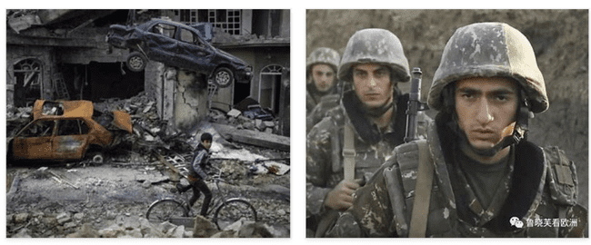
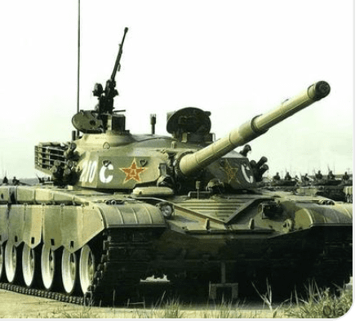
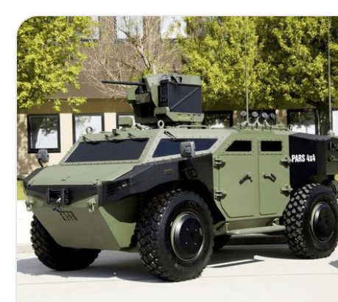
Introduction
Background
Street war is more often, and large scale war is less.
2020 War between
Azerbaijan
Armenia
Side attack is dangerous
Current armored vehicles look at the front
Current armed vehicle is not adapted to street war.
Group Operations
Each at their own way
Objectives
If the Group Operations together
Tank and traditional armored vehicles focus on the front

Slide 5
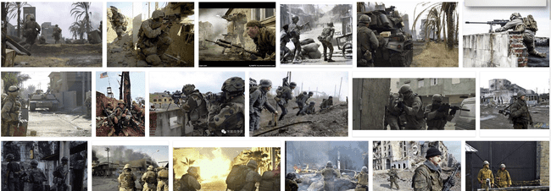
Street War
Is increasing important as the large scale war conflicts are less likely

Slide 6
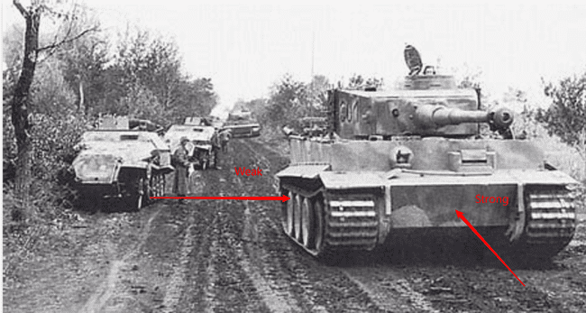
Side attack is dangerous
Most advanced Defensive Armor is in the front
Side attack is also needed
Especially in the city street scenarios
Example
Tiger Tank
Strong at the front
Weak at sides
Attacked by sides
Caused damages
World War II
Not adapted to street war scenarios
Where attacks are from the side street
Of the city

Slide 7
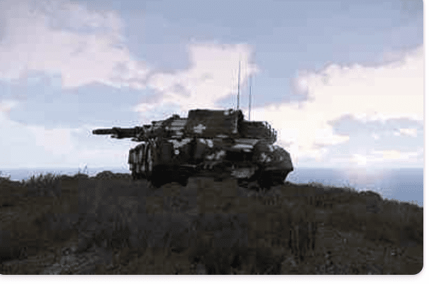
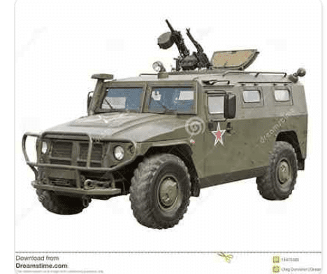
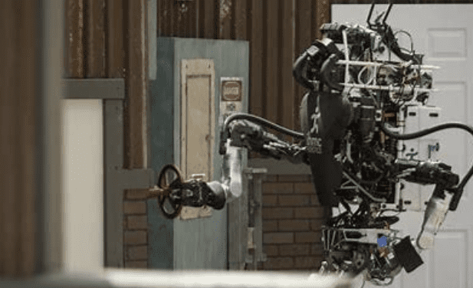
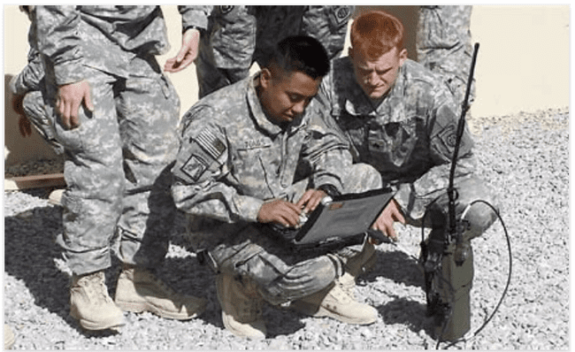
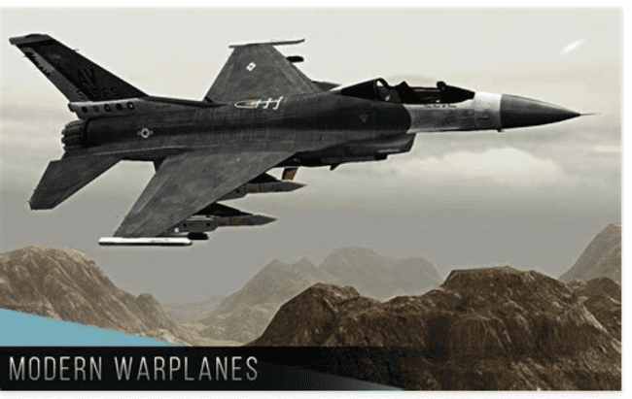
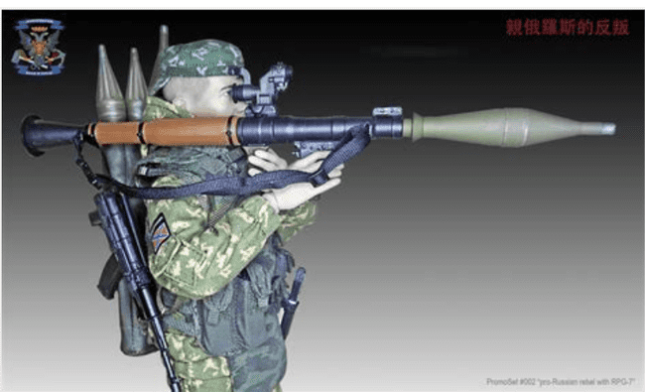
Group Operation with current design
Tank
Armed Car
Communication Station
Planes
RPGs
Automatic Robotics

Slide 8
Need a Robotic Vehicle Design for Street War Scenarios

Slide 9
/ 03 Literature Review

Slide 10
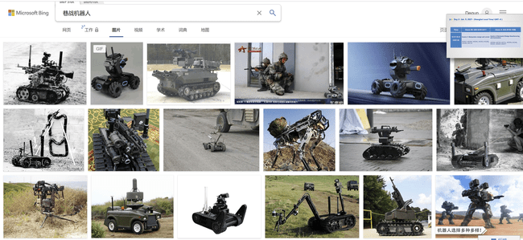
Current Street War Robtics

Slide 11
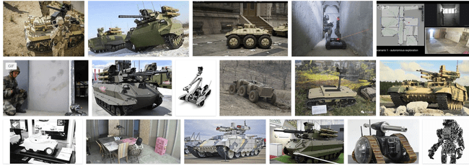
Focus on the front still
The main attack comes from the sudden attack on the side
The soldiers are easily attacked in streets
The tank can not change their position easily
The armed vehicle is exposing the soldiers to the enemy
The plane is hard to accurate identify targets at the street war scenarios
The RPG can be attached to the current vehicle design

Slide 12
/ 03 Methodology

Slide 13
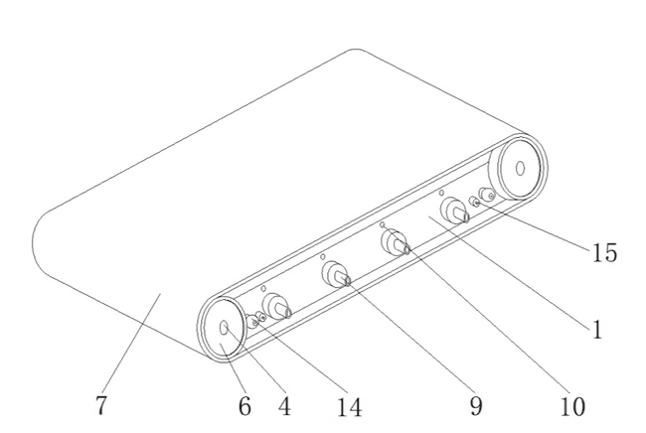
System Design Part 1
1, carriage;
2, engine;
3, first gear;
4, rotating shaft;
5, second gear;
6, active wheel;
7, track;
8, fuel tank;
9, flame injector;
10, fuel inlet;
11, communication module;
12, processor;
13, ESC;
14, camera;
15, infra-red sensing camera;
16, fuel quantity sensor.

Slide 14
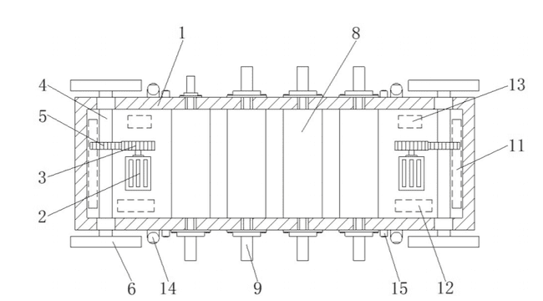
System Design Part 2
1, carriage;
2, engine;
3, first gear;
4, rotating shaft;
5, second gear;
6, active wheel;
7, track;
8, fuel tank;
9, flame injector;
10, fuel inlet;
11, communication module;
12, processor;
13, ESC;
14, camera;
15, infra-red sensing camera;
16, fuel quantity sensor.

Slide 15
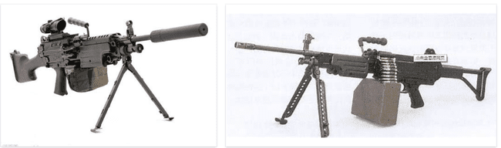
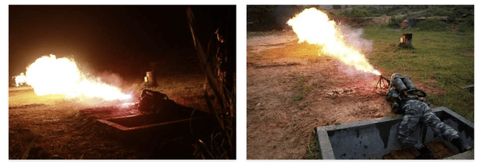
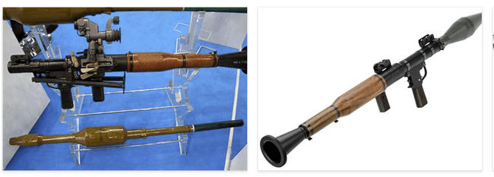
Equipped Weapons
RPGs
Machine Gun
Flamethrower
And so forth..

Slide 16
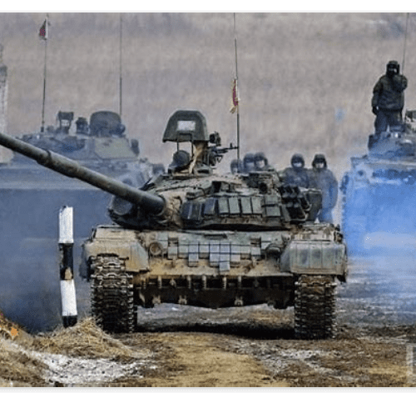
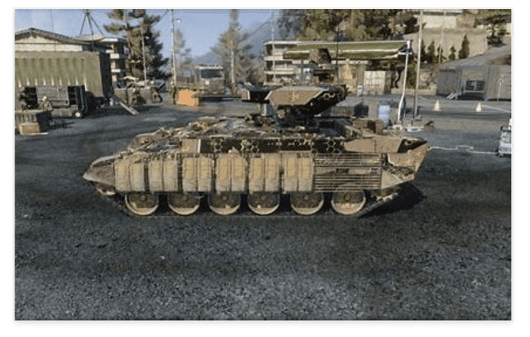
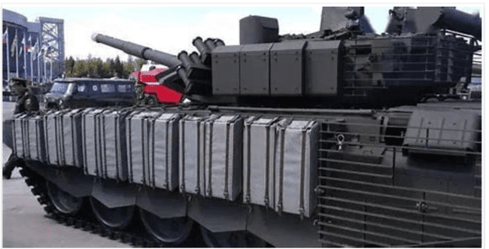
How about defence?
Anti-explosive armour
The moment the rocket attaching the vehicle
The anti-explosive armour will expose in reducing the effects of the attacking rocket.

Slide 17


Research outcome
Invention patent application applied with the protection under the national intellectual property administration PRC.

Slide 18
/ 04 Discussion

Slide 19
Discussion
A new age urban street fighting tracked vehicle to quickly eliminate enemy forces: the Fire Centipede. This flame-tracked vehicle is intended for use in urban street battles, where the opponent uses guerrilla tactics and we use scorched-earth tactics. The vehicle’s use strategy is to set the maximum distance the vehicle can travel and the distance it can return,
start the vehicle, and execute scorched earth tactics[26]. The vehicle is equipped with a vehicle-mounted camera, which can provide information about the status of the battlefield and allow the remote control personnel to control the flame spray according to the actual situation on the battlefield. The vehicle is equipped with a depth camera, based on the depth of field algorithm to calculate the distance to the target, control the flame spray distance to achieve the destruction of targets.
Based on communication module: use 2.4G or 5.8G or mili- tary communication band to communicate [27], processor stem 32 [28] (should be near the attachment of the communication module): the user processes the instructions issued by the commander, if you want to add a deep learning platform, you can use TX2 or NVIDIA nano[29], [30], ESC: the instructions received from the processor can be converted into instructions that the engine can understand, the fuel tank provides the flame thrower with Energy, flamethrower, destroys the opponent’s living force, can be started with a motor or a conventional fuel engine. The engine, receives commands from the processor to spin.
Altering the car provides two methods of attack:
1. Control of the associated flamethrower via a remote sensing module;
2. Designing the object to be identified at the start, e.g. (with a living organism), pattern recognition via the onboard depth camera and infrared sensing camera, and if successful, attack. The vehicle provides two return modes: 1. remote return;
2. designing an automatic return path via a fuel sensor or a power sensor.
In short, we offer that a full tracked vehicle is available and can greatly increase the dominance of the battlefield.

Slide 20
Future Work
Detailed Specifications
Currently, we are only introducing a basic framework for the corresponding robotic vehicle design. However, there are not too many descriptions about which materials should be applied to which sections in utilizing the best possible efforts for the overall performance of this full caterpillar robotic vehicle design. Further knowledge gap should be fulfilled with more domain-specific knowledge in material science to material in the comprehensive demonstration.
Simulation Modelings
With more theoretical verifications and detailed specifi- cations, it is laid a solid foundation for the corresponding simulation such as the Gazebo, which is fully adapted to the Robotic Operating System (ROS) [31]. Based on the ordinary differential equation (ODE) described in the physics engine, it is easy to model the corresponding kinetic and dynamic characteristics of the system, which is for future implementation reference.
Prototype Verification
Along with the development of electronic engineering, such as the printed circuit board toolkit, together with the embedded system design such as Raspberry and Arduino. It is much easier to verify the ideas from scratch as a DIY project. For example, NVIDIA introduces the platform for the self navigational Autopilot car based on the Jetson Nano platform and the 3D printing toolkits with the CAD files open-source on the public [32].
Cooperation between chariots
Since this design focuses on flanking firepower, the future design in collaboration between conventional artillery with this artillery could be modeled using Metacellular automata and Graph Theory Algorithm.

Slide 22
THA NKS
Dequn Teng
dequn.teng@gmail.com

