Slide 1
Search Strategy
Dequn Teng

Slide 2
Outline
Database
Search String
Keywords and synonym
Constructed Formula
Filter
Search Strategy
Result
Time based analysis
Patentee
Highly selected patent
Feedback

Slide 3

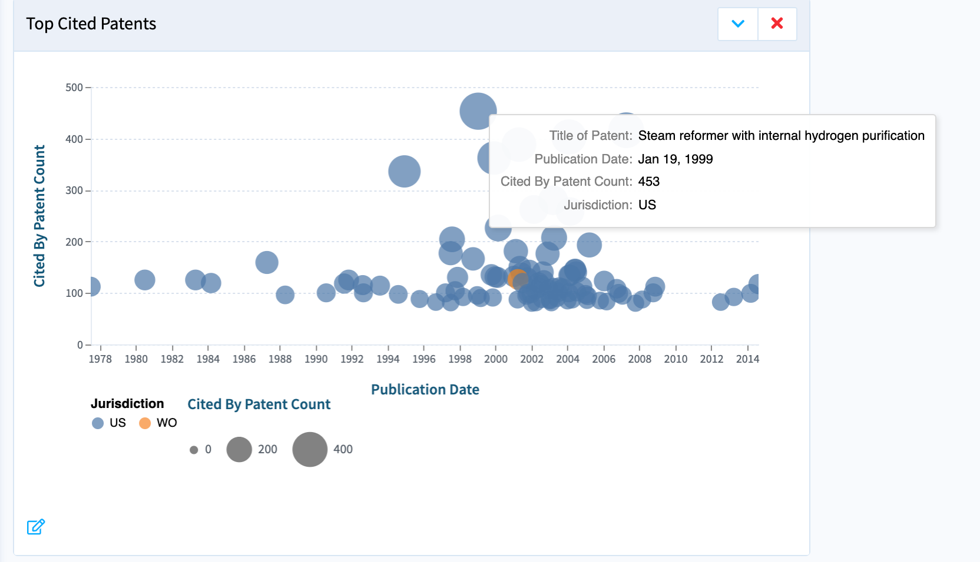
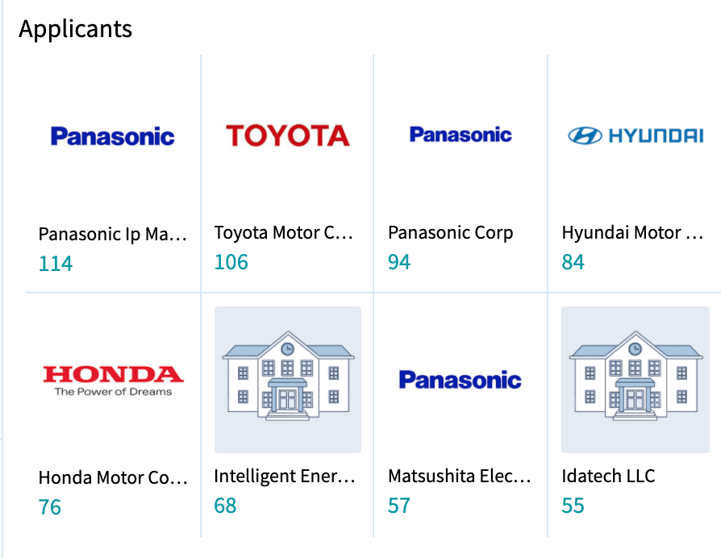
Database
Lens
https://www.lens.org/
Reasons
User Interface
Jurisdiction filter
Legal status filter
Easy script
Visualization
Patent owner
Highly cited patents
Free

Slide 4
Search String
Keywords and synonym
Constructed Formula

Slide 5
Keywords and synonym(Part I)
Hydrogen
Fuel
Cell
Vehicle
Hydrogen oxygen
H
HO
H-O
hydrogen gas
proton exchange membrane
H2
H oxygen
energy
powered
battery
electronic cell
Automobile
Boat
Car
Van
Truck
Plane
System
based system
system based
storage tanks
generator

Slide 6
Keywords and synonym(Part II)
inflammable
Fire
prevention
Confinement
Oxygen concentration
Burnable
Combustion
Flame
explosion gas
blaze heat
smoke Sparks
burst blast
proof*
Protection
Retardant
Extinguishing
Retarding
Resistance
stop

Slide 7
Constructed Formula
Keywords
AND
Synoyms
OR
Filter
Title
Abstract

Slide 8
Search Strategy
Search String
Keyword Decompose
Synonym
OR Synonym AND parts
Search String Update
Database
Lens
Patentee
Highly cited patent
Results and Visualization
Timeseries analysis
Patentee
Highly cited patent

Slide 9
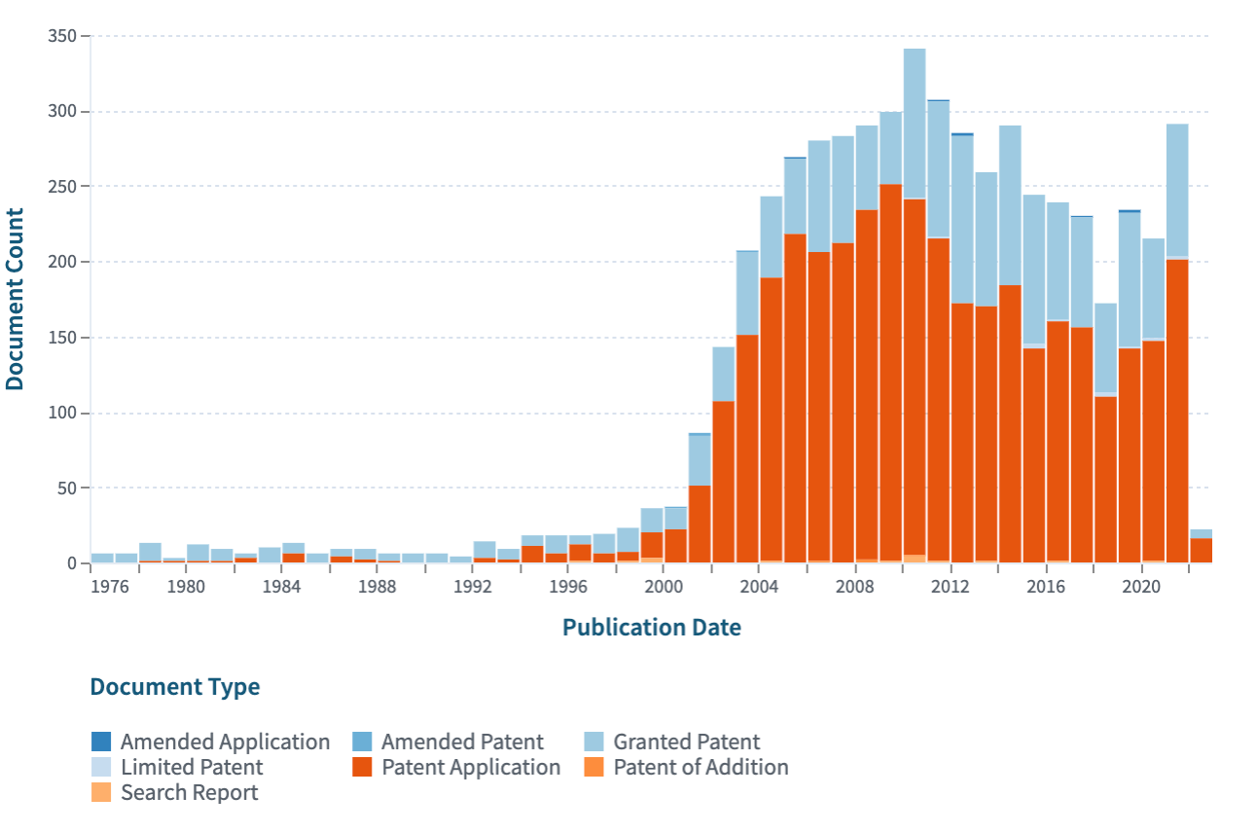
Results: Time based analysis

Slide 10
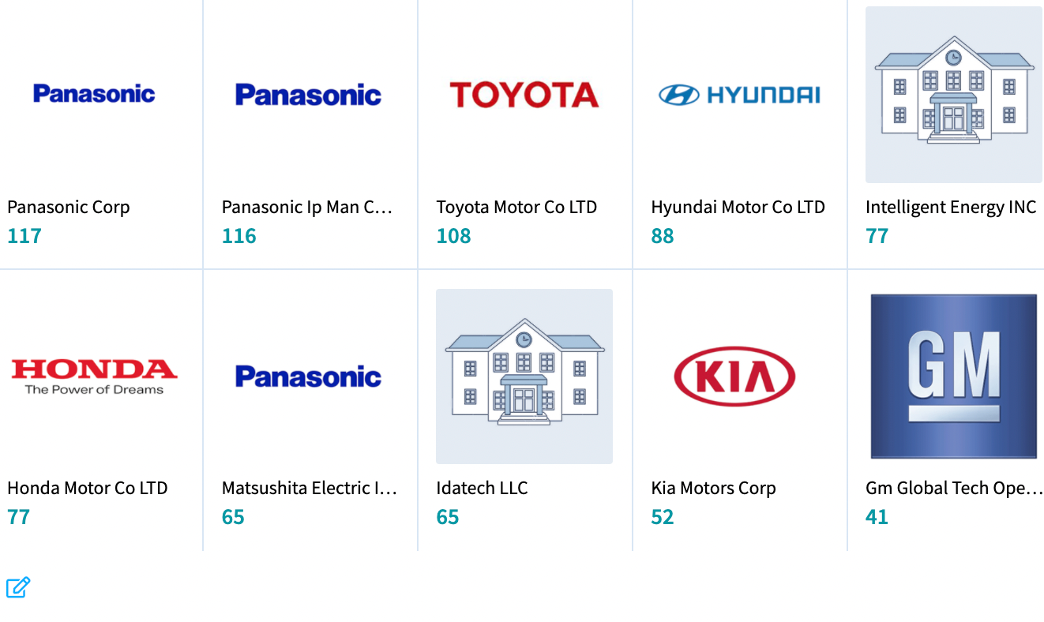
Results: Patentee

Slide 11
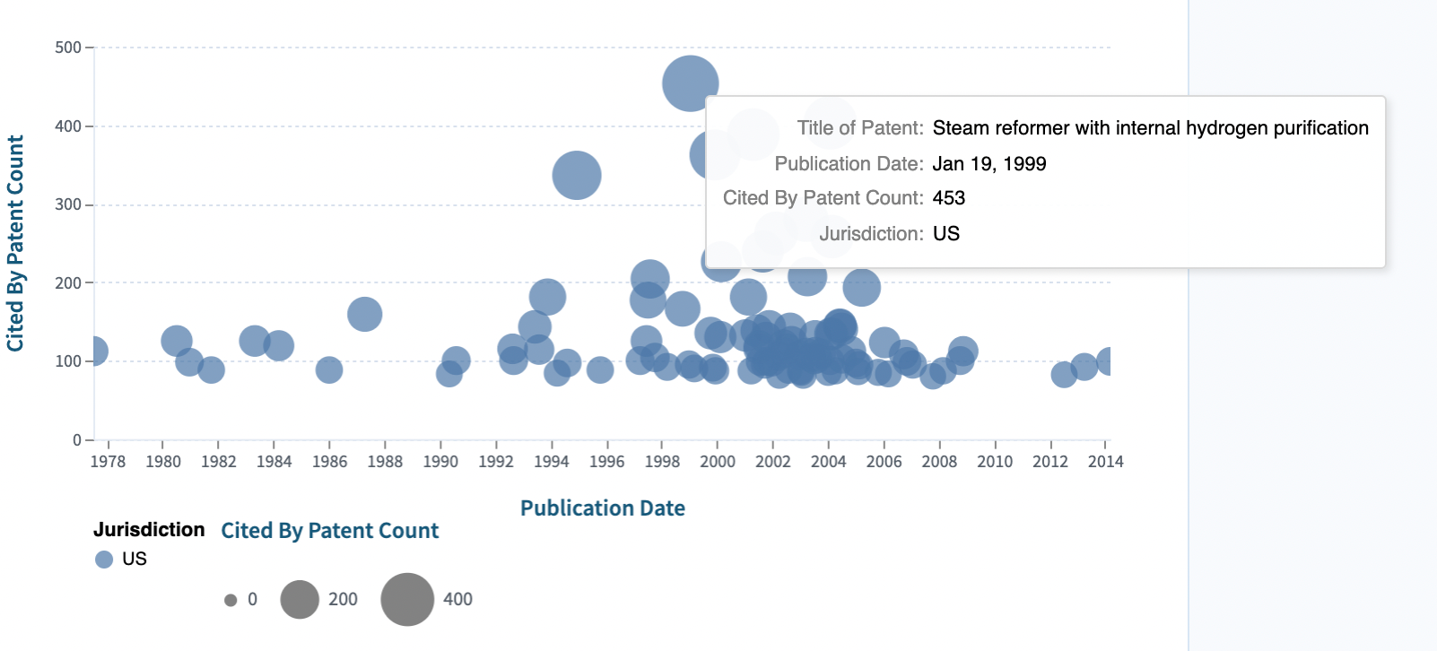
Results: Highly selected patent

Slide 12
Feedback
Filter on
Title and Abstract
If non-interested patents?
Identify the “escaped synonym”

