Slide 1
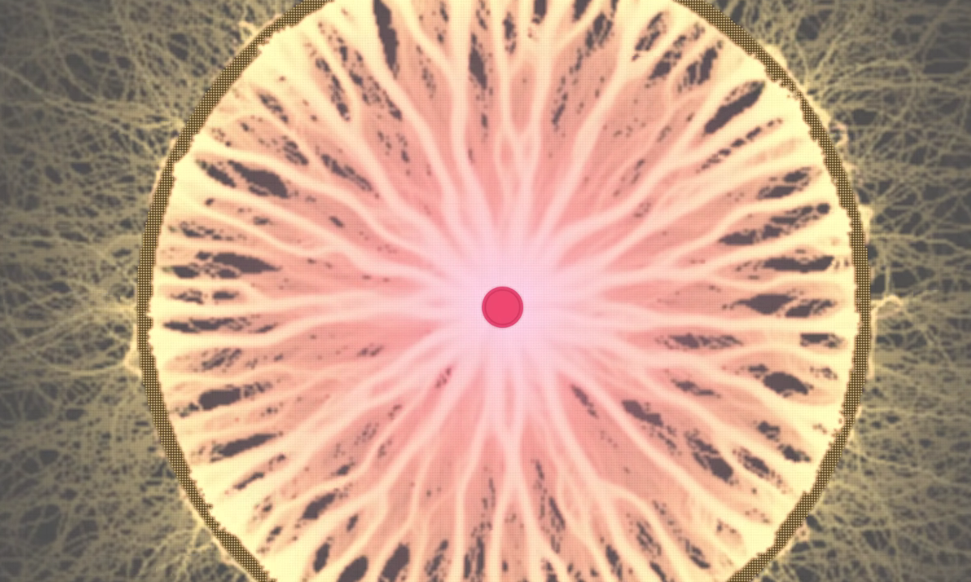
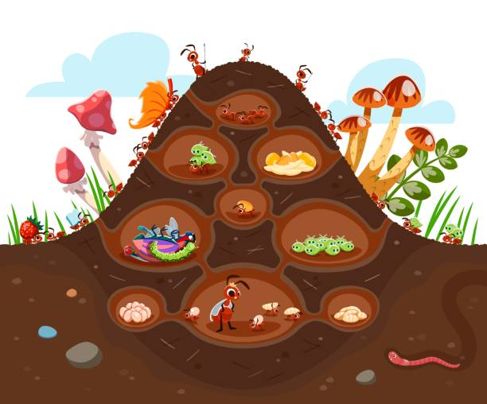
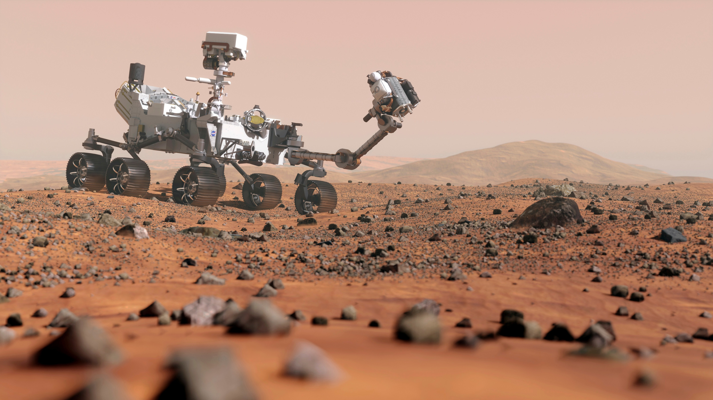
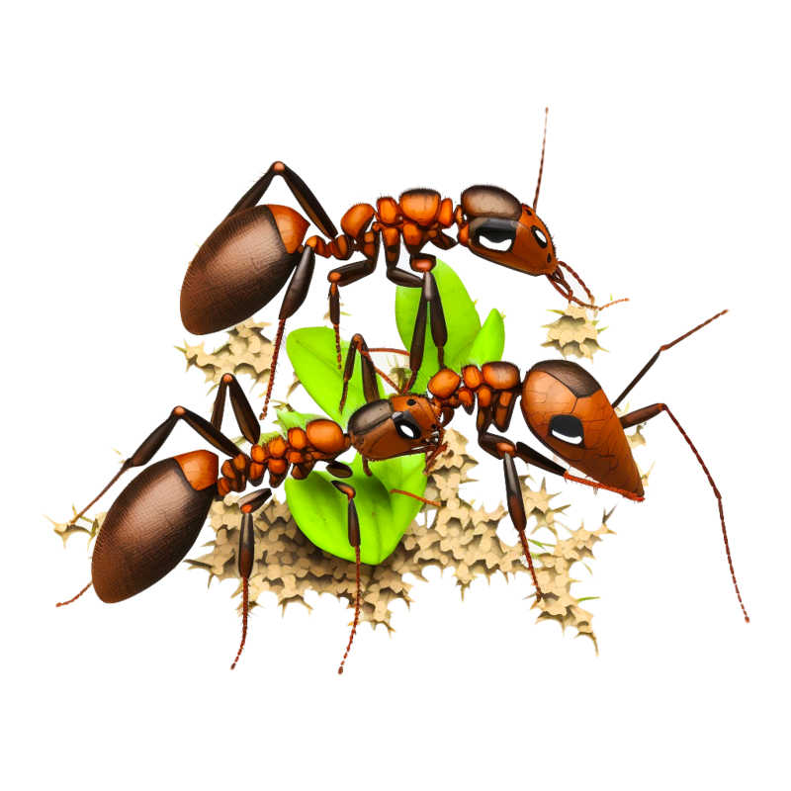
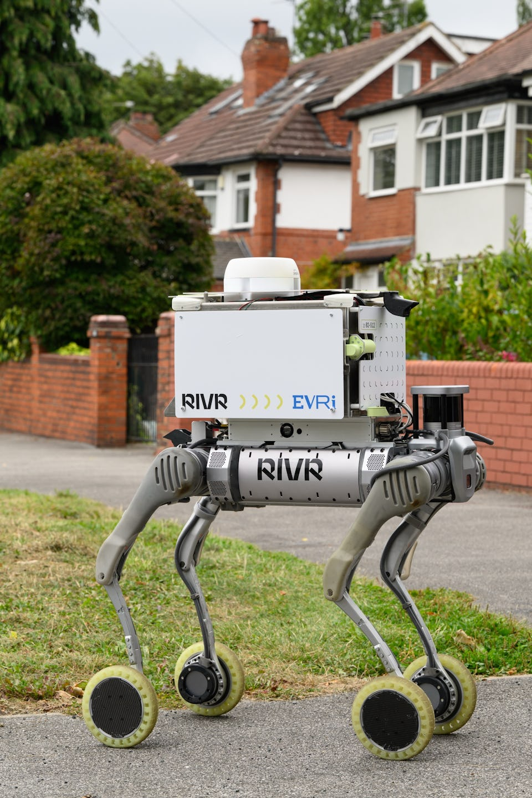
Ricky Nandhra - 220076203
Ant Colony Simulator
How is this useful?
Ant colonies can lead us into the next generation of automation!
They can help from anything from space exploration to home delivery services!
Home Delivery Services
You may have seen those robot dogs in California delivering people's packages. This is also being tested in Leeds now!
The dogs will need to be able to recall themselves, whenever they are low on battery or when they have finished delivering parcels. By leaving a digital pheromone trail, they can quickly find the shortest route back to base and streamline deliveries. Without the need for a person in a rush who might leave your parcel behind the bin.
Space Exploration
Martian rovers are suspiciously like ants. They spread out and search for interesting foreign objects to study the creation of planets. When a rover finds something of value, all the other rovers in the area converge onto that one point and exhaust all the natural resources.
This is what a colony of ants do when they find food, using pheromones, a chemical signal.

