Slide 1

DriverPass System Analysis
Nicholas Kreuziger
Notes:
[No speaker notes required for this slide.]

Slide 2

System Requirements
The System shall allow Customers, Drivers and Employees to modify Scheduling and Availability.
The System shall allow Customers to Register and Maintain their Enrollments.
The System shall be Secure.
The System shall be cloud-based and accessible from any device.
Notes:
The system will empower users, drivers and employees the ability to more dynamically interact with their scheduling. This allows DriverPass to work with the business.
Customers will be empowered to access their own enrollments and course information. This allows DriverPass to serve Customers their educational needs.
The system shall be secure through encryption and authentication. Customer and Employee data will not fall into the wrong hands.
The system will be accessible from any web-enabled device. This will allow drivers to submit notes after appointments, customers to update their scheduling from their phones. Reducing frustration and increasing flexibility.

Slide 3
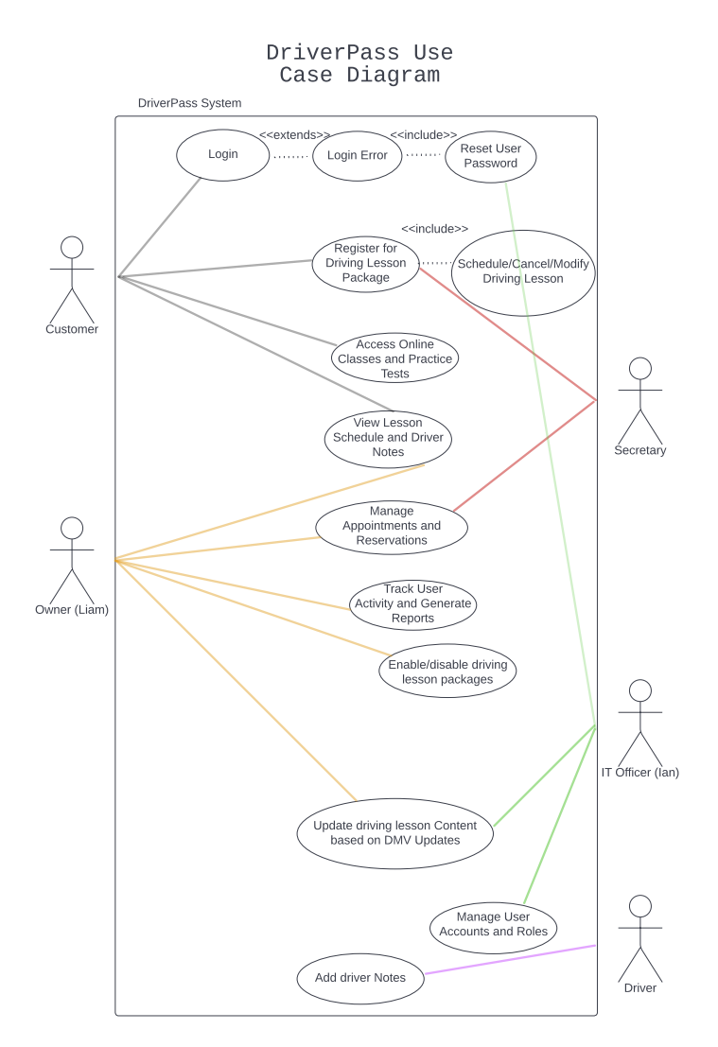
Use Case Diagram
Notes:
This diagram show cases some of the users we had in mind when we created the DriverPass System. Your Customer will be empowered to choose their learning path, interact with their course materials, and schedule with their driver. The Owner will have access to any and all reporting needs in addition to modifying the package offerings of the organization. The Drivers will be able to upload their notes about the lesson directly into the system. Secretaries will be empowered to assist with Driving Package Registration and Appointment Management. The system is designed with YOU in mind helping your business be the best it can be.

Slide 4
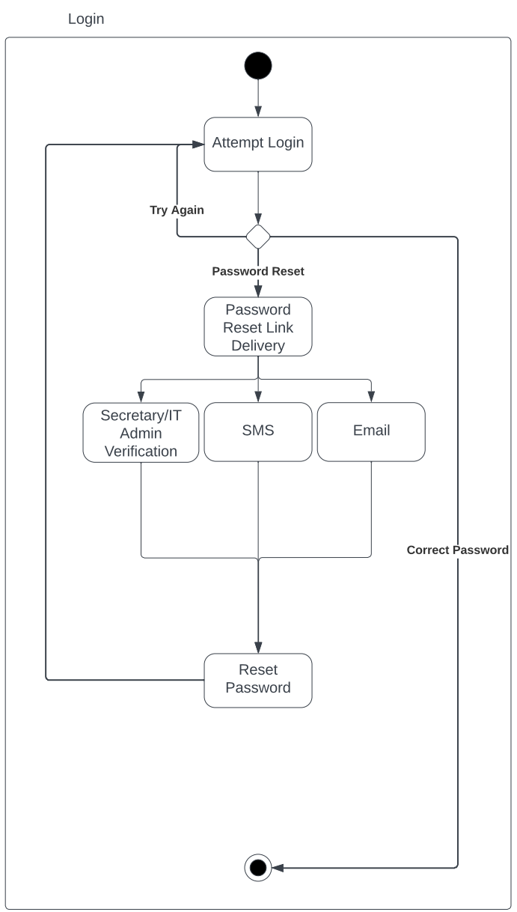
Activity Diagram
Notes:
This diagram demonstrates the workflow behind logins. How many times as a user have you ran into thwarted login attempts? Your system will allow for resetting of a password the same way you may have had to do so in your personal life. There’s an additional feature of allowing your users to call into the office and trigger a password reset. This same workflow applies to any of your employees that may have become logged out of their accounts.

Slide 5
Security
Encryption of the data between the Server and Client will encrypt and secure all data.
The system will allow thorough monitor logging by your IT team to ensure pro-active responses to possible threats.
The cloud provider we select will industry standard security protocols to further secure your information.
Notes:
We believe Security comes from design. We have considered Security in every step of this design process. User Authentication, IT empowering system design and a dedicated team will all secure the success of DriverPass.

Slide 6
System Limitations
Limited Customization: Presently the Owner can only disable packages.
DMV Updates: Dependency on DMV to provide updates to rules, policies or sample questions.
Scalability: Present system may not scale with the business.
Limited User Interface Customization: The present system does not allow thorough customization.
Compliance: Ensuring system remains compliant with regulation, privacy and industry standards will remain a challenge.
Notes:
While presenting these bullet points assure the Client that these are typical limitations and not at all stopping the adoption of this system. This is a first pass product that addresses the core business needs with room for continued growth.
Limited Customization can be addressed by continued development and requirements gathering of the system.
DMV Updates can be further automated by fostering a relationship with the DMV.
Scalability can be planned for as the business develops.
Limited User Interface Customization can be addressed by gathering feedback from users/employees and implementing updates.
Compliance , while a challenge, can be aided by dynamic data gathering efforts and yearly hiring of a consultant.

