Slide 1
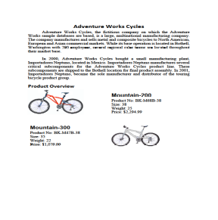
Company History
IMN Solutions PVT LTD is the software company, established in 1987, by George Milton.
The company acquired the MCY corporation for 20 billion dollars.
The company is participating in top open source projects in automation industry.
Data 1
Data 2
Data 3
Data 4
Data 5
Month | Product A | Product B | Product C | Product D | Product E | Product F | Average | Target
Jan | 20000 | 4200 | 8000 | 12000 | 4700 | 15000 | 10650 | 35000
Feb | 8300 | 19000 | 21000 | 15230 | 7230 | 1800 | 12093 | 18000
Mar | 4600 | 9000 | 7500 | 8000 | 30000 | 22000 | 13517 | 13200
Apr | 3530 | 13430 | 3550 | 10670 | 27860 | 5414 | 10742 | 50000
May | 10293 | 23760 | 10378 | 24857 | 12104 | 21350 | 17124 | 25460
Jun | 9070 | 8218 | 23480 | 20492 | 9103 | 12300 | 13777 | 21600
Jul | 23500 | 19230 | 87390 | 25030 | 28000 | 11890 | 32507 | 37800
Aug | 39000 | 30301 | 78356 | 21121 | 30443 | 23230 | 37075 | 40900
Sep | 14340 | 19403 | 89024 | 1230 | 12561 | 29000 | 27593 | 29800

