Slide 1
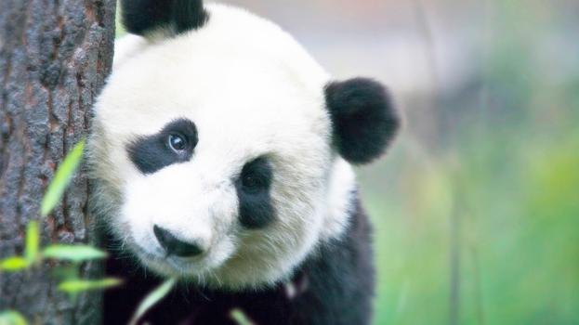
The Giant Panda
The giant panda, which only lives in China outside of captivity, has captured the hearts of people of all ages across the globe. From their furry black and white bodies to their shy and docile nature, they are considered one of the world's most loved animals.
Notes:
Quick Fact Giant pandas have five clawed toes and one pseudo thumb.
Their pseudo thumb, along with pads of skin, help the giant panda strip the more nutritious small bamboo shoots and leaves while holding the stalk in their mouth.

Slide 2
Small Bear or Large Raccoon?
Giant pandas are generally referred to as bears and are typically called panda bears rather than giant pandas. Though we may think they look like bears, there has been a great deal of discussion for decades about where giant pandas fit in the animal kingdom.
While a giant panda has a body that resembles a small bear and climbs trees like a bear, it also has several characteristics in common with the red panda. For example, both giant pandas and red pandas eat bamboo and have the same pseudo thumb. The table below lists the main characteristics the giant panda shares with bears and red pandas.
Bear | Red Panda
Shape | Diet
Size | Paws
Shaggy fur | Eyes
Gait | Nose and teeth

Slide 3
Other Fun Giant Panda Facts
Researchers have recently discovered that the gene responsible for tasting savory or umami flavors, such as meat, is inactive in giant pandas.
For many centuries, giant pandas were thought to be a mythical creature, like a dragon or unicorn.
Unlike other bears in the region, giant pandas don’t hibernate.
Giant pandas can stand erect on their hind legs but rarely walk.
The Qinling panda, another giant panda species with a dark brown and light brown coat, lives only in the mountains of Shaanxi.

