Slide 1
Deployment Steps for .NET Core App in Azure Kubernetes

Slide 2
Azure DevOps is one of the best platforms to create an automated CI/CD pipeline for an application, making this job easy. This article will discuss the steps to deploy a .NET Core application in Azure Kubernetes using the Azure DevOps Starter. Prerequisites
Azure subscription
GitHub account
.NET 6 SDK
Visual Studio 2022

Slide 3
Containers and Container Orchestration
Containers are a form of the virtualized operating system. A container contains all essential executables, binary code, dependencies, and configuration files.
Containers’ maintenance, deployment, scaling, and networking can be automated using a container orchestration system. In addition, you can deploy the same application across multiple environments using container orchestration rather than having to redevelop or redesign it.

Slide 4
What Is Azure Kubernetes Service?
Developed on top of the open-source Kubernetes technology, Azure Kubernetes Service (AKS) is a managed container orchestration service. You can use AKS to administer your hosted Kubernetes environment and easily launch, scale, and manage containerized apps.
Through on-demand resource provisioning, updating, and scaling, AKS simplifies Kubernetes deployment and operation. It enables you to execute your applications in the cloud while eliminating the complexity and operational burden of Kubernetes management.

Slide 5
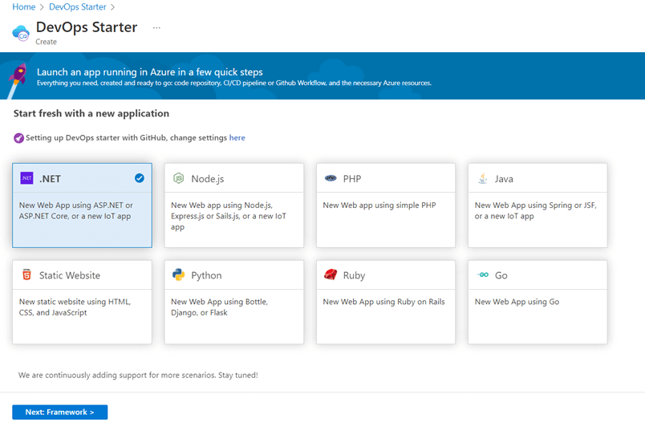
Steps to Deploy a .NET Core Application in Azure Kubernetes
Create an Azure DevOps starter project.
Sign in to your Azure portal, click the Create a resource option, and select DevOps Starter.
Select the .NET runtime, as shown in the following figure, to run the ASP.NET Core application

Slide 6
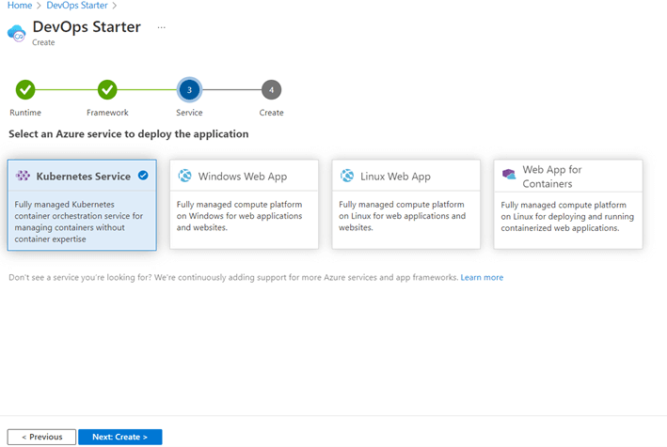
Choose the service
Then, select Kubernetes as the Azure service to deploy this application.
Create the project with the necessary configurations
Now, configure the Azure subscription and settings for the Kubernetes cluster. I will explain these configurations in the upcoming step.

Slide 7
Check the CI/CD pipeline
Check the CI/CD pipeline you created using the Azure DevOps Starter by cloning the ASP.NET Core project to your local machine.
First, add the changes to the staging area.
Commit the changes with an appropriate commit message into the local repository.
push the commits to the GitHub repository.

Slide 8
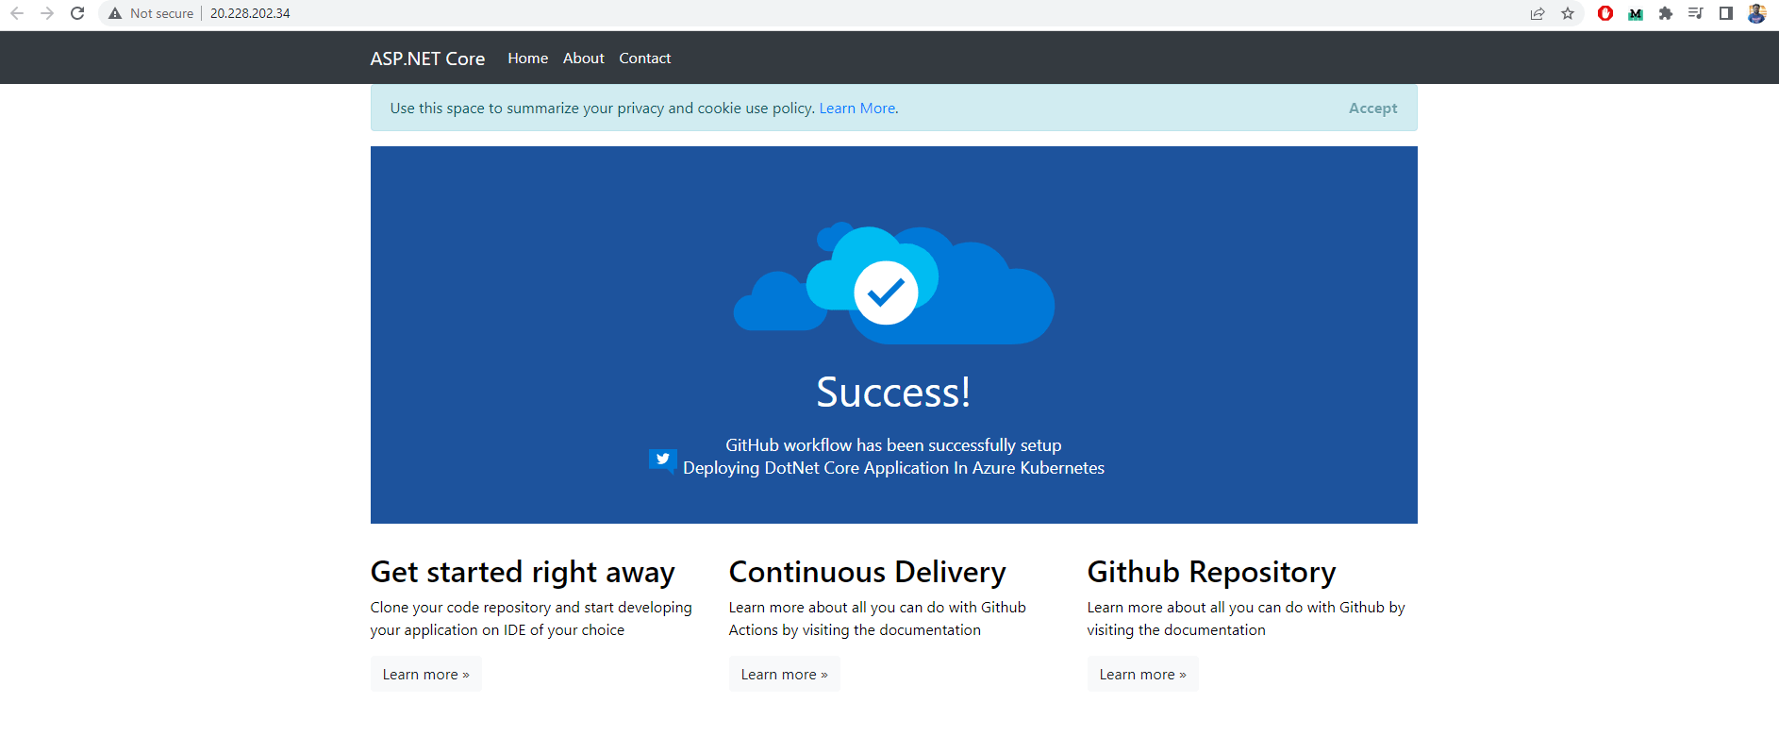
Here, you see that the latest version of the application was deployed successfully to the Azure Kubernetes service.

Slide 9
Thank You

