Slide 1

Synchro Labs, Inc.
CloudStashWeb
Web front-end for Dropbox compatible back-ends, including Dropbox and CloudStash
August 23 , 2017

Slide 2





Synchro Labs, Inc.
https://synchro.io
SynchroLabs
@synchrolabs
Redmond, WA
Founding Team
Bob Dickinson
bob@synchro.io
Blake Ramsdell
blake@synchro.io
@rdd3
@blake182
BobDickinson
bcr

Slide 3
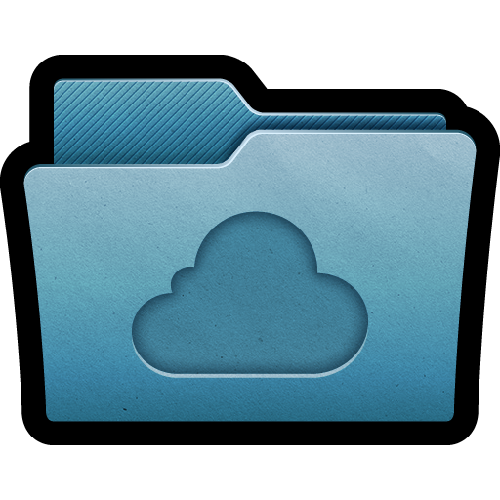
CloudStashWeb
Web front-end for Dropbox compatible back-ends
Open source project, available at: https://github.com/SynchroLabs/CloudStashWeb
Demonstrates use of the Dropbox JavaScript API from Node.js and the browser
Currently running at https://web.cloudstash.net
Running in a Docker container on Joyent Triton, backed by CloudStash API server also running in Docker container and backed by Manta storage

Slide 4
The End

