Slide 1

Delivering and Deploying Turn-Key Self-Orchestrating Solutions
Docker Seattle Meetup
August 17, 2016
Bob Dickinson
Synchro Labs, Inc.
https://synchro.io

Slide 2





Synchro Labs, Inc.
https://synchro.io
SynchroLabs
@synchrolabs
Redmond, WA
Founding Team
Bob Dickinson
bob@synchro.io
Blake Ramsdell
blake@synchro.io
@rdd3
@blake182
BobDickinson
bcr

Slide 3

Alternate Profile Pic
with Ranger, my pet llama

Slide 4
What is Synchro?
Mobile app development platform based on JavaScript and Node.js
Native apps for Android, iOS, Windows, and Windows Phone, and web apps (mobile-optimized and desktop) - all from a single code base
Enterprise focus (integration, dev ops, security)
Open source server and web client, free native mobile dev client
Custom native mobile apps licensed for enterprise deployment

Slide 5
How does it Work?
All of your mobile app code, including UX definition and interaction logic, runs on Synchro server under Node.js
We remote the UX so that it runs on the mobile device and presents as a native mobile client
Apps present as native to end users, but as Node/web apps to developers and DevOps

Slide 6
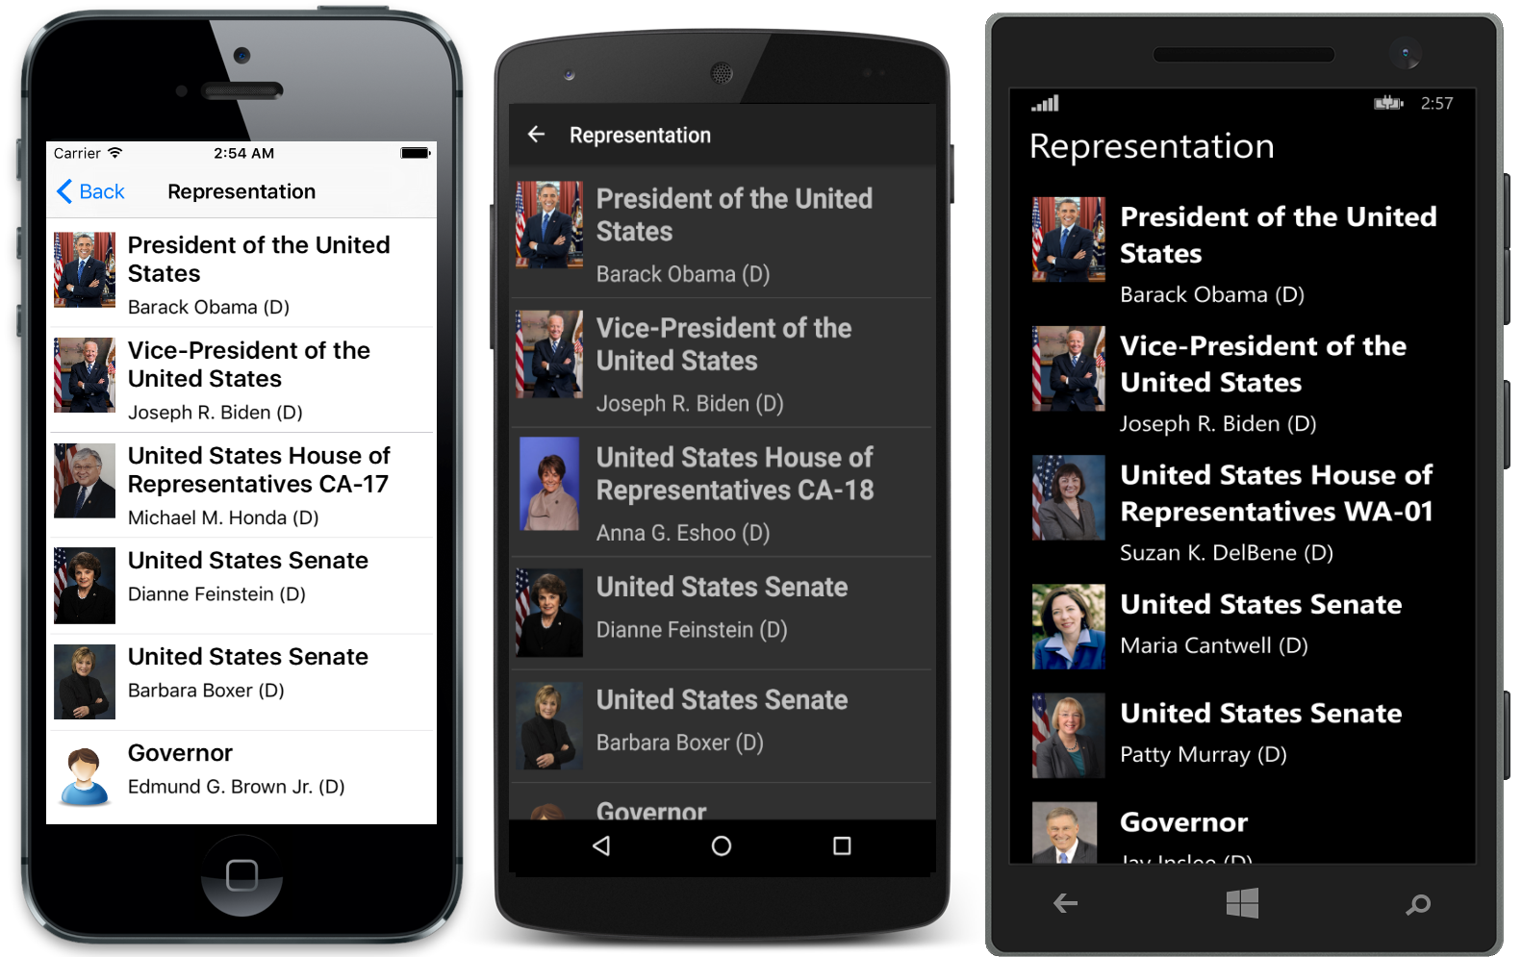
Great Looking Native Apps
Synchro Civics shown above – get it in any App Store
200~ lines of code, all mobile platforms + web, running from the cloud

Slide 7

Much Less Code
PropertyCross App

Slide 8
Everything Runs in the Cloud
Radically simplifies application design
Mobile app code runs on server - no more client/server!
App code can access enterprise resources directly, auth as app/server
Provably secure
No app code ever runs on the mobile client
All communication between mobile client and server is always secure
Mobile client never communicates with anything other than server
Ability to control access, instantly deploy updates, etc.

Slide 9
For More Information…
If you have enterprise apps that you’d like to mobilize
Especially if you already know and love Node.js
Take a look at Synchro: https://synchro.io
Getting started guide, tutorial, samples, documentation, and videos.

Slide 10
Synchro Container and Orchestration Support

Slide 11
Step 1: The Container (AKA: “Yay, a Dockerfile!”)
FROM node:argon
# Create app directory
RUN mkdir -p /usr/src/app
WORKDIR /usr/src/app
# Bundle app source
COPY . /usr/src/app
# Install deps
RUN npm install
RUN cd synchro-apps && npm install
ENV SYNCHRO__PORT 80
EXPOSE $SYNCHRO__PORT
CMD [ "node", "app.js" ]

Slide 12
Step 2: Orchestration Support
Provide turn-key self-orchestrating solutions to our users/customers
Migrate our own production services from managed web app (on Azure) to orchestrated containers/microservices (on Joyent)

Slide 13
The AutoPilot Pattern using ContainerPilot
https://www.joyent.com/containerpilot
“App-centric micro-orchestration”
Containers collaborate to adjust to each other automatically (they run on ”AutoPilot”)
Works with any orchestration solution << MUST HAVE
Very easy to test/develop with production environment << BONUS

Slide 14
A Case Study in Migrating from Managed Services to Orchestrated Micro-Services: Synchro Labs’ Production API Server

Slide 15
Synchro in a Managed Services Environment (Azure)
Front End
DNS, SSL termination, Load distributing proxy
App Management
Start/Stop/Restart
Scaling
Monitoring
Configuration Injection
Redis
(Fully Managed)
Synchro
Storage

Slide 16
Synchro in a Micro-Services Environment (Joyent)
Front End
DNS (Joyent CNS)
Nginx
Nginx
Consul
Synchro
Synchro
Redis
Storage (Manta)

Slide 17
Nginx: The Beast that Must be Tamed
Load-distributing proxy
Session affinity
SSL termination (optional, configurable)
Tuned for security, performance (app-specific)
301 Redirect of http to https
Static file caching (migrated from CDN in managed environment)
Websocket support
Goal: Ability to replace entire nginx.conf (template) if needed via config

Slide 18
Basic App Requirements
Health Check
Endpoint should be configurable, consider allowing localhost access only
Signal Handling
SIGINT for shutdown
SIGHUP if your app reconfigures (especially based on services from consul)
Flexible Configuration Source
From environment vars or file
If from file, location of file should be configurable

Slide 19
Configuration Injection
Runtime
Environment variables
Volumes
Build-time
Environment variables
Files
We want our solution to be non-opinionated about how configuration is injected
We want to be able to use public containers, and also support custom/private containers with baked-in state
Some of our apps/containers themselves aren’t very flexible about how they get configured (I’m looking at you nginx)
Binary files, or even multiline text files (like cert/key), can be tricky to inject via environment vars

Slide 20
Flexible Configuration Injection
The ContainerPilot preStart hook is a great place to process config
Recommendation: For any file-based config…
The local file path should be configurable (via an environment var)
There should be a way to inject file contents as a base64 encoded environment var
#!/bin/sh
preStart()
{
: ${SSL_CERTS_PATH:="/etc/ssl/certs/ssl.crt"}
if [ -n "$SSL_CERTS_BASE64" ]; then
echo $SSL_CERTS_BASE64 | base64 -d > $SSL_CERTS_PATH
fi;
# >>> Process ssl.key, any other files as above
# Rest of preStart logic (consul-template, etc)
}

Slide 21
Configuration Packaging/Consolidation
Package all configuration in one location (in our case: cloud storage)
We need access to files – why not just use volumes?
Support for volume drivers on cloud storage is spotty/early (platform dependent)
No volume driver for Manta storage (yet)
Significant limitations on how volumes can be used in production
Can be difficult to access actual production data from dev using volumes
Goal: Non-opinionated solution to get files from anywhere, at runtime, with no client tooling (custom volume driver, etc) and no micro-service tooling (cli tools, etc) required

Slide 22
StashBox
https://github.com/SynchroLabs/StashBox
An http server/proxy that serves files from configurable endpoints
Supports environment vars, local files, http proxy, and cloud storage: Amazon (S3), Azure, Google, HP, IBM BlueMix, Joyent (Manta), OpenStack, and RackSpace
Can be configured via environment (runtime) or config file (build-time)
Clients require no tooling (just curl)
Available from Docker Hub: synchro/stashbox
Works great with AutoPilot/ContainerPilot

Slide 23
Configuring StashBox Mounts
# StashBox config.json
{
"mounts":
[
{
"mount": "/",
"provider": "file",
"basePath": "stash"
},
{
"mount": "ssl/domain.key",
"provider": "env",
"var": ”SSL_KEY_B64",
"encoding": "base64"
}
]
}

Slide 24
Configuration Consolidated via StashBox
Apps load their config files from StashBox in ContainerPilot preStart script
No tooling required – using curl
The only configuration we have to inject is to point Nginx and Synchro to StashBox for their config files, and to point StashBox to Manta
ALL application state is now in one place – on Manta
Easy to manage/control, very portable
Production test, staging, migration all simplified

Slide 25
Our Environment (runtime state)
# nginx.env
SSL=1
SSL_CERTS_URL=stashbox/config/ssl.crt
SSL_KEY_URL=stashbox/config/ssl.key
# syncro.env
SYNCHRO_CONFIG_URL=stashbox/config/config.json
# stashbox.env
STASHBOX__mounts__0__mount=/config
STASHBOX__mounts__0__provider=manta
STASHBOX__mounts__0__basePath=~~/stor/api_synchro_io/config
STASHBOX__mounts__0__url=https://us-east.manta.joyent.com
STASHBOX__mounts__0__user=synchro
STASHBOX__mounts__0__keyId=<key id>
STASHBOX__mounts__0__key64=<base64 encoded key>

Slide 26
Nginx preStart with StashBox Support
#!/bin/sh
# ContainerPilot preStart
#
preStart()
{
# Get SSL certs from env or remote URL...
: ${SSL_CERTS_PATH:="/etc/ssl/certs/ssl.crt"}
if [ -n "$SSL_CERTS_BASE64" ]; then
echo $SSL_CERTS_BASE64 | base64 -d > $SSL_CERTS_PATH
elif [ -n "$SSL_CERTS_URL" ]; then
curl $SSL_CERTS_URL -s -S -f -o $SSL_CERTS_PATH
fi;
# >>> Process ssl.key, nginx.conf.ctmpl as above
consul-template \
-once -consul consul:8500 \
-template "/etc/containerpilot/nginx.conf.ctmpl:/etc/nginx/nginx.conf”
}

Slide 27
Synchro in a Micro-Services Environment (Joyent)
Front End
DNS (Joyent CNS)
Nginx
Nginx
StashBox
Consul
Synchro
Synchro
Redis
Storage (Manta)

Slide 28
The Synchro AutoPilot Solution
https://github.com/SynchroLabs/SynchroAutoPilot
docker-compose.yml
synchro/synchro_nginx_ap
synchro/synchro_ap
synchro/stashbox
redis
progruim/consul
Dockerfile w/ ContainerPilot support
synchro_nginx_ap
synchro_ap
Real-world nginx.conf.ctmpl
This presentation (/docs)

Slide 29
Synchro Production API Server
Deployed on Joyent Public Cloud (Triton / Manta)
Performance is much better
Price is lower (even running 5 micro-service containers)
Support is outstanding
Using docker-compose.yml from SyncroAutoPilot GitHub project and public images available from Docker Hub
Configured at runtime by pointing Nginx and Synchro to StashBox, and pointing StashBox to Manta
All configuration, including SSL credentials, API keys, Synchro config, and Synchro apps, are stored on Manta
All of our application state is in one place, under our control, and portable
Simulating production on dev is easier and higher fidelity

Slide 30
Questions
If we don’t get to you, please reach out via email
bob@synchro.io - blake@synchro.io - support@synchro.io

Slide 31
The End

