Slide 1
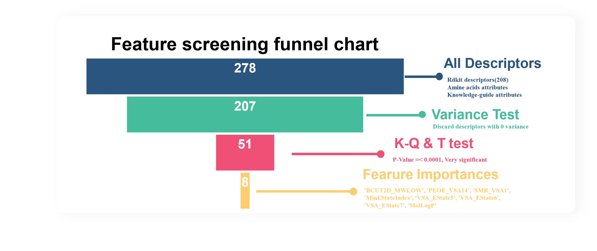
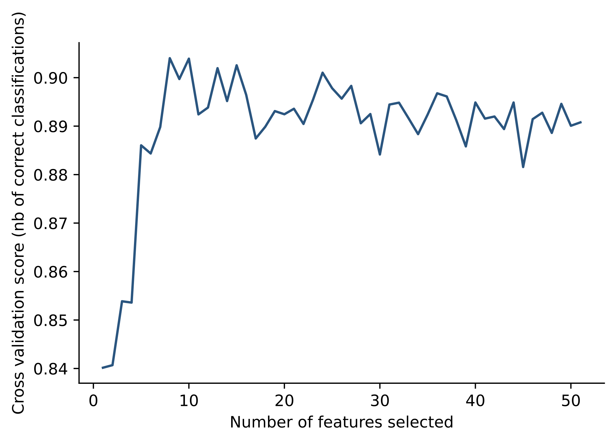
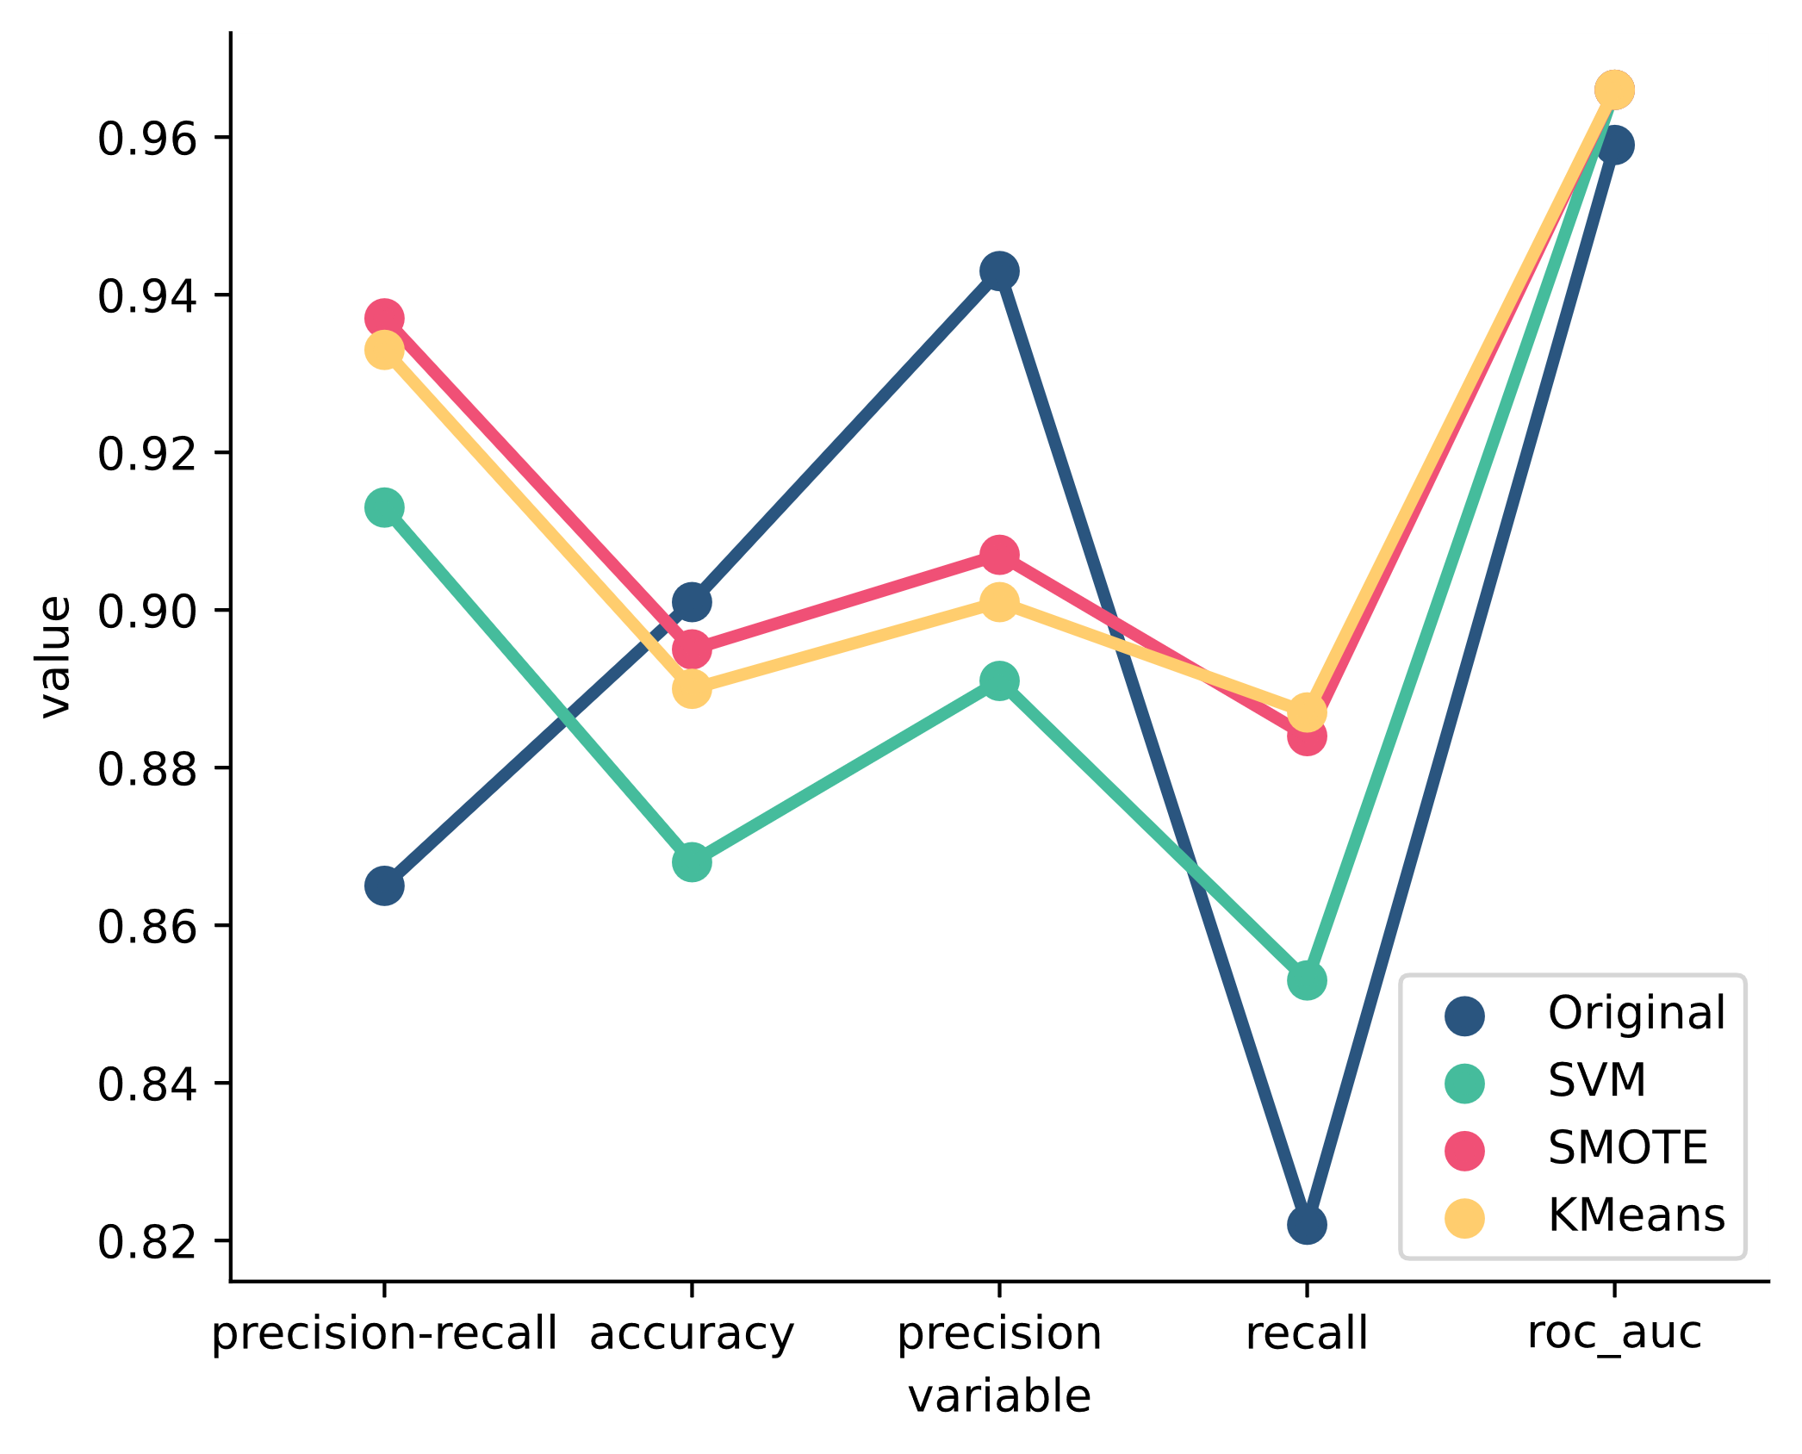
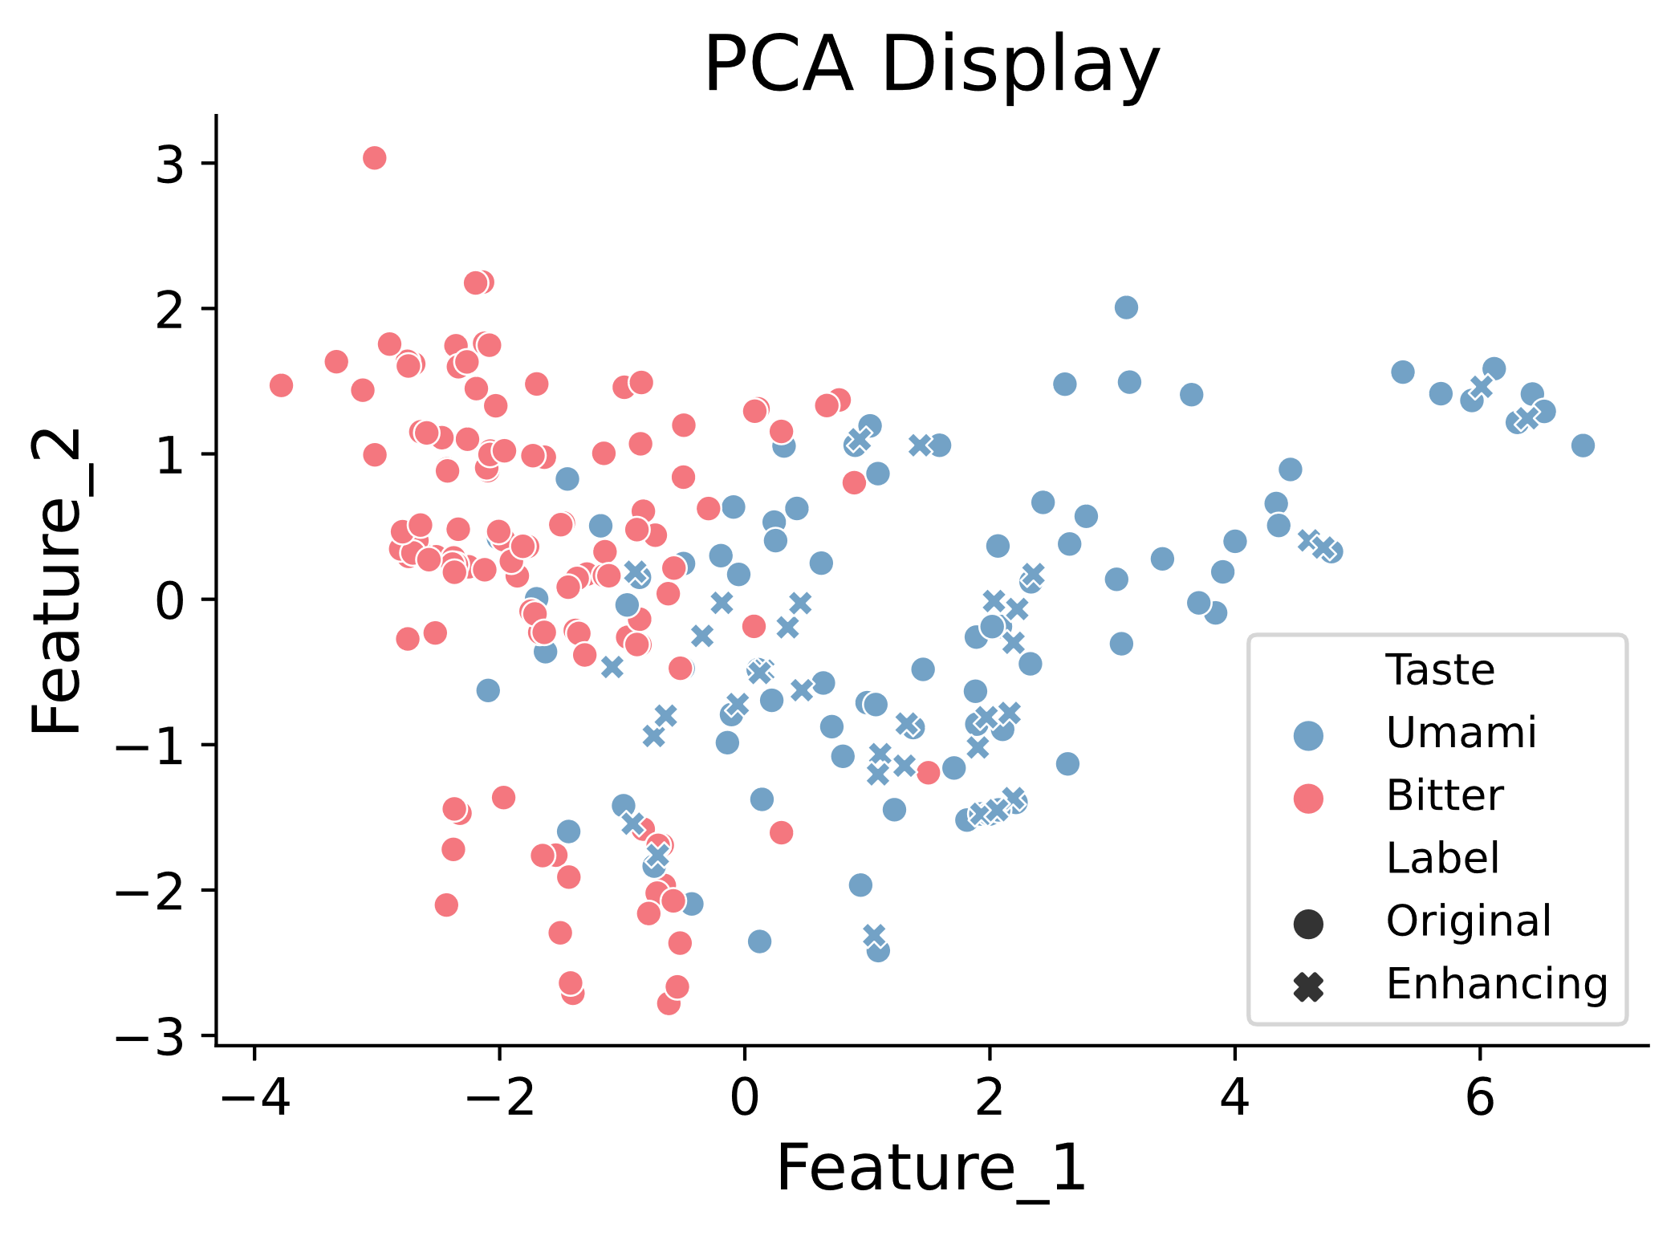
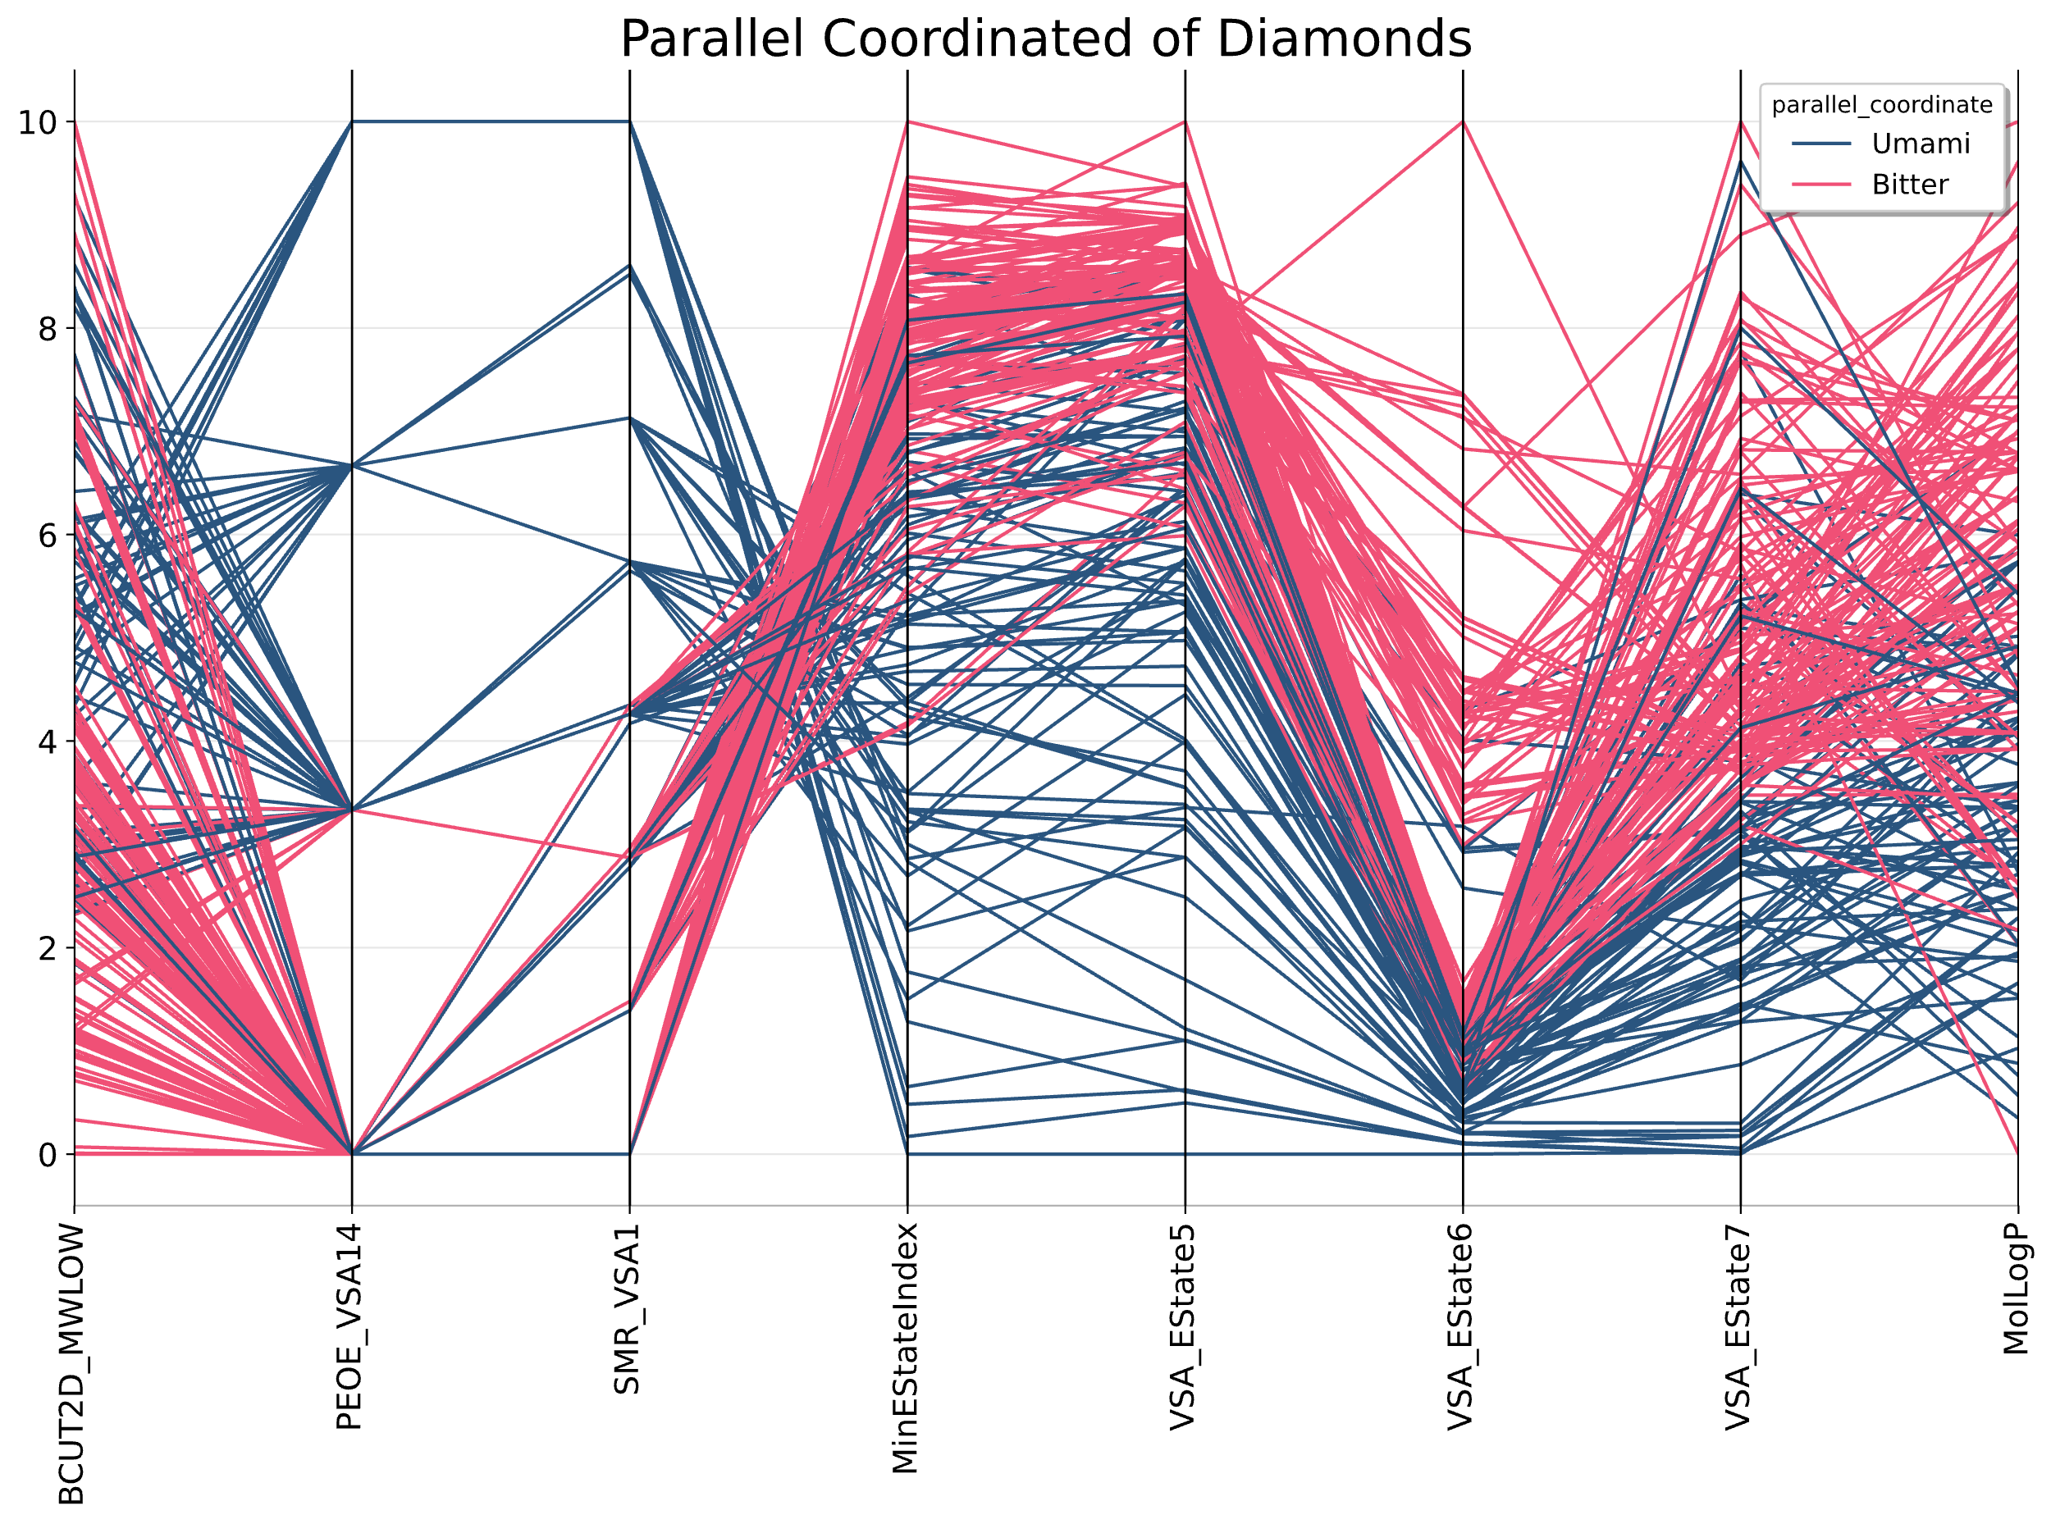
(A)
(B)
(C)
(D)
(E)

Slide 2
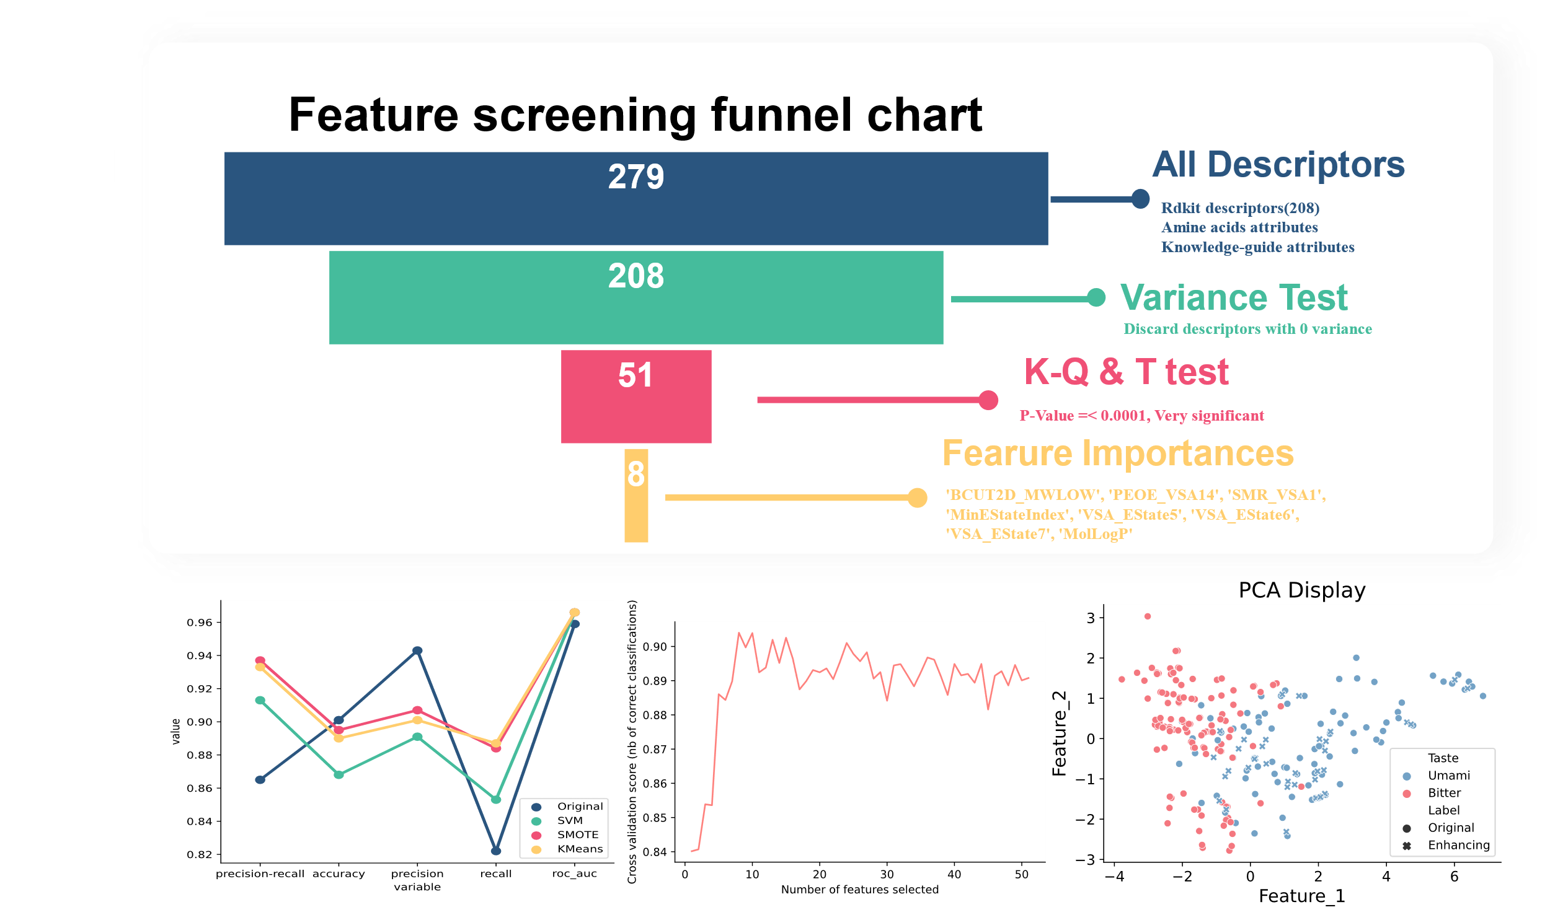

Slide 3
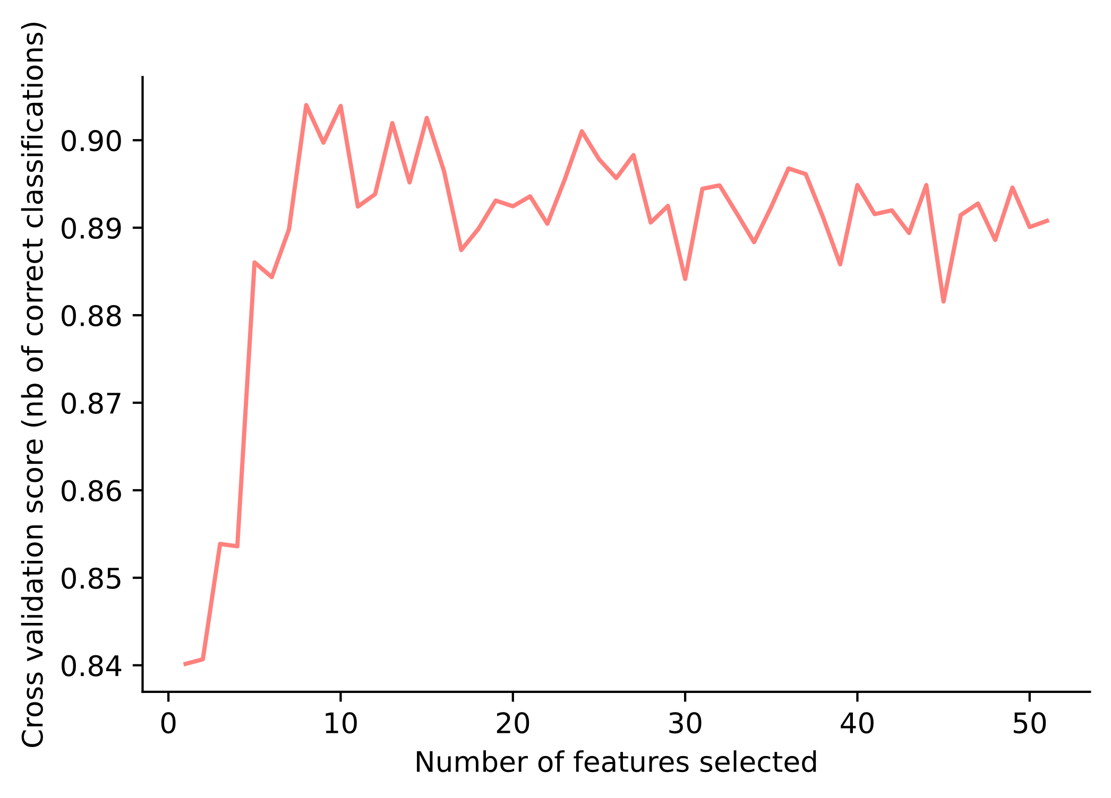
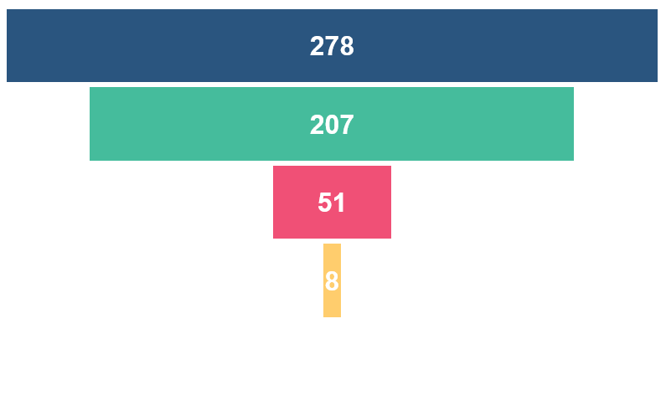
90
Feature screening funnel chart
All Descriptors
Rdkit descriptors(208)
Amine acids attributes
Knowledge-guide attributes
Variance Test
Discard descriptors with 0 variance
K-Q & T test
P-Value =< 0.0001, Very significant
Fearure Importances
'BCUT2D_MWLOW', 'PEOE_VSA14', 'SMR_VSA1', 'MinEStateIndex', 'VSA_EState5', 'VSA_EState6', 'VSA_EState7', 'MolLogP'

Slide 5
All Descriptors
Var Filter
KS/T
Model Filter

