Slide 1
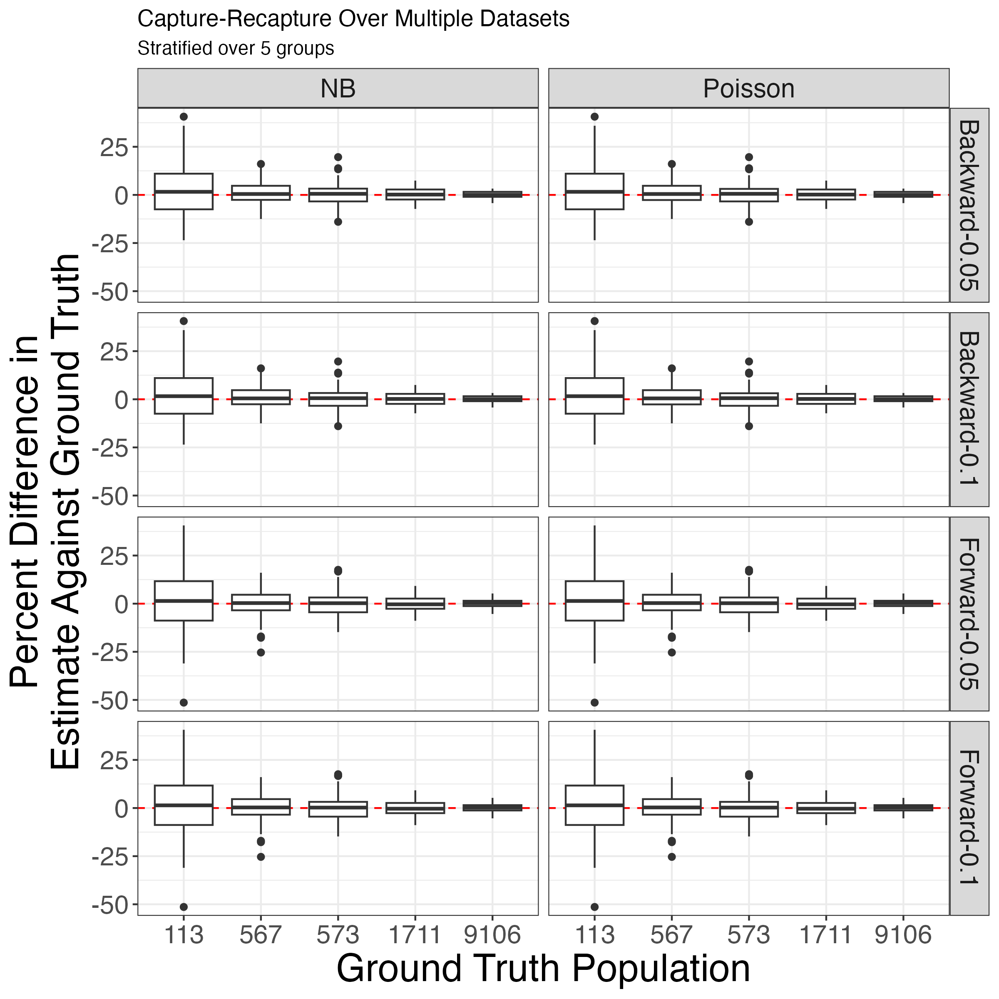
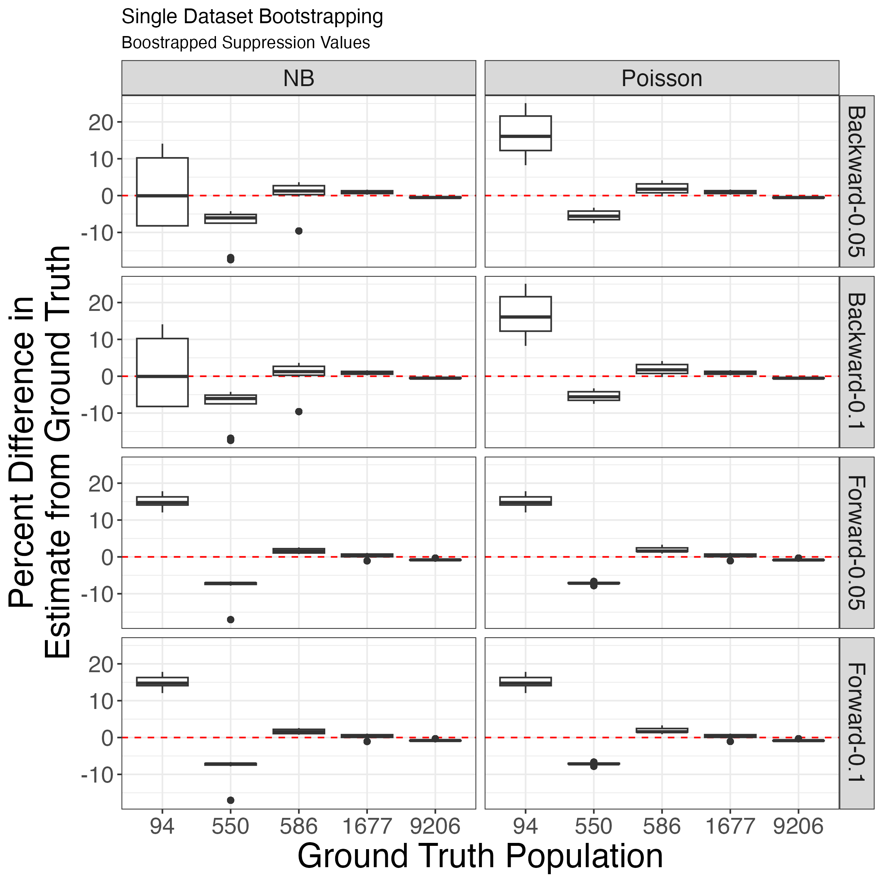




Estimation of Opioid Use Disorder Prevalence Under Unique Data Scenarios: A Simulation Study
Ryan O’Dea MS (1), Benjamin P. Linas MD, MPH (1, 2), Laura F White Ph.D. (3), Joshua A Barocas MD (4), Jianing Wang Ph.D. (5, 6)
(1) Boston Medical Center, (2) Boston University School of Medicine, (3) Boston University School of Public Health, (4) University of Colorado School of Medicine-Divisions of General Internal Medicine and Infectious Diseases, (5) Massachusetts General Hospital, (6) Harvard Medical School
Background
This research aims to improve multiple systems capture-recapture estimation - a method for estimating the number of people who use opioids living in a jurisdiction while addressing underreporting in surveillance, particularly in demographics where data may be increasingly sparse.
Methods
A population was created with simulated capture histories and demographic information, then we examined the accuracy of estimates between Poisson and Negative Binomial (NB) distributions with log-linear models.
Model efficacy was benchmarked by comparing model estimates against the simulated ground truth.
Results
As populations become small, single point estimation using capture recapture loses accuracy showing a potential lack of robustness with respect to capture histories and population size; however, this lack of robustness can be addressed through bootstrapping estimations
This indicates that, with bootstrap methods, we can recover the true prevalence of opioid use disorder in situations where data on certain demographics is sparse.
Takeaway
(Top) Bootstrapping across multiple datasets demonstrates a convergence towards the ground truth, suggesting that in scenarios of single model failure, analogous models are likely sufficient to maintain accuracy and reliability
(Bottom) When emulating our dataset of interest – the Massachusetts Public Health Database, and bootstrapping over small counts, Negative Binomial estimates using backward step-wise MSPs better estimated the true prevalence.
Prevalence Estimation on Massachusetts Data (2022)
Demographic | Known | Estimate (95% CI) | Total (95% CI)
Male | 71,121 | 7,476 (7,306, 7,648) | 78,597 (78,427, 78,769)
Female | 46,429 | 3,767 (3,641, 3,898) | 50,196 (50,070, 50,327)
White | 92,723 | 8,951 (8,762, 9,143) | 101,674 (101,485, 101,866)
Hispanic | 14,829 | 1,287 (1,219, 1,357) | 16,116 (16,048, 16,186)
Black | 7,851 | 881 (823, 944) | 8,732 (8,674, 8,795)
Asian/PI | 495 | 124 (98, 155) | 619 (593, 650)
Other | 1,440 | 283 (245, 326) | 1,723 (1,685, 1,766)
Notes:
Real estimates as a result of fluctuating suppression (e.g. if a value is suppressed, new values are randomly resampled from 1:10) In the simulation, this fluctuation did not make much of a difference; however, the graphics produced on the right are the result of REMOVING values between 1:10.

