Slide 1
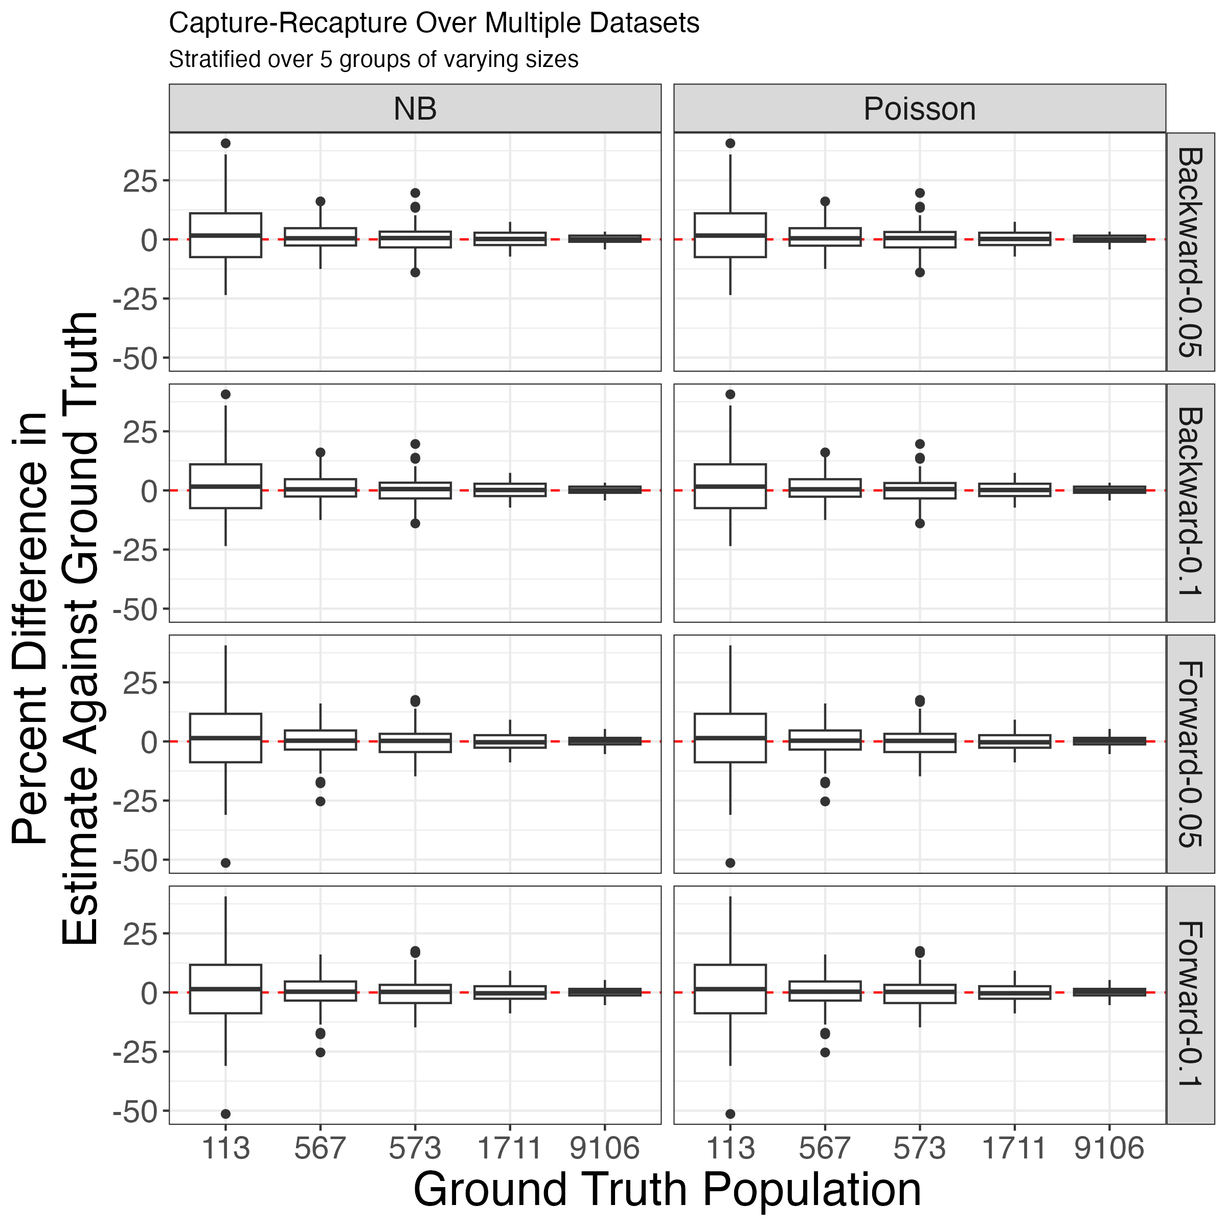
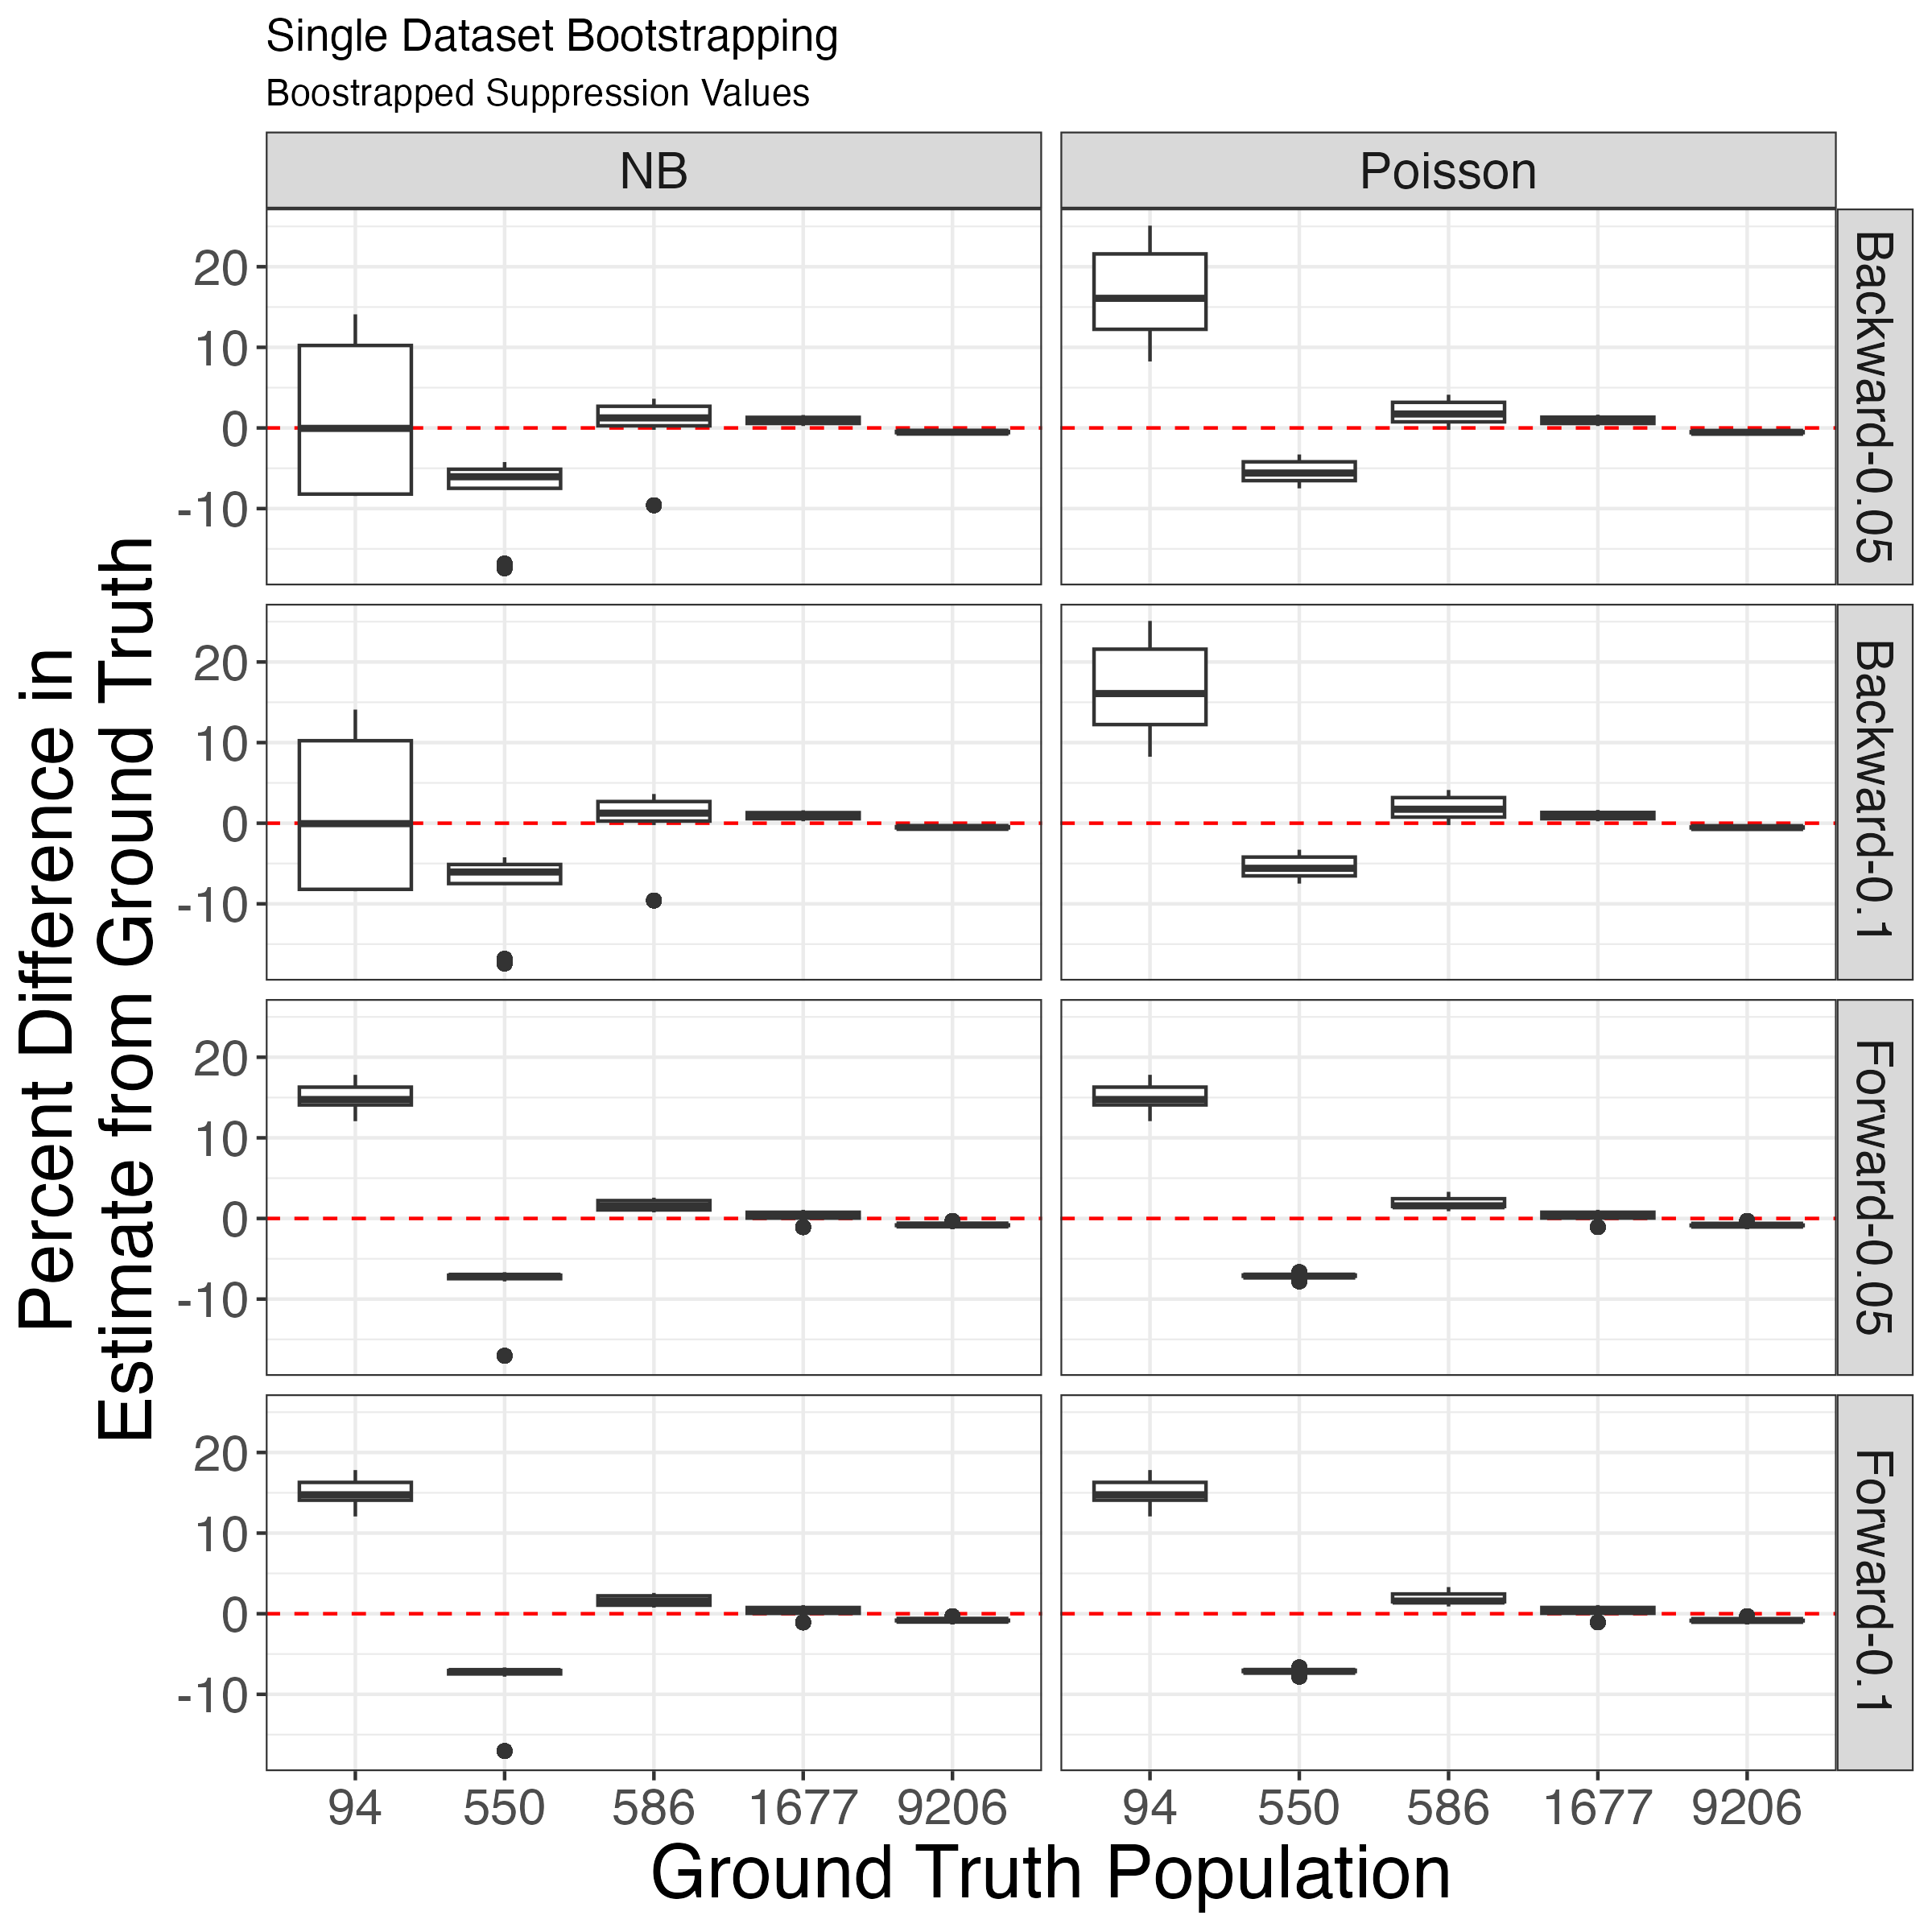




Estimation of Opioid Use Disorder Prevalence Under Unique Data Scenarios: A Simulation Study
Ryan O’Dea MS (1), Benjamin P. Linas MD, MPH (1, 2), Laura F White Ph.D. (3), Joshua A Barocas MD (4), Jianing Wang Ph.D. (5, 6)
(1) Boston Medical Center, (2) Boston University School of Medicine, (3) Boston University School of Public Health, (4) University of Colorado School of Medicine-Divisions of General Internal Medicine and Infectious Diseases, (5) Massachusetts General Hospital, (6) Harvard Medical School
Background
This research aims to investigate multiple systems estimation - a method for estimating the number of people who use opioids living in a jurisdiction while addressing underreporting in surveillance, particularly in demographics where data may be increasingly sparse.
Methods
A population was created with simulated capture histories of six data sources and demographic information.
We examined different model selection procedures (MSP) between Poisson and Negative Binomial (NB) distributions with log-linear models.
Model efficacy and accuracy was benchmarked by comparing model estimates against the simulated ground truth.
We applied these models, stratified by race and sex separately, to Massachusetts Public Health Data with six data sources to estimate the total prevalence of opioid use disorder in the state.
Results
(Top) Bootstrapping across multiple datasets demonstrates a convergence towards the ground truth, suggesting that in scenarios of single model failure, analogous models are likely sufficient to maintain accuracy and reliability.
(Bottom) Bootstrapped backward-stepwise NB models can recover the empirical ground truth at the cost of wide bounds.
When estimating MA prevalence for opioid use disorder, the 95% confidence intervals between the two overall estimates between the stratifications were overlapping.
Takeaway
(Bottom) When emulating a dataset, and bootstrapping over small counts, Negative Binomial estimates using backward step-wise MSPs better estimated the true prevalence.
Prevalence Estimation on Massachusetts Data (2022)
Demographic | Known | Estimate (95% CI) | Total (95% CI)
Male | 71,121 | 7,476 (7,306, 7,648) | 78,597 (78,427, 78,769)
Female | 46,429 | 3,767 (3,641, 3,898) | 50,196 (50,070, 50,327)
White | 92,723 | 8,951 (8,762, 9,143) | 101,674 (101,485, 101,866)
Hispanic | 14,829 | 1,287 (1,219, 1,357) | 16,116 (16,048, 16,186)
Black | 7,851 | 881 (823, 944) | 8,732 (8,674, 8,795)
Asian/PI | 495 | 124 (98, 155) | 619 (593, 650)
Other | 1,440 | 283 (245, 326) | 1,723 (1,685, 1,766)
Notes:
Real estimates as a result of fluctuating suppression (e.g. if a value is suppressed, new values are randomly resampled from 1:10) In the simulation, this fluctuation did not make much of a difference; however, the graphics produced on the right are the result of REMOVING values between 1:10.
Subtitle = Stratified over groups of varying sizes

