Slide 1
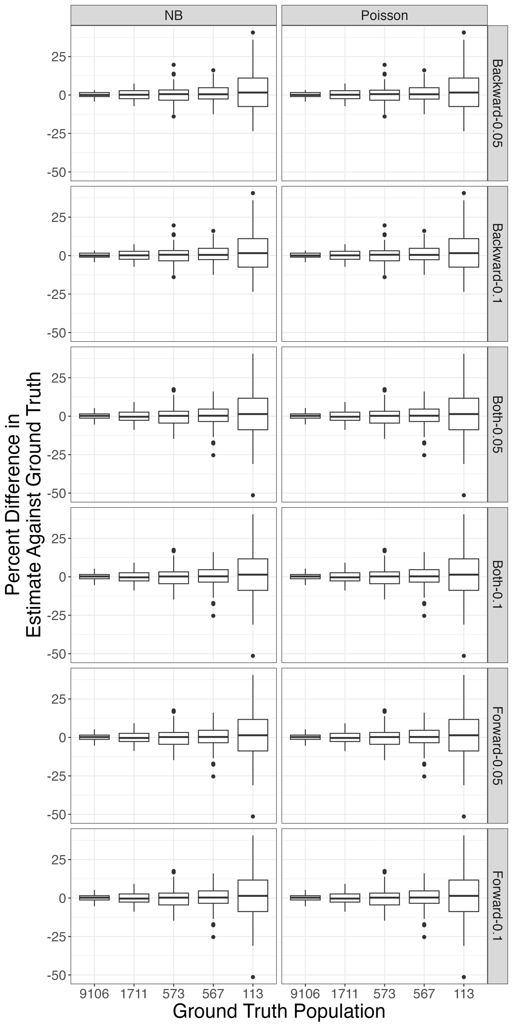



Estimation of Opioid Use Disorder Prevalence Under Unique Data Scenarios: A Simulation Study
Ryan O’Dea MS (1), Benjamin P. Linas MD, MPH (1, 2), Laura White Ph.D. (3), Joshua Barocas MD (4), Jianing Wang Ph.D. (5, 6)
(1) Boston Medical Center, (2) Boston University School of Medicine, (3) Boston University School of Public Health, (4) University of Colorado School of Medicine-Divisions of General Internal Medicine and Infectious Diseases, (4) Massachusetts General Hospital, (6) Harvard Medical School
Abstract
This research aims to improve “capture-recapture” analysis - a method for estimating the number of people who use opioids living in a jurisdiction.
We created a simulated population with a given prevalence of opioid use.
We simulate a population of people who use opioids along with their “capture” of data in administrative records.
We then performed the ”capture-recapture” analysis on the simulated data. and compared estimated prevalence to underlying true prevalence.
Through contrasting different model selection processes, we enhance the precision of OUD prevalence estimates
Results
When populations are large, we can recover the ground truth within 1%.
When populations become small, single point estimation using capture recapture loses accuracy showing a potential lack of robustness with respect to capture histories and population size.
We attempt to address this lack of robustness through bootstrapping, which allows us to recover the ground truth
Takeaway
CRC is a valuable method for estimating the hidden prevalence of OUD, but its effectiveness depends on selecting appropriate models based on available data. Through contrasting different approaches, we highlight the estimation process for strata-specific prevalence and interpret strengths and limitations of common model selection strategies, enhancing the precision of OUD prevalence assessments for uniquely stratified data.
Outcomes
[[TABLE OF ESTIMATE FOR 2021 HERE]] – seeing if I can get 2022 data from the PHD in time
Notes:
Real estimates as a result of fluctuating suppression (e.g. if a value is suppressed, new values are randomly resampled from 1:10) In the simulation, this fluctuation did not make much of a difference; however, the graphics produced on the right are the result of REMOVING values between 1:10.

