Slide 1

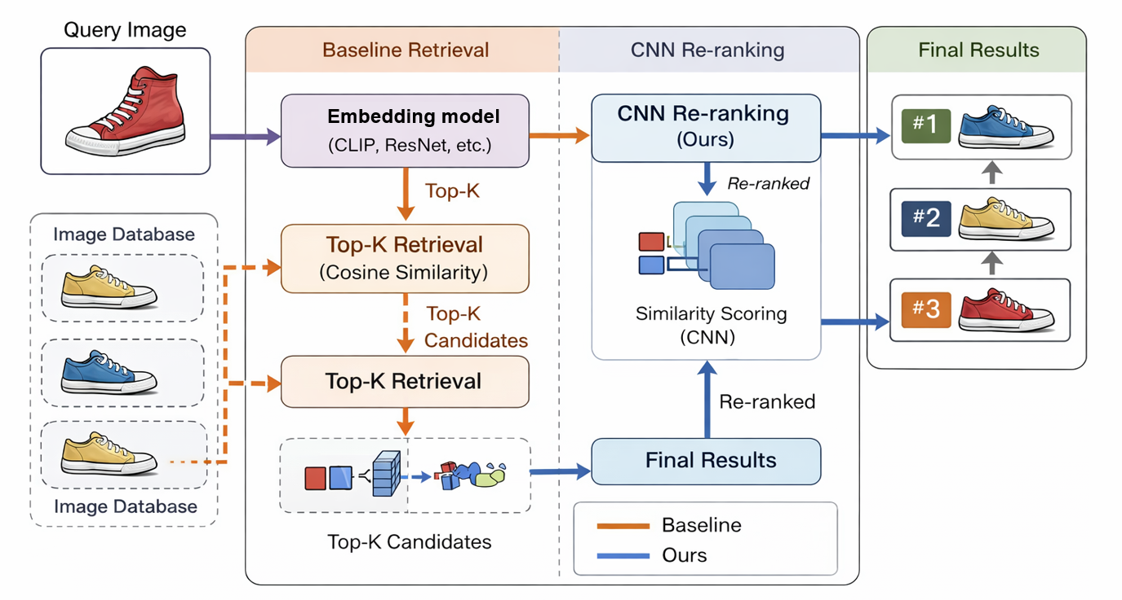
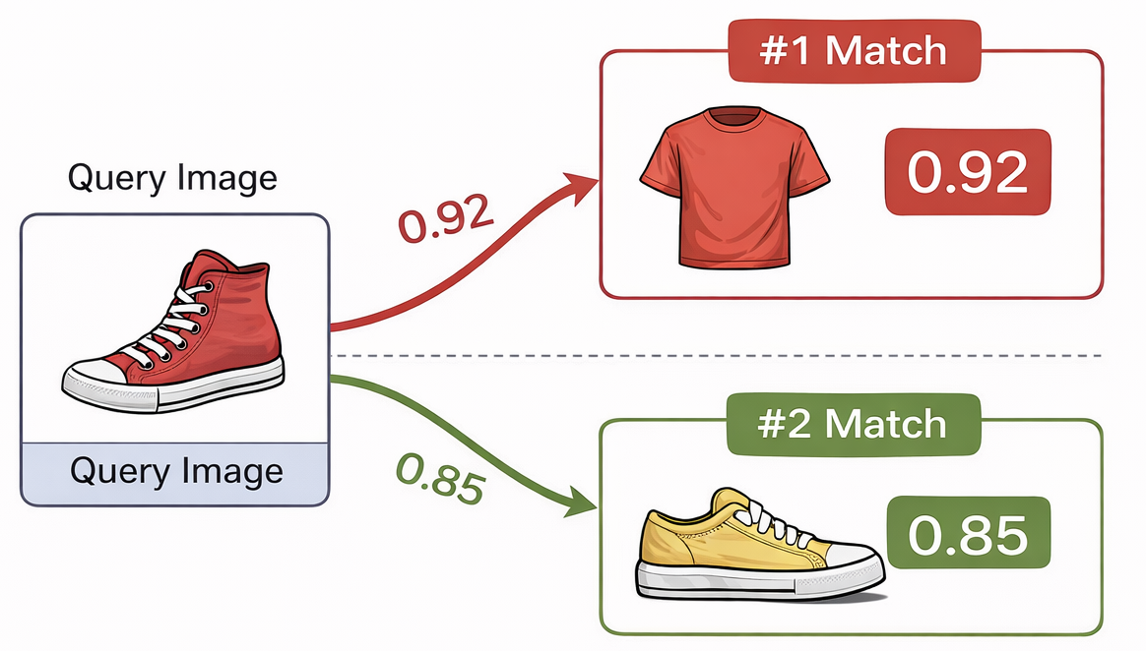
Towards Efficient Reranking for Semantic Image Retrieval
Linli Shi,Yang Han, Zhifei Yu
Problem Statement
Overall Approach
Most image retrieval systems use embeddings with cosine similarity, which is efficient but fixed and non-adaptive.
As a result, they often rely on superficial features (e.g., color) rather than true semantic similarity, leading to incorrect rankings.
We first retrieve Top-K candidates using cosine similarity, then refine the ranking using a lightweight CNN-based similarity model.
Solution
Milestones
We propose a lightweight CNN-based re-ranking module to improve image retrieval results by learning a better similarity function. Instead of relying on fixed cosine similarity, our method refines the Top-K retrieved candidates using a data-driven model that compares query–candidate image pairs. Specifically, (1) we first retrieve Top-K images using embedding and cosine similarity, (2) then compute pairwise similarity scores using a CNN model, and (3) re-rank the candidates based on these learned scores. This approach captures fine-grained visual differences while remaining more efficient than transformer-based re-ranking methods.
1.Reproduce baseline image retrieval system (embedding + cosine similarity)
2.Implement CNN-based re-ranking module
3.Train reranking model with pairwise data
4.Evaluate performance and analyze results

