Slide 1
DIGITAL COMMUNICATION PROJECT REVIEW - 1
ARVINDHAN K - 22BEC1026 J Naveen VIGNESH -
PRAHADEESWAR C – 22BEC1146

Slide 2
PROJECT TITLE
Study and Analysis in MIMO Wireless Channel for STBC and Equalization Techniques by Using Matlab

Slide 3
Objective
The objective of this project is to analyze and enhance data transmission rates in MIMO wireless channels by utilizing advanced techniques such as Space-Time Block Coding (STBC) and Zero Forcing (ZF) equalization. The study aims to improve the reliability and efficiency of wireless communication systems through innovative signal processing methods. Ultimately, the project seeks to contribute to the development of robust wireless technologies that meet future data flow demands.

Slide 4
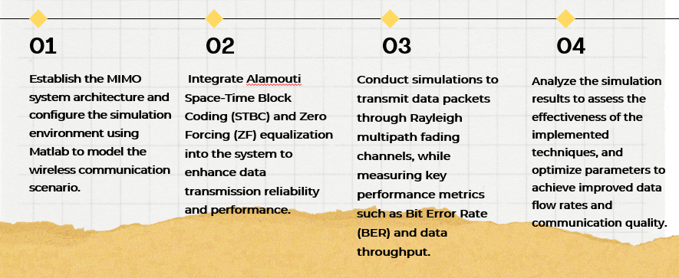
Work Flow

Slide 5
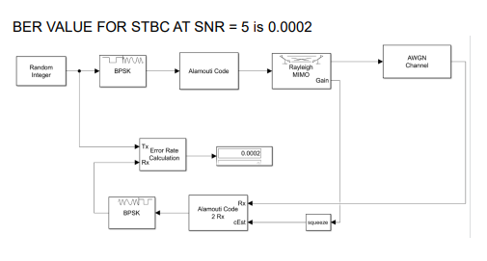
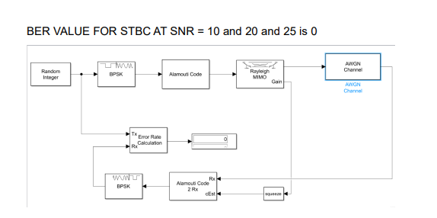
Block Diagram

Slide 6
Methodology
MIMO System Design: Implement a MIMO architecture using Alamouti STBC and BPSK modulation to enhance data transmission rates.
Simulation and Testing: Conduct simulations in Matlab to evaluate system performance under Rayleigh fading and AWGN conditions, focusing on Bit Error Rate (BER).
Performance Optimization: Analyze simulation results to optimize system parameters, aiming to improve data flow rates and overall communication reliability.

Slide 7
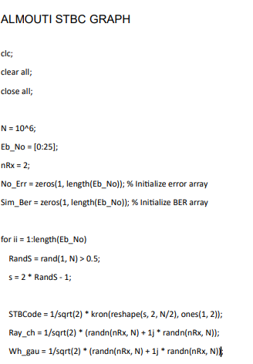
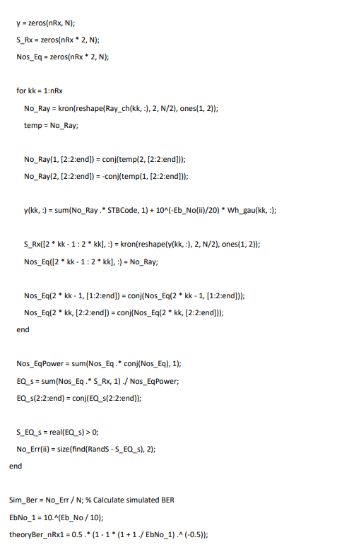
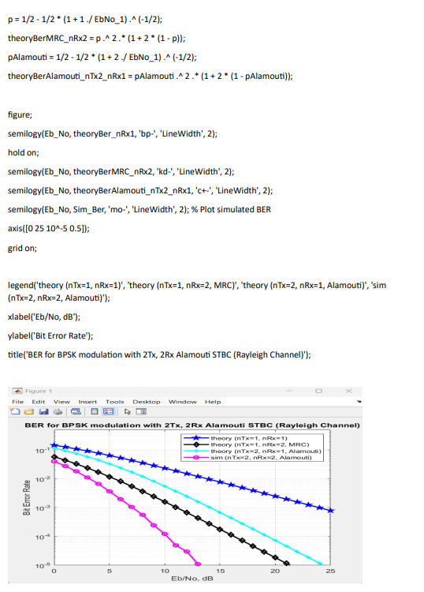
CODE AND OUTPUT

Slide 8
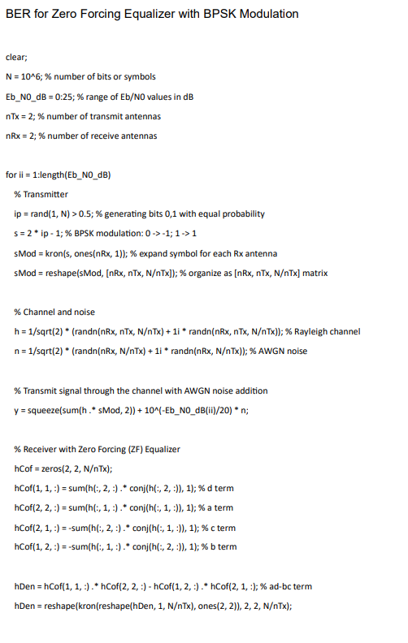
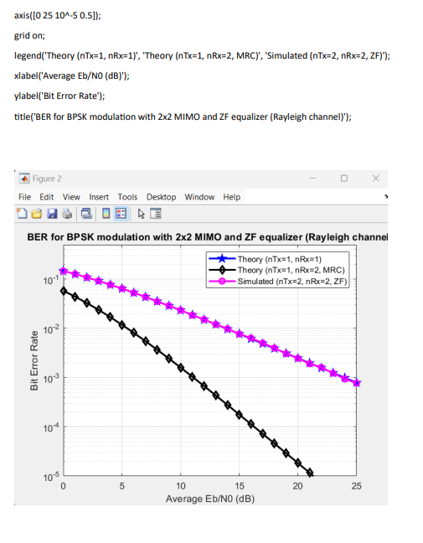
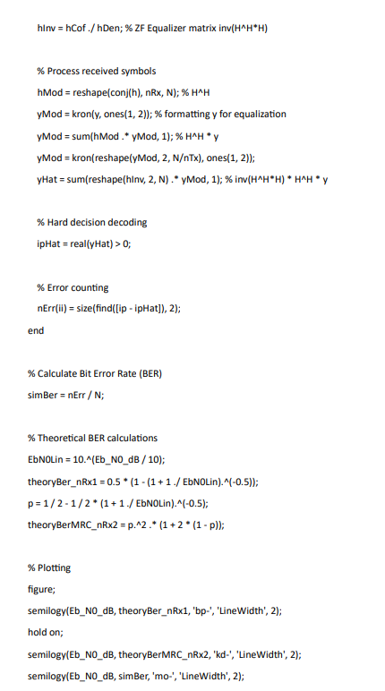
CODE AND OUTPUT

Slide 9
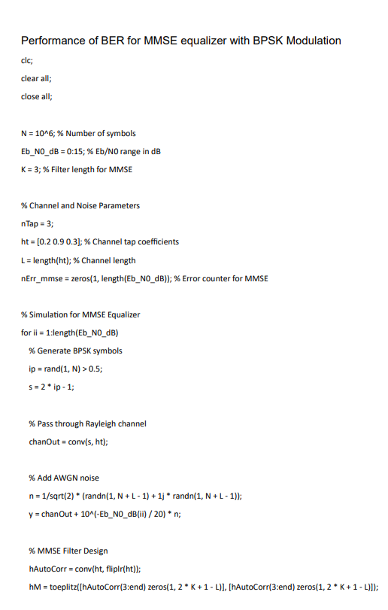
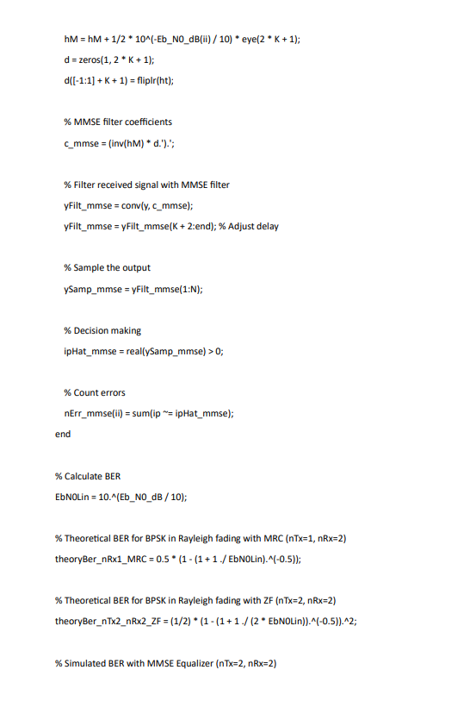
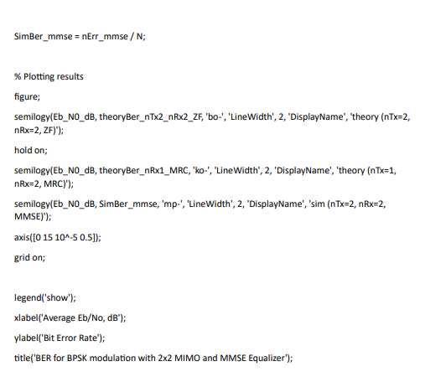
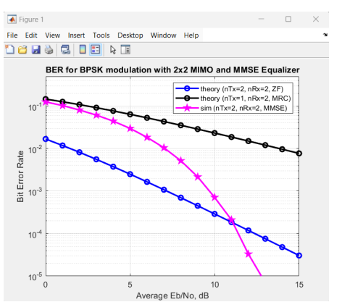
CODE AND OUTPUT

Slide 10
Conclusion
In conclusion, this project highlights the critical role of advanced techniques like Alamouti STBC and Zero Forcing equalization in optimizing MIMO wireless communication systems. By leveraging these methods, the study not only addresses the challenges of data transmission in fading environments but also emphasizes the importance of simulation tools like Matlab for performance analysis. The insights gained from this research contribute to the ongoing development of robust wireless technologies, ensuring higher data rates and improved service quality for future applications.

