Slide 1

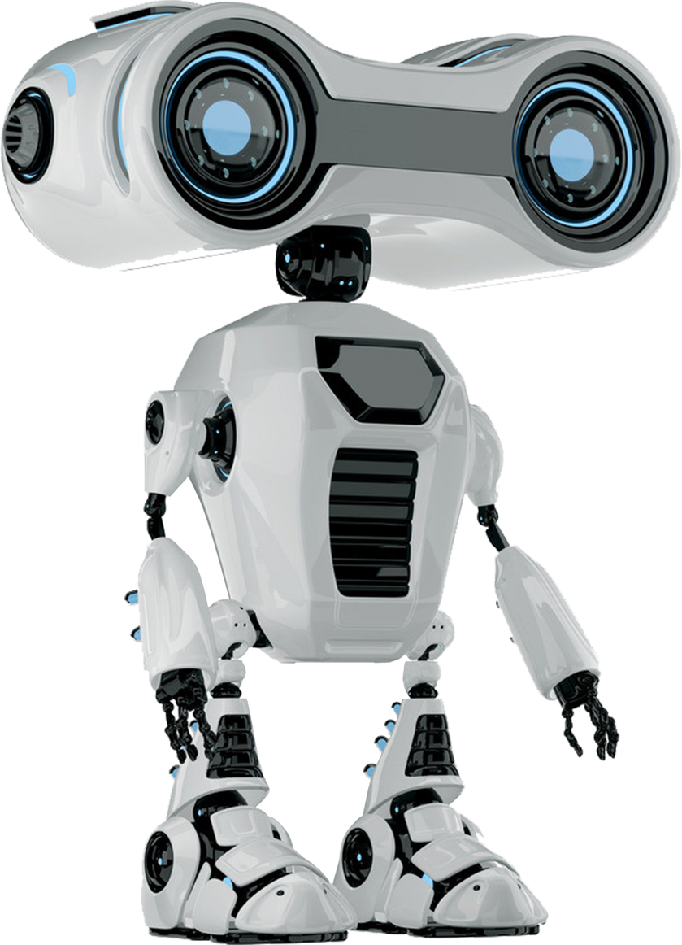



SPROUT-IQ
The intelligent agriculture bot that optimizes crop growth and delivers tailored recommendations using advanced sensors and machine learning.

Slide 2


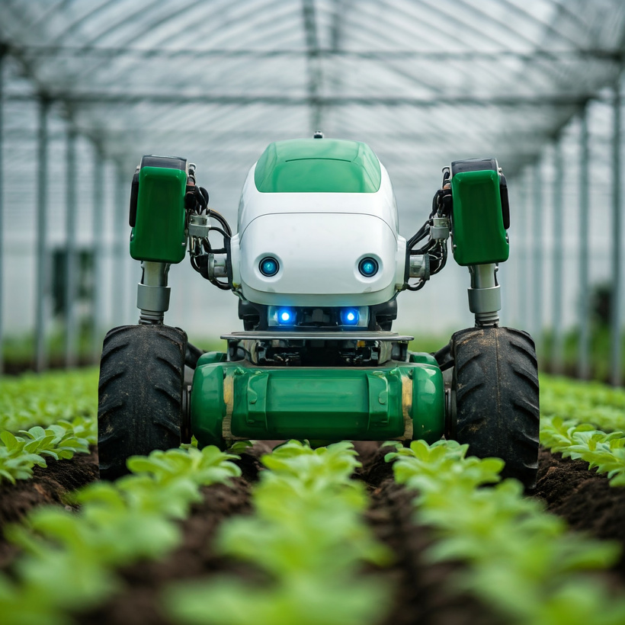
Problem Statement
Lack of Efficient and Automated Solutions for Crop Recommendation and Plant Growth Optimization
According to a study in 2018, the agricultural sector employed about 50% of the workforce yet only contributed to 17-18% of India’s overall GDP. Soil testing can be a tedious task, inaccurate manual analysis could lead to loss of crops and low productivity infertility of soil.

Slide 3
Solution Overview
Introducing Sprout-IQ, an innovative agricultural bot designed to improve crop recommendations and plant growth optimization.
In an industry where manual soil testing often leads to inaccuracies and low productivity, Sprout-IQ automates this process using advanced sensors—such as NPK, temperature, humidity, and moisture sensors—to assess soil conditions in real-time. This data is processed through machine learning to recommend the best crops for each field.
With a sturdy, portable design, Sprout-IQ navigates rough terrains, making it suitable for both small and large farms. By delivering precise, data-driven insights, Sprout-IQ aims to boost crop yield, efficiency, and profitability, fostering smarter, more sustainable farming.

Slide 4


Components Overview
Servo Motor
Controls precise movements for tasks like positioning sensors and navigating narrow areas.
Arduino
Interfaces with sensors and controls other hardware components, acting as the bot’s controller.
HC-05
Enables Bluetooth communication for wireless control and data transmission.
BLDC Motor
Provides powerful and efficient movement, allowing the bot to navigate varied terrains.
Ultrasonic Sensor
Measures distance to obstacles, enabling the bot to detect and avoid obstacles.
DHT11 Sensor
Monitors temperature and humidity levels, gathering environmental data for crop recommendations.
Moisture Level Sensor
Measures the soil’s moisture content, providing key data on soil conditions.

Slide 5

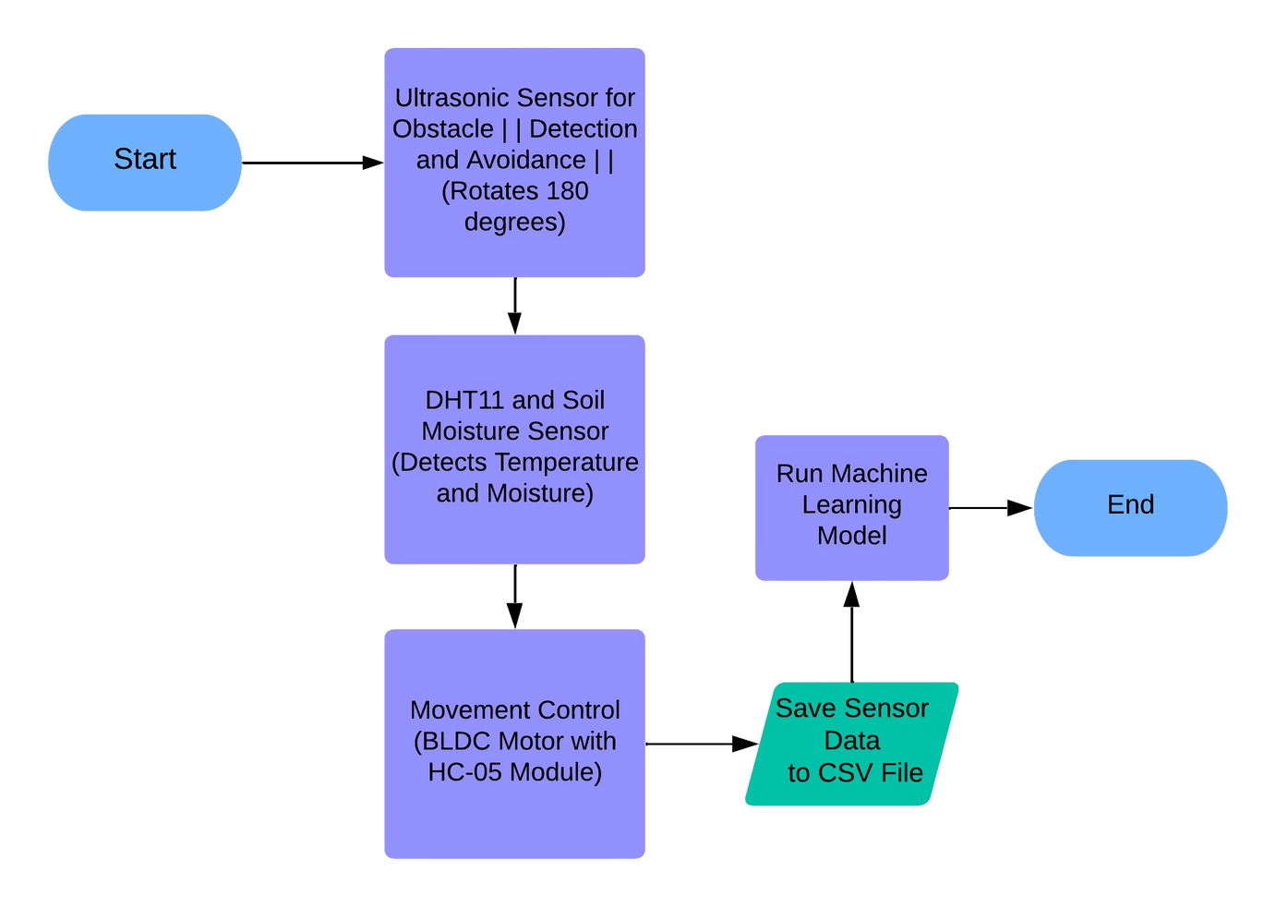
Process Flow Diagram

Slide 6

Operational Flow
1. Initialization
The bot begins its operation upon startup, preparing all systems and components for functioning.
2. Obstacle Detection and Avoidance
Using an ultrasonic sensor that rotates 180 degrees, Sprout-IQ continuously scans its environment to detect obstacles, ensuring safe navigation through the field.
3. Environmental Monitoring
The DHT11 sensor measures ambient temperature and humidity, while the soil moisture sensor assesses soil moisture levels. These sensors provide essential data for optimal crop growth conditions.
4. Movement Control
Based on sensor readings, the BLDC motor, controlled via the HC-05 Bluetooth module, allows Sprout-IQ to move efficiently across various terrains, adapting its path as needed.
5. Data Logging
All sensor data, including environmental conditions and soil metrics, are saved to a CSV file. This step ensures that valuable information is recorded for later analysis.
6. Machine Learning Analysis
Finally, the saved data is processed through a machine learning model. This model analyzes the information to recommend the most suitable crops for the given conditions, enhancing agricultural productivity.

Slide 7
Target Market
Market Segments
Market Opportunity
Small and Medium Farmers: Primary users who benefit from optimized crop recommendations, better yields, and soil health data.
Large Agricultural Enterprises: For large-scale operations that need data-driven insights for efficient resource allocation.
Agricultural Researchers and Institutions: Academic and research institutions that may use Sprout-IQ for advanced studies in soil analysis and crop suitability.
The rise in digital agriculture and precision farming creates a significant demand for automated, data-driven solutions like Sprout-IQ.
Growing awareness of sustainable farming practices increases the appeal of tech-enabled solutions in agriculture.

Slide 8

THANK YOU!

