Slide 1
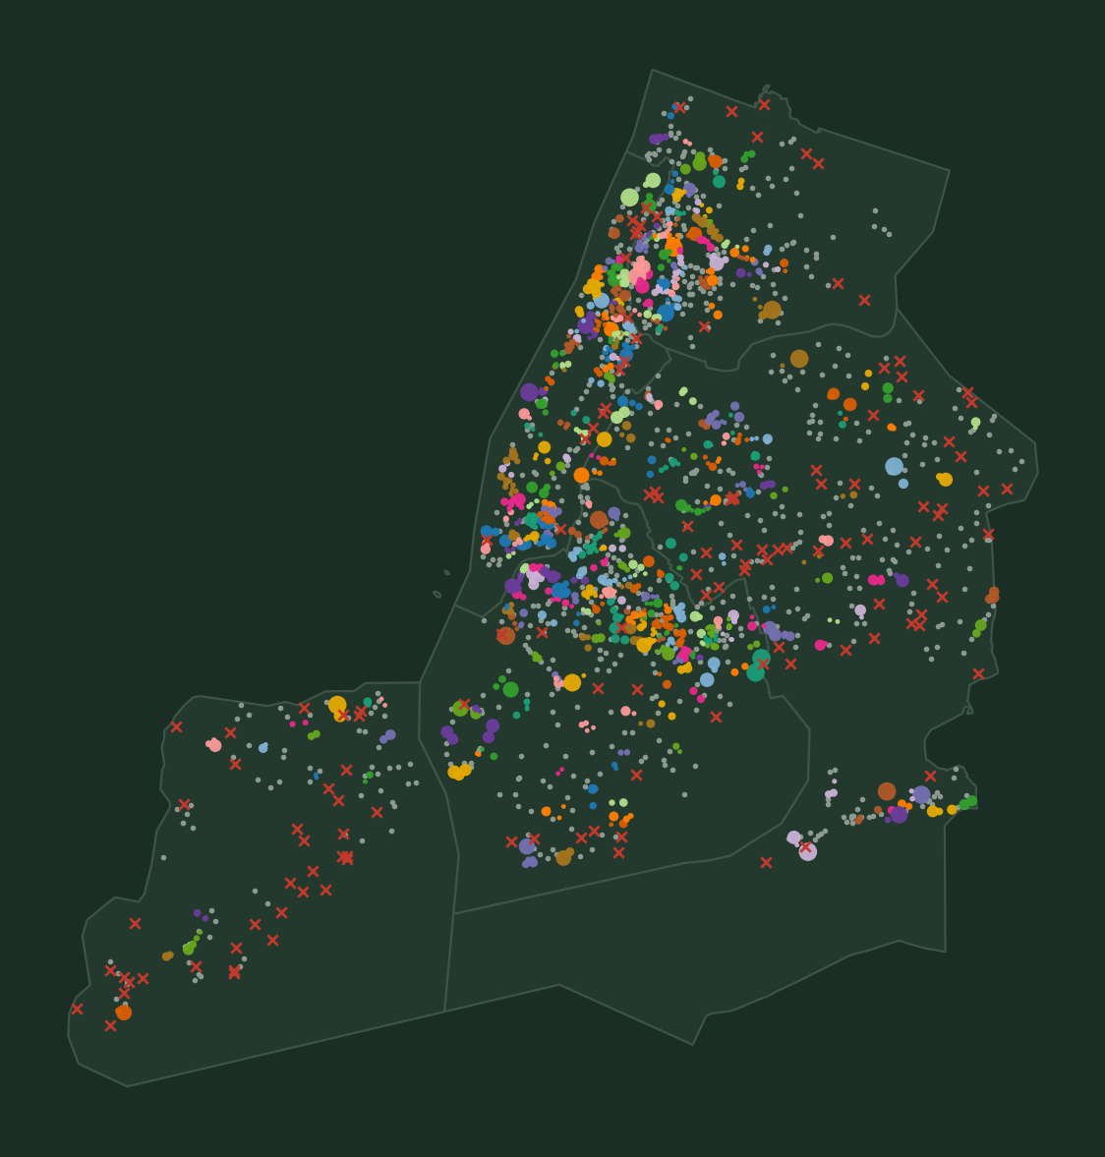
How Are New York's Parks
Connected by Streets?
Grouping 1,902 small and medium parks by the shape of the walking network — not just by distance
NYC Parks properties · OpenStreetMap walking network · Cityseer 5.8
October 2026
Notes:
Space-Syntax-inspired analysis of NYC parks with Cityseer. Map colours = few-turn (N1) groups.

Slide 2
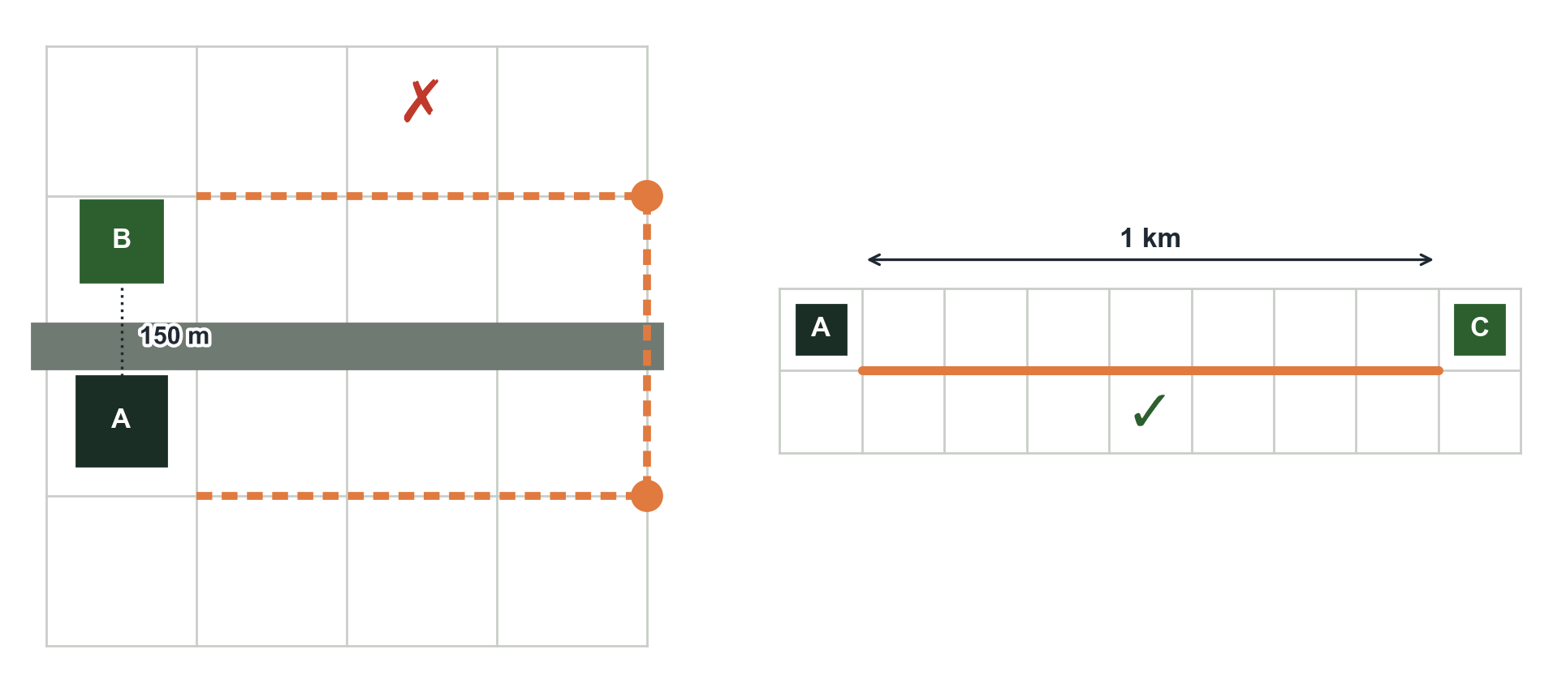
Close is not the same as connected
Why: next, we test whether connected groups of parks go with more shops and visits nearby.
We usually ask how far apart two parks are. But people pick routes that are easy to follow.
A route with few turns feels simple — like walking along one straight avenue.
So we ask: which parks are linked by the street layout itself?
Close on the map — but you must walk around a barrier
Farther apart — but one straight street
This idea comes from Space Syntax, a field that studies how the shape of streets guides where people walk.
Notes:
Contrast: proximity vs configuration.

Slide 3
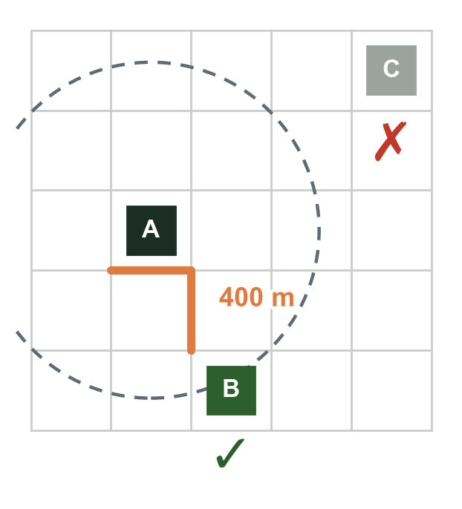
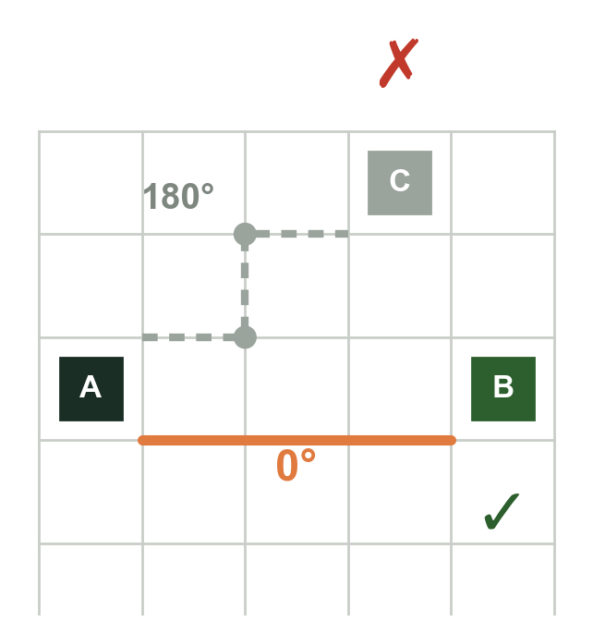
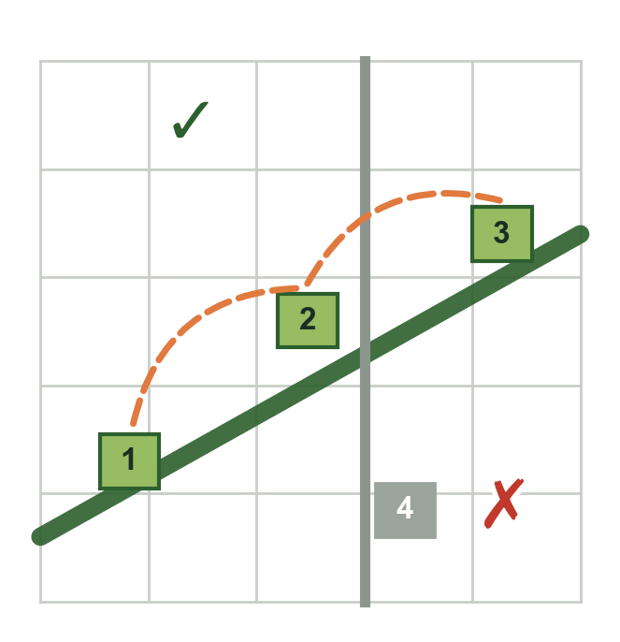
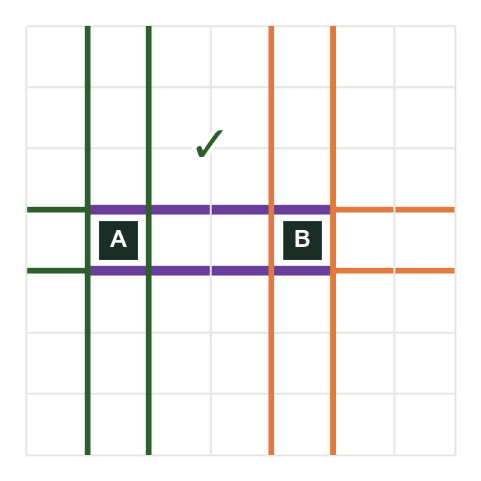
Four ways two parks can be “connected”
D
Short walk
N1
Few turns
N2
Same street axis
N3
Shared walking zone
The two parks are only a few minutes' walk apart along real streets (200–800 m).
You can walk from one park to the other while turning very little.
Both parks sit along one continuous street you can follow without switching streets.
The streets reached by walking (almost) straight from each park overlap more than distance explains.
The usual “nearby” — our baseline.
Directions that say: “just go straight.”
Two shops on the same avenue.
Two schools whose students use the same streets.
For all four: every park in a group must be within a 10-minute walk (800 m) of every other park in that group.
Notes:
One-page summary of the four definitions (D, N1, N2, N3); formal versions are in the appendix.

Slide 4
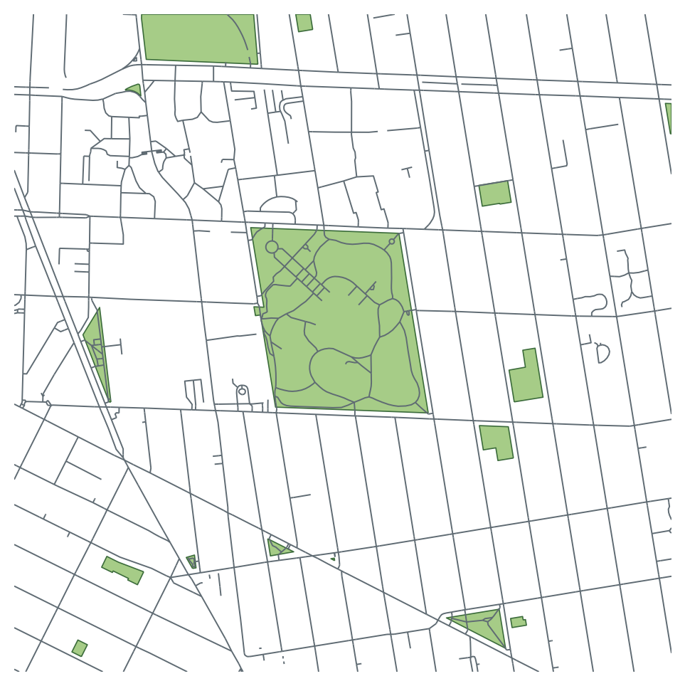
What we used
1,902
small & medium parks — we left out huge parks such as Central Park, and lots that are not real parks
496k
walkable streets and paths from OpenStreetMap, the free “Wikipedia of maps”
25 → 180
very long parks (e.g. parkway medians) cut into ~400 m pieces, so one park cannot link places kilometres apart
Walking network (lines) and parks (green) around Fort Greene, Brooklyn
Notes:
Data sources and filters.

Slide 5
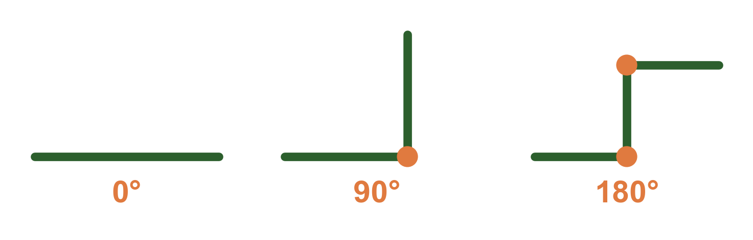
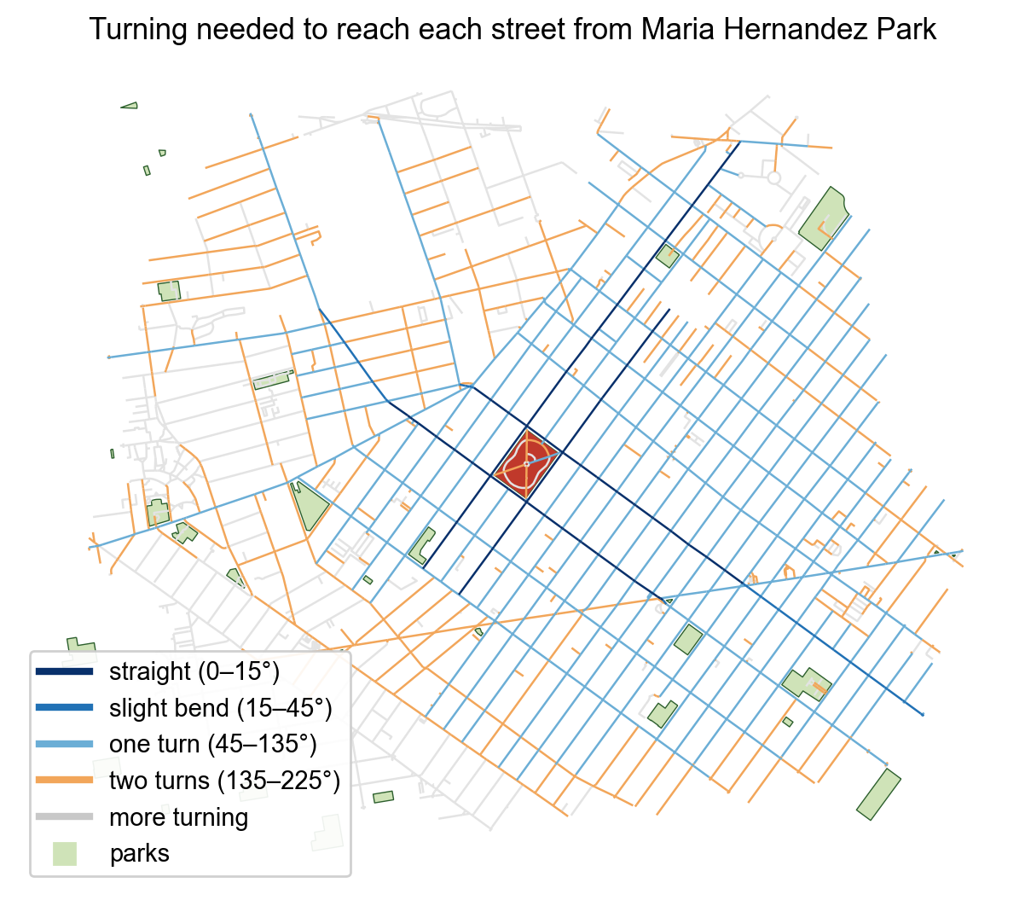
Counting how much a route turns
Going straight = 0°. Turning a corner ≈ 90°.
Between two parks we find the route that turns the least (not the shortest one) and add up its turns.
Map: from one park, dark-blue streets are reached by going straight, light blue with one turn, orange with two.
Computed with Cityseer, an open-source tool for analysing street networks.
Notes:
Angular (simplest-path) cost explained.

Slide 6
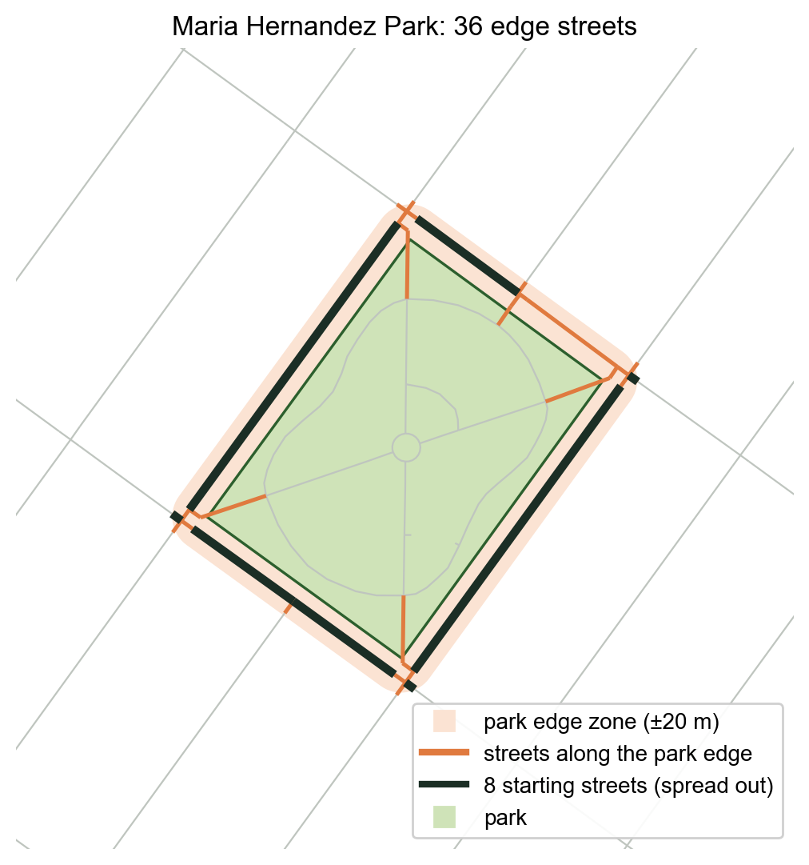
Where does a park meet the street?
We don't know where each park's entrances are.
So we treat the streets running along the park's edges (orange) as its doors.
Big parks have many edge streets, so we start from at most 8 spread-out ones (black). This keeps big parks from getting an unfair advantage.
Notes:
Boundary-based attachment, no entrance data.

Slide 7
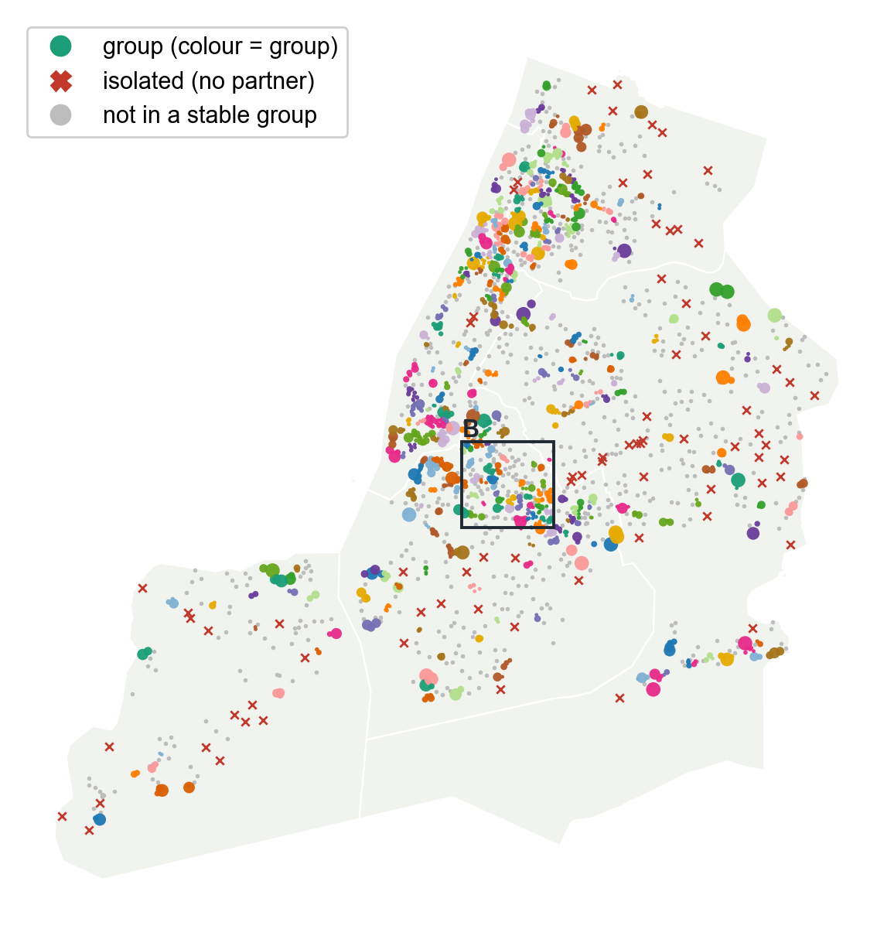
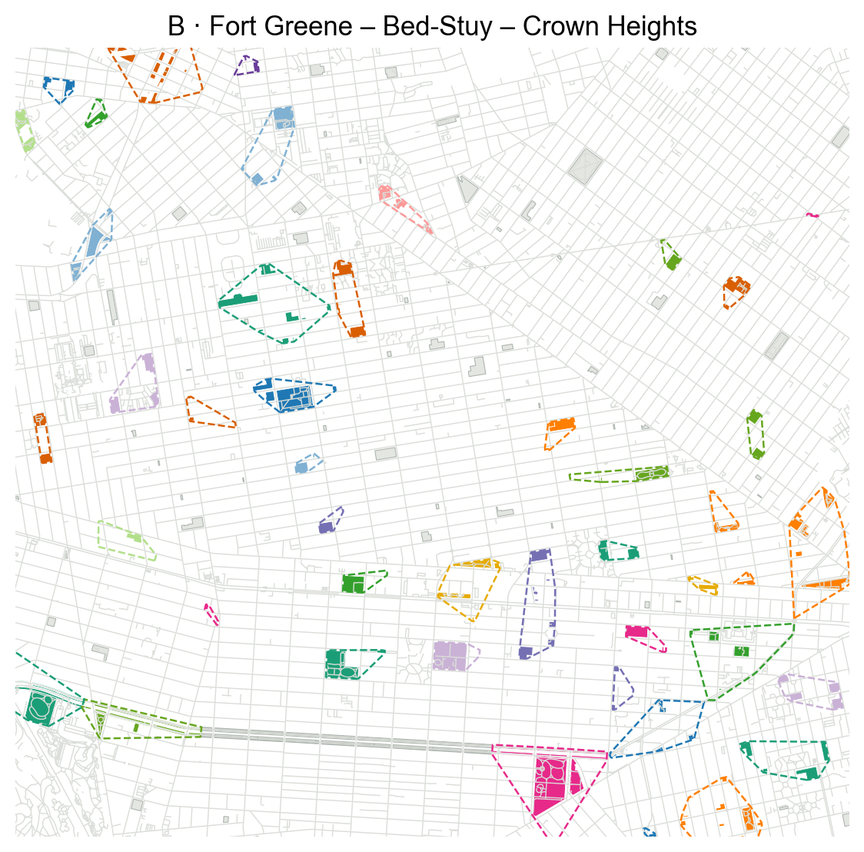
D · Parks within a short walk (baseline)
349
groups
1,274
parks in a group
3
parks in a typical group
76
parks with no other park nearby
Each colour is one group. This is pure proximity — the other three definitions are compared against it.
Notes:
D links parks whose shortest walking distance is ≤ 200/400/800 m; same grouping procedure as the others.

Slide 8
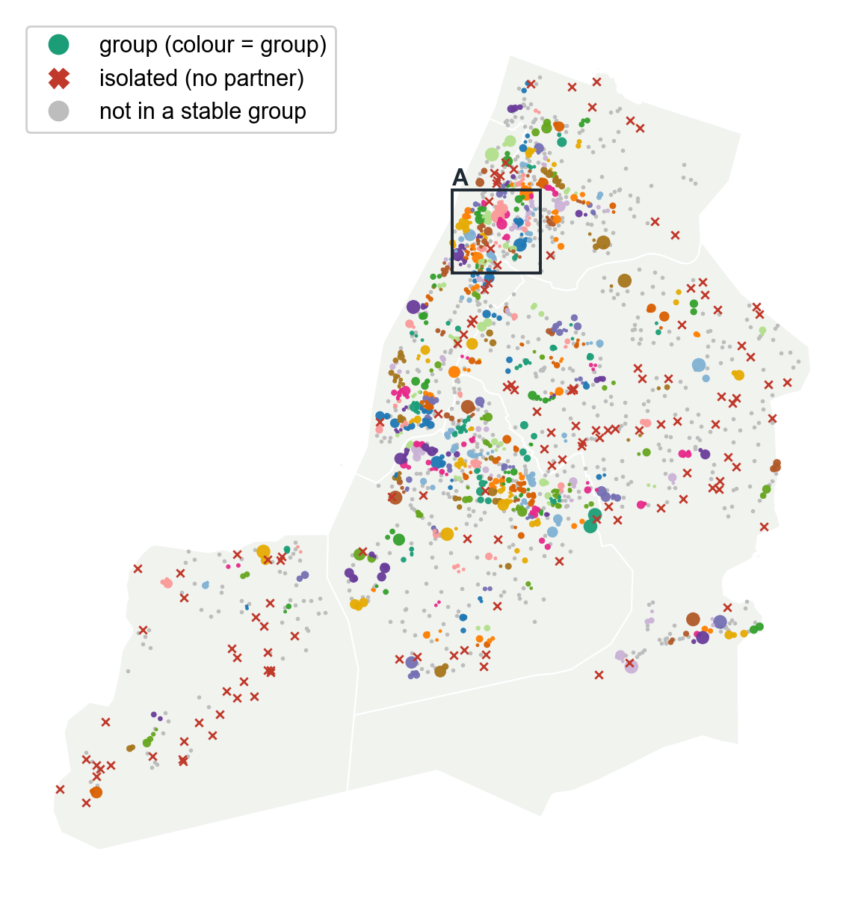
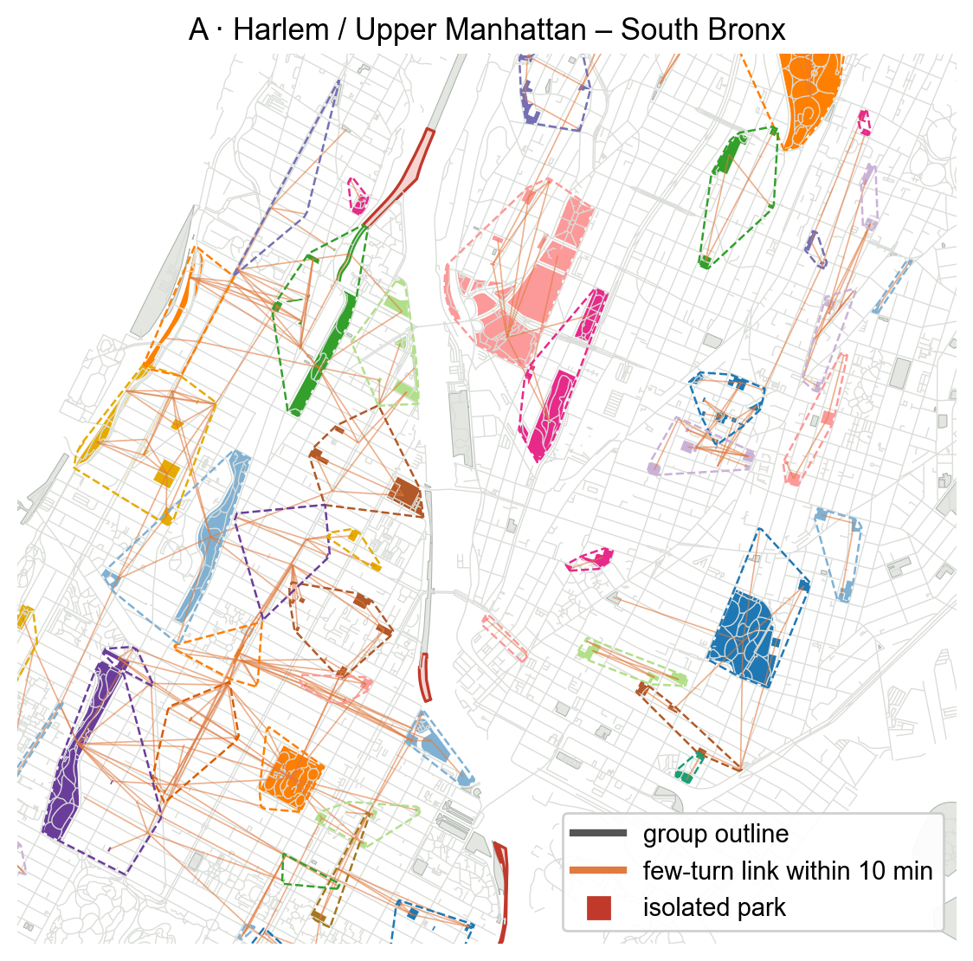
N1 · Parks linked by few-turn routes
340
walkable groups
1,178
parks in a group
3
parks in a typical group
132
parks with no few-turn partner
Each colour is one group. Orange lines: few-turn links within a 10-minute walk.
Notes:
N1 results.

Slide 9
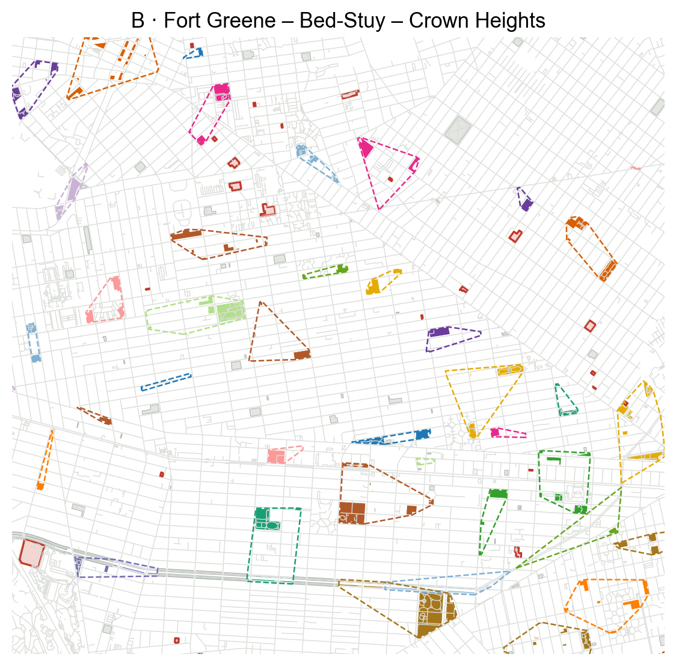
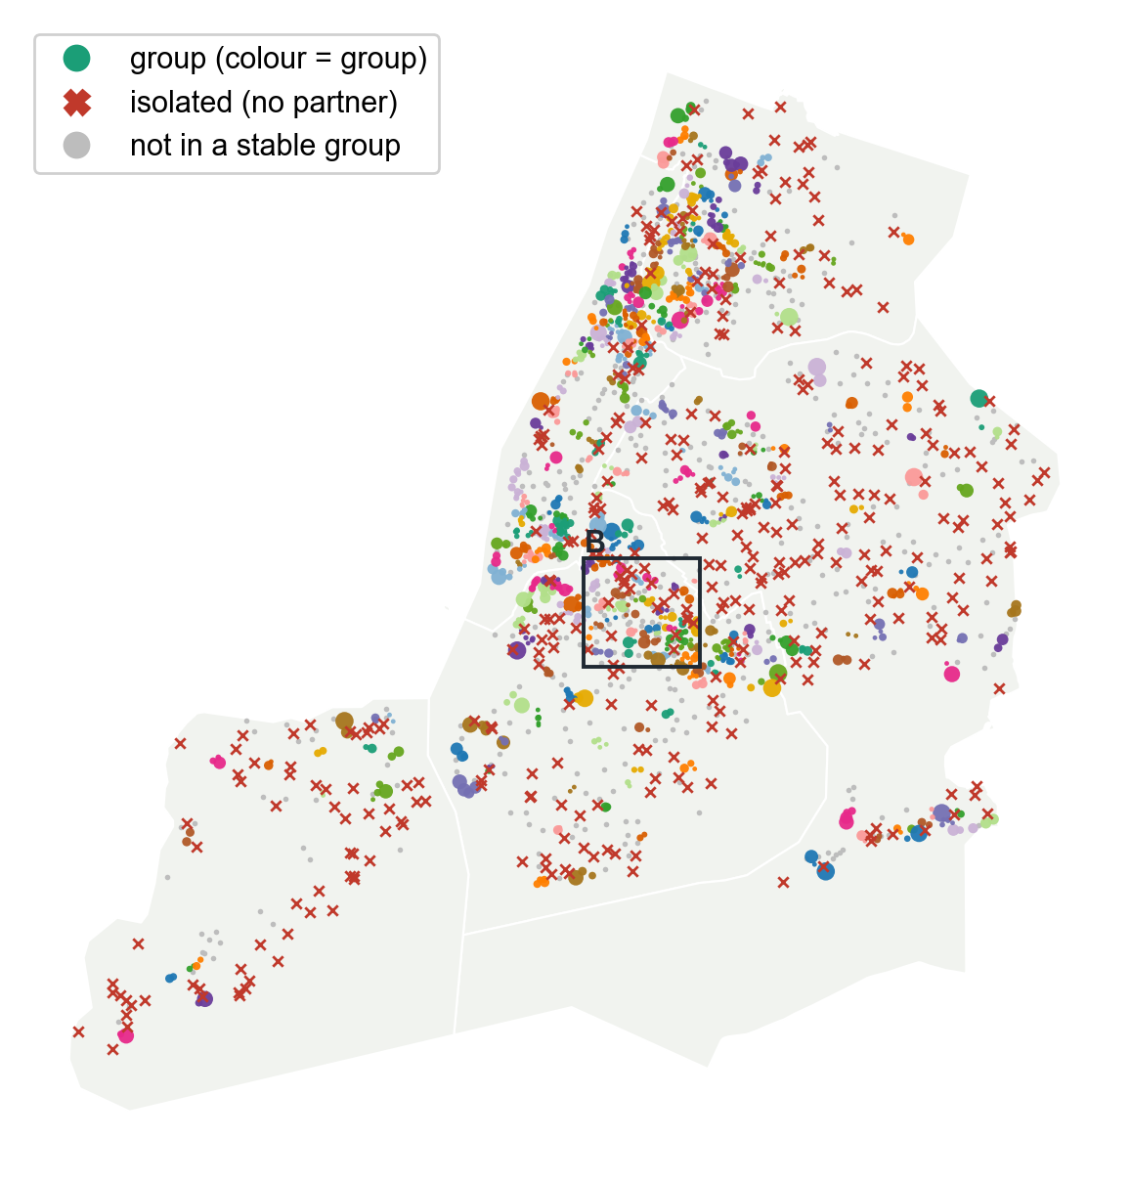
N2 · Parks along the same street axis
329
groups
1,212
parks in a group
“Street axis” = one continuous street you can follow without switching streets (direction change < 30° at each junction).
46% of N2 groups touch a main street (top 5% of through-walking) — kept as a group attribute.
Notes:
N2 results.

Slide 10
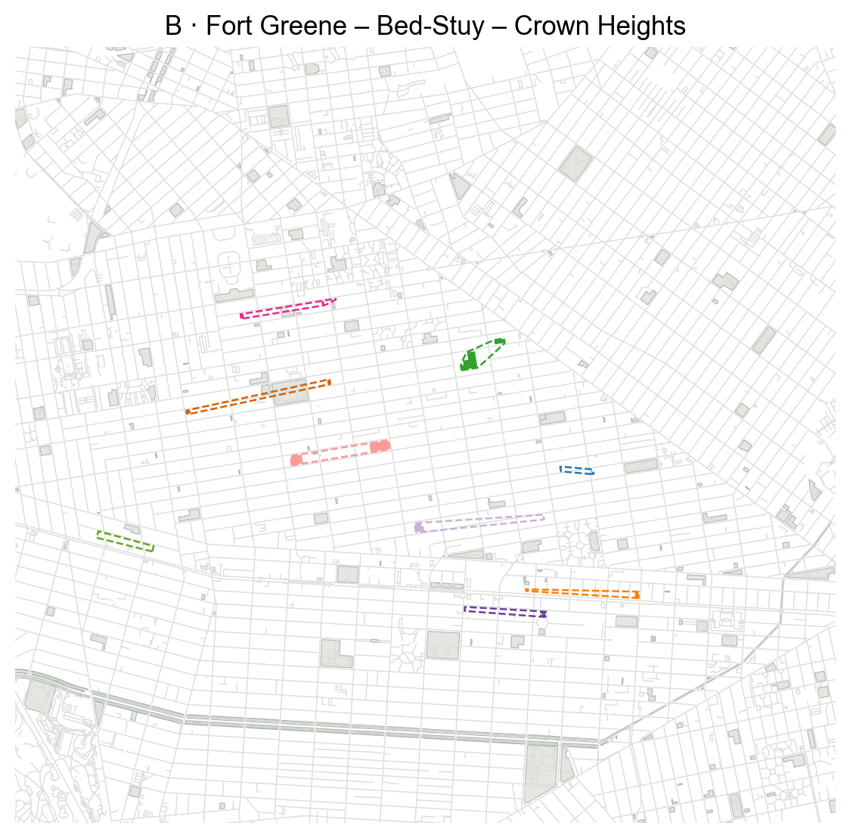
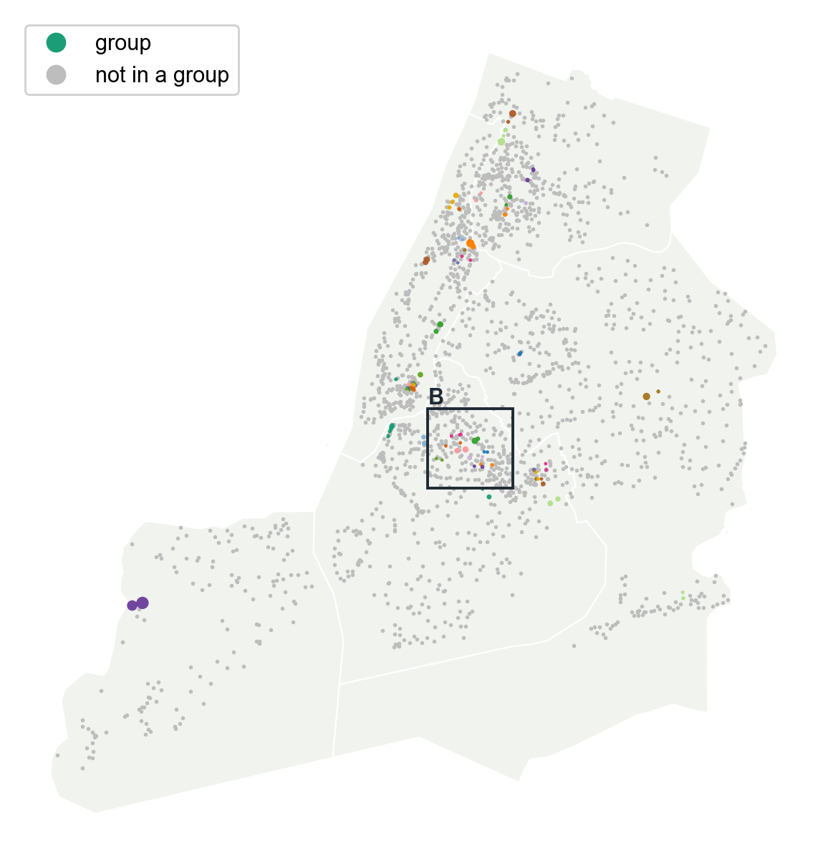
N3 · Parks sharing a walking zone
47
groups (mostly pairs)
113
parks in a group
Rare: two parks' straight-walk zones seldom overlap more than their distance alone explains.
N3 is a weak signal — useful mainly as a contrast to N1 and N2.
Notes:
N3 results.

Slide 11
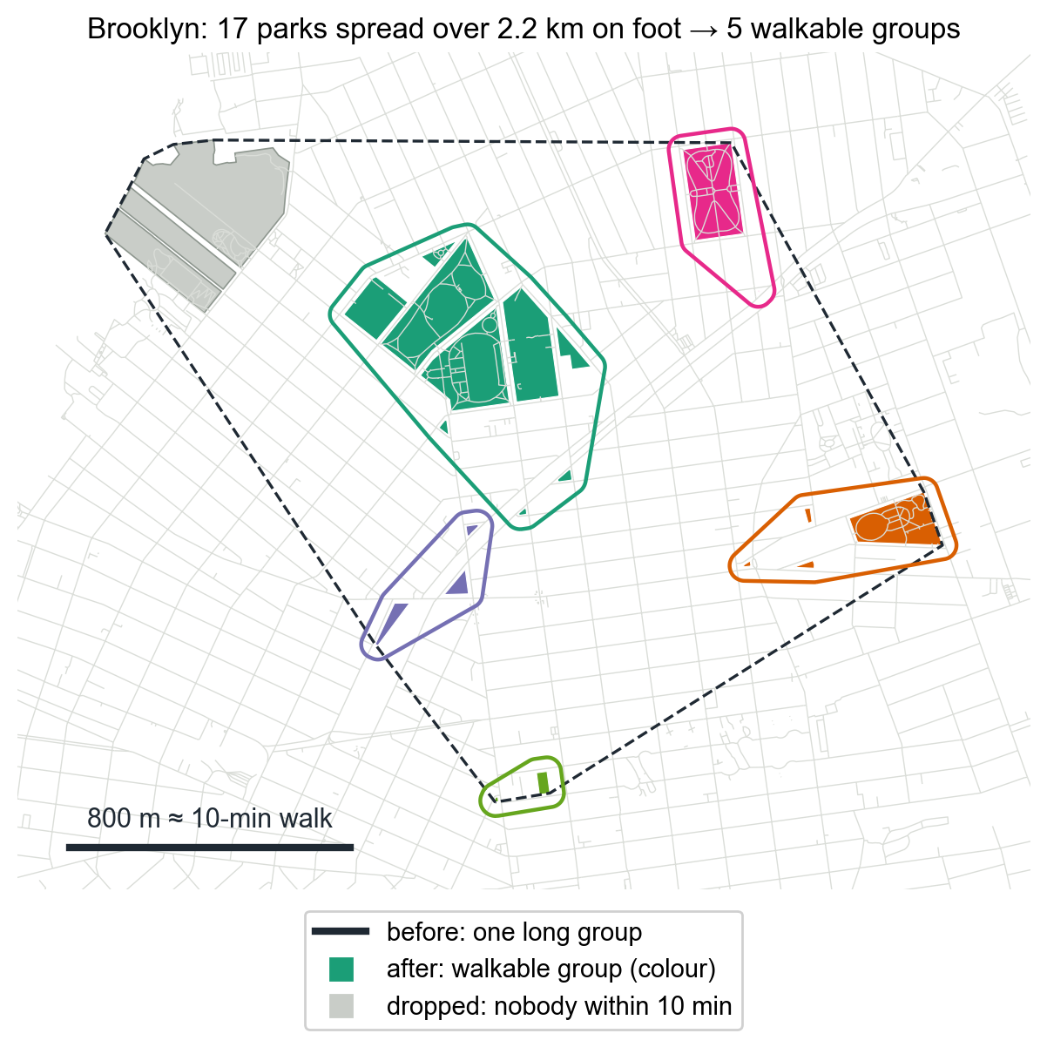
Groups must be walkable: the 10-minute rule
Street-shape links can chain parks across several kilometres.
So inside each group, every pair of parks must be within a 10-minute walk (800 m along real streets).
Long groups are split; a park with nobody within 10 minutes leaves the group.
 | groups | largest group
D short walk | 281 → 349 | 29 → 16
N1 few turns | 217 → 340 | 41 → 15
N2 same axis | 231 → 329 | 32 → 22
N3 walking zone | 63 → 47 | 8 → 8
Notes:
Walking-distance safeguard.

Slide 12
Is this just about distance?
We compare each definition with D, which groups parks by walking distance only.
N1: 59% of its grouped pairs are also grouped by D — the other 41% come from street shape.
N2: 64% · N3: 51%.
So street shape changes which nearby parks belong together.
Notes:
Share of grouped pairs also grouped by D.

Slide 13
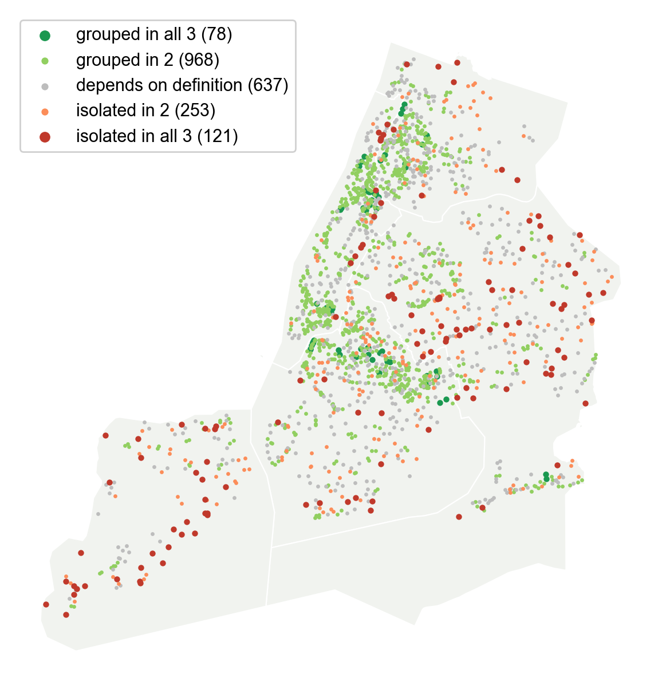
Parks left alone
Mostly in Staten Island and Queens, where streets curve and dead-end.
Also parks squeezed next to highways or along the waterfront.
They sit outside the walkable “park network” — worth a look for planning.
Notes:
Isolated under N1, N2 and N3.

Slide 14
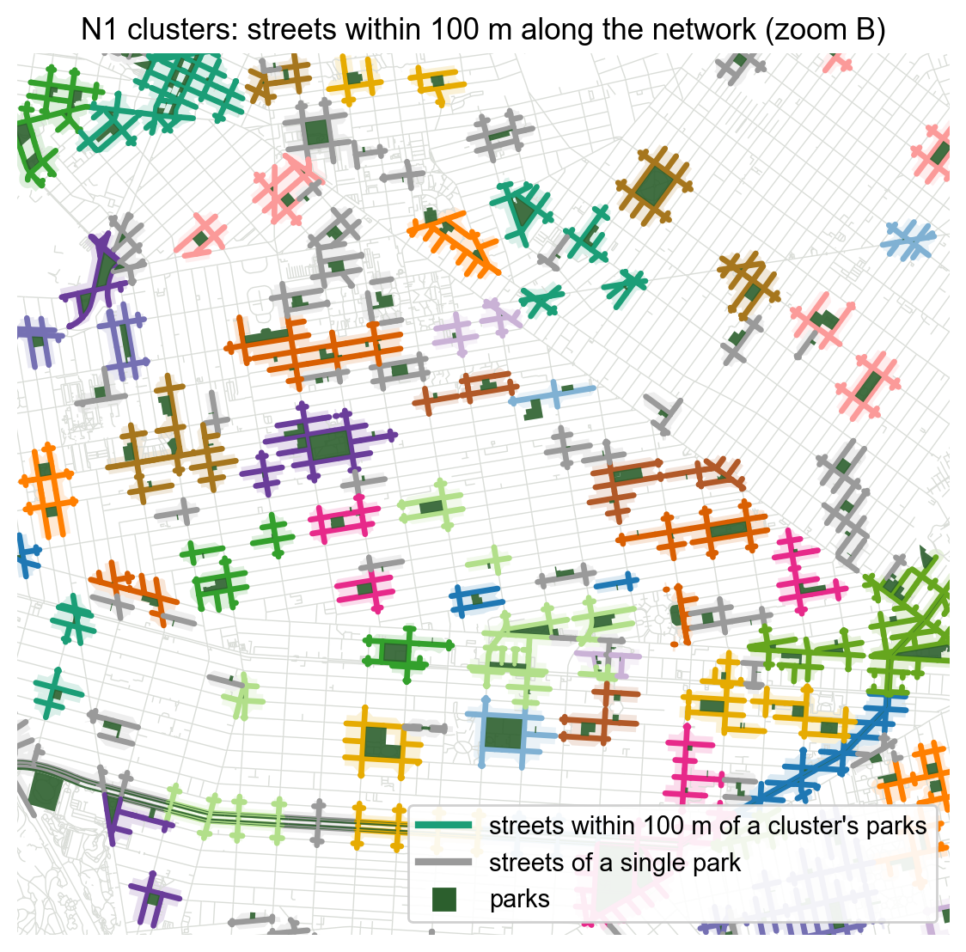
Next step: parks and commercial activity
Every park belongs to one cluster per definition (a single park counts as its own cluster).
A cluster's commercial area = the streets within 100 m of its parks, measured along the walking network.
A shop near two parks counts once, for the park that is closer on foot.
Next: count shops, business variety and visits in each area (Advan POIs) and compare clusters across D, N1, N2 and N3, controlling for park size, population, jobs and street accessibility.
Ready now: park and cluster tables with street, population, income, jobs, land-use and subway controls.
Notes:
Outputs: outputs/NYC/clusters (network commercial areas), outputs/NYC/controls (street and context controls), outputs/NYC/analysis (park and cluster tables). Straight-line 100 m buffers are kept for comparison.

Slide 15
Takeaways
Street shape matters
Few-turn links form 340 walkable park groups across NYC; 132 parks have no few-turn partner.
Not just distance
41% of few-turn group pairs are not grouped by walking distance alone.
Four lenses
Distance, few turns, same street axis and shared zone give different groups — ready for the commercial analysis.
Next: measure shops and visits on the streets within 100 m of each cluster and run the regressions.
Notes:
Summary.

Slide 16
Appendix · Technical details
Pipeline and tools
Network representation and park attachment
Angular cost on the dual graph
D, N1, N2, N3: formal definitions and parameters
From park graphs to groups (percolation)
Proximity check
Limitations
Notes:
Appendix.

Slide 17
Pipeline and tools
OSM pedestrian network (C / S)
Cityseer dual graph
Park attachment (no entrances)
Angular relations & centrality
Park graphs N1 · N2 · N3
Persistence, consensus & 10-min split
Parks: NYC Parks properties (2,061) → flagship parks, non-park parcels and parks > 100 acres removed → 1,902 parks; 25 long linear parks split into 180 pieces (2,057 graph nodes)
Network: OSM via OSMnx with a custom walk filter (keeps streets tagged sidewalk=separate), NYC + 3.2 km buffer; borough networks with 3.2 km non-reporting buffers
Software: Cityseer 5.8 (dual graph, simplest/shortest-path Dijkstra, angular centrality), NetworkX (graphs, Louvain), GeoPandas/Shapely

Slide 18
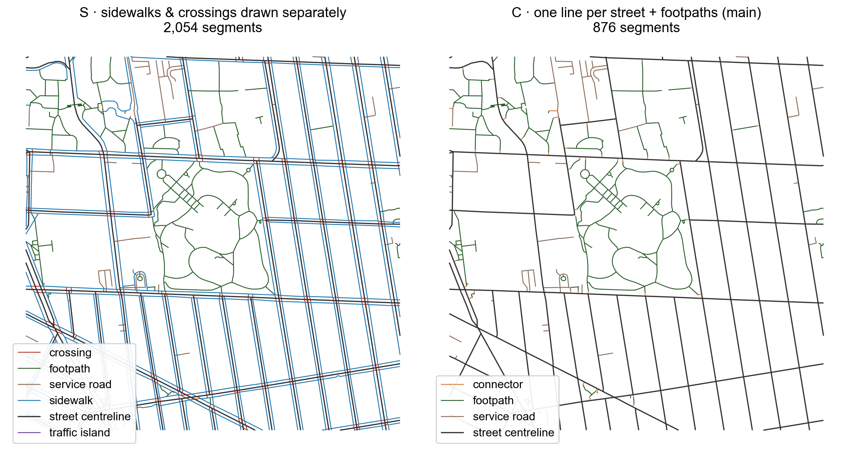
Network representation and park attachment
S draws sidewalks and crossings separately: parks facing each other across a street are ~180° apart.
C (street centrelines + pedestrian-only paths) behaves like a Space Syntax segment map → main analysis; S = sensitivity.
Attachment: segments within ±20 m of the boundary whose in-band length ≥ 50% of the segment or ≥ min(2.5·d, 25% of perimeter)
K = 8 sources by farthest-point sampling; “unresolved” if attached only to components < 200 segments

Slide 19
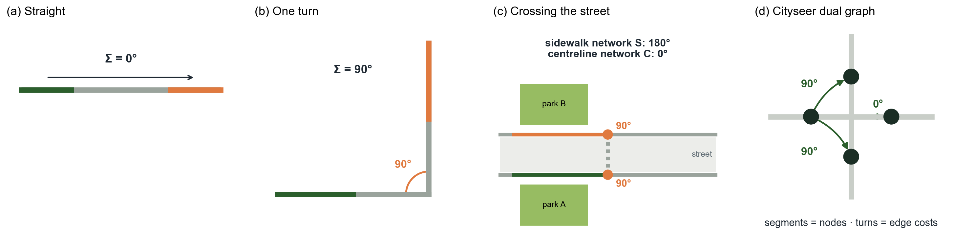
Angular cost on the dual graph
Simplest path Cityseer routes on the dual graph (street segments = nodes) and minimises the cumulative change of direction in degrees, including bends inside segments.
Metric bound Each search runs up to 3.2 km; R ∈ {800, 1600, 3200} m filters the path length afterwards — distance bounds the search, it does not define the edge.

Slide 20
D · Walking distance (formal)
edge ⇔ D_{ij} ≤ d
D = shortest walking distance between the two parks' attachment segments (Cityseer shortest-path trees)
3 settings: d ∈ {200, 400, 800} m
Includes adjacent parks (shared frontage, touching polygons) — proximity itself
Same grouping procedure as N1–N3 (percolation filter, Louvain γ = 2, consensus, 10-min split): the proximity baseline for RQ3

Slide 21
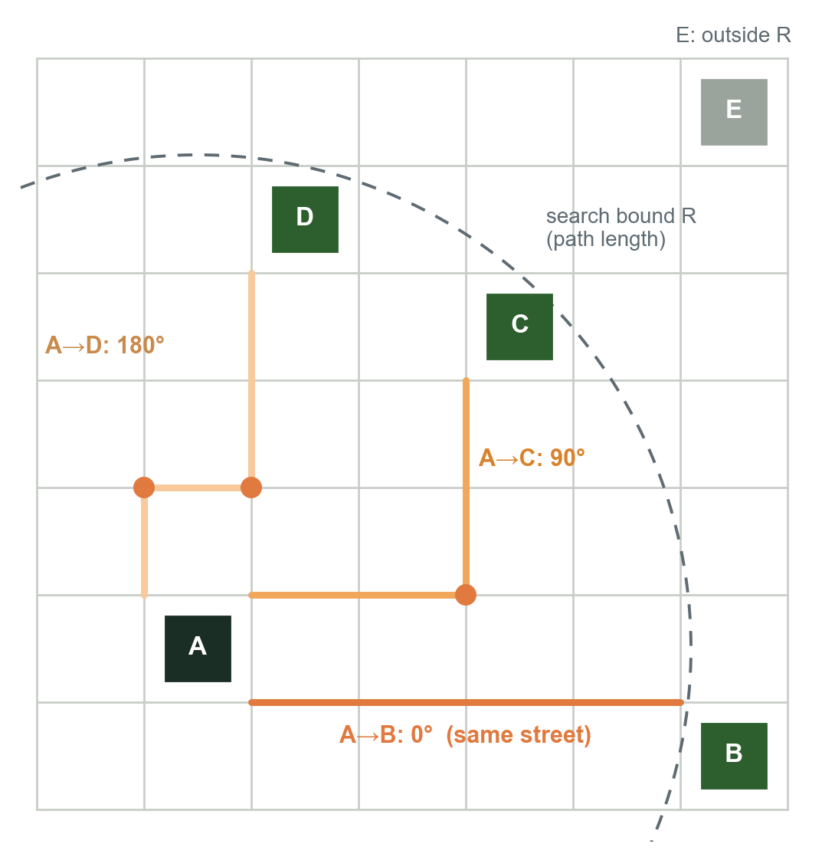
N1 · Formal definition
A_{ij}(R) = min over source u ∈ B_{i}, target v ∈ B_{j} of angular cost(u → v), path length ≤ R
edge ⇔ A_{ij} ≤ θ
θ | reading | edges from A
15° | same straight street | B
45° | nearly straight | B
90° | one right-angle turn (strict) | B, C
180° | two turns | B, C, D
24 settings: θ ∈ {15, 45, 90, 180}° × R ∈ {800, 1600, 3200} m × {best pair, ≥ 2 robust pairs}
Groups: Louvain communities on the 9 non-percolating settings (weights exp(−A/45°)), consensus ≥ 0.5, then split to a 10-min walking diameter
Measured one-turn routes cost ~90–100° (bends inside segments), so θ = 90° is strict

Slide 22
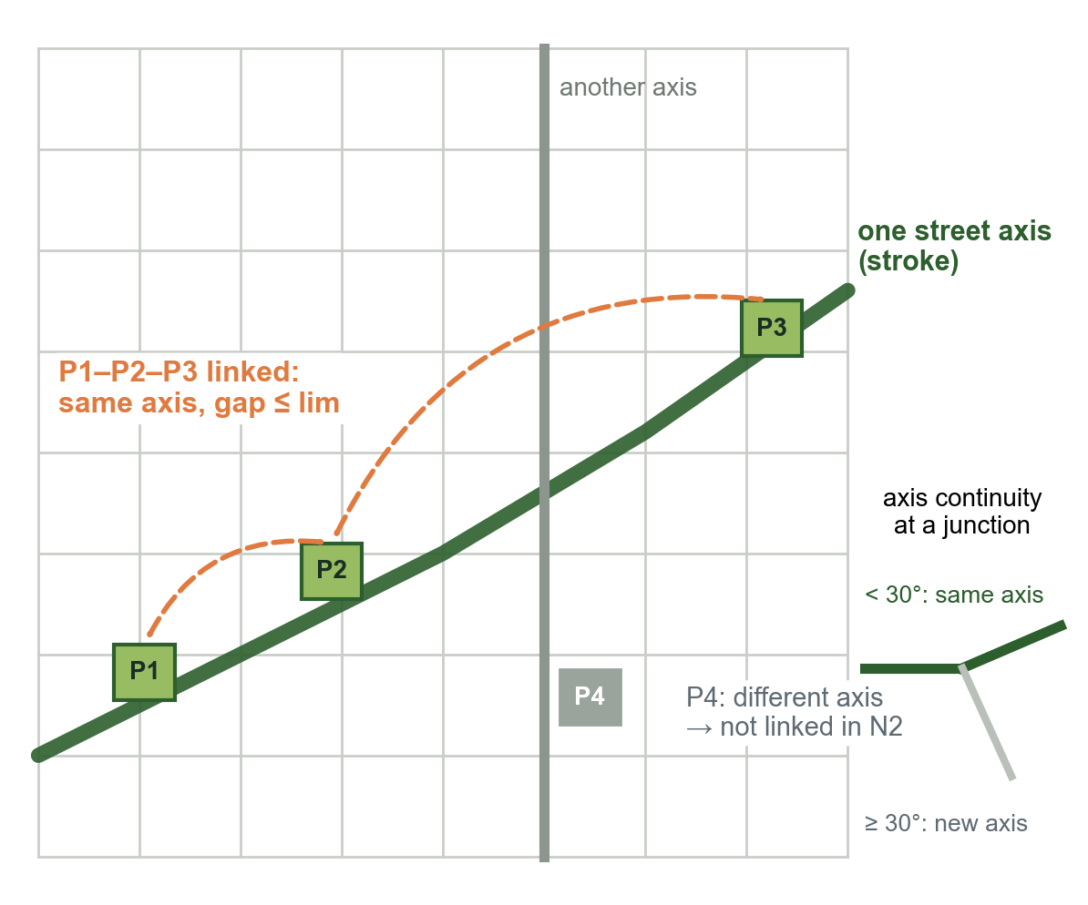
N2 · Street-axis continuity (formal)
edge ⇔ same stroke and gap_{along} ≤ lim
stroke = segments chained where the direction changes < 30° at a junction (20°, 45° also tested)
Gap: distance along the stroke between the two parks' attachment intervals (0 if they overlap)
9 settings: stroke angle ∈ {20, 30, 45}° × lim ∈ {400, 800, 1600} m; E0 pairs excluded; network C
Main street = stroke in the top 5% / 10% of network length by mean NACH-1600, NACH_{r} = log(choice_{r} + 1) / log(depth_{r} + 3) — a cluster attribute, not an edge condition
Groups: same procedure as all definitions, split to a 10-min walking diameter

Slide 23
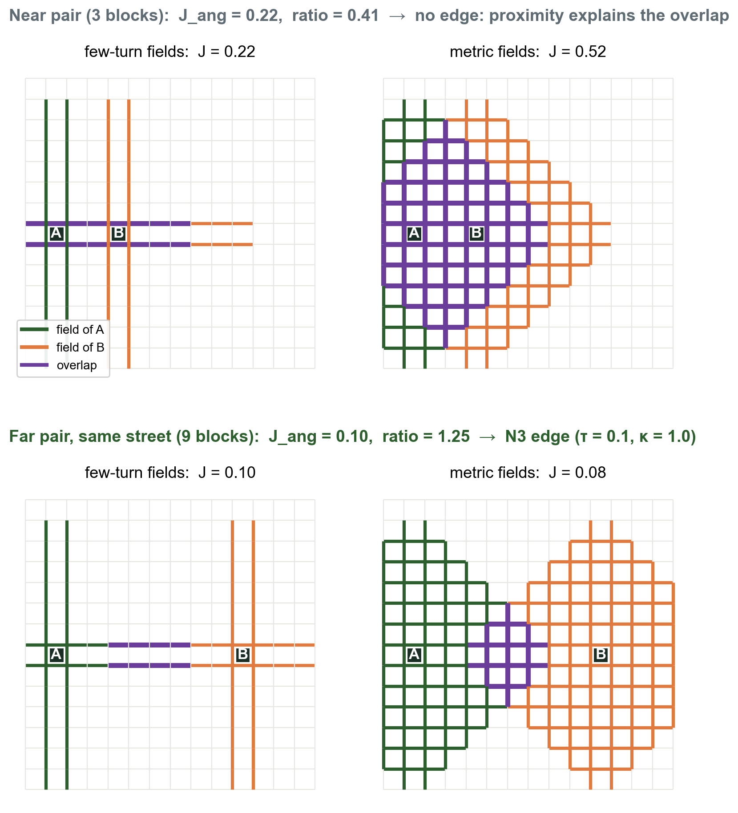
N3 · Formal definition
Field = segments reachable with angular cost ≤ θc and path length ≤ R
J = length-weighted Jaccard of two parks' fields, for angular and metric fields
Edge if J_{ang} ≥ τ and J_{ang} / J_{met} ≥ κ
16 settings: θc ∈ {45, 90}° × R ∈ {800, 1600} m × τ ∈ {0.1, 0.2} × κ ∈ {1.0, 1.25}
Toy grid: the near pair shares fields only because it is close (ratio 0.41); the far pair on one street keeps sharing its few-turn field (ratio 1.25).

Slide 24
From park graphs to robust groups
Percolation Once θ ≥ 45° at R ≥ 1.6 km, or one turn is allowed, most of a borough's parks fall into one component; Queens and Staten Island percolate much later.
Communities In each setting, Louvain communities find internally dense sets of parks (resolution γ = 1, 2, 4).
Consensus Co-membership share across settings → average-linkage clusters (≥ 0.5) → split to a 10-min walking diameter.
Isolation IsolationPersistence = share of settings with no configurational edge; ≥ 0.8 = robust isolated.

Slide 25
Proximity check (AUC)
Proximity AUC: probability that a connected pair is closer than an unconnected one; > 0.85 = proximity-dominated.
Result: no definition crosses 0.85 once distance is held to its search bound.
Spearman (angular cost vs network distance) ≈ 0.55.

Slide 26
Limitations
Percolation: allowing one turn connects almost all parks in a borough — groups rely on strict settings and community detection
Turn costs include bends inside segments (one turn ≈ 90–100°), so θ = 90° is a strict one-turn threshold
OSM completeness and mapping style (separately drawn sidewalks) affect angular costs; S results differ from C
Park entrances unknown (boundary attachment); N2 computed on C only; long linear parks split into ~400 m pieces
D: only the 200 m setting avoids percolation, so D groups are tight walking-distance groups
N1 and N2 groups overlap substantially (ARI 0.69) — street-axis continuity is a stricter subset of few-turn links
Groups not yet validated against observed park use or pedestrian counts

