Slide 1
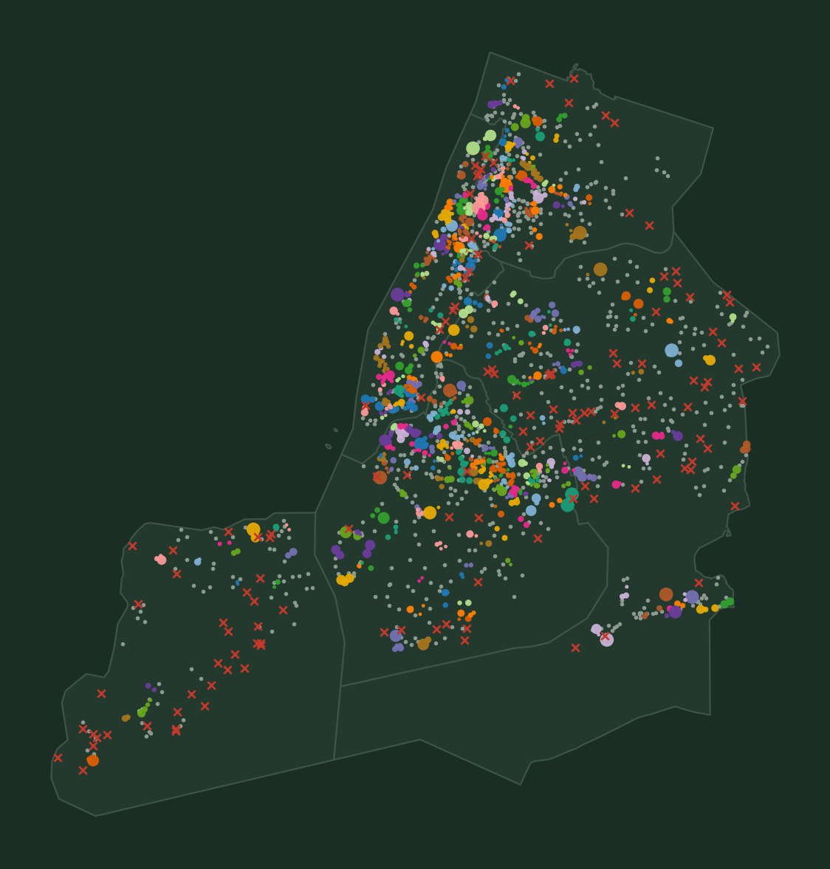
Configurational
Park Networks
in New York City
Which parks are linked by the street configuration — few-turn routes, shared corridors, shared fields — rather than by mere proximity?
2,057 park features · OSM pedestrian network · Cityseer 5.8 angular analysis
October 2026
Notes:
Space-Syntax-inspired analysis of NYC parks. Parks are nodes; edges are angular (configurational) relations computed on the pedestrian network with Cityseer simplest-path (angular) routines. Colours on the map = N1 groups (γ=2).

Slide 2
Not proximity: parks related through street configuration
Question Which small & medium parks form configurational groups, and which remain isolated?
Principle Distance is only a search bound; the edge itself is angular / syntactic.
Three definitions N1 few-turn routes · N2 shared corridor · N3 shared few-turn field.
Robustness Every definition is a grid of parameter settings; groups and isolation are what persists across them.
Walkable Every pair of parks in a group is within a 10-minute walk (800 m).
N1
Angular few-turn
total turning on the simplest route ≤ θ
N2
Shared corridor
both parks on the same high-NACH stroke
N3
Field overlap
few-turn catchments overlap more than distance predicts
OSM pedestrian network (C / S)
Cityseer dual graph
Park attachment (no entrances)
Angular relations & centrality
Park graphs N1 · N2 · N3
Persistence & robust groups
Pipeline implemented as STEP notebooks 02–13 (Cityseer 5.8, OSMnx, GeoPandas, NetworkX).
Notes:
Distance (R) is used only as a computational search bound. Edges are defined by angular cost (N1), co-membership in a high-choice angular corridor (N2), or excess overlap of few-turn catchments (N3).

Slide 3
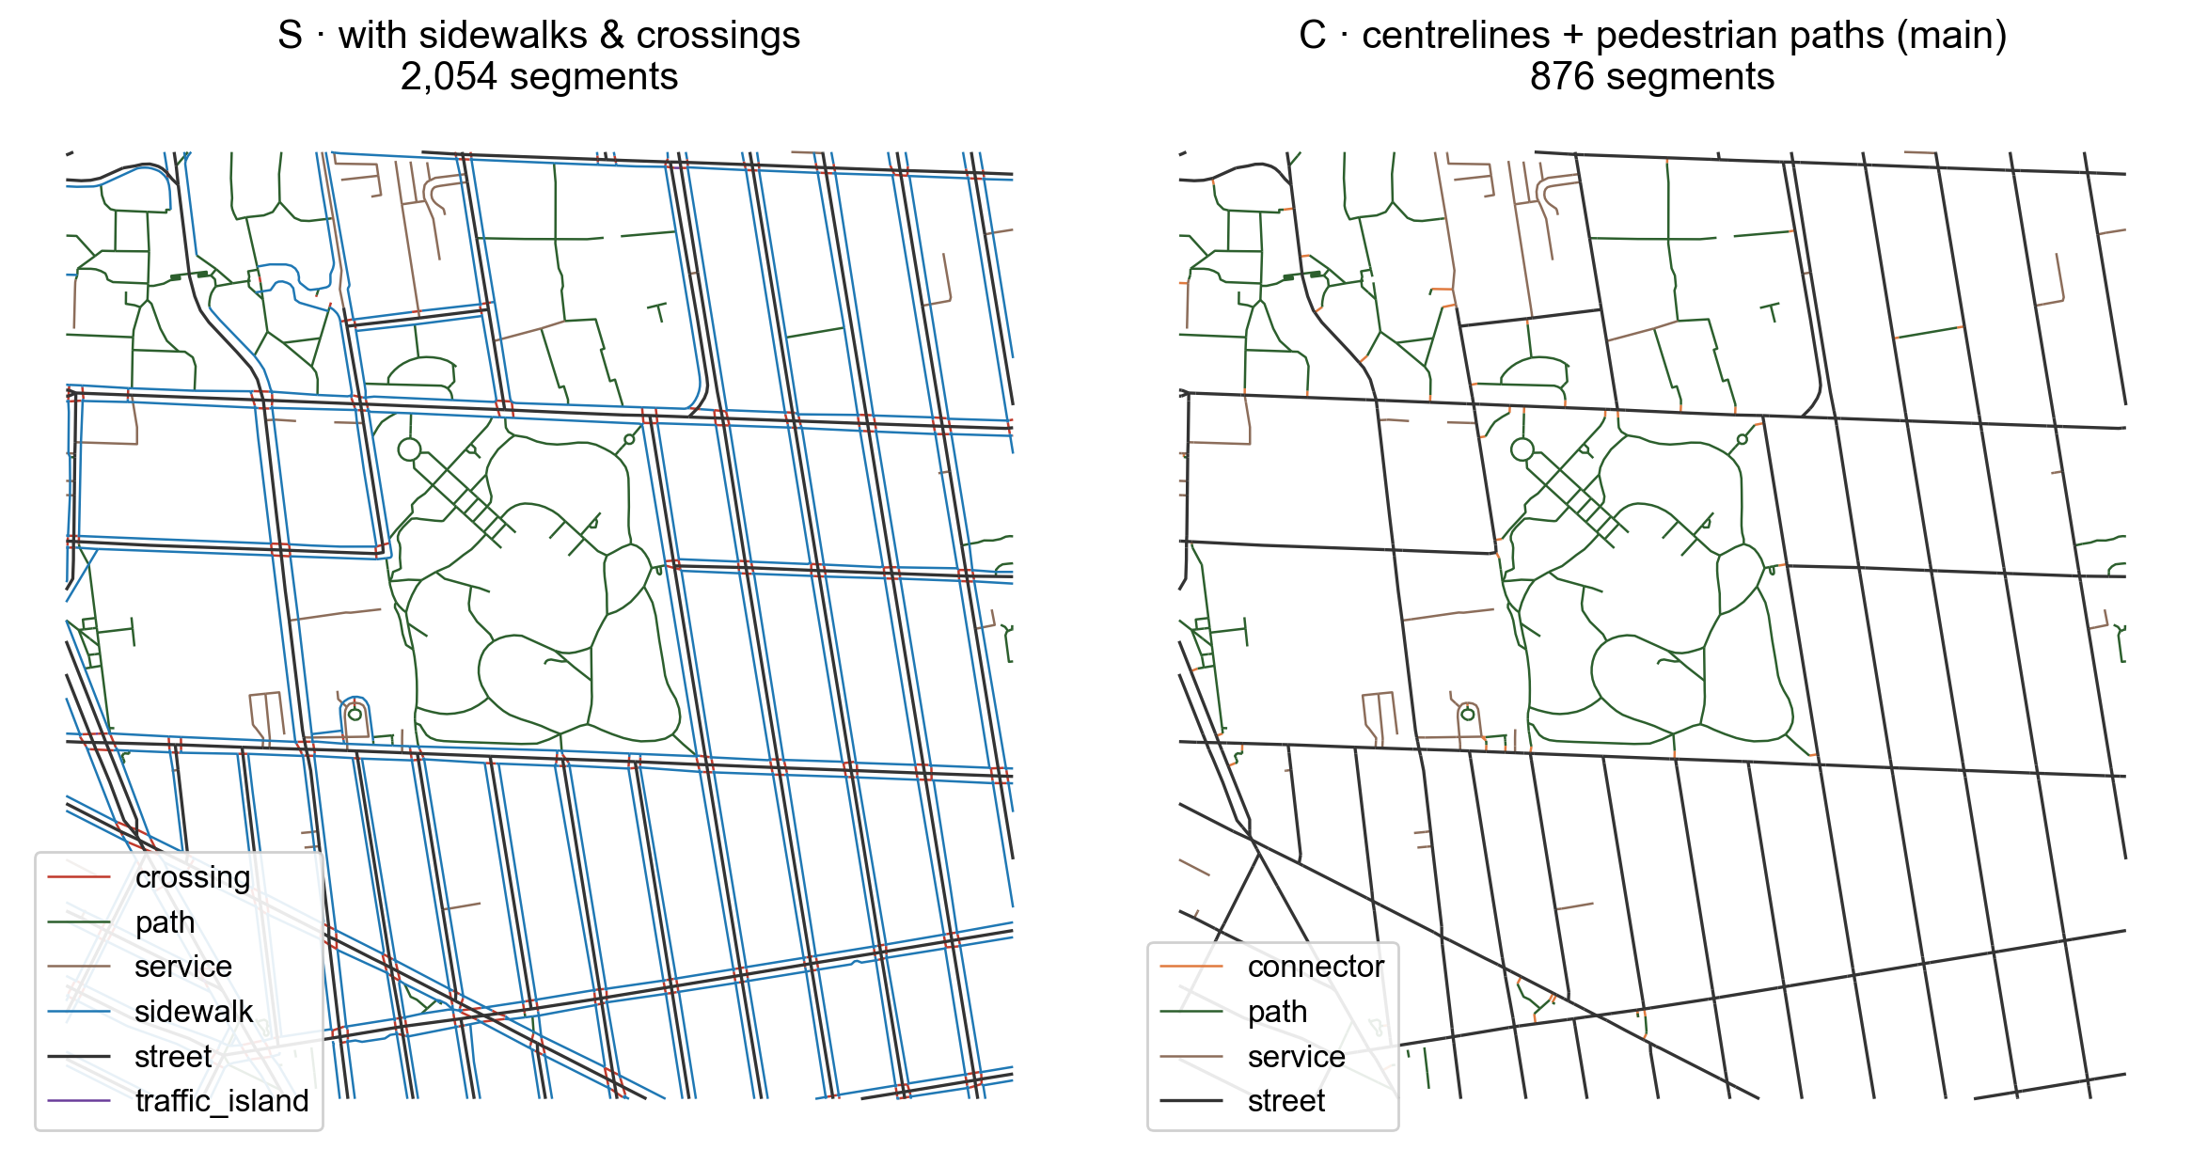
Data: parks and two pedestrian network representations
1,902
parks analysed (of 2,061): flagship parks, non-park parcels and parks > 100 acres excluded
25 → 180
long linear parks (parkways, malls, esplanades) split into ~400 m pieces
496k
network segments in C (main); 1.02M in S with sidewalks
S draws sidewalks and crossings separately: parks facing each other across a street are 180° apart. C (street centrelines + pedestrian-only paths) is the Space-Syntax-like segment map used for the main analysis.
Notes:
OSM rebuilt with a custom walk filter (keeping streets tagged sidewalk=separate), NYC + 3.2 km buffer, retain_all=True. Linear parks split so a single multi-km parkway cannot chain distant parks together; pieces of the same park are never linked.

Slide 4
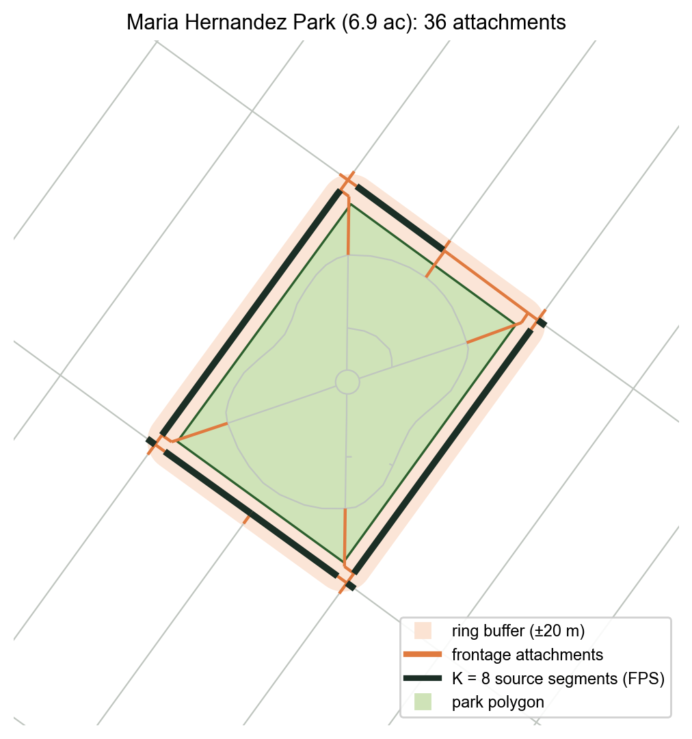
Attaching parks to the network without entrance data
1
Ring buffer
Segments within ±20 m of the park boundary (±10 m on S): the first ring of streets around the park.
2
Frontage rule
Keep a segment only if ≥ 50% of it, or ≥ min(2.5·d, 25% of perimeter), lies in the ring — streets that merely clip a corner are dropped.
3
Size control
Up to K = 8 source segments per park by farthest-point sampling along the boundary; robustness measured as a share, not a count.
4
Unresolved ≠ isolated
Parks attached only to tiny OSM fragments are flagged unresolved rather than isolated.
Notes:
Alternatives compared in STEP 3: boundary sampling every 25 m (misses short frontages) and centroid-nearest segment (one point, often an internal path). The ring buffer with frontage rule was chosen.

Slide 5
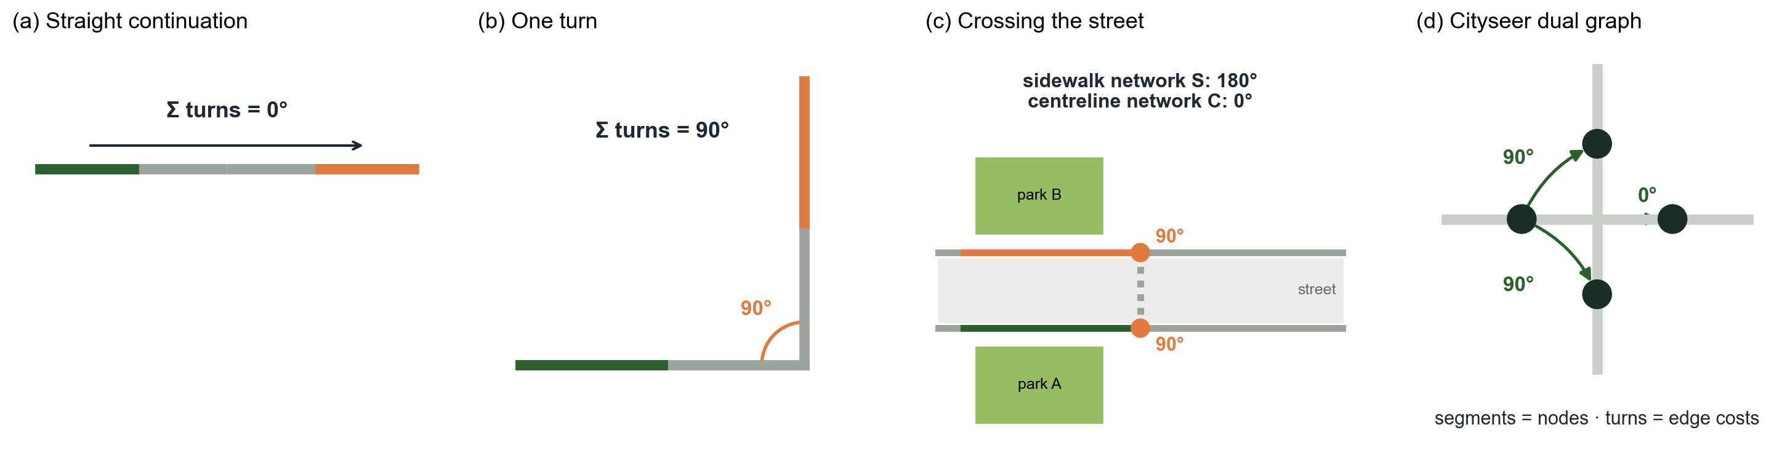
Angular cost: how many degrees does the simplest route turn?
Simplest path Cityseer routes on the dual graph (street segments = nodes) and minimises the cumulative change of direction, in degrees, including bends inside segments.
Metric bound Each search runs up to 3.2 km of walking; R ∈ {800, 1600, 3200} m filters the path length afterwards — distance bounds the search, it does not define the edge.
Notes:
NetworkStructure.dijkstra_tree_simplest(src, max_seconds=3200, speed=1 m/s) returns simpl_dist (degrees) and agg_seconds (= path length in metres). Synthetic tests in STEP 2: straight 0°, L-turn 90°, quarter arc 90°, sidewalk crossing 180°, symmetric.

Slide 6
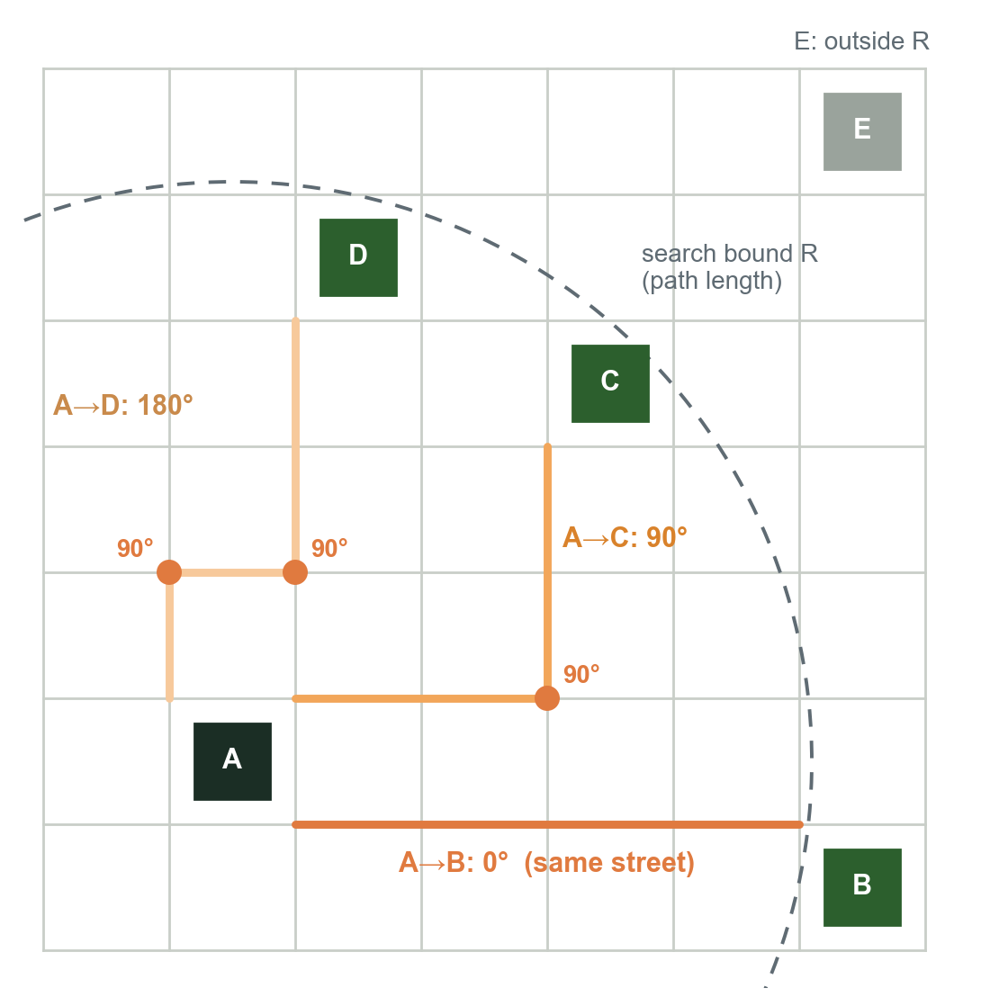
N1 · Angular few-turn network
Two parks are linked if the simplest route between them turns little in total
A_{ij}(R) = min over source u ∈ B_{i}, target v ∈ B_{j} of angular cost(u → v), path length ≤ R
edge ⇔ A_{ij} ≤ θ
θ | reading | edges from A
15° | same straight street | B
45° | nearly straight | B
90° | one right-angle turn (strict) | B, C
180° | two turns | B, C, D
24 settings: θ ∈ {15, 45, 90, 180}° × R ∈ {800, 1600, 3200} m × {best pair, ≥ 2 robust pairs}
Trivial co-frontage (shared street segment, touching polygons) and pieces of the same park are excluded
Notes:
B_i = attachment segments of park i; sources are the K=8 farthest-point-sampled segments. A_ij is symmetrised as min(A_ij, A_ji). Robust variant requires at least two attachment pairs meeting the threshold. Measured one-turn routes cost ~90–100° because bends inside segments are counted, so θ = 90° only admits near-orthogonal single turns.

Slide 7
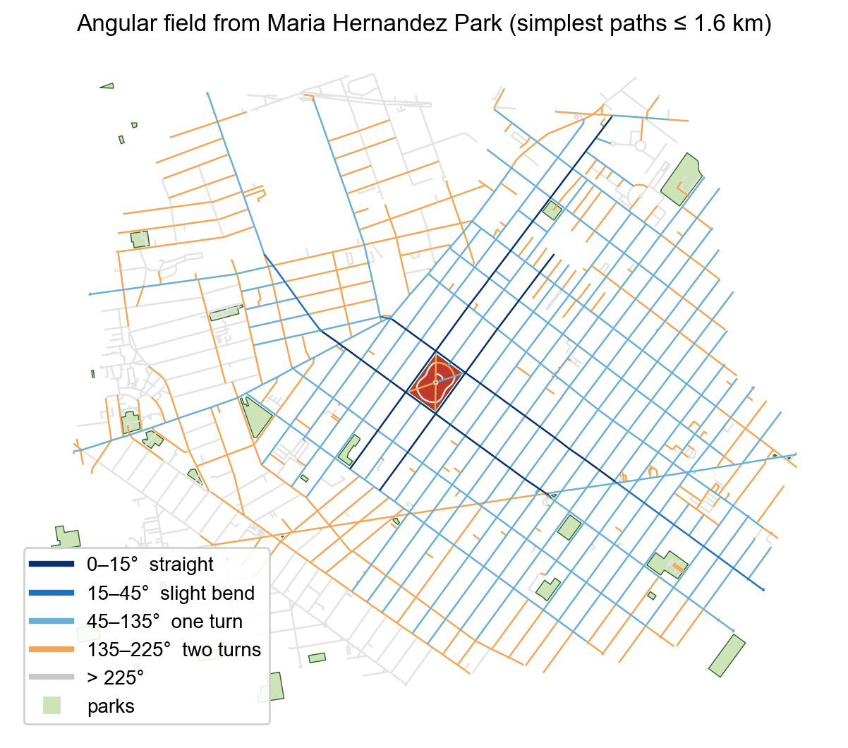
N1 · How it is computed
1
Angular trees
One simplest-path search per source segment (≤ 3.2 km) on borough networks with 3.2 km buffers
2
Park pairs
Minimum angle to every attachment of every other park → 212,137 directed park pairs
3
Threshold grid
Apply θ and R; build 24 park graphs; classify isolated / dyad / chain / 2-core
4
Groups
Communities on the 9 non-percolating settings (weights exp(−A / 45°)); consensus; split to a 10-min walking diameter
Notes:
The angular field shows the minimum angular cost from one park's source segments: streets fronting the park stay near 0° for kilometres, one turn gives ~90°. This field is what N1 thresholds.

Slide 8
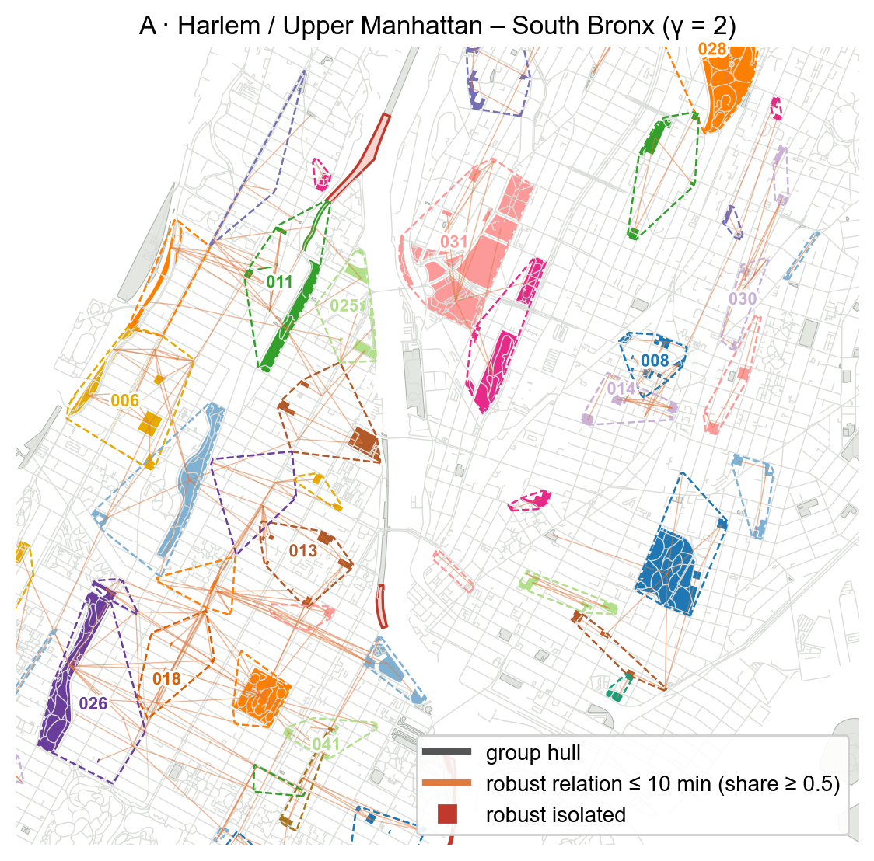
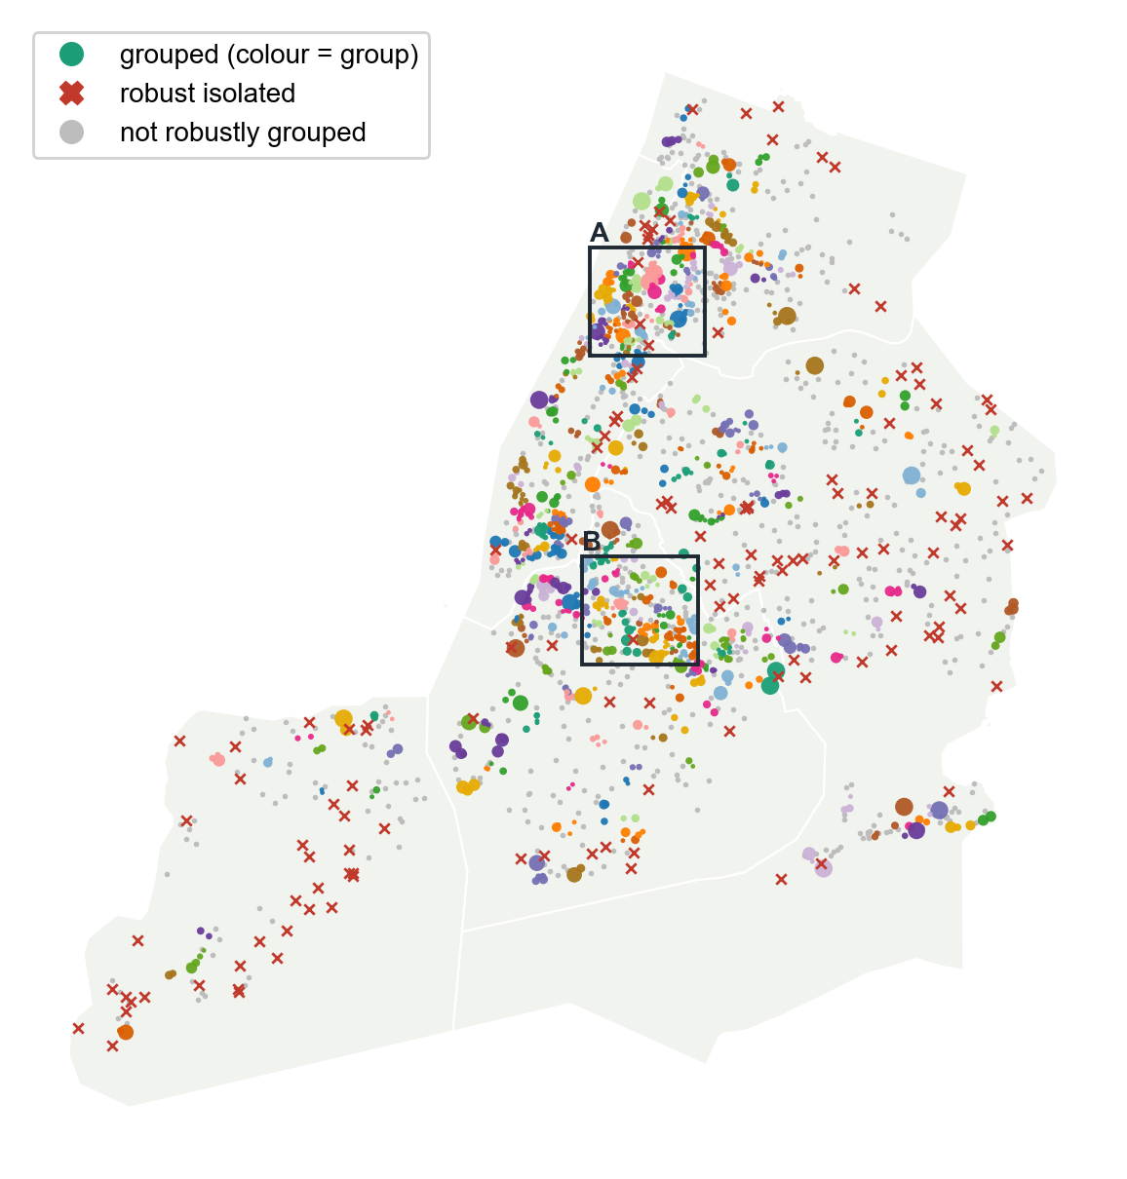
N1 · Groups of parks linked by few-turn routes
340
walkable groups (γ = 2, every pair ≤ 10 min)
1,178
parks in a group
391 m
median walking span within a group
132
robust isolated (≥ 80% of settings)
Notes:
Robust group = parks that share a Louvain community in most non-percolating settings (average co-membership ≥ 0.5), split so that every pair is within a 10-minute walk. Dashed lines = group hulls; orange lines = park relations present in ≥ 50% of settings and within 10 minutes.

Slide 9
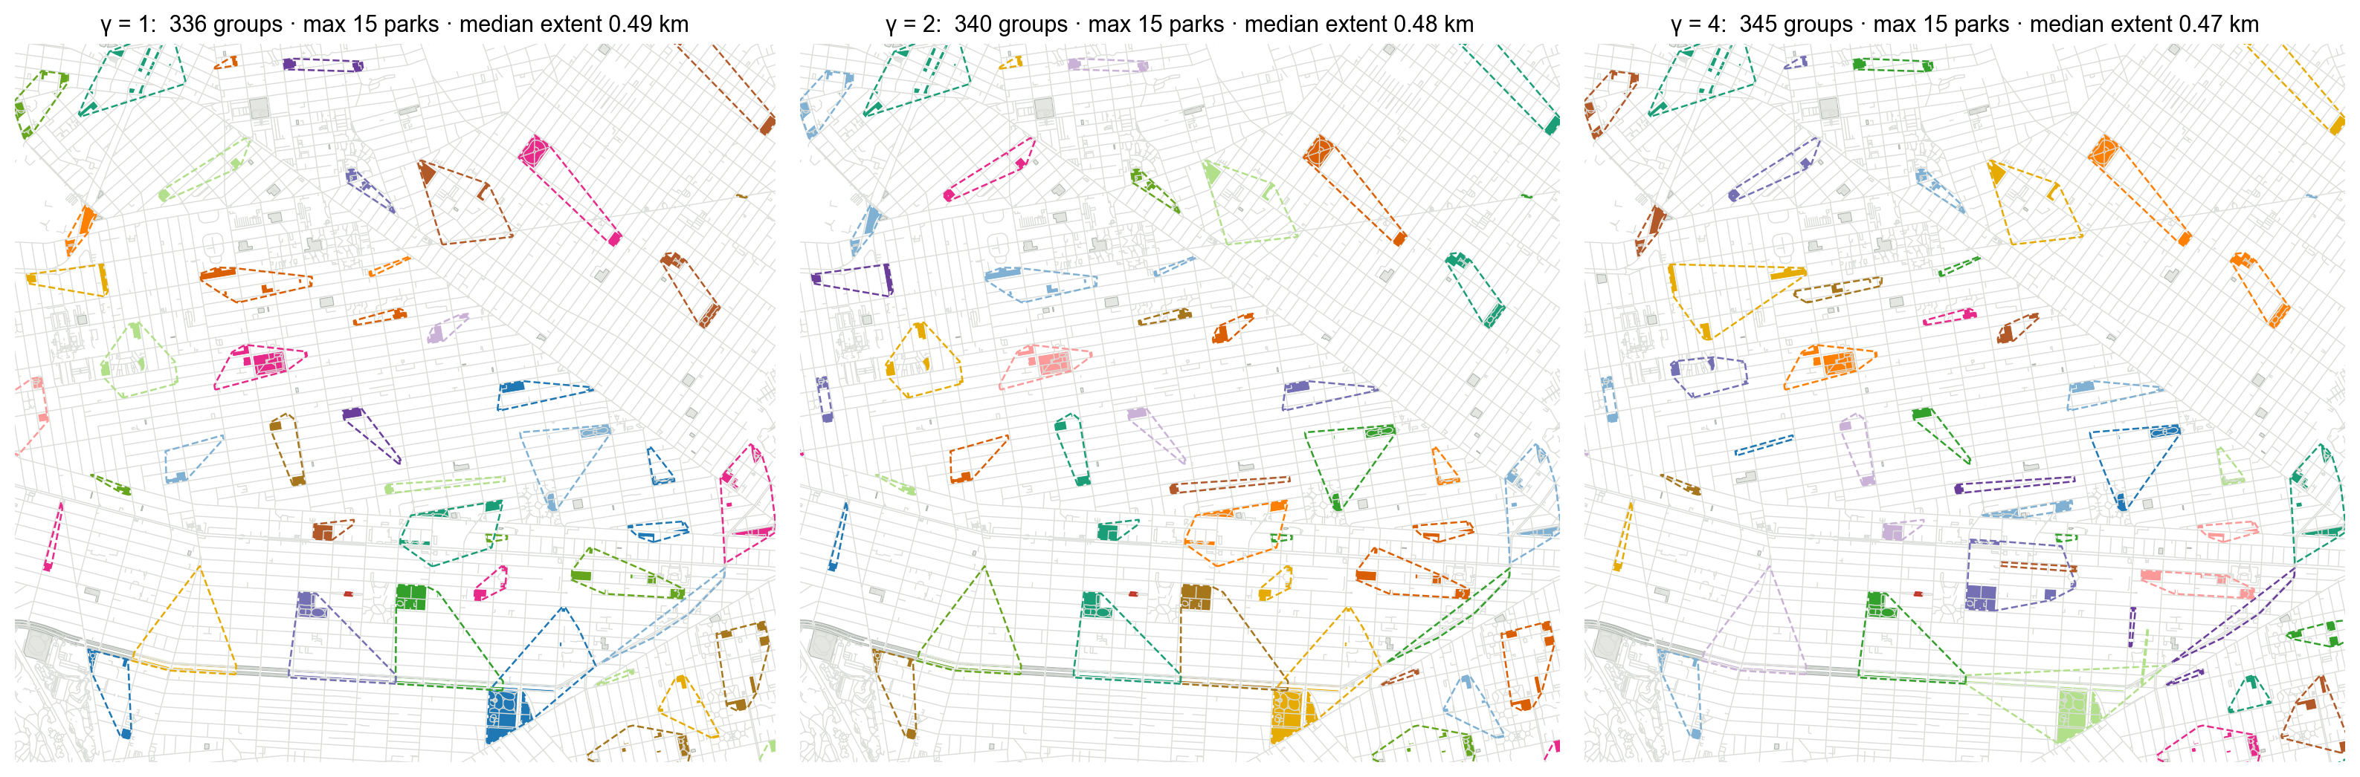
N1 · Three scales of grouping
Louvain resolution γ: 1 = neighbourhood scale, 4 = block scale (zoom B)
γ = 1 336 groups · max 15 parks · median span 395 m
γ = 2 340 groups · max 15 parks · median span 391 m
γ = 4 345 groups · max 15 parks · median span 370 m
Notes:
Same consensus procedure at three resolutions. Higher γ splits large neighbourhood groups into block-scale groups; isolation persistence does not change with γ.

Slide 10
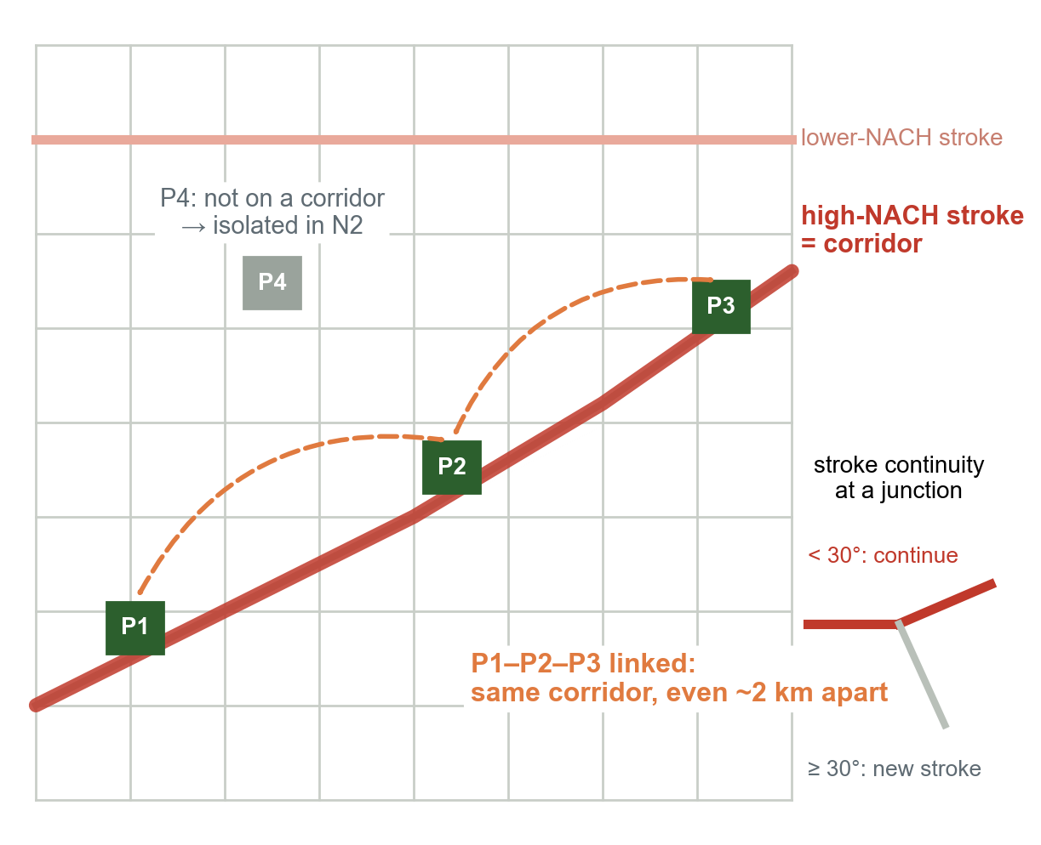
N2 · Shared configurational corridor
Two parks are linked if they sit on the same major movement corridor
NACH_{r} = log(choice_{r} + 1) / log(depth_{r} + 3)
angular choice and total angular depth from Cityseer centrality_simplest
Strokes: chain segments whose direction changes < 30° at each junction (axial-line-like continuity lines)
Corridor: strokes with the highest mean NACH covering the top p% of network length
Edge: both parks attach to the same corridor stroke (optional 3.2 km along-corridor limit)
18 settings: r ∈ {800, 1600, 3200} m × p ∈ {2, 5, 10}% × limit {3.2 km, none}
Notes:
Raw choice is density-inflated (Manhattan dominates), hence the NACH-like normalisation. Stroke-level membership avoids the giant-component collapse of 'same backbone component'. Computed on network C only.

Slide 11
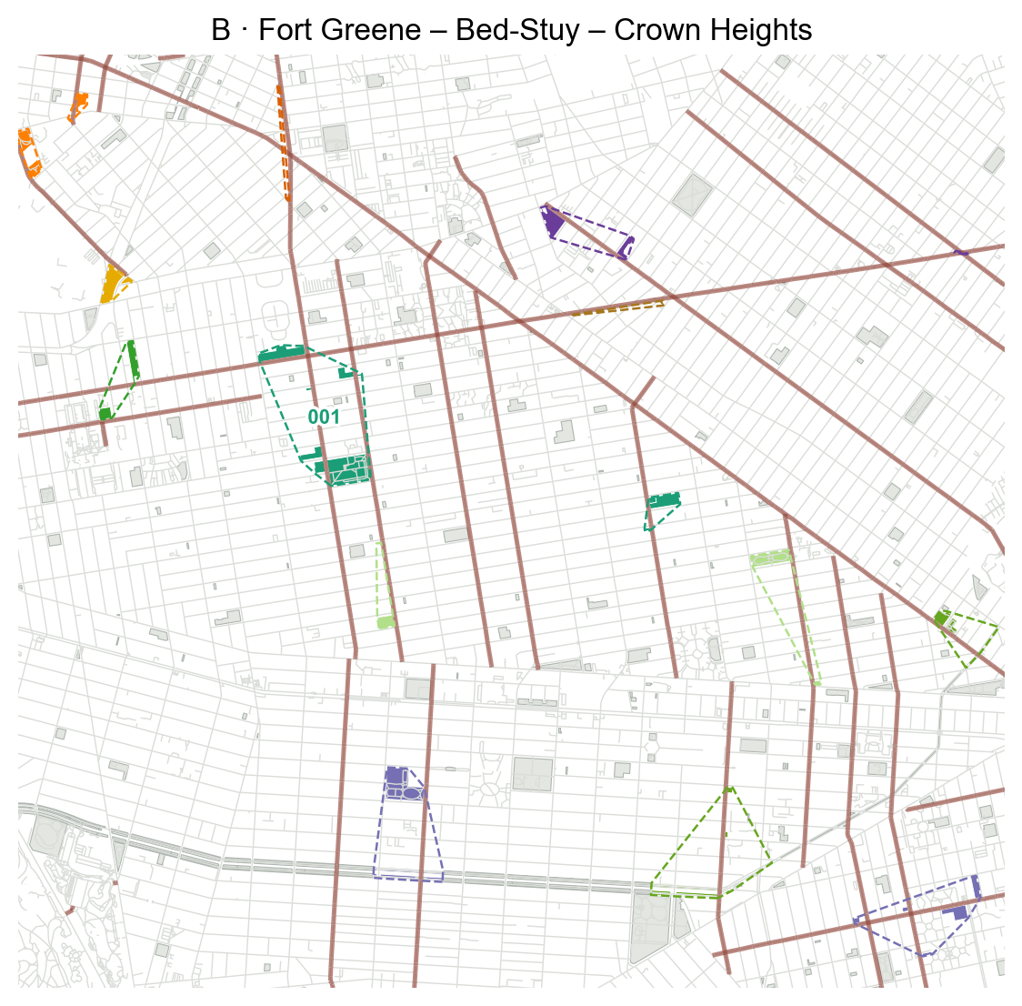
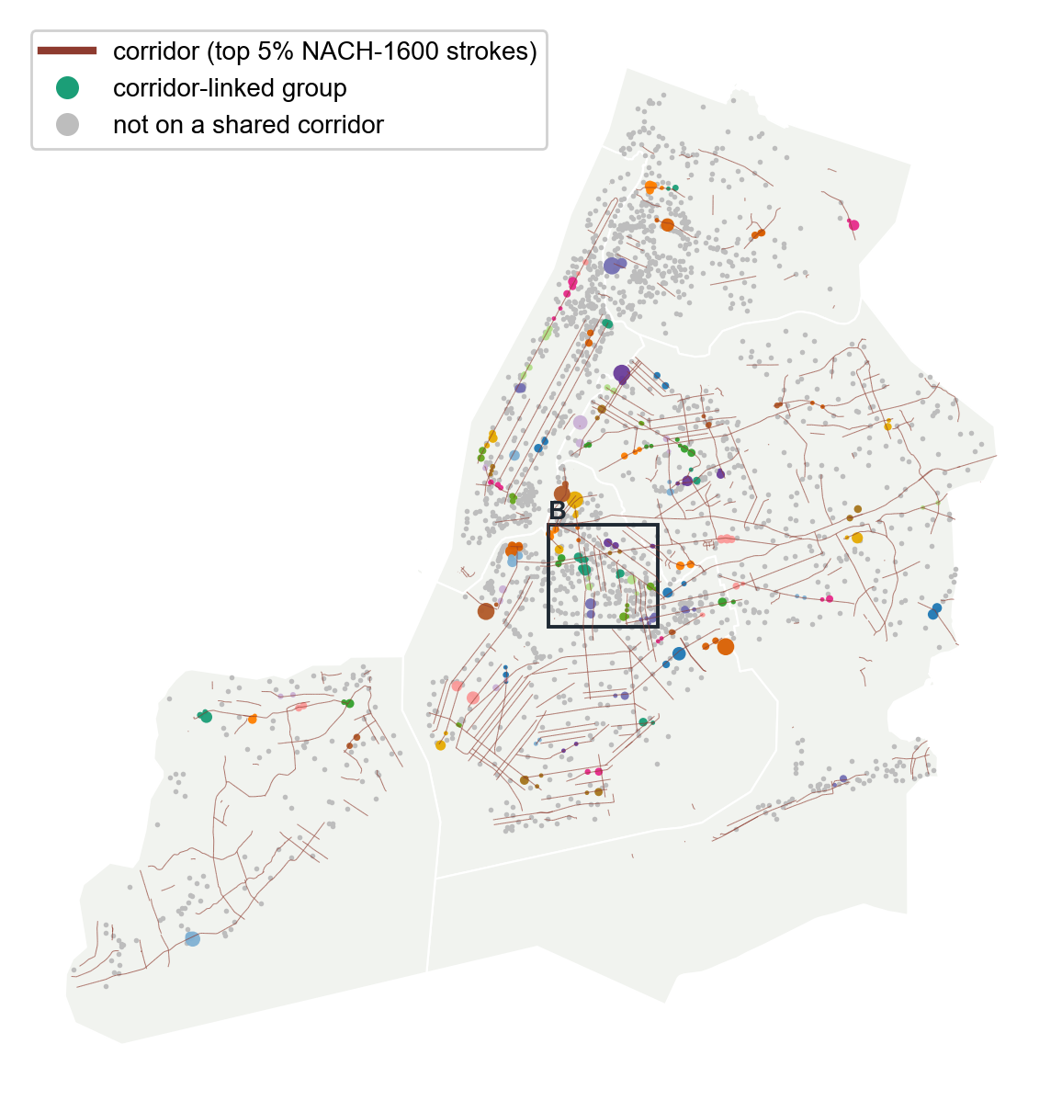
N2 · Corridor-linked parks
100
corridor groups
253
parks on a shared corridor
371 m
median walking span within a group
Most parks are off the top corridors — N2 isolation means "not embedded in a major corridor".
Notes:
Red lines = corridor strokes (top 5% NACH-1600 by length). N2 groups are long by design: they follow corridors.

Slide 12
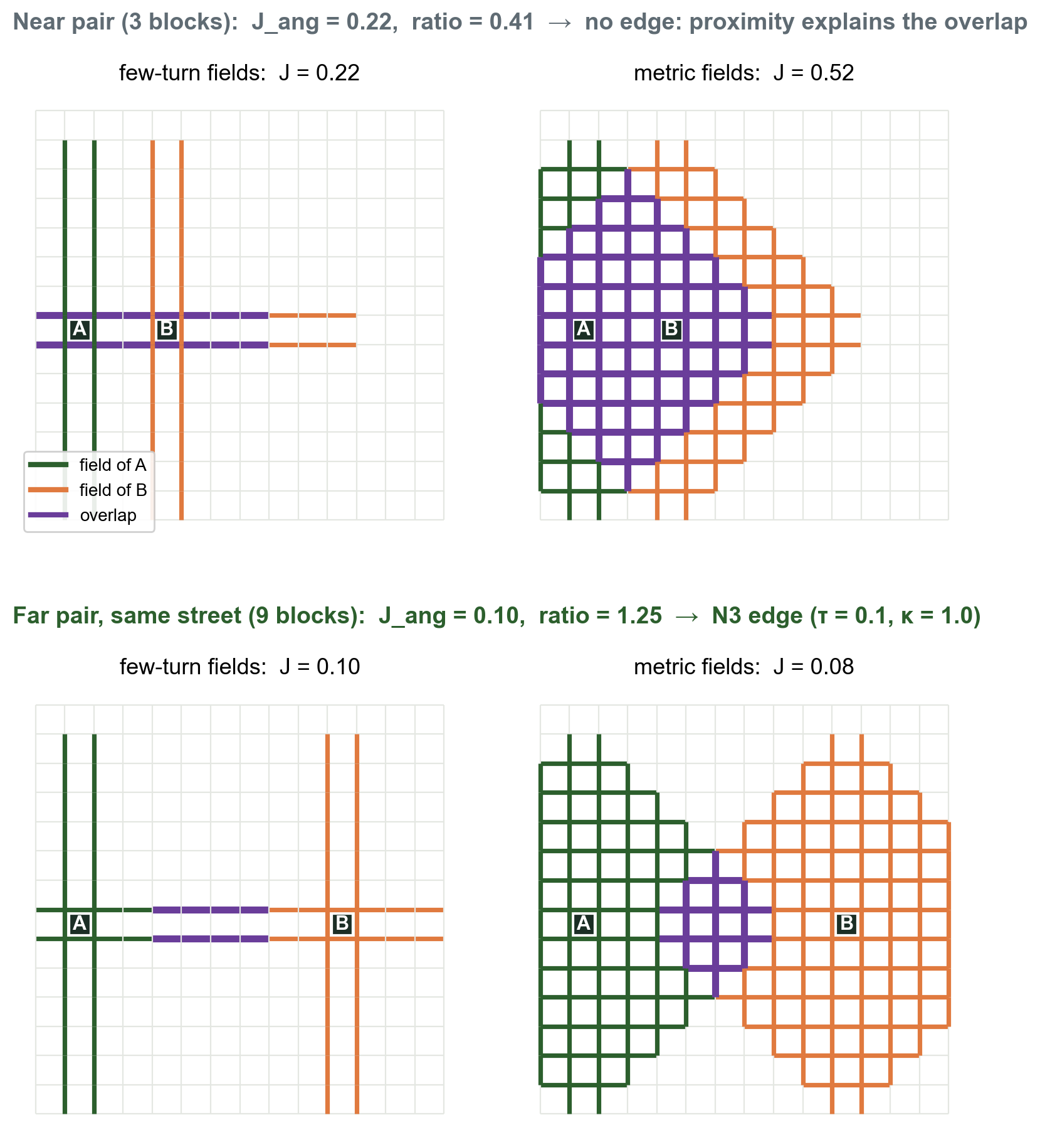
N3 · Excess few-turn field overlap
Do two parks share the same few-turn field more than their distance implies?
Field = segments reachable with angular cost ≤ θc and path length ≤ R
J = length-weighted Jaccard of two parks' fields; computed for angular and metric fields
Edge if J_{ang} ≥ τ and J_{ang} / J_{met} ≥ κ
16 settings: θc ∈ {45, 90}° × R ∈ {800, 1600} m × τ ∈ {0.1, 0.2} × κ ∈ {1.0, 1.25}
Toy grid: the near pair shares fields only because it is close (ratio 0.41); the far pair on one street keeps sharing its few-turn field (ratio 1.25 > κ = 1.0). Only such pairs become N3 edges, so N3 is sparse.
Notes:
Replaces 'similar centrality features' (not a relation) with a relational, configurational overlap measure; the metric ratio controls for proximity.

Slide 13
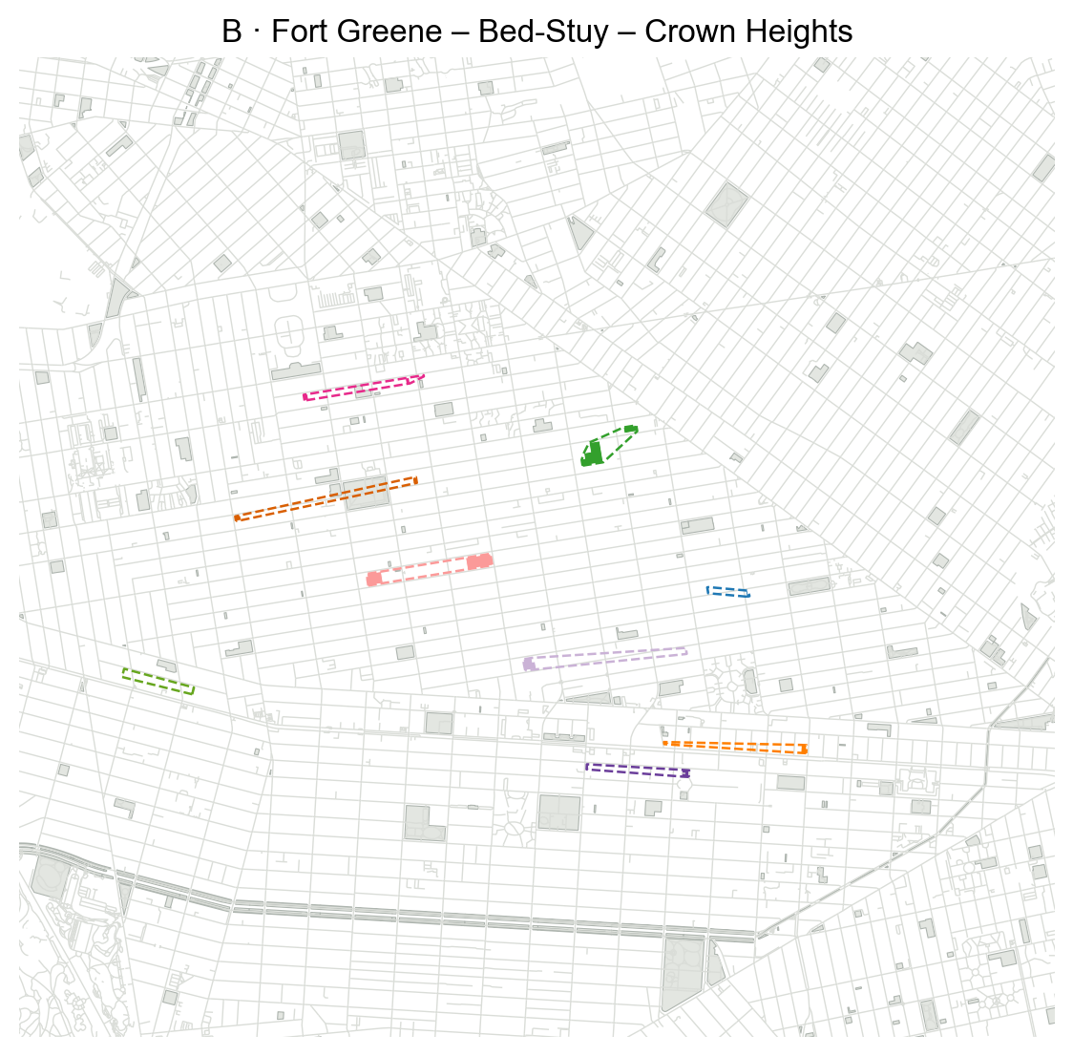
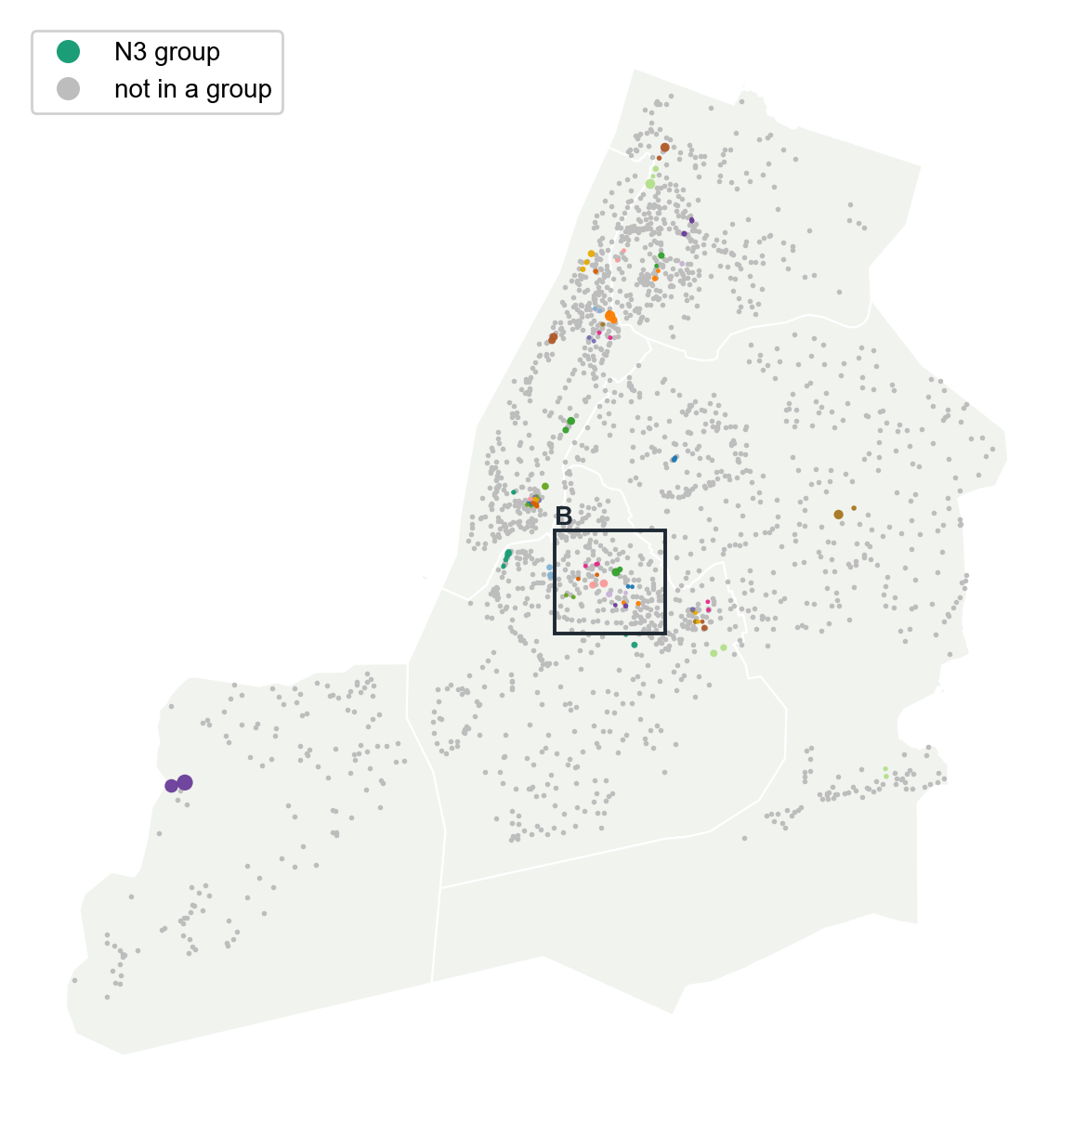
N3 · A sparse, weak definition
47
groups (mostly pairs)
8
largest group
1,619
parks never in an N3 edge in ≥ 80% of settings
Few-turn fields rarely overlap more than distance predicts: report N3 as weak.
Notes:
As anticipated in the research design, the field-overlap definition is the weakest; it is retained as a contrast.

Slide 14
From park graphs to robust groups
Percolation Once θ ≥ 45° at R ≥ 1.6 km, or one turn is allowed, most of a borough's parks fall into one component — a grid-city finding, but components can no longer separate groups. Queens and Staten Island percolate much later.
Communities In each setting, Louvain communities find internally dense sets of parks.
Consensus Co-membership share across settings → average-linkage clusters (≥ 0.5), then split to a 10-minute walking diameter = robust groups.
Isolation IsolationPersistence = share of settings with no configurational edge; ≥ 0.8 = robust isolated.
Notes:
N1 groups use only the 9 settings whose largest component holds < 50% of the parks of every borough (R1600 th15 best, R1600 th15 rob, R3200 th15 best, R3200 th15 rob, R800 th15 best, R800 th15 rob, R800 th45 best, R800 th45 rob, R800 th90 rob). All 24 settings are still used for isolation persistence. Percolation is measured per borough because water barriers dilute the citywide share.

Slide 15
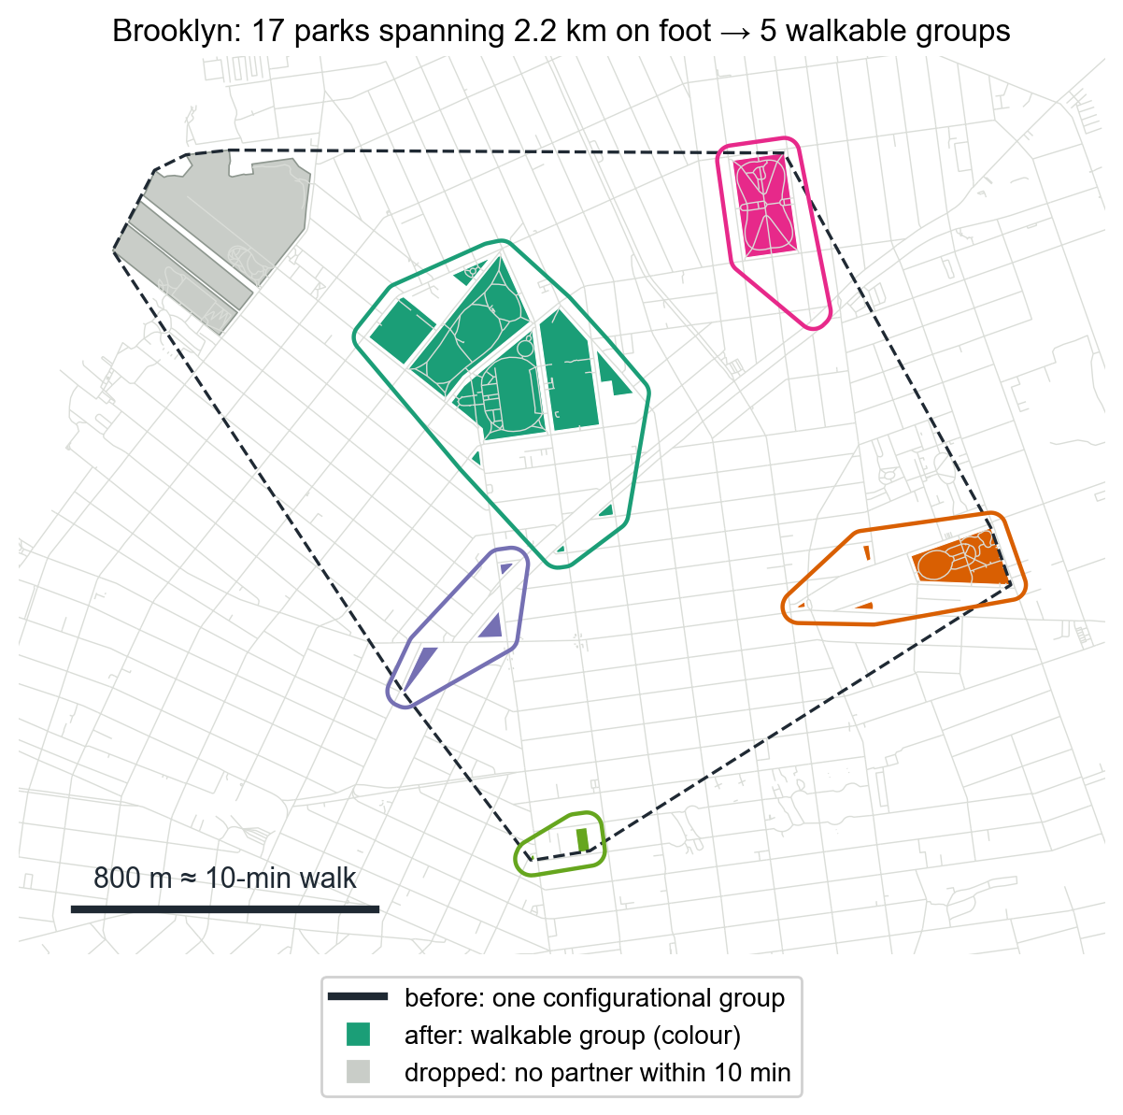
Walkable groups: a 10-minute limit
Configuration decides who can be grouped; walking distance caps how far a group can stretch
Within each consensus group, complete-linkage clustering on shortest walking distance, cut at 800 m
Every pair of parks in a final group is ≤ 10 minutes apart on foot; parks with no such partner are flagged "beyond walk limit"
 | groups | largest group | median walking span
N1 few-turn (γ = 2) | 217 → 340 | 41 → 15 | 467 → 391 m
N2 corridor | 73 → 100 | 22 → 7 | 2,053 → 371 m
N3 field | 63 → 47 | 8 → 8 | 696 → 414 m
Sensitivity of the walking limit (N1, γ = 2)
5 min (400 m): 366 groups · 1,013 parks grouped · largest 11
10 min (800 m): 340 groups · 1,178 parks grouped · largest 15
15 min (1200 m): 293 groups · 1,195 parks grouped · largest 22
Notes:
Example: 17 parks formed one configurational group spanning 2.2 km on foot; the 10-minute cap splits it into 5 walkable groups and drops 1 parks with no partner within 10 minutes. Distance is a safeguard, not the relation.

Slide 16
Is it just proximity?
Can network distance alone predict the configurational edges?
Proximity AUC: probability that a connected pair is closer than an unconnected one; > 0.85 = proximity-dominated.
No definition crosses 0.85 once distance is held to its search bound.
Edge overlap with a distance-only graph of equal density: N1 0.27, N2 0.03, N3 0.00
Notes:
The 'all pairs' AUC for N1 is inflated mechanically: with R = 800 m every edge is shorter than 800 m by construction. Spearman(A, network distance) ≈ 0.55.

Slide 17
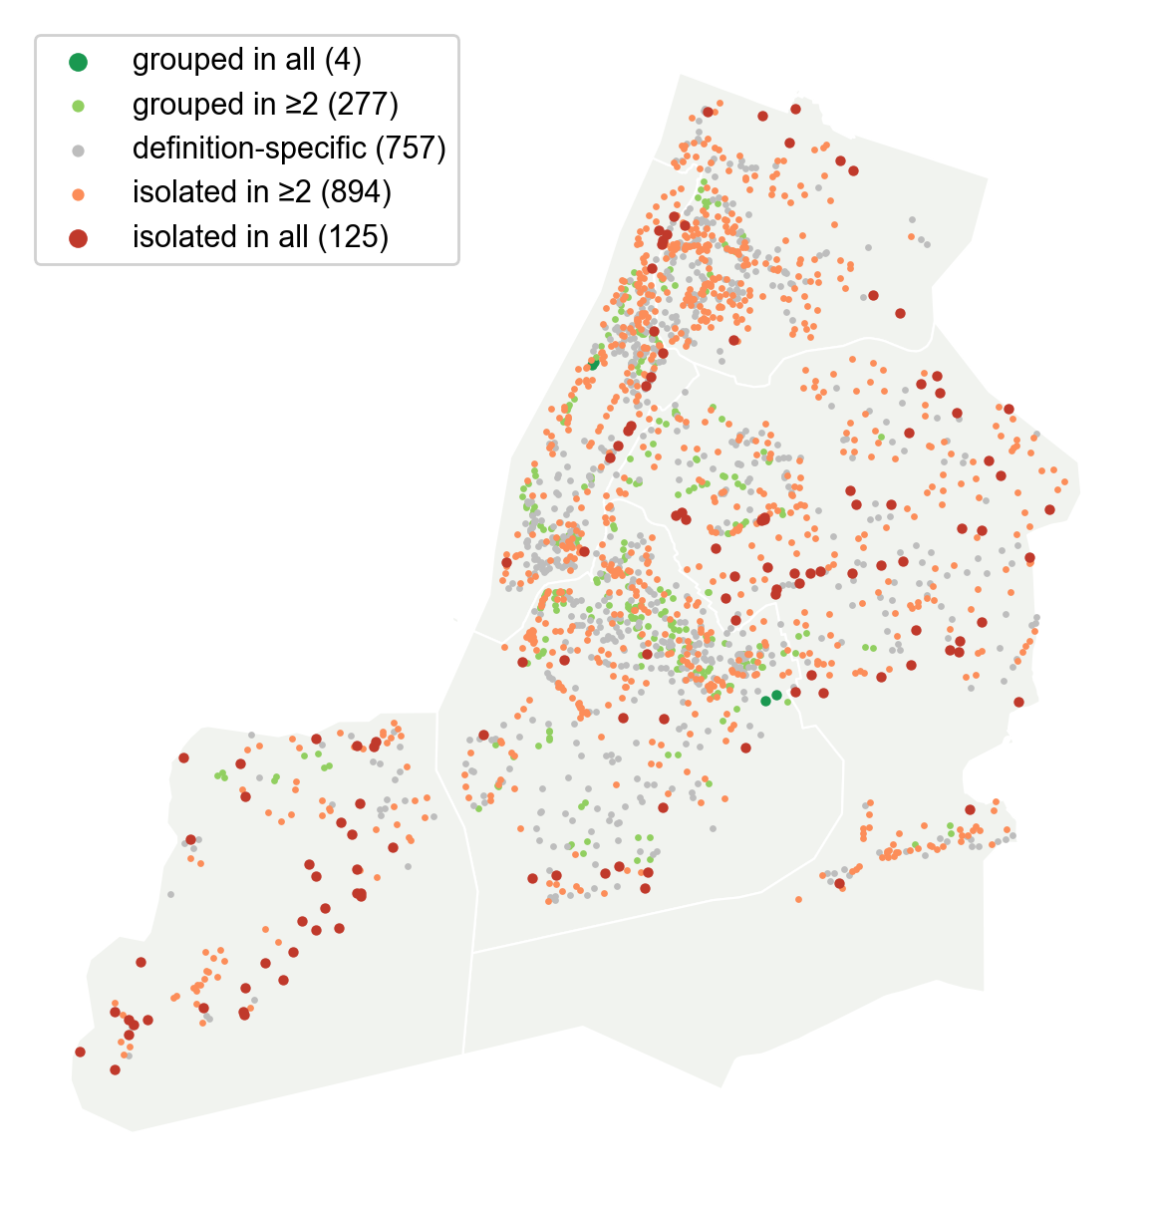
Across definitions: who is grouped, who is isolated?
The three definitions capture different structure: group agreement between them is near zero (ARI ≈ 0).
Only 4 parks are grouped under all three; isolation concentrates in Staten Island and Queens (curvilinear, low-connectivity street patterns) and on expressway-side parkways.
Notes:
Isolated in all = robust isolated (≥ 0.8) in N1, N2 and N3. N2/N3 isolation is common by construction, so the N1 status is the key filter.

Slide 18
Takeaways & limitations
N1 is the core result
340 walkable few-turn groups (γ = 2), every pair within a 10-min walk; 132 parks robustly isolated.
Configuration ≠ proximity
Within its search bound, distance does not dominate any definition (AUC < 0.85).
Definitions differ
N2 finds corridor chains, N3 is weak; groups barely overlap across definitions.
Percolation: allowing one turn connects almost all parks in a borough — groups rely on strict settings and community detection
Turn costs include bends inside segments (one turn ≈ 90–100°), so θ = 90° is a strict one-turn threshold; θ ≈ 100–110° is worth testing
OSM completeness and mapping regime (separately drawn sidewalks) affect angular costs; S results differ from C
N2 computed on C only; large linear parks are split into ~400 m pieces; park entrances unknown (boundary attachment)
Next: validate groups with observed park use / pedestrian counts; test alternative group resolutions per borough
Notes:
Outputs: outputs/NYC/geojson (parks/groups/edges per definition), outputs/NYC/regroup/map_final_groups.html.

