Slide 1
ATTRIBUTE-BASED ENCRYPTION FOR SECURE ACCESS TO DATA WITHIN A CLOUD DATABASE
Sunny To, Smit Patel, Gustavo Vazquez

Slide 2
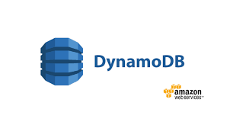
Goal
The goal of this project is to utilize a cloud environment where users are granted or denied access to data using Attribute-Based Encryption (ABE)
We will create a database filled with fake student/faculty information using Amazon DynamoDB
Users that provide attributes that fall within the policy set by the ABE will determine which sets of data the user will have access too
This will provide authentication and secure access to the data set within the cloud

Slide 3
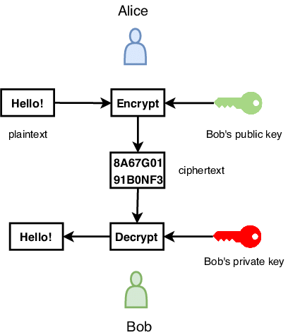
Asymmetric Key Encryption
Alice encrypts messages using Bob’s public key
The Bob receives the encrypted message and is able to decrypt it using his private key
Bob encrypts messages using his private key
People with Bob’s public key can decrypt the message

Slide 4

Attribute-Based Encryption
ABE is another category of Asymmetric Key Encryption Algorithm (public-key based one-to-many encryption)
Decryption is only possible if some set of attributes of the user key matches the attribute of the ciphertext
Mainly two types of ABE schemes:
Key-Policy ABE (KP-ABE)
Ciphertext-policy ABE (CP-ABE)
CP-ABE (the one we chose to use for this project) uses access trees to encrypt data and users’ private keys are generated over a set of attributes of the user

Slide 5
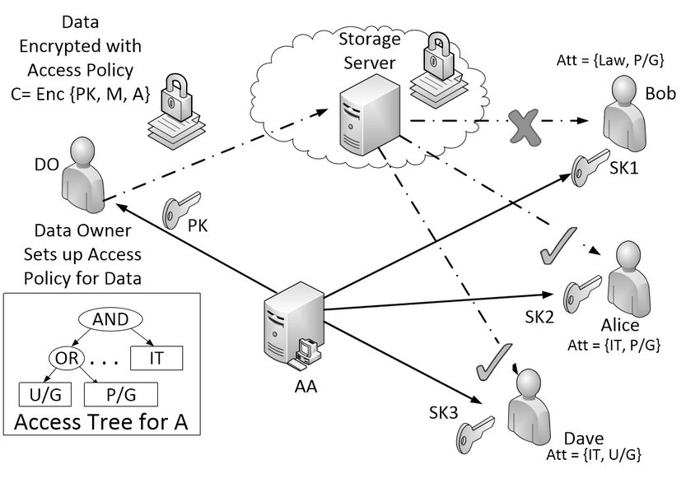
CP-ABE
Notes:
AA is the

Slide 6




How Data is encrypted
Policy Set by the Student

Slide 7

Data is encrypted by the policy the Student set.
GPA, Favorite Snack
aks9j84jj, qiw8sjd3h2

Slide 8


Decryption
Attribute input by an User

Slide 9



Decryption
Hello!
29dkals
29dkals

Slide 10


Requirements
AWS Cloud Service
Programming Language: Java
Database: DynamoDB on AWS
Open Source CP-ABE library https://github.com/junwei-wang/cpabe

Slide 11
Progress
AWS DynamoDB created
Learn Java
Learn how to navigate DynamoDB with Java
Learn how to use the CP-ABE library
Implement CP-ABE Policy to AWS DynamoDB

Slide 12
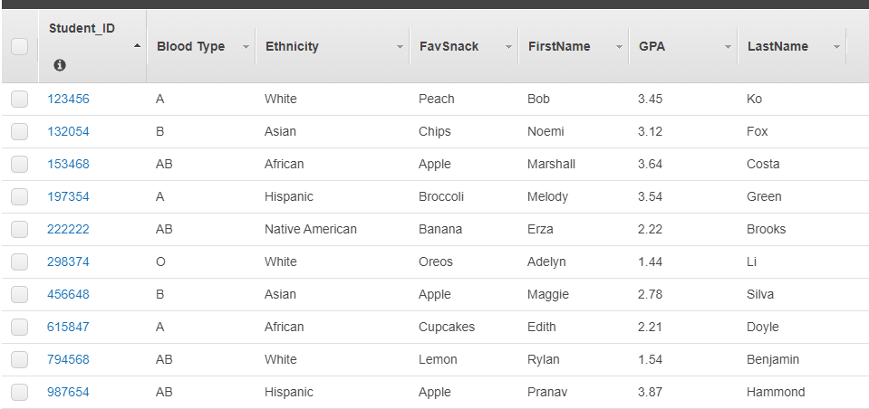
AWS DynamoDB

Slide 13
DEMO

Slide 14
~Fin~

