Slide 1
ATC’26 · Hong Kong · November 2026
A Novel AI-Native GPU Kernel
Programming Language for
Autonomous Kernel Tuning
Heng Shi
·
Xiaofeng Guan
·
Sijie Wu
·
Enming Fan
·
Chenpeng Wu
Qiqi Gu
·
Jiahang Xie
·
Guoqing Bao
·
Jianguo Yao
Shanghai Enflame Intelligence & Shanghai Jiao Tong University

Slide 2
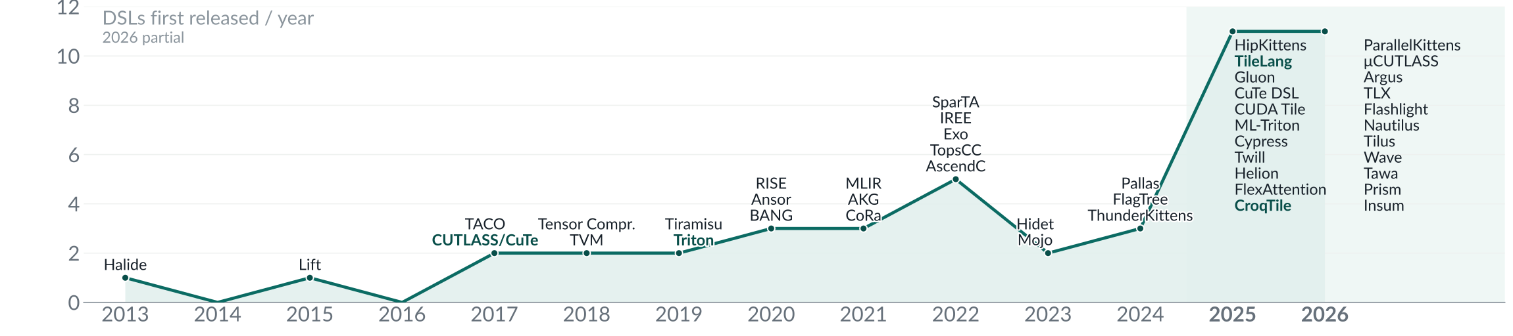
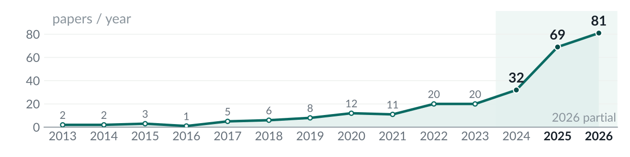
02 / 19
Operator work keeps growing
Model families converge.
Kernel variants multiply.
22
/46
DSLs in 2025–26
Notes:
The top chart shows DSL releases; the lower-right chart shows operator-optimization papers. The survey contains 276 papers and 46 DSLs; 22 DSLs were released in 2025–26. These are survey counts, not a census. Model-level convergence does not eliminate kernel-level diversity. The next slide explains why.

Slide 3
03 / 19
Why kernels multiply
1
Operator variants
MHA · MQA · GQA · MLA
2
Hardware diversity
MI300X · Ascend · TPU · Trainium
3
New GPU instructions
Hopper wgmma → Blackwell tcgen05
4
Operator fusion
Conv + BN + ReLU → one kernel
Notes:
The question on the previous slide has four answers, and they stack.
One: the models converged but the operators did not. Three model families ship — encoder, decoder, diffusion — yet inside that decoder the attention operator keeps splitting: MHA, MQA, GQA, MLA, sliding-window, block-sparse. The same attention math also produced FlashAttention-2, -3 and -4, each a different dataflow against a different memory hierarchy. Convergence at the model level is exactly what lets operator variants multiply: the layer is fixed, so all remaining variation has to live in the kernel.
Two: hardware multiplied. Outside NVIDIA there are GPUs from AMD, Intel and MetaX, and non-GPU DSAs from Huawei Ascend, Cambricon MLU/BANG, Google TPU, AWS Trainium, Groq LPU and Cerebras WSE. Each has its own instruction set and its own DSL, so one kernel source does not cover them.
Three: on NVIDIA itself the ISA breaks every generation. Hopper's sm90a instruction set — wgmma, TMA, thread-block clusters — was replaced on Blackwell sm100 by tcgen05 with TMEM and 2-CTA pairs, and the consumer sm120 part has neither: mma.sync only. wgmma is an "a"-target instruction; it does not carry forward. Everything written for Hopper has to be re-derived, not recompiled.
Four: fused operators everywhere. The economics explain why. In the past the model was a lego toy — conv, batch-norm, ReLU, matmul, standard operators stacked. Now a two-percent inference gap maps to real money at fleet scale, so extreme performance is the goal and the whole layer collapses into one fused operator. That is why the operator, not the model, is where the work went.

Slide 4
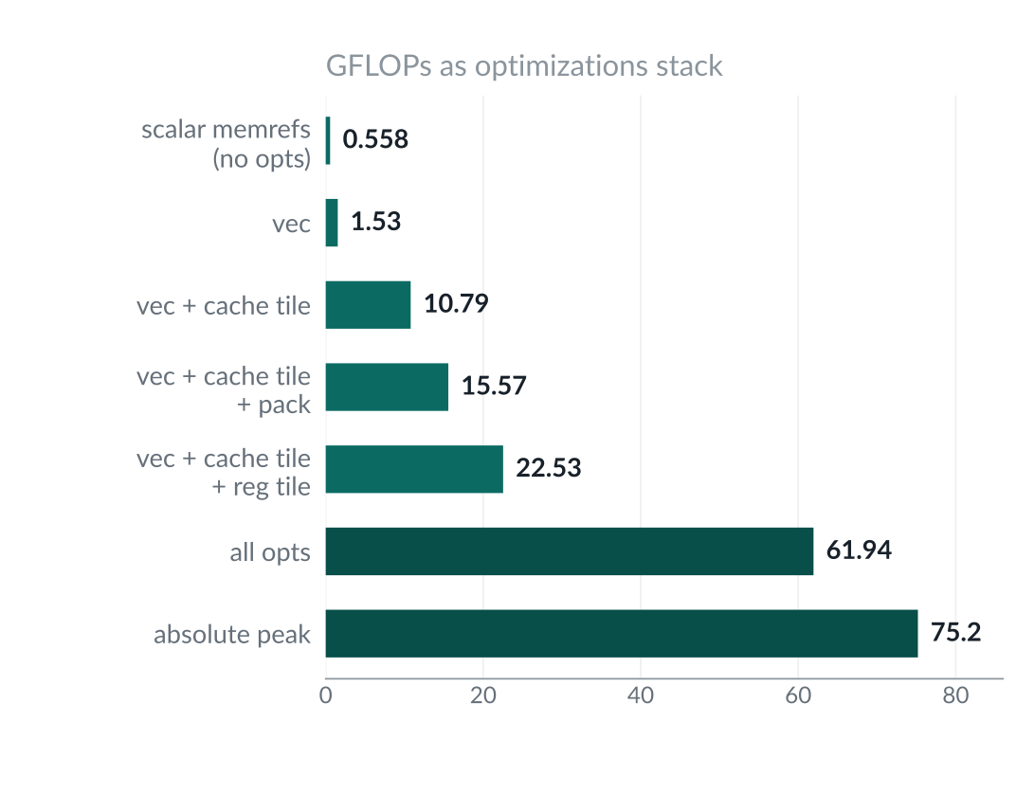
04 / 19
Kernel optimizations interact
Tiling
Data reuse
Swizzling
Multibuffering
Unrolling
Vectorization
Approximation
Sparsity
Fusion
L2 bypass
Async copies
Warp specialization
MMA layouts
Clusters / DSMEM
Scheduling
Low-precision MMA
Notes:
An operator is never just a loop nest. It is a sequence of transformations, and the first eight are the ones that recur across virtually every kernel. Each buys a different resource: tiling buys locality inside the cache hierarchy; keeping data stationary buys bandwidth; swizzling removes bank and partition conflicts; multibuffer and prefetch hide memory latency behind compute; unrolling gives the scheduler enough instructions to fill issue slots; vectorisation spends SIMD, SPMD and tensor units; approximate compute trades exactness for cycles, FFT-based convolution being the classic case; and sparsification turns dense arithmetic into CSR, COO or structured N:M work that sparse ALUs can exploit. Entries nine to sixteen are the kernel-level tricks these enable in practice: fusing producer and consumer loops, streaming stores that bypass L2, asynchronous copies with tile-shape swaps for the tail, warp specialisation in which dedicated warps do the data movement while others compute, layout and MMA swizzles on modern tensor cores, thread-block clusters sharing distributed shared memory, explicit instruction scheduling, and low-precision matrix instructions.
The chart on the right is that stack applied to one kernel: 0.56 GFLOPs with no optimisation, 75.2 at the absolute peak.
None of these sixteen is free. Each one changes the dataflow, changes the tile shape that fits, and changes what the next one can do. That is the real difficulty: the optimisations interact, and the search over their combinations is what the rest of this talk is about.
Reference: Source · typical operator development process · arXiv 2108.13191

Slide 5
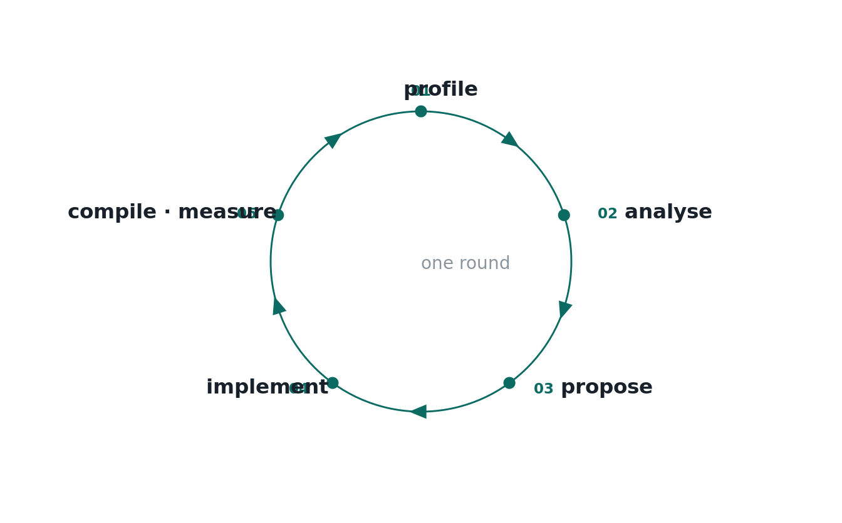
05 / 19
Bottleneck-driven tuning
1
Profile
2
Identify bottleneck
3
Choose structural edit
4
Implement
5
Compile · measure · keep / reject
Bottleneck → structural change
Notes:
The expert does not start from a candidate or a search space. They profile the kernel first with Nsight Compute, analyse the bottleneck second, and only then propose a structural change, implement it, compile it and decide whether to keep it. That profile-and-analyse front half is the part a compiler pipeline cannot do and a plain search does not do.

Slide 6
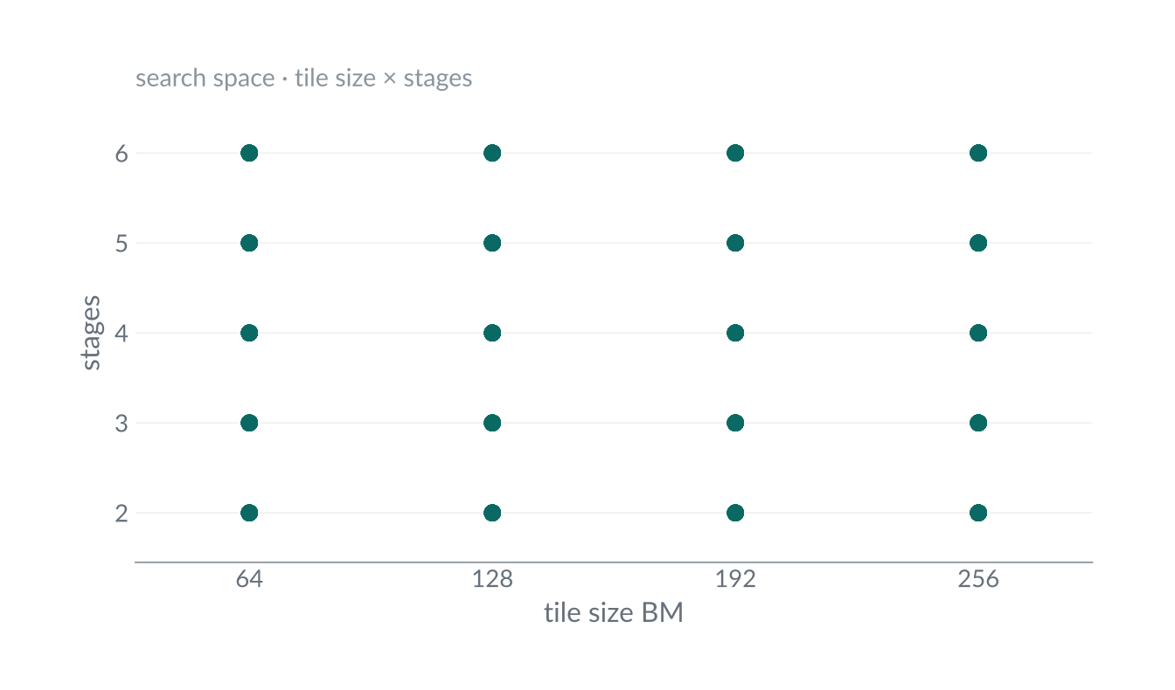
06 / 19
Template search
Tile size · stages · warps · swizzle
Fixed skeleton
Parameter search
Resource pruning + benchmarking
Search within the template
Notes:
Autotuning sits between the expert loop and a compiler pipeline. Nothing is fixed, because the pipeline is not; nothing is hand-judged, because a benchmark decides. What replaces both is a template with tunable knobs left open — tile sizes, stages, warp counts, swizzle — and a search over that space. Each point in the grid is a configuration: tile size against pipeline stages, with the N-tile, K-tile and swizzle variants making up the rest of the space. Resource limits prune much of it before anything runs — configurations past the SMEM or register limit never reach the GPU — and a benchmark decides among the rest. It never profiles the kernel or asks why it is slow, and the skeleton, warp specialisation and pipeline depth are fixed in advance.

Slide 7
07 / 19
Compiler transformations
data tiling / blocking
→
Loop tiling
data stationary
→
Cache staging
MLIR · TVM · IREE
multibuffering & prefetch
→
Software pipelining
Schedule DSL
· Halide / TVM TE
loop unroll
→
Unrolling
Compiler passes
· loop transformations
vectorisation
→
Vectorization
Performance depends on exposed transformations
loop fusion
→
Fusion
instruction scheduling
→
Instruction scheduling
Notes:
A compiler pipeline writes the kernel once and lets a pass list rewrite it the same way for each shape and each chip. The optimisation tricks map onto loop transformations: tiling becomes loop tiling and blocking, keeping data stationary becomes a cache-read stage, swizzling becomes loop reorder and interchange, multibuffering becomes software pipelining with peeling, and the rest run down the pass list to instruction scheduling. MLIR, TVM and IREE are the compilers; Halide IR, Accera and TVM's tensor expressions are scheduling DSLs that sit in front of one.

Slide 8
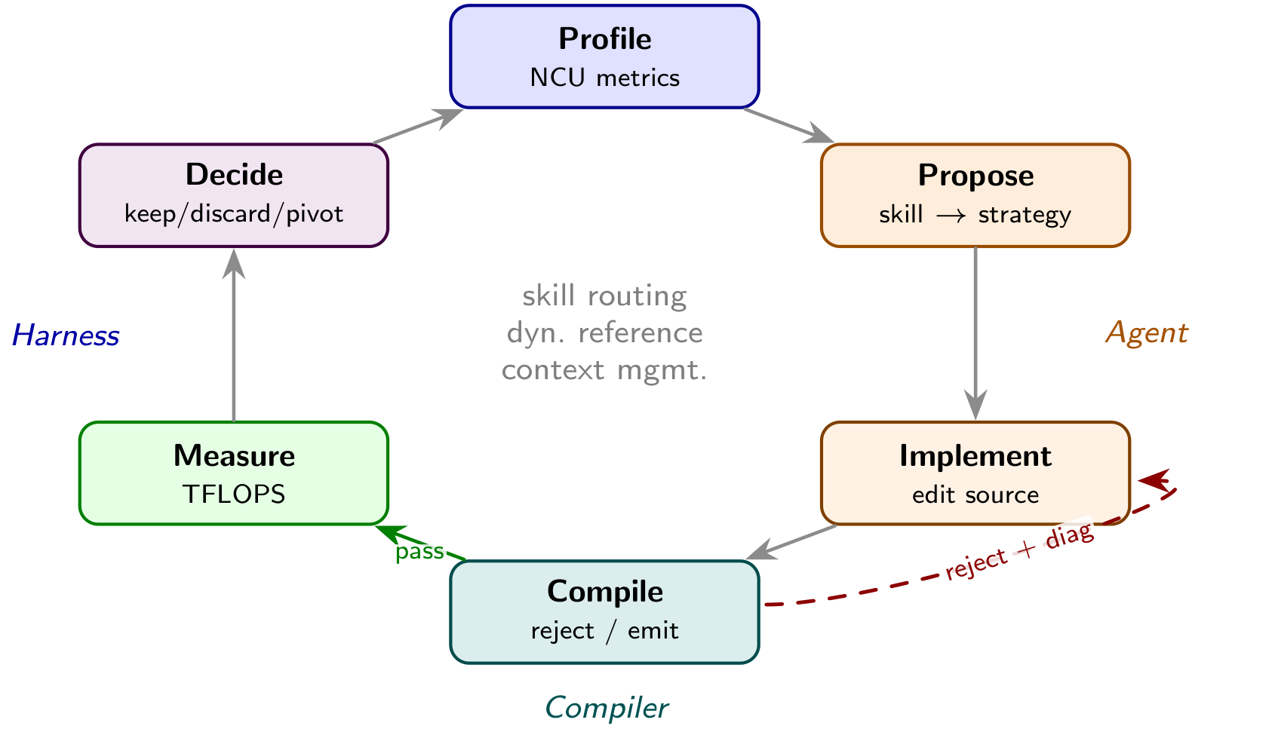
08 / 19
Agents rewrite the kernel
Profile → edit → evaluate
Workflow
Planning · search · refinement
Full source edits
· structural + parametric
Evals
Correctness · speed · generalization
Tooling
Profiler · compiler · benchmark
Knowledge
Skills · references · history
Notes:
The agent reads source and profiler feedback, proposes structural or parametric changes, and writes the next kernel. The compiler and harness compile, verify, measure and decide. Existing systems differ in workflow, evaluation, tools and knowledge. CroqTile addresses the representation and feedback interface used inside that loop. Representative systems and detailed references are in the survey and original notes.

Slide 9
09 / 19
Design for agent failures
Failure
Requirement
Context pressure
Compact source
Coupled edits
Independent primitives
Opaque failures
Early, actionable feedback
Notes:
Three pain points define the first design principle: design the language against the failures the agent actually hits, one requirement per failure. Read down the left column.
F1, token footprint. A production GEMM in CUDA or CuTe runs to hundreds of lines, so one iteration of the agent's edit eats the context window. The paper names that consequence the volume-quality reverse principle: past a saturation point more tokens make the agent worse, not better, because the profiler history and the earlier attempts it needs to learn from are pushed out of the working window. The requirement is R3, a compact representation in which source, score and trajectory share the same window.
F2, coupled code sites. One structural change fans out. Enabling TMA touches the descriptor, the swizzle, the copy instruction, the barrier and the arrival notification, and a single missed site is silent corruption rather than a compile error, because the levers are entangled in the substrate. The requirement is R1, and R4 with it: one edit, one site, and each axis — TMA, staging, warp specialisation, swizzle — turnable on its own.
F3, feedback quality. An invalid configuration comes back as a GPU hang of tens of seconds or an opaque device error, so the iteration learns only that it failed. The requirement is R2: rejection before launch, with a diagnostic that names the constraint, the observed value and the repair.
In one line, the first principle says: optimize the language for these three pains — compact source, decoupled sites, compile-time rejection. The next pages show the syntax answering F1 and F2; the compiler answers F3 later.
Reference: Source · paper §2.2–2.3 · R1–R4

Slide 10
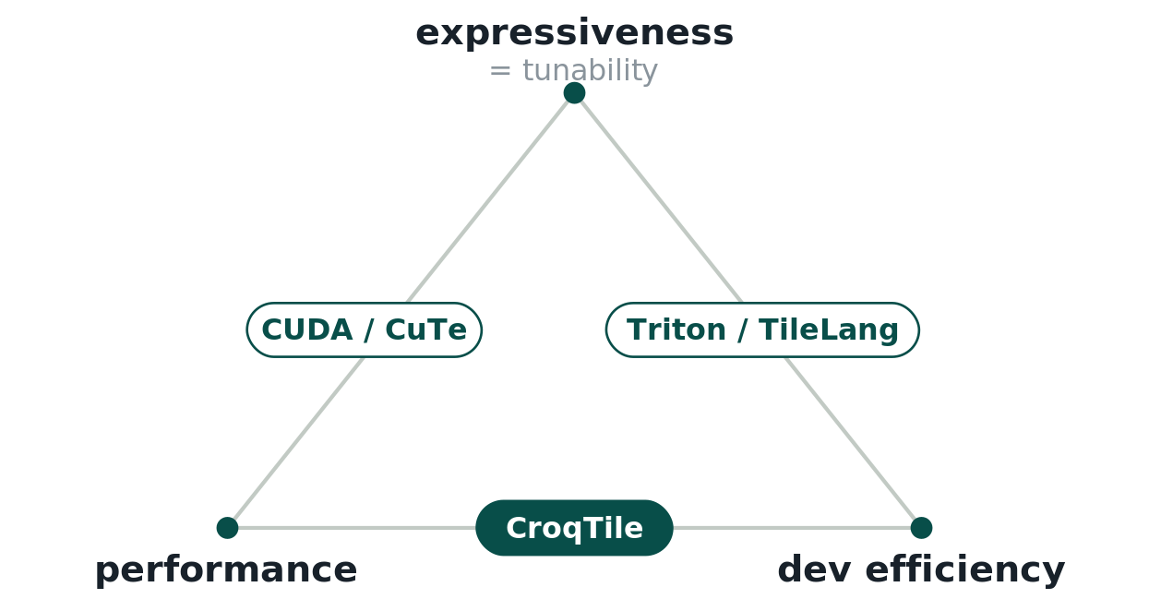
10 / 19
Performance + cheap iteration
Expressiveness · performance · iteration cost
CUDA / CuTe
Explicit control
Long source · coupled edits
Triton / TileLang
Compact tile operations
Some structural controls hidden
CroqTile
Compact + explicit
Independent performance controls
Notes:
The paper identifies an expressiveness–tunability dilemma. CUDA and CuTe expose low-level controls but require lengthy, coupled edits. Tile DSLs make common operations concise, while some of the evaluated DSL versions hide structural controls. This is a comparison of the versions and capabilities evaluated in the paper, not an impossibility theorem about all DSLs. CroqTile keeps critical controls explicit through compact independent primitives.

Slide 11
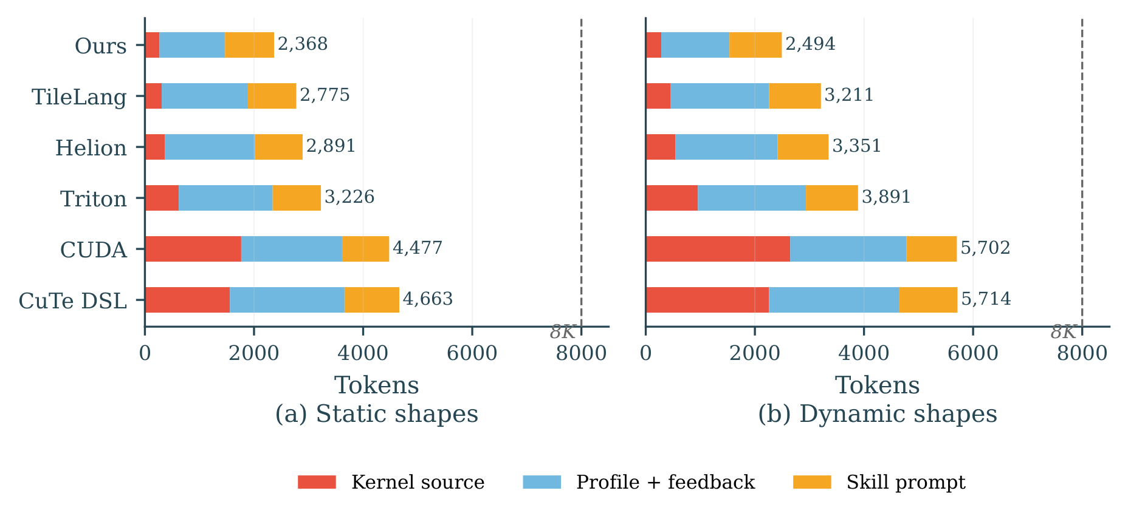
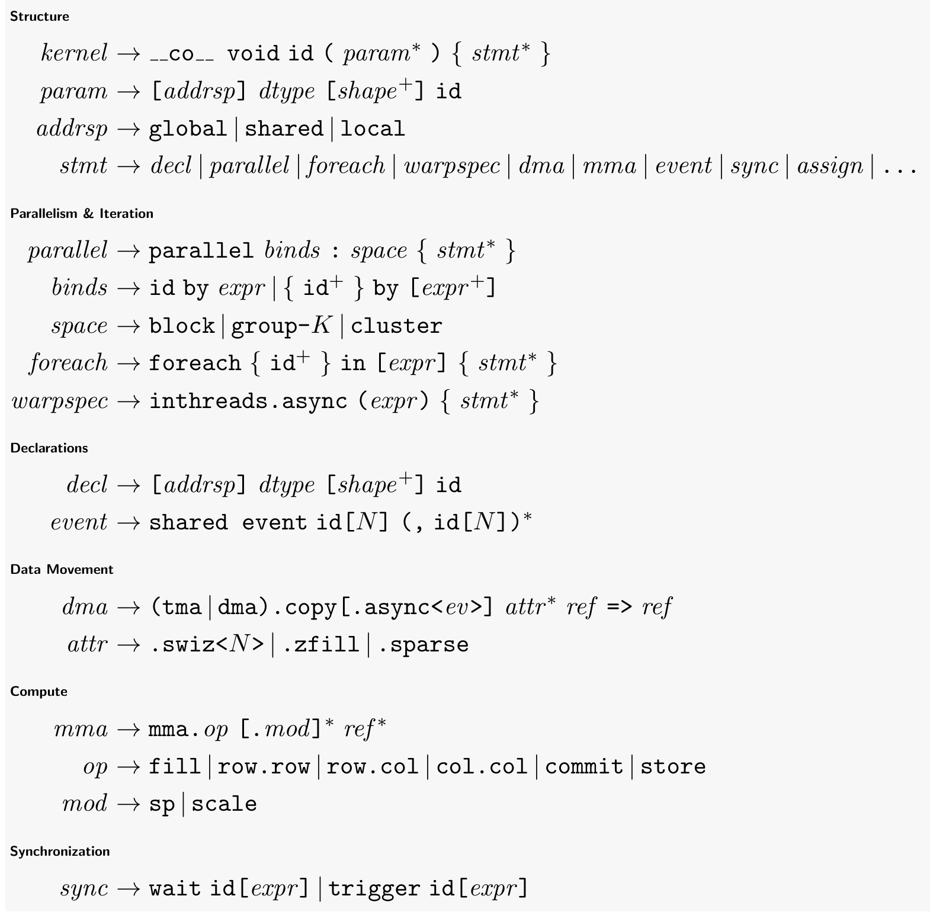
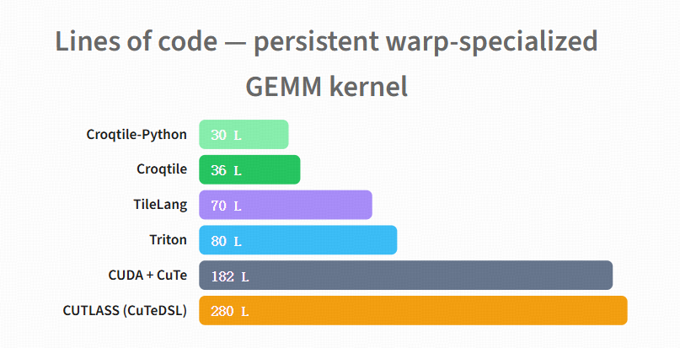
11 / 19
Compact syntax preserves context
Notes:
Paper Figure 11 uses an 8K-token working set as a comparison reference, not a model context limit. CroqTile consumes about 2,370 tokens per static-shape attempt versus 4,480 for CUDA and 4,660 for CuTe DSL, leaving 1.6 times more room for history. Dynamic shapes increase its footprint by 5%, versus 16–28% for other DSLs, leaving 2.4 times more history than CUDA. Source, profile feedback and skills are counted; model-internal thinking is excluded. The lower chart compares source length for the same GEMM; the grammar shows the compact surface. Do not infer sixty iterations from an 8K budget.

Slide 12
12 / 19
parallel: one construct, three levels
CroqTile
TileLang
CuTe / CUTLASS
CUDA
parallel
{
bm
,
bn
}
by
[
cdiv
(
M
,
WARP_M
)
,
Parallelism primitives
cdiv
(
N
,
WARP_N
)
]
:
block
{
CroqTile
2
parallel
p
by
1
:
group
-
4
{
mma
.
row
.
row
mc
,
ma
,
mb
;
TileLang
4
}
Triton
5
parallel
{
m
,
n
}
CUTLASS
6
by
[
WARP_M
,
2
]
:
thread
{
.
.
.
}
}
CUDA
8
parallel
p1
by
2
:
group
-
4
{
inthreads
.
async
(
p1
==
0
)
{
/
*
TMA
*
/
}
inthreads
.
async
(
p1
==
1
)
{
/
*
MMA
*
/
}
}
Notes:
The second action is where the work goes. CroqTile has one construct that names the parallel structure: a tile shape, a binding and a level. The same construct covers CTA tiling, warpgroup specialisation and thread-level work. That is why the language needs two primitives where CUDA needs eight, and why turning a tile kernel into a persistent or warp-specialised one changes the binding, not the body.

Slide 13
13 / 19
tma: one statement per transfer
CroqTile
Triton
TileLang
CuTe / CUTLASS
CUDA
// TMA load: global -> shared (1 line)
tma
.
copy
.
swiz
<
128
>
TMA load + store · source lines
lhs
.
subspan
(
WARP_M
,
TILE_K
)
.
at
(
bm
,
iv_k
)
=>
lhs_s
;
CroqTile
2
// TMA store: shared -> global (1 line)
TileLang
4
tma
.
copy
out_s
=>
Triton
12
output
.
subspan
(
WARP_M
,
WARP_N
)
.
at
(
bm
,
bn
)
;
CUTLASS
20
CUDA
35
Notes:
The fourth action is data movement. One statement expresses a TMA copy: the descriptor, the swizzle, the cache promotion and the async pipeline are generated. Across the DSLs, the same load and store take four lines in TileLang, twelve in Triton, twenty in CUTLASS and thirty-five in CUDA.

Slide 14
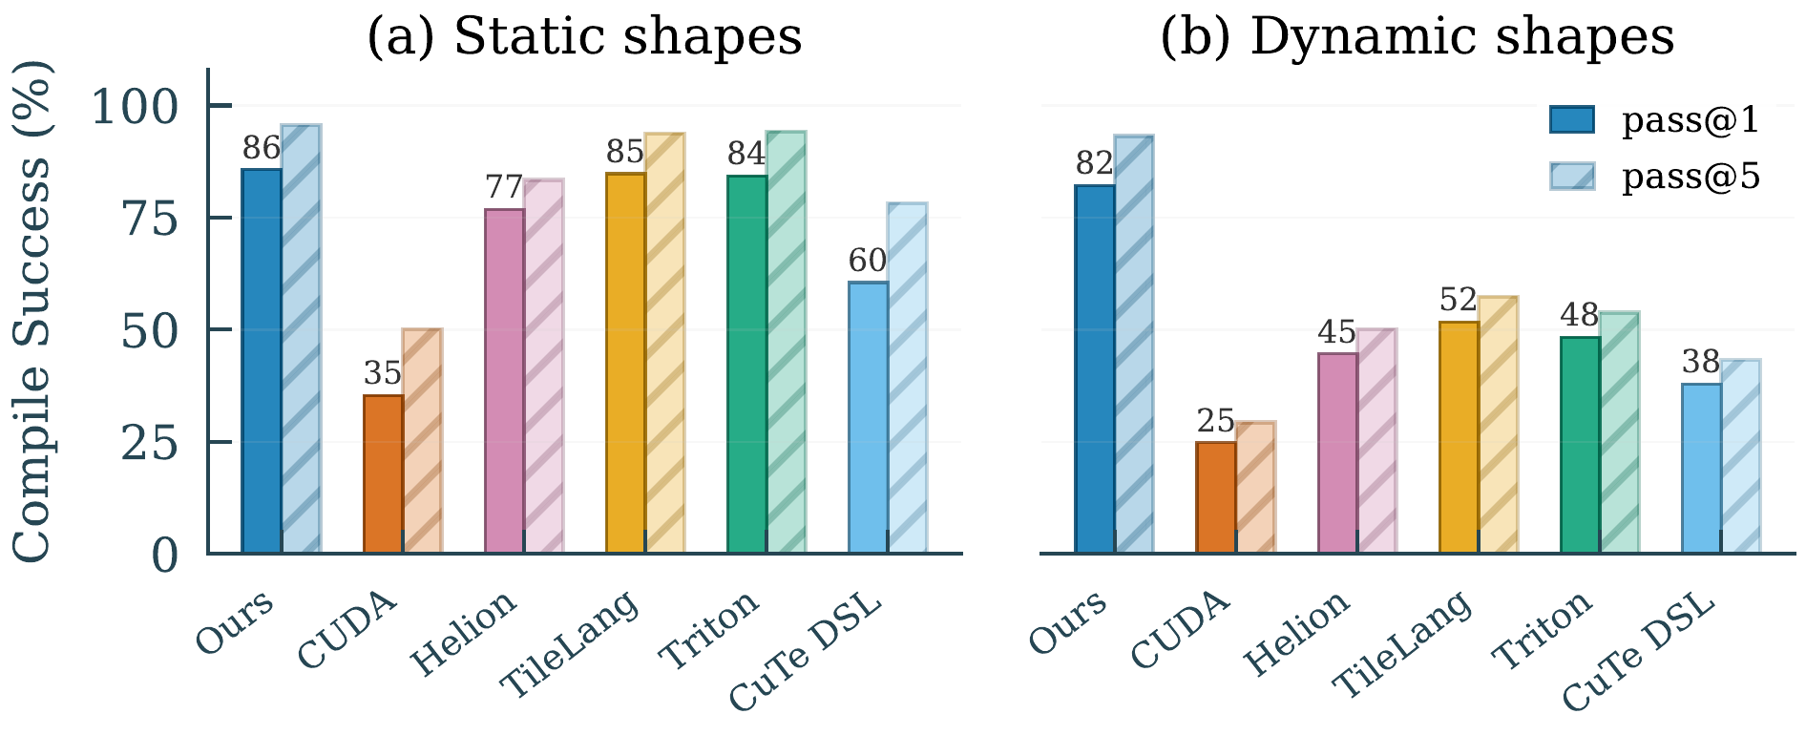
14 / 19
Compile success across shapes
pass@1 / pass@5 · static + dynamic
1
Static shapes
85.7% pass@1
2
Dynamic shapes
82.1% pass@1 · Triton 48%
3
Type system
Symbolic shapes · compile-time inference
Fewer edit sites → smaller repairs
Notes:
Paper §4.2 and Figure 9 report compile pass@1 and pass@5. CroqTile reaches 85.7% pass@1 on static shapes and 82.1% on dynamic shapes; Triton reaches 48% on dynamic shapes. Decoupled code sites and symbolic shape inference explain the design mechanism. Cross-DSL results support an association, not an isolated causal claim about site count. The benchmark controls agent, hardware and budget.

Slide 15
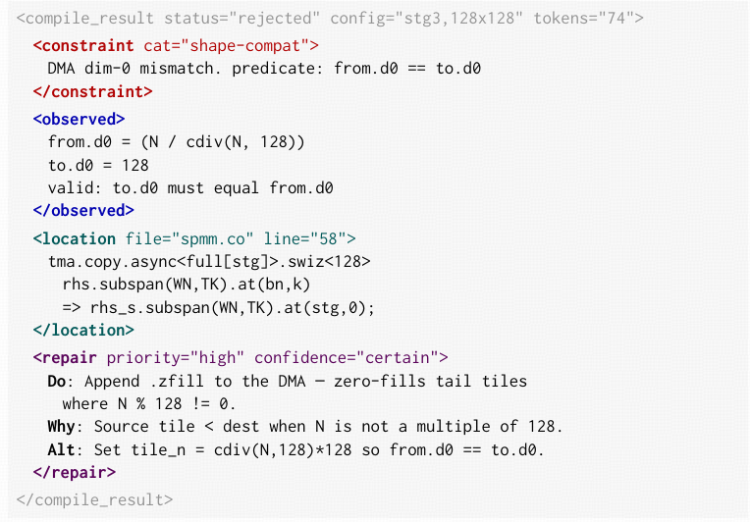
15 / 19
Diagnostics that guide repair
Constraint · observed · location · repair
1
Symbolic engine
Shape + resource checks before launch
2
Runtime assertions
Dynamic constraints checked at runtime
3
XML-tagged messages
Structured feedback for the harness
4
Root cause + fix
Exact edit site + repair hint
Notes:
This page names the failure that costs more than any other: debug. In CUDA an invalid configuration comes back as a hang of tens of seconds or an opaque device error surrounded by template noise, so one failed attempt can burn thousands of tokens and the agent's patience, and it teaches the agent only that something was wrong.
CroqTile attacks it on four fronts. A symbolic engine and a shape type system widen what can be checked at compile time. A runtime layer adds near-zero-cost assertions for the errors that only a dynamic shape can expose. The compiler emits its messages as XML-tagged blocks, so the harness can parse them without guessing. And each message carries the root cause and the fix.
Reference: Source · paper §2.1 · §2.3 R1/R4 · §3.3 diagnostics · 74-token envelope · coupled-round cost: reference deck

Slide 16
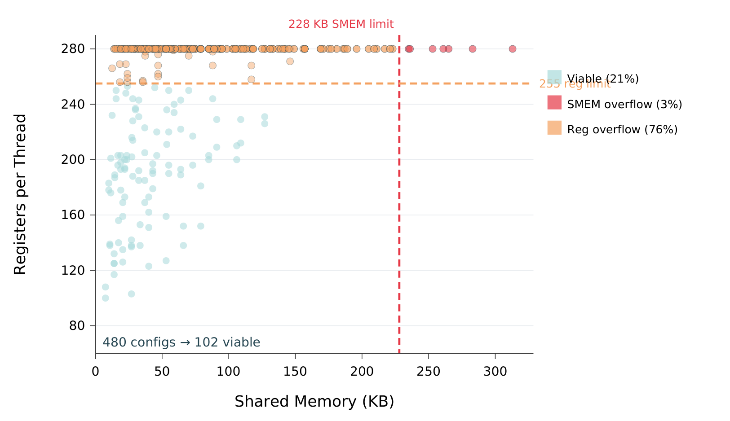
16 / 19
Prune before GPU execution
Sparse GEMM · configuration pruning
1
Check constraints
353 checks
· 7 modules
2
Filter + rank candidates
480 → 102
configurations · 79% pruned
3
Return actionable feedback
74 tokens
· constraint + location + repair
Generic feedback: −14.9%
throughput
Notes:
This is the compiler half of the argument. Three things come out of the compiler.
First, checks: 353 of them in seven modules, run while lowering, so a tile that does not divide, a shared-memory allocation over the limit, a swizzle that does not match its shape or a barrier that would deadlock is a message in under ten milliseconds instead of a hang on the GPU. Second, ranking: the compiler knows registers and shared memory for every candidate and can reject those with zero occupancy before any measurement, which kills 79 percent of the 480-point sweep. Third, the message shape is fixed at constraint, observed, location, repair.
The co-design point is the last line: the same diagnostics made generic cost 168 TFLOPS, 14.9 percent, because the harness can only act on a repair that names the locus. That is why the compiler and the harness were designed together.
Reference: Source · paper §3.3 · §4.4: pruning figure and ablation

Slide 17
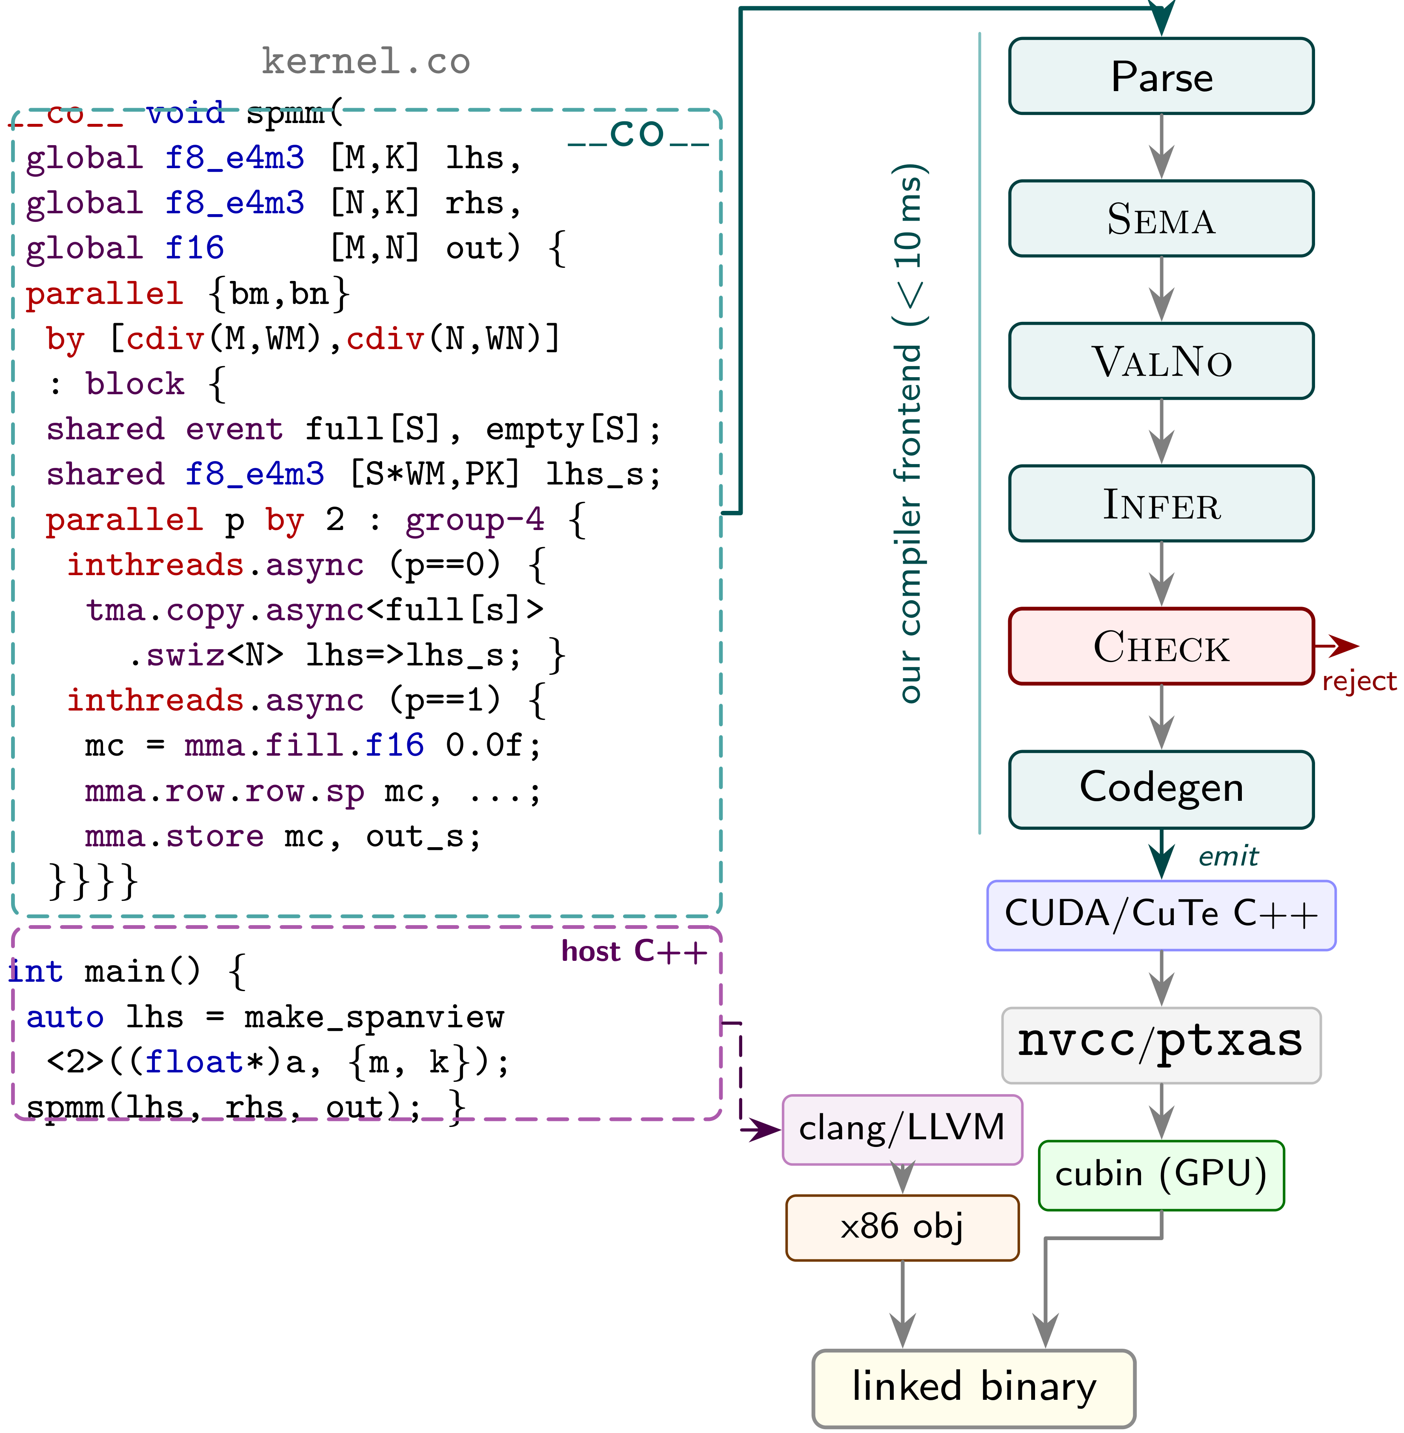
17 / 19
Close the autonomous loop
Result
1.23× vendor libraries
Geomean · vendor-referenced workloads
Notes:
One sequential agent follows six phases. Compiler rejection returns directly to implementation with structured feedback. Skill routing supplies the loop protocol, DSL contract and bottleneck-indexed ideas. Dynamic reference injection supports refinement without a handwritten starter. The paper reports 1.23× geometric-mean speedup on vendor-referenced workloads. In the sparse-GEMM ablation, removing compiler–harness features costs 25.8% throughput; removing tuning mechanisms costs 12.0%. These ablations are workload-specific, not averages over all operators. The two figures show the tuning loop and compilation pipeline; convergence is on the next slide.

Slide 18
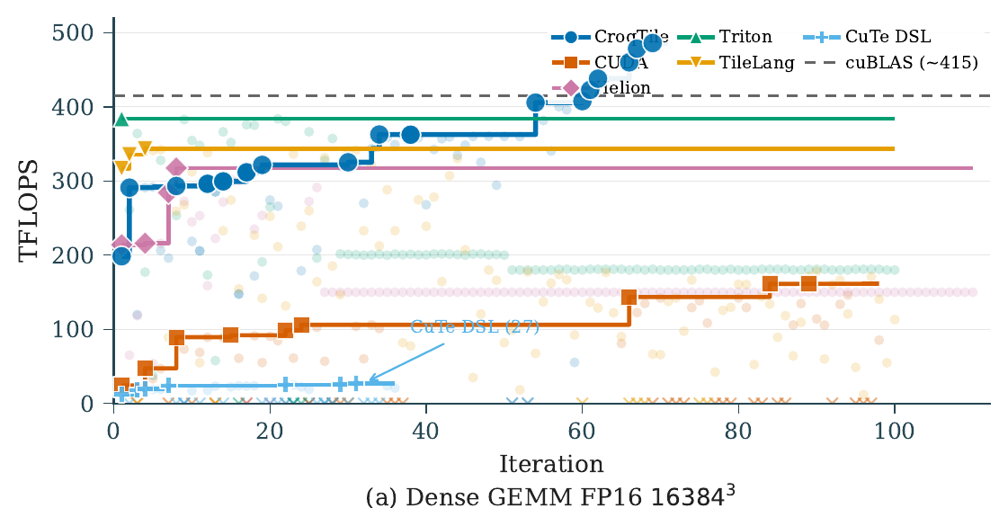
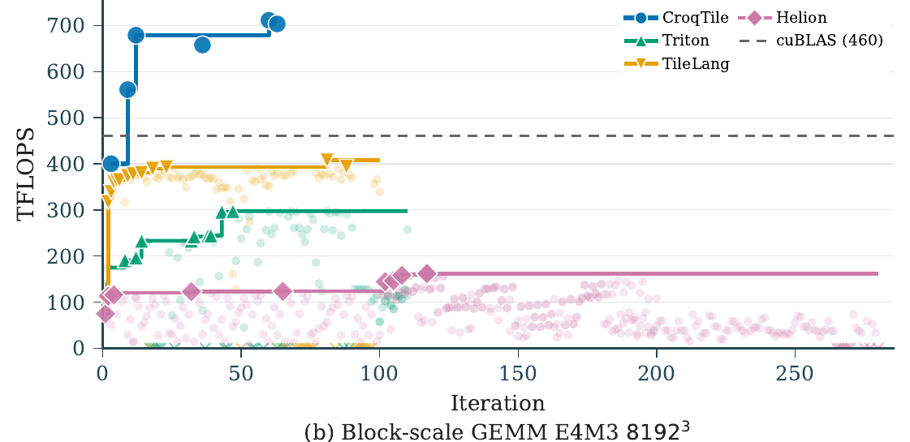
18 / 19
Tuning beyond cuBLAS
Notes:
Two tuning cases, side by side. The left is dense FP16 GEMM at 16384 cubed: CroqTile climbs through the DSL baselines and the vendor library, reaching the cuBLAS line first and then passing it. The right is block-scale E4M3 GEMM at 8192 cubed: the same picture against Triton, TileLang, Helion and cuBLAS. The point of the page is convergence speed, not just the final number.

Slide 19


19 / 19
CroqTile · open source
Autonomous tuning needs
Compact syntax
· more tuning history
Open source
Independent primitives
· structural edits
Actionable diagnostics
· cheap repair
CroqTile repository
Notes:
The takeaway is language–agent co-design: compact syntax preserves useful history, independent primitives make structural edits local, and compiler diagnostics turn rejection into a small repair. CroqTile is open source; the QR code links to the repository. Invite questions.

