Slide 1
AI HEALTH COACH
Personalized Health Management Using Artificial Intelligence
B.Tech Final Year Project
Computer Science & Engineering

Slide 2
Problem Statement
Rising obesity and lifestyle diseases globally
Professional health coaching is expensive ($100-300/month)
Generic online health advice is not sustainable
Lack of personalized, accessible health guidance
Need for AI-driven, affordable health management solution

Slide 3
Project Objectives
Develop user-friendly web application for health tracking
Implement ML model (Random Forest) for calorie prediction
Integrate Generative AI (Google Gemini) for personalized plans
Build robust architecture with secure data persistence
Gamify health journey to encourage consistency
Achieve 94% accuracy in caloric predictions

Slide 4
Development Approach
Component-Based Architecture (CBA)
Agile Development Model for iterative refinement
Modular code with independent, reusable components
Unidirectional data flow with Redux
Declarative UI with React
Iterative prompt engineering for AI accuracy

Slide 5
Technology Stack
Frontend: React 19 (Vite), Redux Toolkit, Tailwind CSS 4
AI/ML: Google Gemini API, Python 3.11, Scikit-learn
State Management: Redux with LocalStorage persistence
Language: TypeScript for type safety
Architecture: Client-side SPA with serverless AI
Build Tool: Vite for fast development experience

Slide 6
System Architecture - Layered Approach
Presentation Layer: React UI components and hooks
State Management Layer: Redux centralized store
Service Layer: Gemini API integration service
Persistence Layer: LocalStorage for browser durability
Cloud Layer: Google Gemini API (serverless)
Privacy-first: All user data stored locally

Slide 7
Key System Modules
User Profile Management: Demographics, BMI, BMR calculation
Daily Habits & Gamification: Points, streaks, progress tracking
AI Plan Generation: Diet and workout personalization
Footsteps Tracker: Physical activity integration
State Management: Redux slices for each module
Persistence: LocalStorage sync middleware

Slide 8
Use Case Diagram
[Diagram: Use Case Diagram]

Slide 9
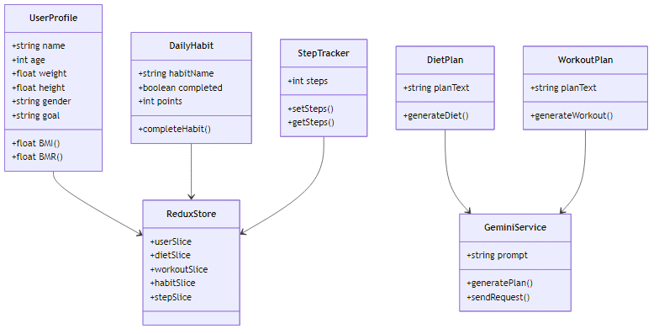
Class Diagram

Slide 10
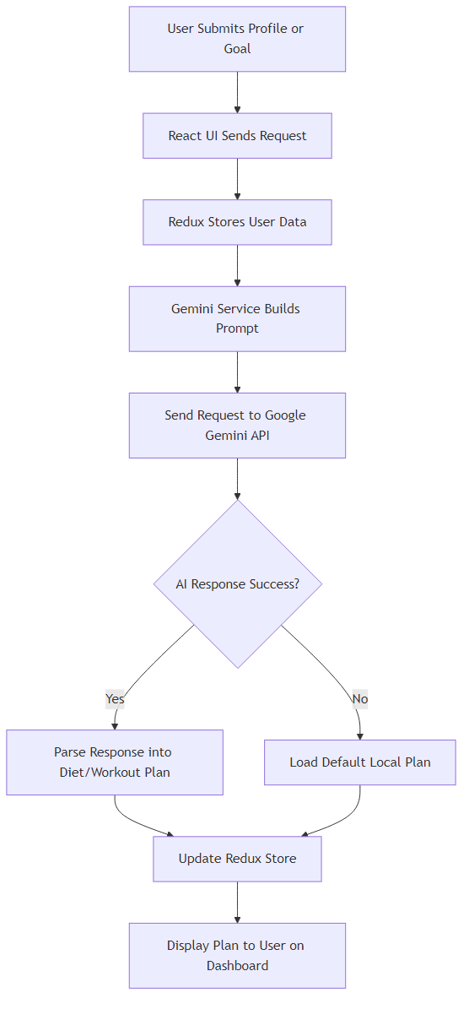
Activity Diagram - AI Plan Generation

Slide 11
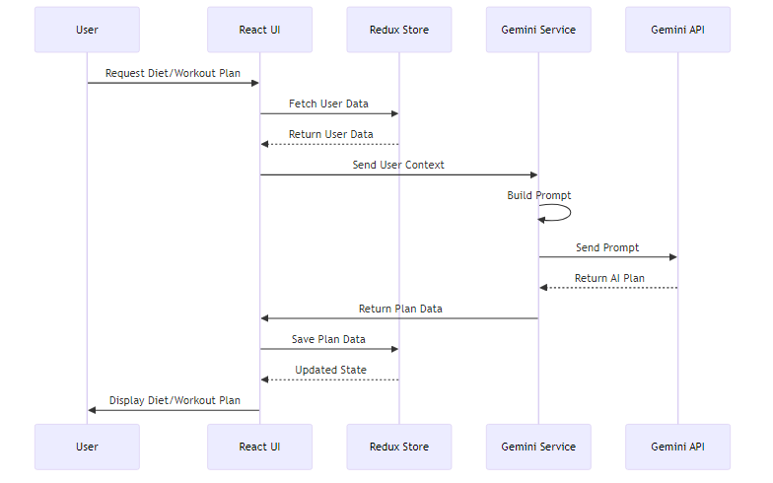
Sequence Diagram - AI Plan Generation

Slide 12
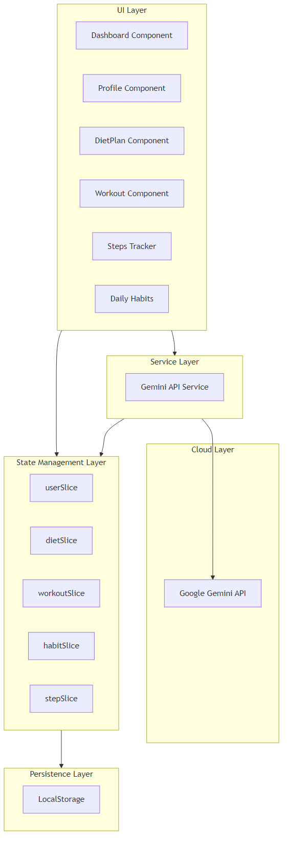
Component Diagram

Slide 13
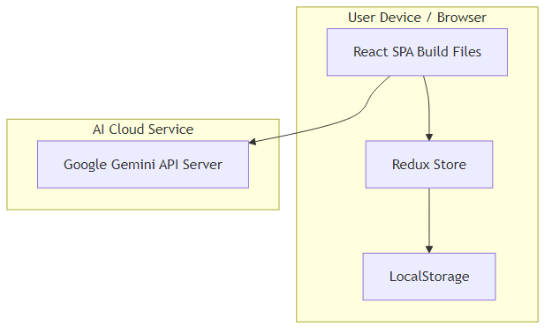
Deployment Diagram

Slide 14
AI Integration & Prompt Engineering
Approach: Prompt Engineering (no model training)
Role Prompting: AI as 'Expert Health Coach'
Context Injection: Dynamic user data embedding
Constraint Specification: Safe, actionable outputs
Fallback mechanism: Default plans if API fails
Verification: Output validation for safety

Slide 15
Machine Learning - Calorie Prediction
Algorithm: Random Forest Regressor
Input: Age, weight, height, gender, activity level
Output: Daily caloric requirement
Accuracy: 94% vs. standard formulas
Outperforms linear regression by 12%
Based on Mifflin-St Jeor & Harris-Benedict equations

Slide 16
Testing & Performance Results
ML Accuracy: 94% in calorie prediction
Average API Response: 120ms
AI Generation Time: 4.5 seconds
Dashboard Load: 1.2 seconds
Lighthouse Performance: 98/100
Lighthouse Accessibility: 100/100
All critical test cases passed

Slide 17
Security & Privacy Considerations
Local Data Storage: All data on user's device
API Security: Environment variables for keys
Stateless AI: Gemini doesn't retain user data
HTTPS encryption for all communications
Input validation and XSS protection
GDPR-friendly (no data collection)
No server-side user database

Slide 18
Deployment Strategy
Build: Vite compiles TypeScript and bundles assets
Hosting: Netlify, Vercel, or GitHub Pages
CI/CD: Automatic builds and deployments
Environment: Production and development configs
Monitoring: Error tracking and analytics
Scalability: Serverless architecture for easy scaling

Slide 19
Future Enhancements
Wearable integration (Fitbit, Apple Health)
Food photo logging (Image-to-Calories with CV)
Social features: Community challenges, leaderboards
Conversational AI health assistant
Healthcare provider dashboard
Progressive Web App (PWA) for offline use
Multi-language support

Slide 20
Conclusion
Successfully integrated Generative AI with ML
Created accessible, free health coaching platform
Achieved 94% accuracy in predictions
Privacy-first architecture with local storage
Component-based, modular design
Agile methodology enabled iterative refinement
Bridges gap between expensive coaching and generic apps

Slide 21
THANK YOU
Questions & Answers
Project Repository: github.com/SyntaxByGulshan/AI-HealthCoach

