Slide 1
Kudu

Slide 2

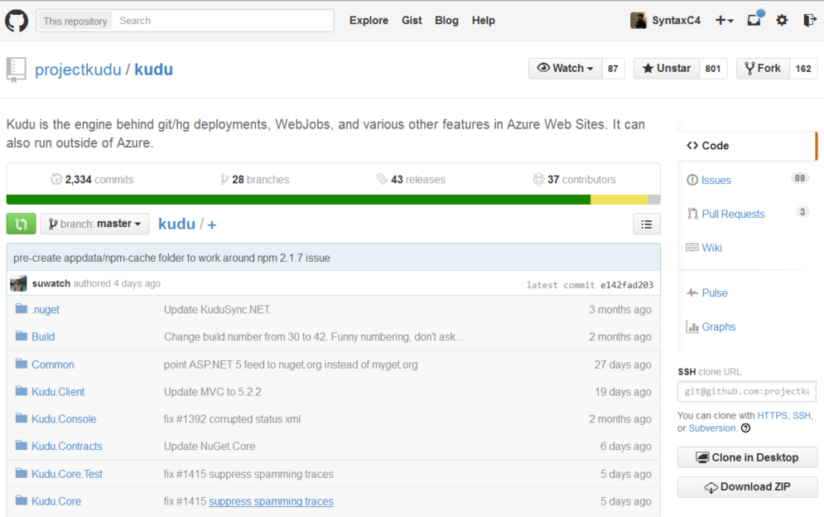


Kudu
http://github.com/projectkudu/kudu
Available on…
Azure Web App
Windows Server 2012 R2

Slide 3
Anatomy of a Web App
foo.azurewebsites.net
foo.scm.azurewebsites.net
User Site
“Monaco”
WebDeploy
Upload to site
Install from gallery
“Kudu”
WebJobs
Pre-installed
Site Extensions
“Bring your own”
Site Extensions
Azure Web App

Slide 4
Lesser known Kudu
Deployments
Debug Console
Runtime Versions
Source Control
Process Explorer
Web Hooks
WebJobs
Virtual File System
Site Extensions
Deployment Hooks
WebJobs API
REST API
SCM Site

Slide 5
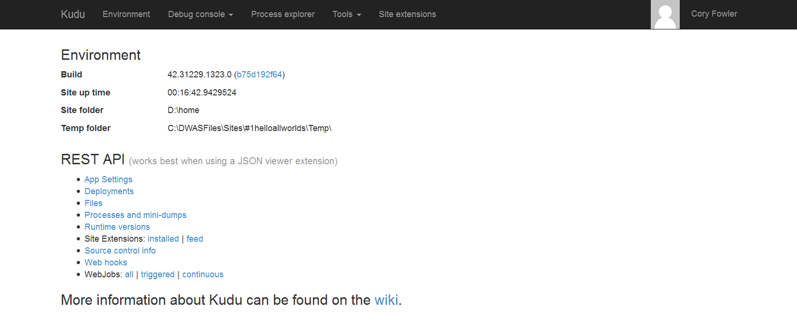
Kudu Console

Slide 6
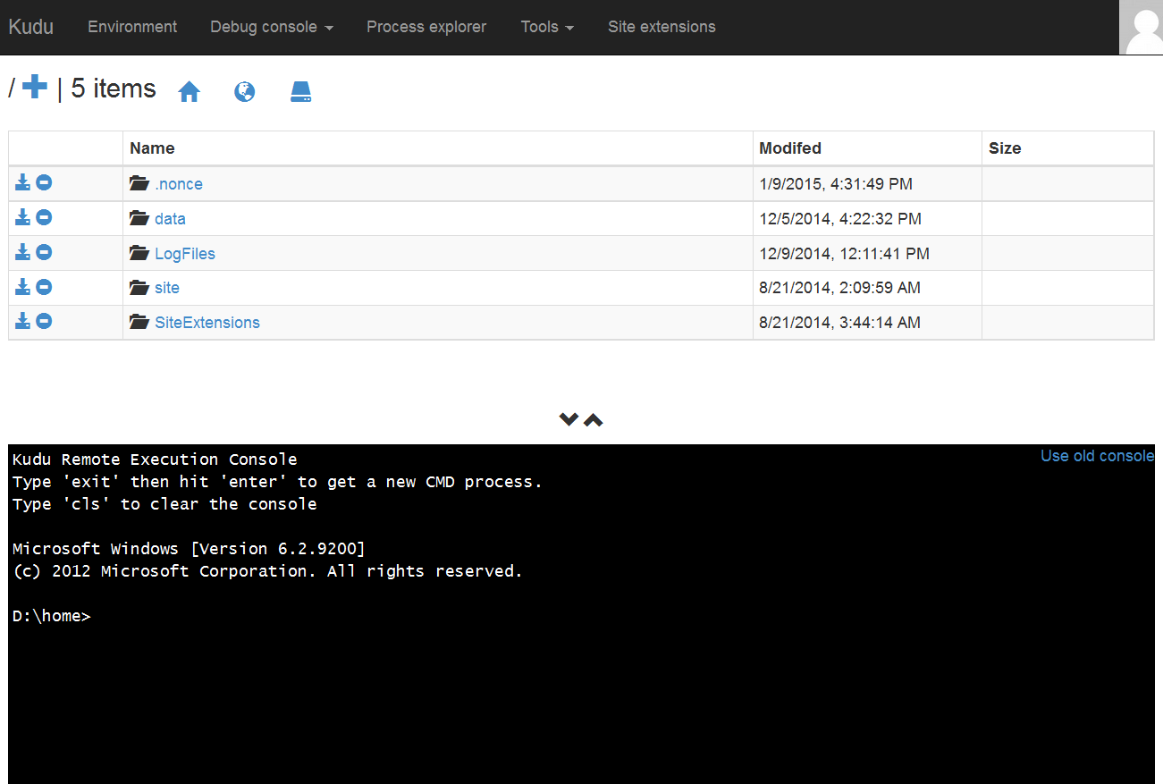
Debug Console

Slide 7
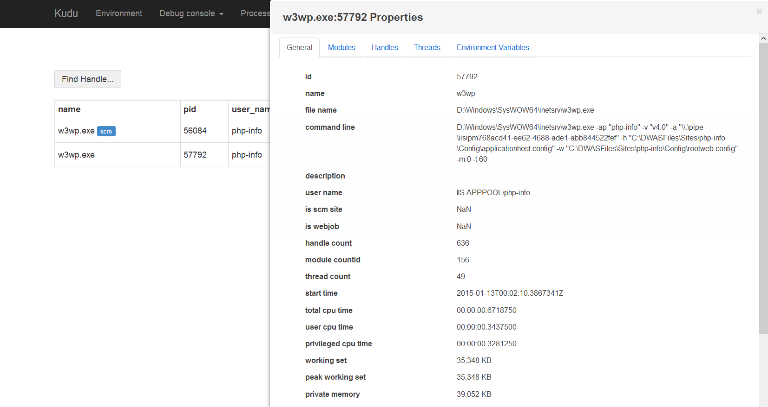
Process Explorer

Slide 8
Kudu Debugging Features
Demo

Slide 9

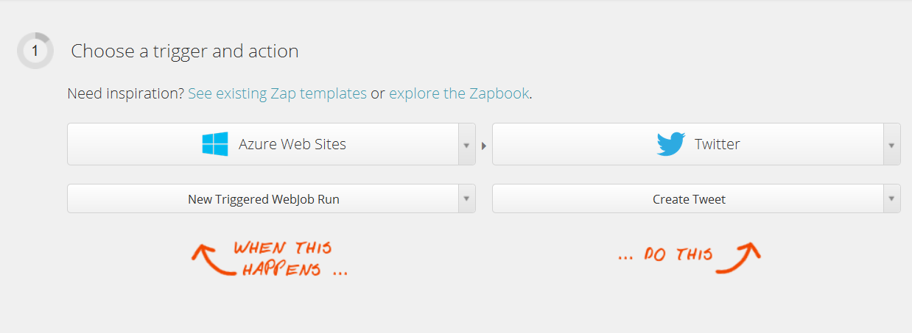
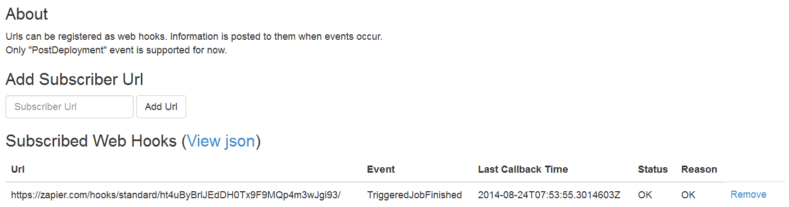
Web Hooks

Slide 10
Web Hooks
Demo

Slide 11
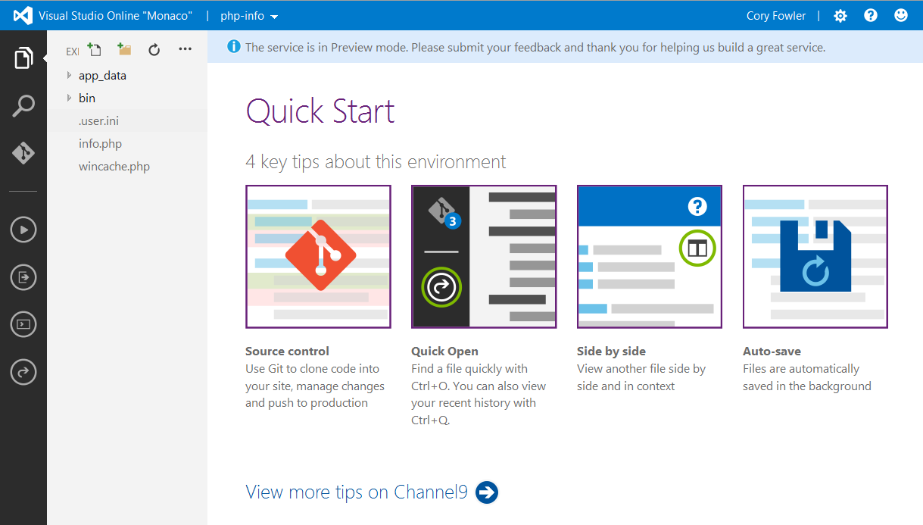
Pre-Installed Site Extensions

Slide 12
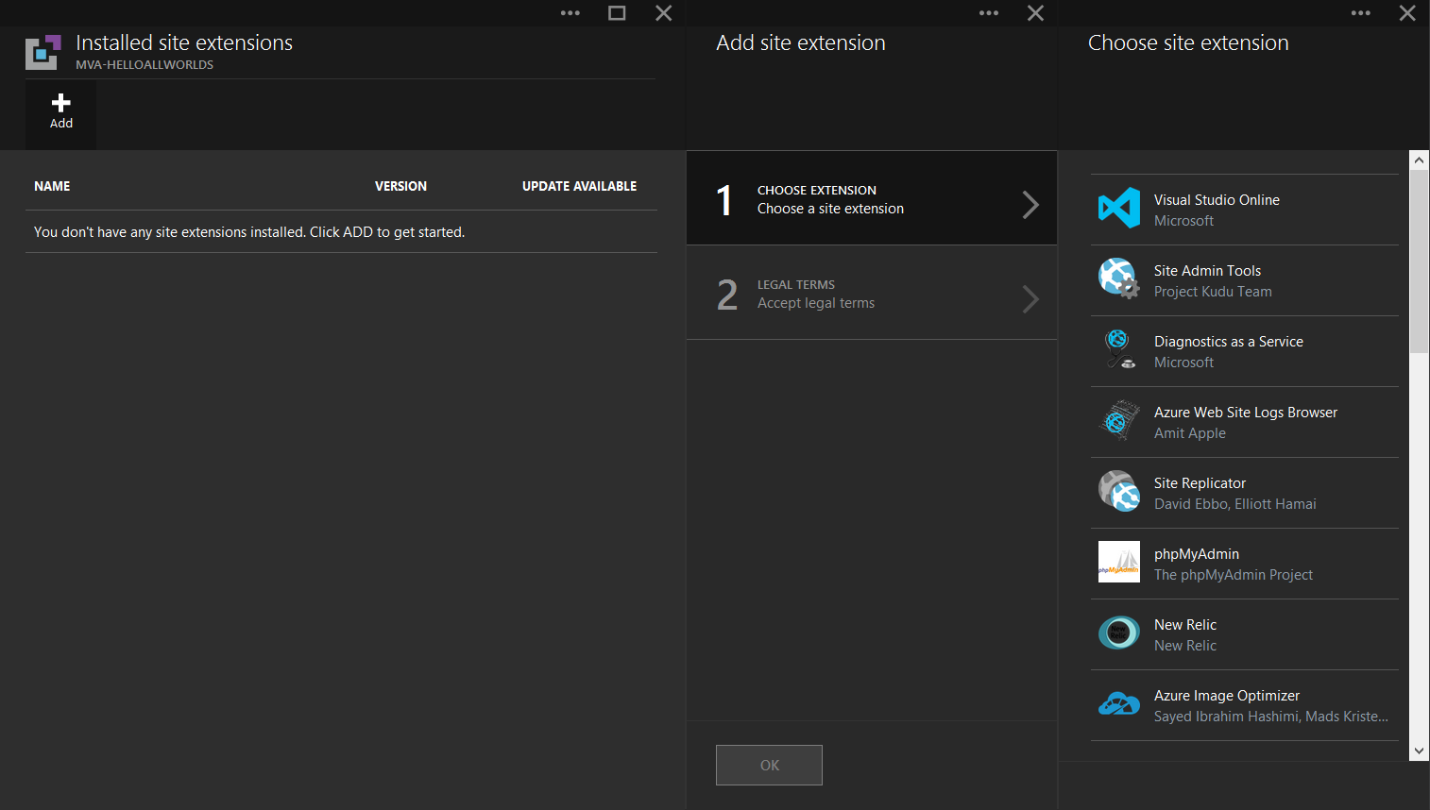
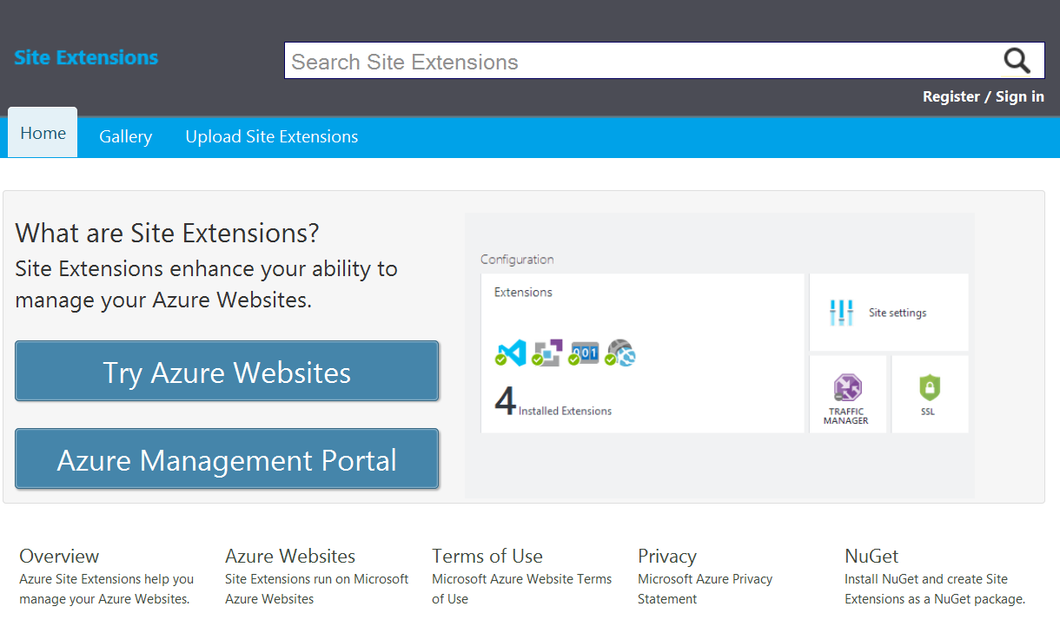
BYO Site Extensions

Slide 13
Site Extensions
Demo

Slide 14

WebJobs

Slide 15
WebJobs

Slide 16
Web Jobs
Demo

