Slide 1
Azure Container Service
Ralph Squillace
@ralph_squillace
Senior Content Engineer
(Senior means “old”)

Slide 2
Demo Why should we care about containers?
Ralph Squillace

Slide 3
101 advantages
It’s faster
It’s more portable
It improves the dev cycle
It improves the ops cycle
It promises to help make you more agile

Slide 4
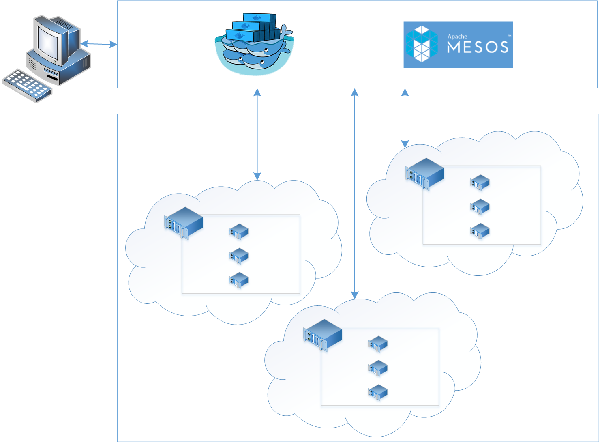

Azure Container Services
App1
App2

Slide 5


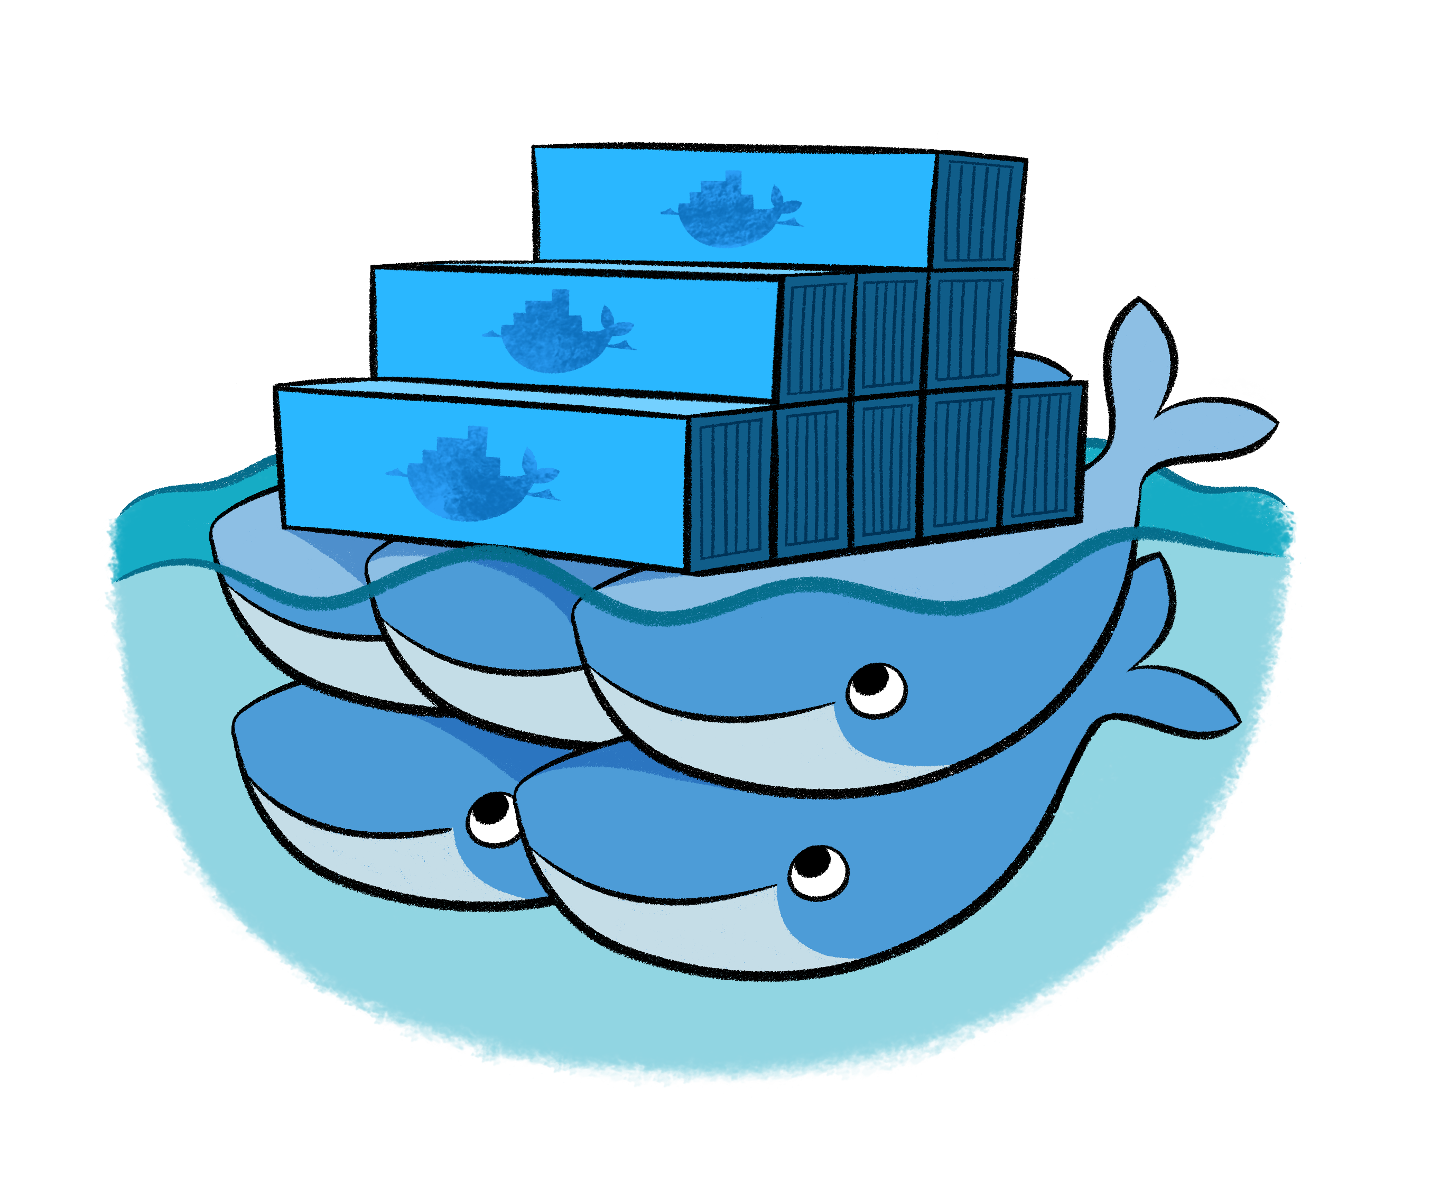

Azure Container Service
Application
Orchestrator
ARM
Template
Infrastructure

Slide 6
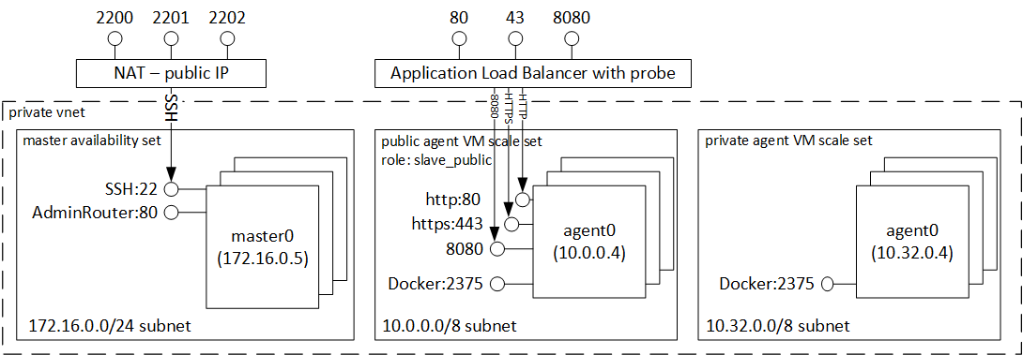
Azure Container Service

Slide 7
Build for Flexibility and Agility

Slide 8
Where is the service boundary?
Order Processing
Finance
Shelf
ForkLift
StockItem
StockItem
StockReport
Company Valuation
Picker
PickingOrder
General Ledger

Slide 9
Building Microservices, Sam Newman, O’Reilly Media
Loose Coupling
A change in one service does not require a change in another
High Cohesion
Related behavior sits together, unrelated behavior sits separately
Building Microservices, Sam Newman, O’Reilly Media

Slide 10
Bounded Contexts?
Order processing
Finance
Shelf
ForkLift
StockItem
StockItem
StockReport
Company Valuation
Picker
PickingOrder
General Ledger

Slide 11
Bounded Contexts?
Order processing
Finance
Shelf
ForkLift
StockItem
StockItem
StockReport
Company Valuation
Picker
PickingOrder
General Ledger

Slide 12
Things?
Order Processing
Finance
Shelf
ForkLift
StockItem
StockItem
StockReport
Company Valuation
Picker
PickingOrder
General Ledger

Slide 13
Sam Newman’s High Level Advice: Do whatever works
Err towards the monolithic side
Getting boundaries wrong can result in problems, e.g. chatty services
Easier to move boundaries in than out
NOTE: this means that if you are new to microservices it can be easier to start with an existing monolithic codebase
Bypass the temptation to decompose too early

Slide 14
Comparing OS Architectures
Platform
Independent
Docker
Docker Client
Docker Compose
Docker Swarm
Docker Registry
Docker Engine
REST Interface
Platform
Specific
libcontainerd
libnetwork
graph
plugins
Containerd + runC
Windows
Compute Services
Other OS Functionality
Control Groups
Job objects
Namespaces
Object Namespace, Process Table, Networking
Layer Capabilities
Registry, Union like filesystem extensions
Linux
Control Groups
cgroups
Namespaces
Pid, net, ipc, mnt, uts
Layer Capabilities
Union Filesystems: AUFS, btrfs, vfs, zfs*,DeviceMapper
Other OS Functionality

Slide 15
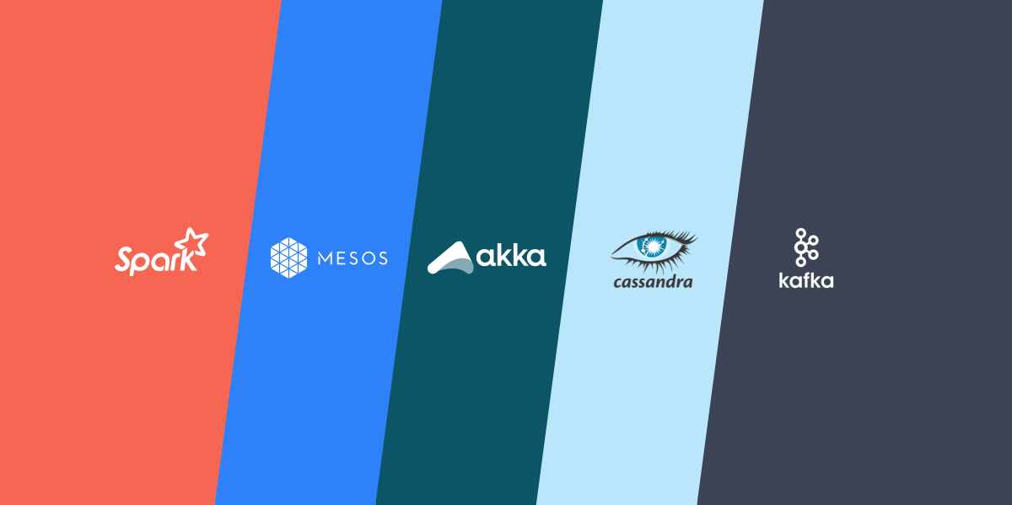
Not Everything is a Docker Container

Slide 16
How do we deploy ACS?
Portal
Quickstart Gallery
CLI (official and unofficial)
CI/CD
Configuration Management
http://aka.ms/acs

