Slide 1
OZIR Ljetni akcelerator 2025
Luka Volarević, Zvonimir Mabić

Slide 2
Mrežne postavke
Cluster 2 op2os | IP | Cluster 1 op1os | IP | Storage | IP
master0 | 10.0.16.21 | master0 | 10.0.16.18 | storage | 10.0.16.26
master1 | 10.0.16.22 | worker0 | 10.0.16.19
master2 | 10.0.16.23 | worker1 | 10.0.16.20
worker0 | 10.0.16.24
worker1 | 10.0.16.25
DNS za cluster 1: *.op1os.lan.croz.net
DNS za cluster 2: *.op2os.lan.croz.net
DNS za storage: storage.opos.lan.croz.net

Slide 3
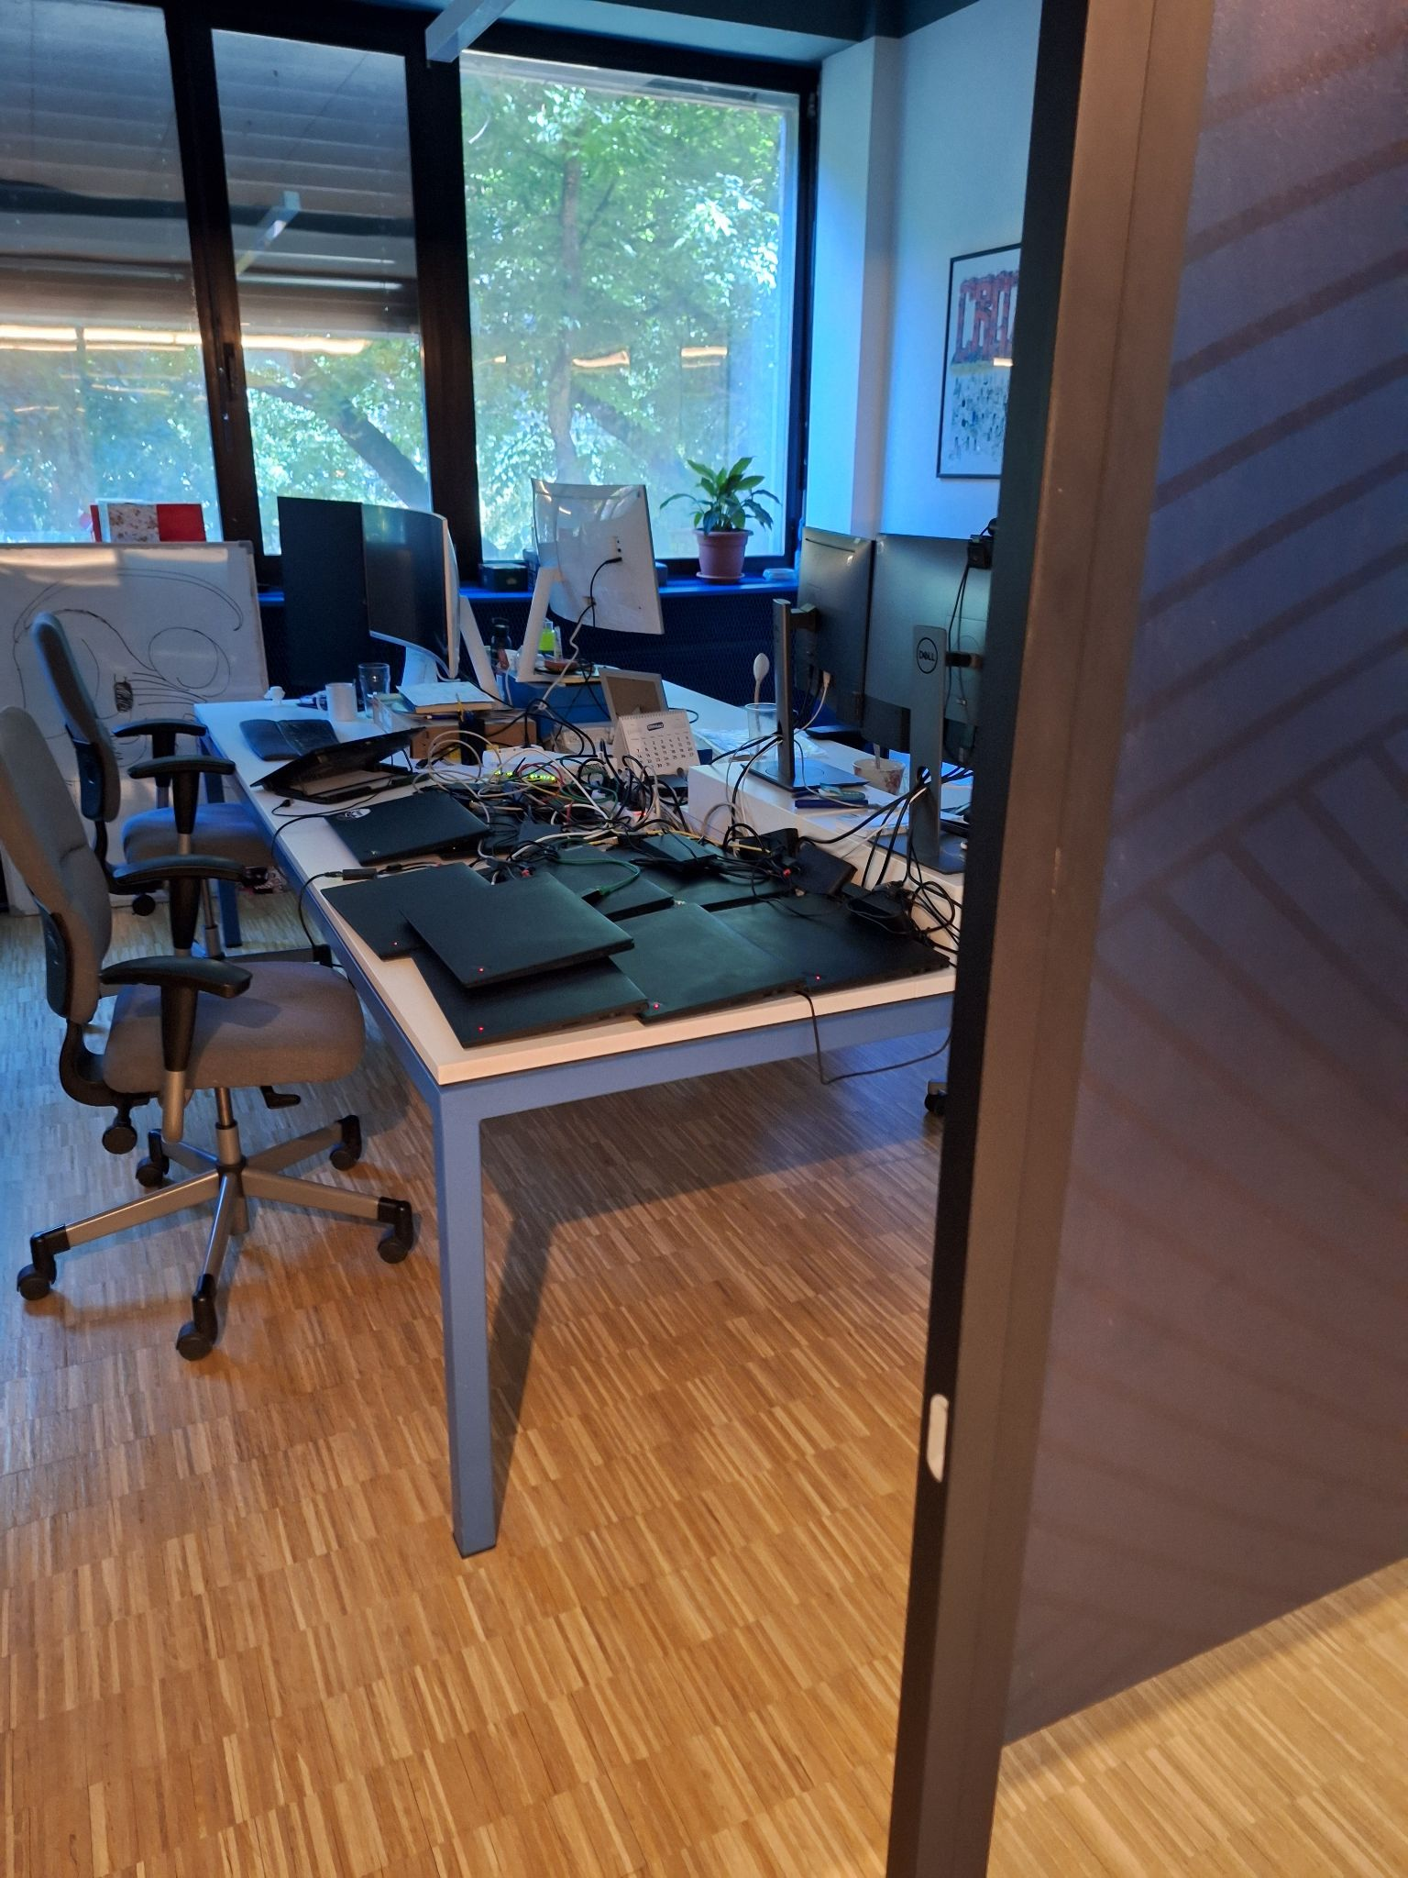
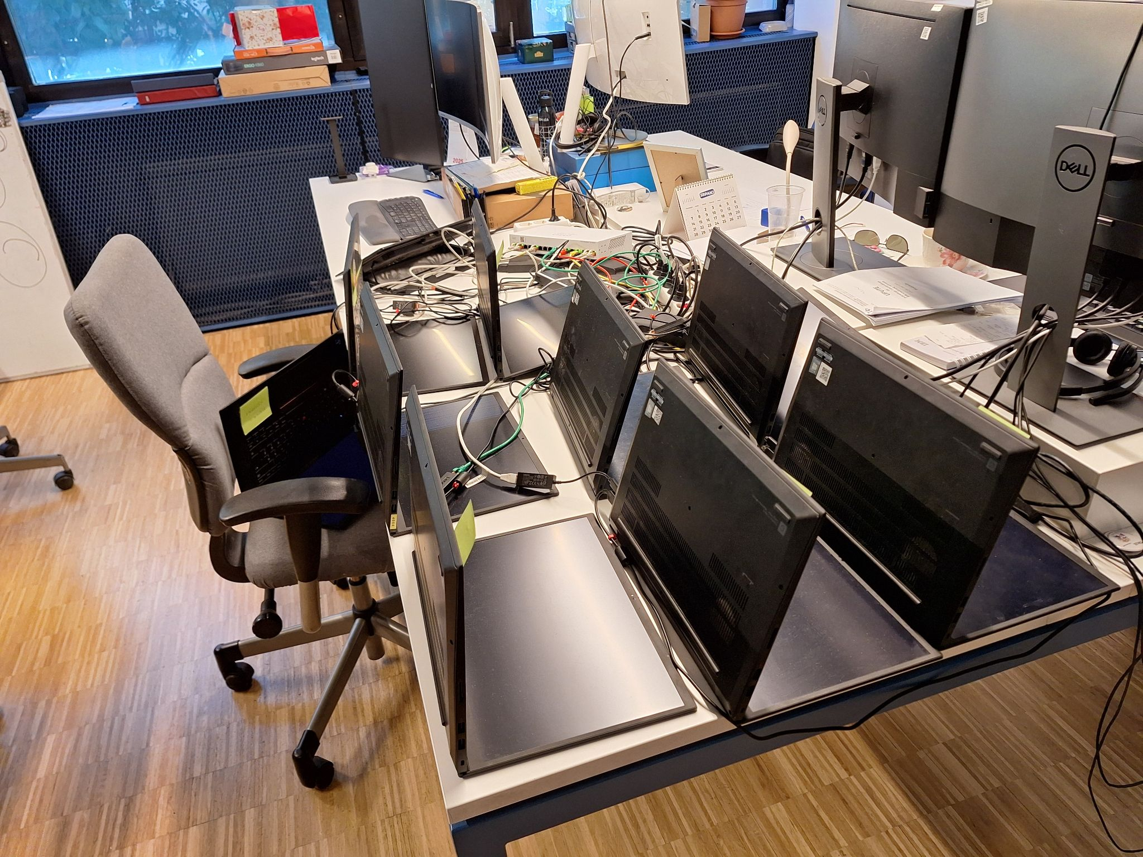
Cluster setup

Slide 4
Agent based instalacija clustera
apiVersion: v1
baseDomain: lan.croz.net
compute:
- name: worker
replicas: 2
architecture: amd64
controlPlane:
name: master
replicas: 3
architecture: amd64
metadata:
name: op2os
networking:
clusterNetwork:
- cidr: 10.128.0.0/14
hostPrefix: 23
machineNetwork:
- cidr: 10.0.16.0/23
serviceNetwork:
- 172.22.0.0/16
networkType: OVNKubernetes
platform:
baremetal:
apiVIPs:
- 10.0.16.29
ingressVIPs:
- 10.0.16.30
fips: false
pullSecret: 'Pull secret'
sshKey: 'ssh-rsa ... op2os'
apiVersion: v1alpha1
kind: AgentConfig
rendezvousIP: 10.0.16.21
hosts:
- hostname: master0
role: master
interfaces:
- name: enp0s13f0u2
macAddress: 60:7D:09:37:5F:D4
networkConfig:
interfaces:
- name: enp0s13f0u2
type: ethernet
state: up
mac-address: 60:7D:09:37:5F:D4
ipv4:
enabled: true
address:
- ip: 10.0.16.21
prefix-length: 23
dhcp: false
ipv6:
enabled: false
dns-resolver:
config:
server:
- 10.0.10.2
- 10.0.10.3
routes:
config:
- destination: 0.0.0.0/0
next-hop-address: 10.0.16.1
next-hop-interface: enp0s13f0u2
table-id: 254
install-config.yaml
agent-config.yaml

Slide 5
Agent based instalacija clustera
Kreiranje agent ISO
Praćenje instalacije i pristup clusteru
$ ./openshift-baremetal-install --dir install-dir agent create image
$ ./openshift-install --dir install-dir wait-for bootstrap-complete --log-level=info
$ ./openshift-install --dir install-dir wait-for install-complete --log-level=info
$ export KUBECONFIG=<install-dir>/auth/kubeconfig
$ oc get nodes

Slide 6
Agent - Platform: NONE
apiVersion: v1alpha1
kind: AgentConfig
metadata:
name: op1os
rendezvousIP: 10.0.16.18
hosts:
- hostname: master0
role: master
interfaces:
- name: enp0s13f0u2
macAddress: 60:7d:09:37:5f:bb
networkConfig:
interfaces:
- name: enp0s13f0u2
type: ethernet
state: up
mac-address: 60:7d:09:37:5f:bb
ipv4:
enabled: true
address:
- ip: 10.0.16.18
prefix-length: 23
dhcp: false
dns-resolver:
config:
server:
- 10.0.10.2
- 10.0.10.3
routes:
config:
- destination: 0.0.0.0/0
next-hop-address: 10.0.16.1
next-hop-interface: enp0s13f0u2
table-id: 254
apiVersion: v1
baseDomain: lan.croz.net
compute:
- architecture: amd64
hyperthreading: Enabled
name: worker
replicas: 0
controlPlane:
architecture: amd64
hyperthreading: Enabled
name: master
replicas: 1
metadata:
name: op1os
networking:
clusterNetwork:
- cidr: 10.128.0.0/14
hostPrefix: 23
machineNetwork:
- cidr: 10.0.16.0/23
networkType: OVNKubernetes
serviceNetwork:
- 172.30.0.0/16
platform:
none:
pullSecret: ...
sshKey: ...
HaProxy
Sav promet preko bootstrapa
Baremetal ne podržava 1 master + 2 worker
Radimo single node
Ne postoje VIP adrese
Slični configi kao i platform baremetal
Praćenje instalacije i pristup clusteru
Ključna razlika u “platform:”
Dodavanje workera
./openshift–baremetal-install --dir install-dir agent create image

Slide 7
HaProxy
global
log 127.0.0.1 local2
global
log 127.0.0.1 local2
pidfile /var/run/haproxy.pid
maxconn 4000
daemon
defaults
mode http
log global
option dontlognull
option http-server-close
option redispatch
retries 3
timeout http-request 10s
timeout queue 1m
timeout connect 10s
timeout client 1m
timeout server 1m
timeout http-keep-alive 10s
timeout check 10s
maxconn 3000
listen api-server-6443
bind 10.0.16.26:6443
mode tcp
option httpchk GET /readyz HTTP/1.0
option log-health-checks
balance roundrobin
server master0 master0.op1os.lan.croz.net:6443 weight 1 verify none check check-ssl inter 10s fall 2 rise 3
listen machine-config-server-22623
bind 10.0.16.26:22623
mode tcp
server master0 master0.op1os.lan.croz.net:22623 check inter 1s
listen ingress-router-443
bind 10.0.16.26:443
mode tcp
balance source
server worker0 worker0.op1os.lan.croz.net:443 check inter 1s
server worker1 worker1.op1os.lan.croz.net:443 check inter 1s
listen ingress-router-80
bind 10.0.16.26:80
mode tcp
balance source
server worker0 worker0.op1os.lan.croz.net:80 check inter 1s
server worker1 worker1.op1os.lan.croz.net:80 check inter 1s
Vrtimo na storage laptopu
LoadBalancer
dnf install haproxy &&s
sudo haproxy -c -f /etc/haproxy/haproxy.cfg
sudo ss -tulpn | grep haproxy
Namjestiti firewall
Dodati ingresscontroller za workere

Slide 8
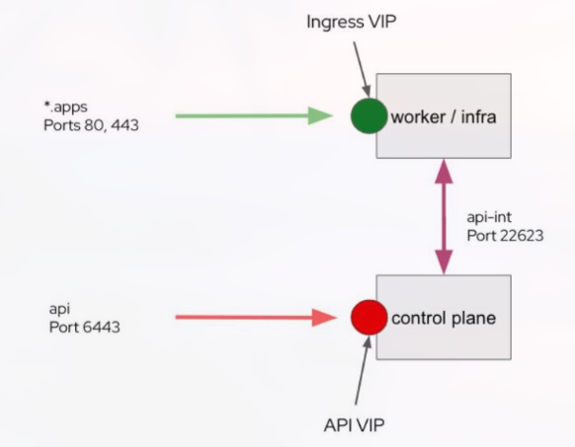
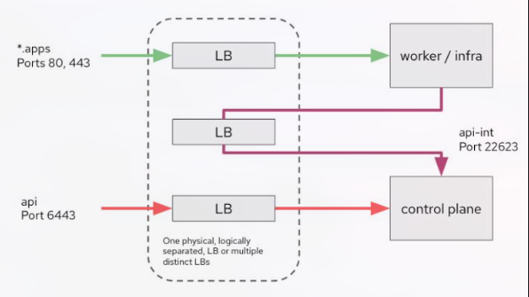
Razlike

Slide 9
NFS server i external provisioner
Instalacija i exposeanje shared direktorija
Spajanje clustera na server preko NFS subdir external provisionera
sudo dnf install nfs-utils
sudo systemctl enable --now nfs-server
sudo systemctl status nfs-server
# Izmjena /etc/exports i dodavanje /srv/nfs/shared <ip_adresa_cidr>(rw,sync,no_subtree_check)
sudo exportfs -rav
sudo exportfs -v
oc new-project nfs-provisoner
helm repo add nfs-subdir-external-provisioner https://kubernetes-sigs.github.io/nfs-subdir-external-provisioner/
helm install nfs-subdir-external-provisioner nfs-subdir-external-provisioner/nfs-subdir-external-provisioner \
--set nfs.server=10.0.16.26 \
--set nfs.path=/exported/path

Slide 10
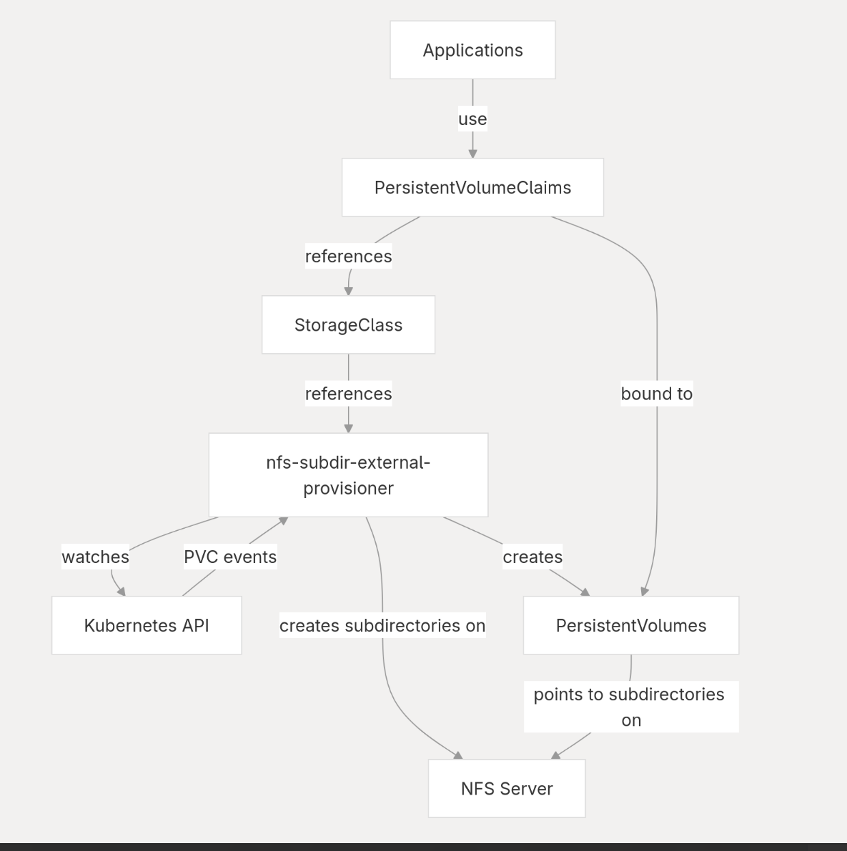
NFS subdir external provisioner

Slide 11
NFS CSI
apiVersion: storage.k8s.io/v1
kind: StorageClass
metadata:
name: nfs-csi
provisioner: nfs.csi.k8s.io
parameters:
server: 10.0.16.26
share: /nfs/exports
reclaimPolicy: Delete
volumeBindingMode: Immediate
allowVolumeExpansion: true
mountOptions:
- nfsvers=4.1
NFS kao standardizirani storage driver
StorageClass
Mogućnost stvaranja VolumeSnapshota
apiVersion: snapshot.storage.k8s.io/v1
kind: VolumeSnapshotClass
metadata:
name: nfs-snapshot-class
driver: nfs.csi.k8s.io
deletionPolicy: Delete

Slide 12
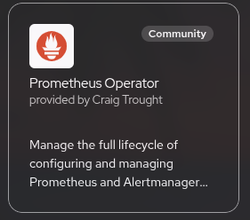
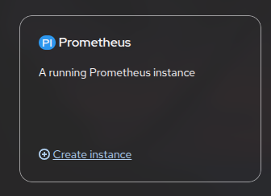
Prometheus
Platforma za praćenje metrika i alertova
Instalacija preko operatora
Nakon instalacije stvoriti instancu
snake_case metrike
Queries
openshift-storage i prometheus
namespaceovi
Exposamo service za pristup konzoli

Slide 13

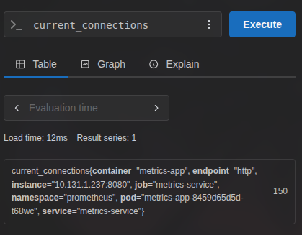
Tester aplikacija
Radi jednostavnosti
Ručno mijenjani metrics
const express = require('express');
const app = express();
let currentConnections = 150;
app.get('/metrics', (req, res) => {
res.set('Content-Type', 'text/plain');
res.send(`current_connections ${currentConnections}
`);
});
app.get('/change_metric', (req, res) => {
const val = Number(req.query.value);
currentConnections = val;
res.redirect('/metrics');
});
const port = process.env.PORT || 8080;
app.listen(port);

Slide 14
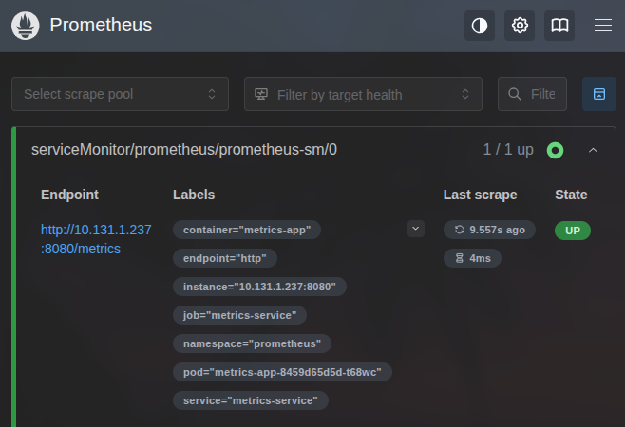
Prometheus - Service monitor
Odredimo service, port i
endpoint
Možemo vidjeti target health
na dashboardu
apiVersion: monitoring.coreos.com/v1
kind: ServiceMonitor
metadata:
name: prometheus-sm
namespace: prometheus
spec:
endpoints:
- interval: 30s
path: /metrics
port: http
selector:
matchLabels:
operated-prometheus: 'true' # matching sa servisom od aplikacije

Slide 15
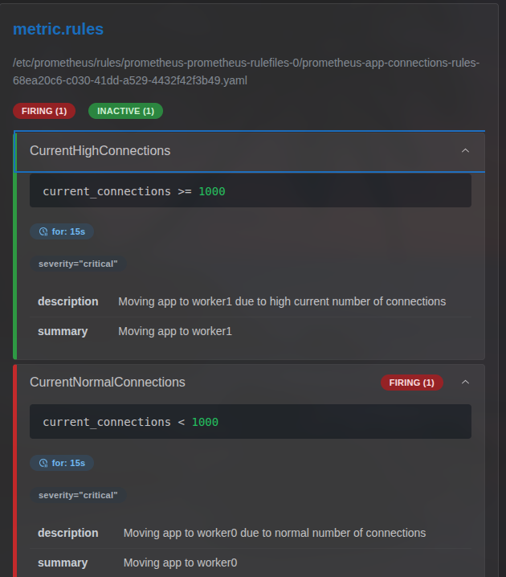
PrometheusRule
PrometheusRule tip
Sadrži grupe pravila
Labeli za višu kontrolu
apiVersion: monitoring.coreos.com/v1
kind: PrometheusRule
metadata:
name: metrics-rule
namespace: prometheus
spec:
groups:
- name: metrics.rules
rules:
- alert: HighConnections
annotations:
description: More than 1000 connections are active.
summary: High number of connections detected
expr: current_connections > 1000
for: 30s
labels:
severity: critical

Slide 16
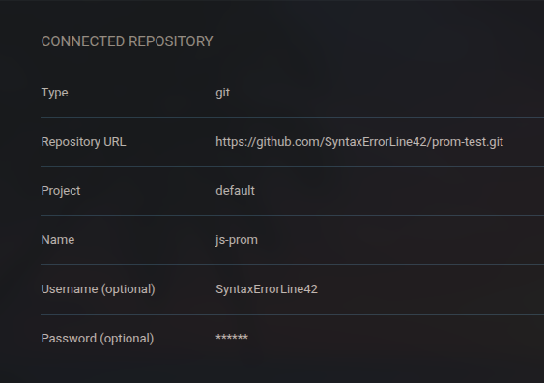
Argo CD
Platforma za Continuous Delivey
Syncing s git repom
Instalacija:
Exposamo rute za pristup dashboard
$ kubectl create namespace argocd
$ kubectl apply -n argocd -f https://raw.githubusercontent.com/argoproj/argo-cd/stable/manifests/install.yaml
$ oc label namespace <namespace_od_aplikacije> argocd.argoproj.io/managed-by=<namespace_od_operatora>

Slide 17
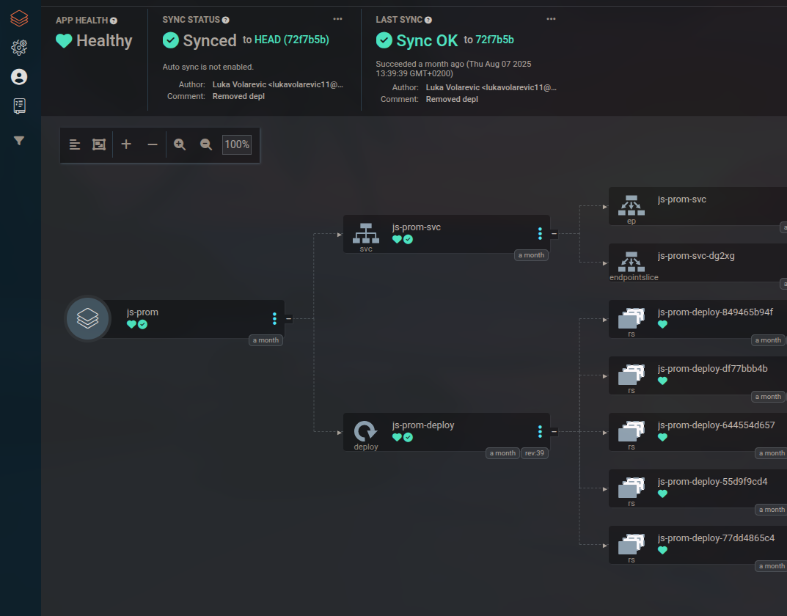
Argo CD
GitOps

Slide 18

Argo Workflows
Spajanje platformi Prometheus i Argo
Zadatak: napraviti job s obzirom na metriku
U deploymentu dodati –auth-mode=server
Napraviti potreban RBAC
Sample Workflow za test
$ oc create namespace argo
$ oc apply -n argo -f https://github.com/argoproj/argo-workflows/releases/download/v3.7.0/install.yaml
$ oc -n argo port-forward service/argo-server 2746:2746
apiVersion: argoproj.io/v1alpha1
kind: Workflow
metadata:
generateName: hello-world-
spec:
entrypoint: hello
templates:
- name: hello
container:
image: alpine:3.18
command: [sh, -c]
args: ["echo 'hello world'"]

Slide 19

Argo Events
Služi za senzore i webhookove
Webhook prima HTTP zahtjeve
Senzor odlučuje što dalje
Dodati admin policy
Stvoriti EventBus
$ oc new-project argo-events
$ oc apply -f https://raw.githubusercontent.com/argoproj/argo-events/stable/manifests/install.yaml
apiVersion: argoproj.io/v1alpha1
kind: EventBus
metadata:
name: default
namespace: argo-events
spec:
nats:
native:
replicas: 1

Slide 20
Argo Events
Event Source (webhook)
- Webhook sluša post na 12000/hello
- Sensor stvara isti workflow kao u prijašnjem testeru
Sensor (workflow)
apiVersion: argoproj.io/v1alpha1
kind: Sensor
metadata:
name: webhook-sensor
namespace: argo-events
spec:
dependencies:
- name: hello-dep
eventSourceName: webhook-source
eventName: hello
triggers:
- template:
name: trigger-workflow
argoWorkflow:
group: argoproj.io
version: v1alpha1
resource: workflows
operation: submit
source:
resource:
apiVersion: argoproj.io/v1alpha1
kind: Workflow
metadata:
generateName: hello-from-webhook-
spec:
entrypoint: hello
templates:
- name: hello
container:
image: alpine:3.18
command: ["sh", "-c"]
args: ["echo 'Hello from Webhook!'"]
apiVersion: argoproj.io/v1alpha1
kind: EventSource
metadata:
name: webhook-source
namespace: argo-events
spec:
eventBusName: default
service:
ports:
- port: 12000
targetPort: 12000
webhook:
hello:
endpoint: /hello
method: POST
port: '12000'

Slide 21
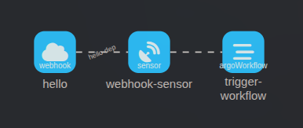
Argo “FLOW”
Kako to sve zajedno izgleda?

Slide 22
Alert Manager
AlertManager Config
AlertManager
Problemi s community verzijom Prometheusa (detaljno objašnjeno u dokumentaciji)
kind: AlertmanagerConfig
apiVersion: monitoring.coreos.com/v1alpha1
metadata:
name: alertmanager-config
namespace: js-prom
labels:
alertmanagerConfig: "main"
spec:
receivers:
- name: argo-webhook
webhookConfigs:
- url: 'http://webhook-source-eventsource-svc-argo-events.apps.op1os.lan.croz.net/hello'
route:
groupInterval: 10s
groupWait: 0s
receiver: argo-webhook
repeatInterval: 1h
apiVersion: monitoring.coreos.com/v1
kind: Alertmanager
metadata:
name: alertmanager
namespace: js-prom
spec:
replicas: 2
alertmanagerConfigSelector:
matchLabels:
alertmanagerConfig: main
# configSecret: alertmanager-<ime_alertmanagera>-generated

Slide 23
Kronologija
Prometheus scrapea target current_connections
PrometheusRule vidi da je target iznad 1000, prekršen je rule, stvara se alert
Prometheus šalje alert do AlertManagera
Alert manager šalje HTTP POST request na webhook endpoint koji smo zadali
Argo Events vidi aktivnost na webhooku, šalje event na Event Bus koji funkcionira kao queue
Argo Sensor osluškuje Event Bus, kad vidi novi event pokreće novi Workflow
Zadani workflow ispisuje echo poruku koju možemo vidjeti u "Logs" unutar "Workflows"

Slide 24
Premještaj podova između nodeova
Zadatak: na low connections neka aplikacija bude na worker0, na high worker1
Radimo novi PrometheusRule, jedna grupa dva alert pravila
Novi Webhook (dva endpointa)
Novi AlertManagerConfig Receivers i routes (jedan default)
AlertManager ponavljamo, stari EventBus

Slide 25
Premještaj podova između nodeova
Najbitnija stvar: workflow izvršava kubectl komande (prethodno dodati RBAC)
image: bitnami/kubectl
command: [sh, -c]
args:
- >
kubectl patch deployment js-prom-deploy -n js-prom --type= -p='{"spec":{"template":{"spec":{"nodeSelector":{"kubernetes.io/hostname":"worker1.op1os.lan.croz.net"}}}}}'
image: bitnami/kubectl
command: [sh, -c]
args:
- >
kubectl patch deployment js-prom-deploy -n js-prom --type -p='{"spec":{"template":{"spec":{"nodeSelector":{"kubernetes.io/hostname":"worker0.op1os.lan.croz.net"}}}}}'

Slide 26
Postavljanje Ceph clustera
Jedna mašina za NFS i Ceph
Po jedan pool za svaki cluster
Instalacija preko cephadm
$ sudo cephadm bootstrap \
--cluster-network 10.0.16.0/23 \
--mon-ip 10.0.16.26 \
--registry-url registry.redhat.io \
--registry-username '<naš_username>' \
--registry-password '<naša_lozinka>' \
--dashboard-password-noupdate \
--initial-dashboard-user admin \
--initial-dashboard-password ceph \
--allow-fqdn-hostname \
--single-host-defaults
$ sudo ceph orch daemon add osd <ime_hosta>:/dev/<ime_diska>
$ sudo ceph osd pool create cluster1
$ sudo ceph osd pool application enable cluster1 rbd
$ sudo ceph osd pool create cluster2
$ sudo ceph osd pool application enable cluster2 rbd

Slide 27
Problem single-node Ceph clustera
$ sudo ceph -s
cluster:
id: 567b397c-7dc7-11f0-9e25-3c18a057a79b
health: HEALTH_WARN
Degraded data redundancy: 398/4379 objects degraded (9.089%), 114 pgs degraded, 288 pgs undersized
1 pool(s) have no replicas configured
OSD count 1 < osd_pool_default_size 2
too many PGs per OSD (304 > max 250)
services:
mon: 1 daemons, quorum storage (age 22h)
mgr: storage.rqqgvr(active, since 22h), standbys: storage.nctwlc
osd: 1 osds: 1 up (since 22h), 1 in (since 22h)
rgw: 1 daemon active (1 hosts, 1 zones)
data:
pools: 9 pools, 304 pgs
objects: 3.98k objects, 13 GiB
usage: 13 GiB used, 941 GiB / 954 GiB avail
pgs: 398/4379 objects degraded (9.089%)
174 active+undersized
114 active+undersized+degraded
16 active+clean
#!/bin/bash
sudo ceph config set mon mon_allow_pool_size_one true
sudo ceph config get mon mon_allow_pool_size_one
pools=$(sudo ceph osd pool ls)
for pool in $pools; do
sudo ceph osd pool set "$pool" pg_autoscale_mode off
sudo ceph osd pool set "$pool" size 1 --yes-i-really-mean-it
sudo ceph osd pool set "$pool" min_size 1
sudo ceph osd pool set "$pool" pg_num 8
sudo ceph osd pool set "$pool" pgp_num 8
done

Slide 28
ODF
RedHatov storage stack
Instalacija preko Operator Hub-a
Novi useri na Cephu
Posebna skripta za spajanje na Ceph
$ ceph auth add client.odf.cluster1user mon 'allow *' osd 'allow *' mgr 'allow *'
$ ceph auth add client.odf.cluster2user mon 'allow *' osd 'allow *' mgr 'allow *'
$ python3 ceph-external-cluster-details-exporter.py --rbd-data-pool-name cluster2 --rgw-endpoint 10.0.16.26:3333 --run-as-user client.odf.cluster2user
$ python3 ceph-external-cluster-details-exporter.py --rbd-data-pool-name cluster1 --rgw-endpoint 10.0.16.26:3333 --run-as-user client.odf.cluster1user

Slide 29
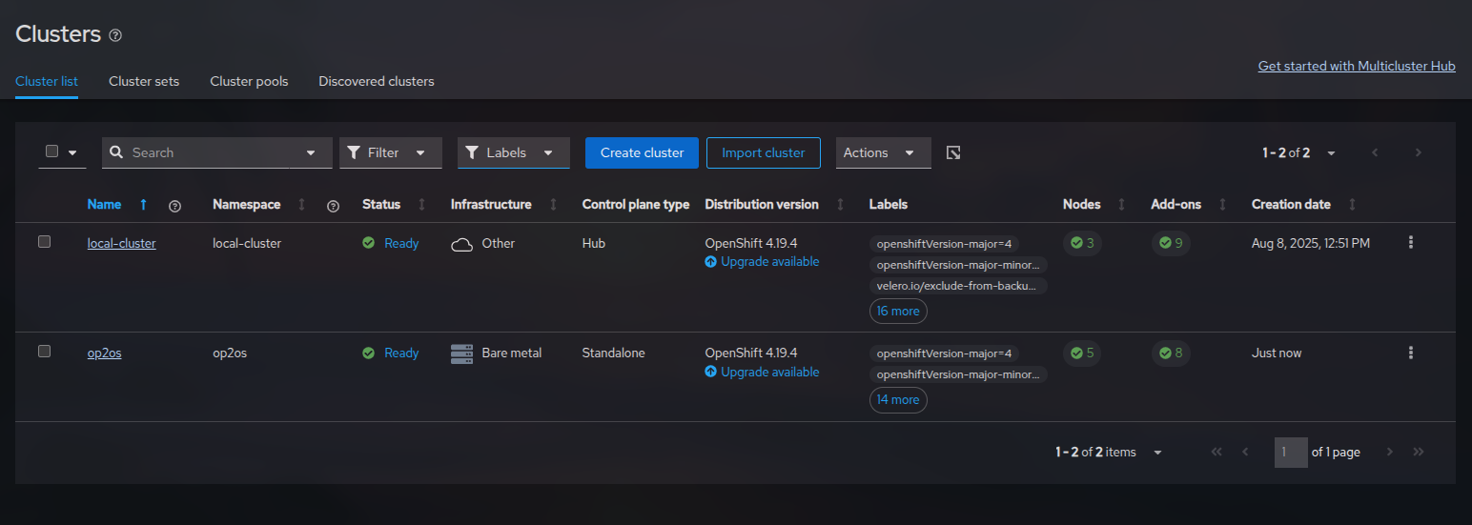
ACM
Alat za upravljanje multi-cluster sustavom, hub and spoke arhitektura
Instalacija preko Operator Hub-a i dodavanje clustera preko konzole

Slide 30
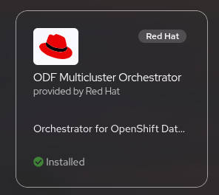
Disaster Recovery
CILJ: Napraviti failover sa jednog na drugi cluster
Testna aplikacija
ODF Multicluster Orchestrator
DRPolicy
Odabir clustera, namespacea, PVCa
Failover cluster

Slide 31

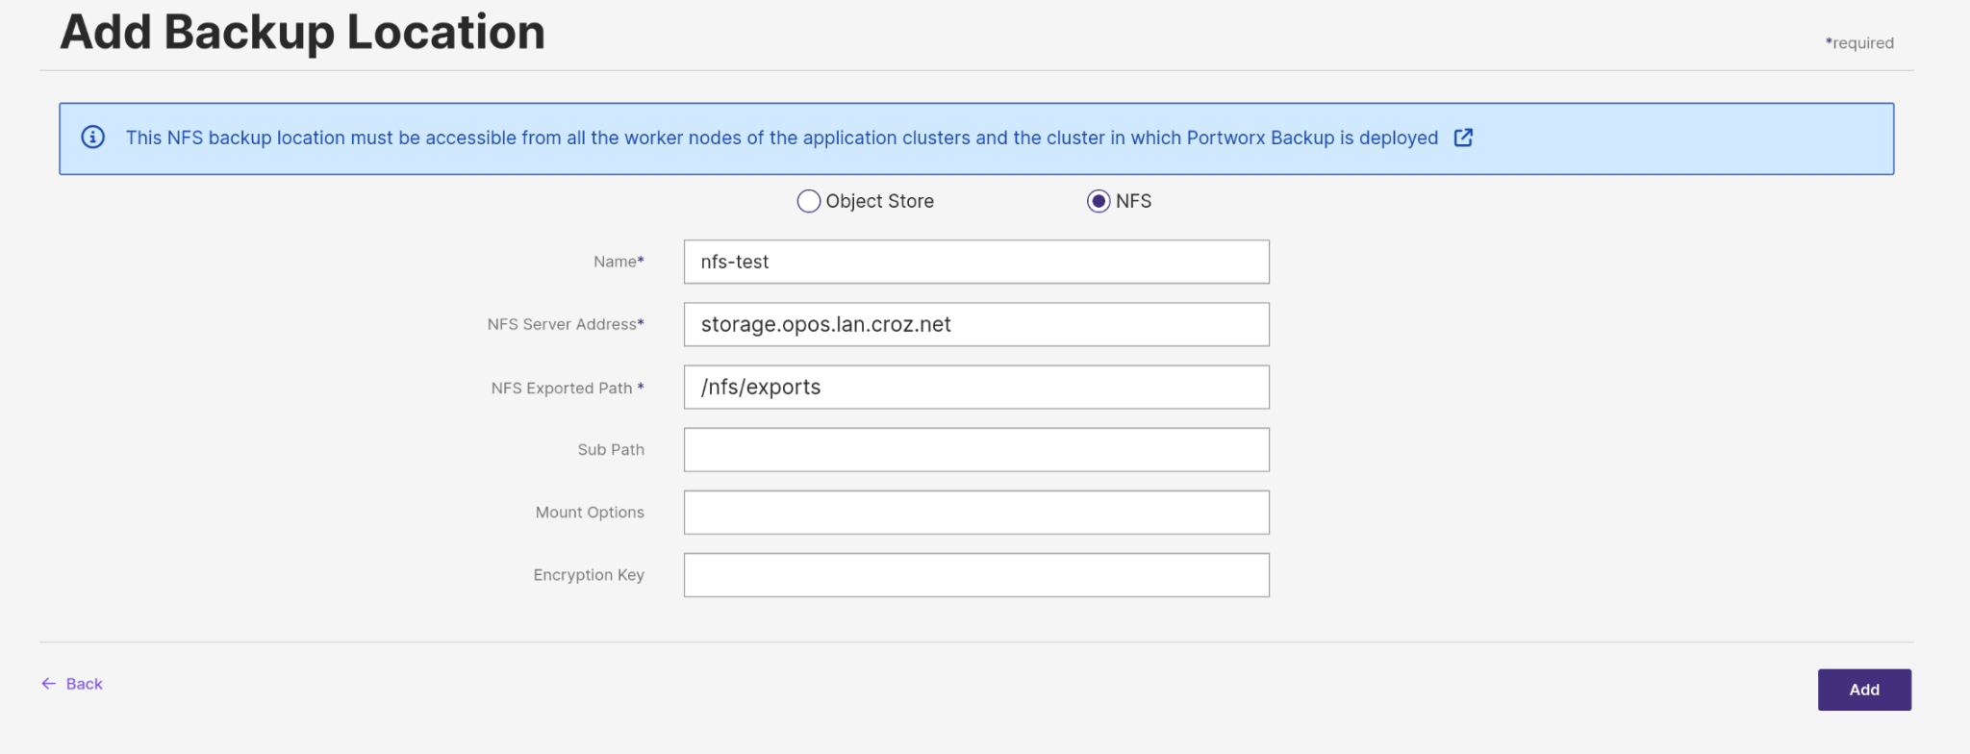
Portworx Backup
Backup i disaster recovery platforma
Baziran na Portworx CSI storage sustavu
Enterprise verzija samo za setup od 3+ workers

Slide 32
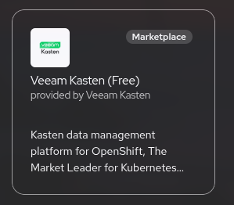
VEEAM KASTEN
Data protection platforma
Pruža Disaster Recovery rješenja
Backup Policy
Prvo odlazimo na https://www.veeam.com/products/cloud/kubernetes-backup/free-kubernetes.html te se ulogiramo i verificiramo profil
Route automatski napravljen
$ oc new-project kasten-io \
--description="Kubernetes data management platform" \
--display-name="Veeam Kasten"

Slide 33
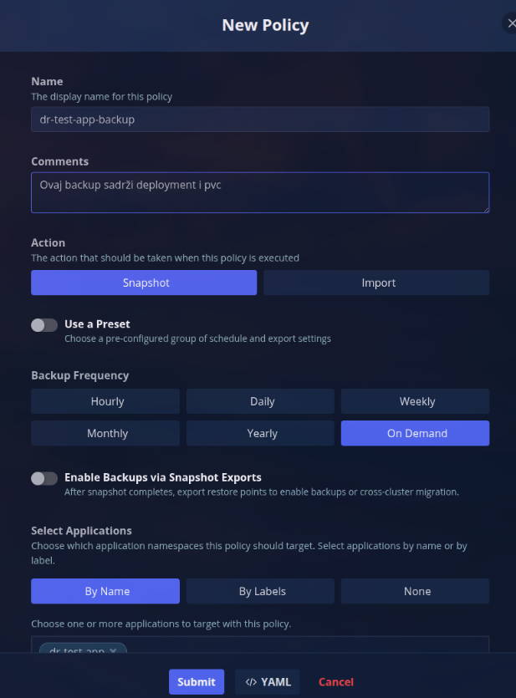
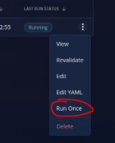
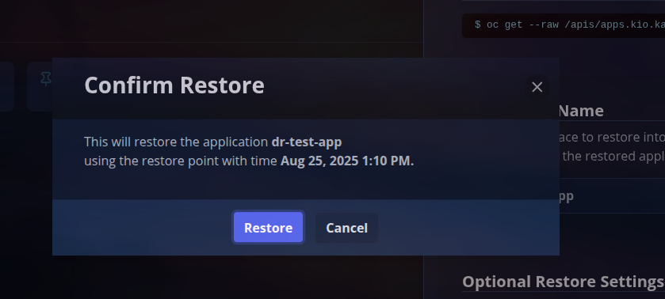
VEEAM KASTEN
Napravili smo sample app
Dodali anotaciju na
VolumeSnapshotGroupove

Slide 34
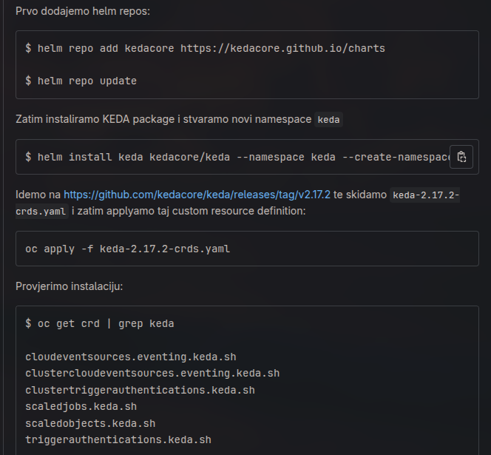
KEDA
Platforma za autoscaling
Motivacija: Scaling na osnovu
crona, cpu usage i metrics
Operator deprecated, koristimo
helm
Za testne potrebe koristimo
jednostavan web server app

Slide 35
KEDA: 1. CPU USAGE
apiVersion: keda.sh/v1alpha1
kind: ScaledObject
metadata:
name: keda-test-cpu
spec:
scaleTargetRef:
name: keda-test
minReplicaCount: 1
maxReplicaCount: 2
triggers:
- type: cpu
metadata:
type: Utilization # Postotak CPU usagea
value: "20" # Ako je CPU opterecenje iznad '20%' od definiranog requested CPU valuea
Na veliko opterećenje povećati
broj podova
Postotak iskorištenosti requested
vrijednosti definiranu u
deploymentu

Slide 36
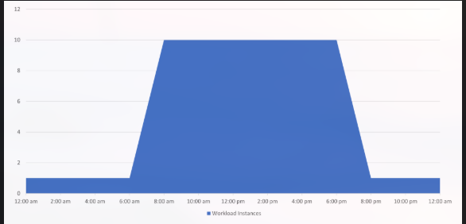
KEDA: 2. CRON
apiVersion: keda.sh/v1alpha1
kind: ScaledObject
metadata:
name: keda-test-cron
spec:
scaleTargetRef:
name: keda-test
minReplicaCount: 0
maxReplicaCount: 2
triggers:
- type: cron
metadata:
start: "0 9 * * *"
end: "0 17 * * *"
timezone: "Europe/Zagreb"
desiredReplicas: "2"
pollingInterval: "30"
2 poda između 9 i 17 sati
Aplikacija se gasi izvan radnog
vremena
S vremenom se postepeno
smanjuju

Slide 37
KEDA: 3. METRICS
apiVersion: keda.sh/v1alpha1
kind: ScaledObject
metadata:
name: keda-test-http
spec:
scaleTargetRef:
name: keda-test
minReplicaCount: 1
maxReplicaCount: 2
triggers:
- type: prometheus
metadata:
serverAddress: http://prometheus-operated-prometheus.apps.op2os.lan.croz.net
metricName: current_connections
threshold: "1000"
query: current_connections
Koristimo metrics iz prijašnjih
primjera

Slide 38
WOL
Motivacija: remote power on nodeova u clusteru
BIOS postavka
ethtool <ime_interfacea> | grep Wake → Provjera dostupnosti
ethtool -s <ime_interfacea> wol g → Enable WOL
Korištenje
$ wakeonlan <MAC_ADRESA>
Sending magic packet to 255.255.255.255:9 with <MAC_ADRESA>

Slide 39
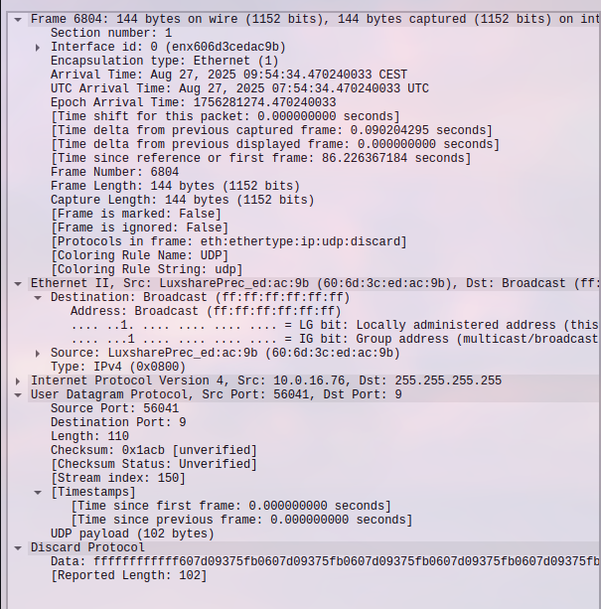
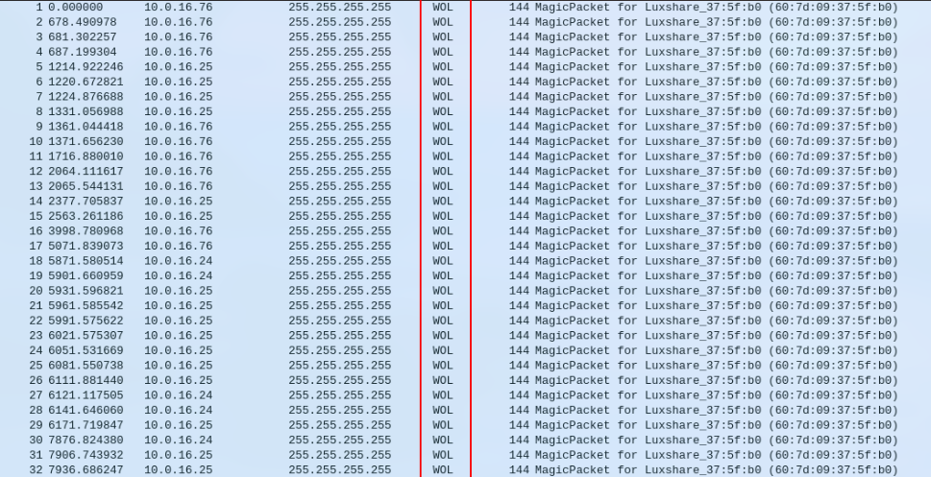
WireShark

Slide 40
Remote Power On Nodeova
Image s wakeonlan i kubectl komandom
RBAC
Dva Joba, jedan za paljenje jedan za gašenje
Glavna ideja: za gašenje debug node i drain, za paljenje WOL i uncordon
Za vremensku kontrolu ili CronJob ili KEDA Cron

Slide 41

VIRTUALIZACIJA
Zadatak: dodati virtualku kao node
Namještanje mreže
Namještanje Volumea
Remote Powering On

Slide 42
Mrežne postavke za VM
apiVersion: nmstate.io/v1
kind: NodeNetworkConfigurationPolicy
metadata:
name: br-ex-network
spec:
nodeSelector:
choosealone: true
desiredState:
ovn:
bridge-mappings:
- localnet: br-ex-network
bridge: br-ex
state: present
Koristimo postojeći bridge br-ex i stvaramo lokalnu mrežu na njemu
Dodajemo labelu workeru na kojem pokrećemo VM da VM koristi njegov bridge
Stvaramo novi NNCP i pomoću NAD kreiramo novi network interface koji prosljeđujemo VMu

Slide 43
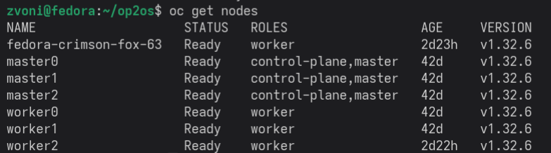
Dodavanje VM nodea u cluster
Ideja: Što će se dogoditi ako napravimo VM i pokušamo ga dodati kao node u cluster?

Slide 44
Virtualizacija - Remote Power On
$ oc patch virtualmachine.kubevirt.io/dis -n openshift-storage --type merge -p '{"spec":{"runStrategy":"Halted"}}'
oc drain worker2 --ignore-daemonsets --delete-emptydir-data --force
—----------------------------------------------------------------------------------------------
$ oc patch virtualmachine.kubevirt.io/dis -n openshift-storage --type merge -p '{"spec":{"runStrategy":"Always"}}'
$ oc uncordon worker2

Slide 45
Dodavanje VM nodea - Prva Metoda
Preuzimanje Discovery ISO sa konzole Openshift profila (ne clustera)
Bitno je da VM zadovoljava zahtjeve za cluster - minimalno 2 vCPU i 8GB RAM
Node selector postaviti na worker0
U mrežnim postavkama dodati kreiranu mrežu
Kroz nmtui namjestiti statičku IP adresu
U konzoli Add worker, imenovanje i potvrda CSRova

Slide 46
Dodavanje VM nodea - Druga Metoda
Iz clustera izvlačimo ignition file i serviramo ga preko python servera
Pokrenemo VM, preuzmemo RHCOS ISO, pa pokrenemo instalaciju sa ignition fileom
$ oc extract -n openshift-machine-api secret/worker-user-data-managed --keys=userData --to=- > worker.ign
$ sudo coreos-installer install /dev/vda --ignition-url http://10.0.16.76:9956/worker.ign --insecure-ignition

Slide 47
Dodavanje VM nodea - Treća Metoda
hosts:
- hostname: worker2
interfaces:
- name: enp2s0
macAddress: 02:ba:0d:00:00:06
networkConfig:
interfaces:
- name: enp2s0
type: ethernet
state: up
mac-address: 02:ba:0d:00:00:06
ipv4:
enabled: true
address:
- ip: 10.0.16.109
prefix-length: 23
dhcp: false
dns-resolver:
config:
server:
- 10.0.10.2
- 10.0.10.3
Agent based instalacija sa nodes-config.yaml
Praćenje instalacije
oc adm node-image create nodes-config.yaml --registry-config=<putanja_do>/pull-secret
oc adm node-image monitor --ip-addresses <ip_novog_cvora> -v=4

Slide 48

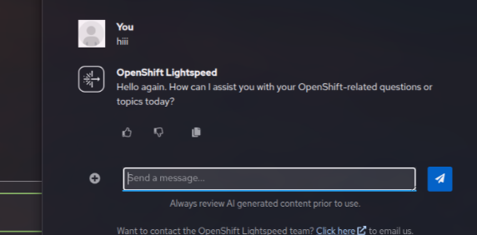
Lightspeed
AI asistent integriran u Openshift konzolu
Koristi službenu Openshift dokumentaciju za pružanje odgovora
Ideja: lokalno pokrenuti GPT-OSS:20b model i servirati ga na Lightspeed

Slide 49
Ollama
Lokalni runtime za LLM-ove
Instalacija u cluster:
Odgovori su često spori pa treba podesiti timeout na servisu
oc apply -f https://raw.githubusercontent.com/llamastack/llama-stack-k8s-operator/main/release/operator.yaml
git clone https://github.com/opendatahub-io/llama-stack-k8s-operator.git
./llama-stack-k8s-operator/hack/deploy-quickstart.sh --provider ollama --model gpt-oss:20b
oc expose svc/ollama-server-service -n ollama-dist
oc annotate route ollama-server-service --overwrite haproxy.router.openshift.io/timeout=10m

Slide 50
OLSConfig
apiVersion: ols.openshift.io/v1alpha1
kind: OLSConfig
metadata:
name: cluster
spec:
llm:
providers:
- credentialsSecretRef:
name: openai-api-keys
models:
- name: 'llama3.2:1b'
name: ollama
type: openai
url: '<ollama-proxy-url>'
ols:
conversationCache:
postgres:
credentialsSecret: lightspeed-postgres-secret
dbName: postgres
maxConnections: 2000
sharedBuffers: 256MB
user: postgres
type: postgres
defaultModel: 'llama3.2:1b'
defaultProvider: ollama
deployment:
console:
replicas: 1
replicas: 1
logLevel: INFO
olsDataCollector:
logLevel: INFO
Za spajanje na Lightspeed potreban je proxy kojim “glumi” OpenAI API (?)
Provider type je openai, a url pokazuje na Ollama proxy
Radi brzine rada korišten je lightweight model llama3.2:1b

Slide 51

Pitanja?
HVALA NA PAŽNJI!

